Slide 1

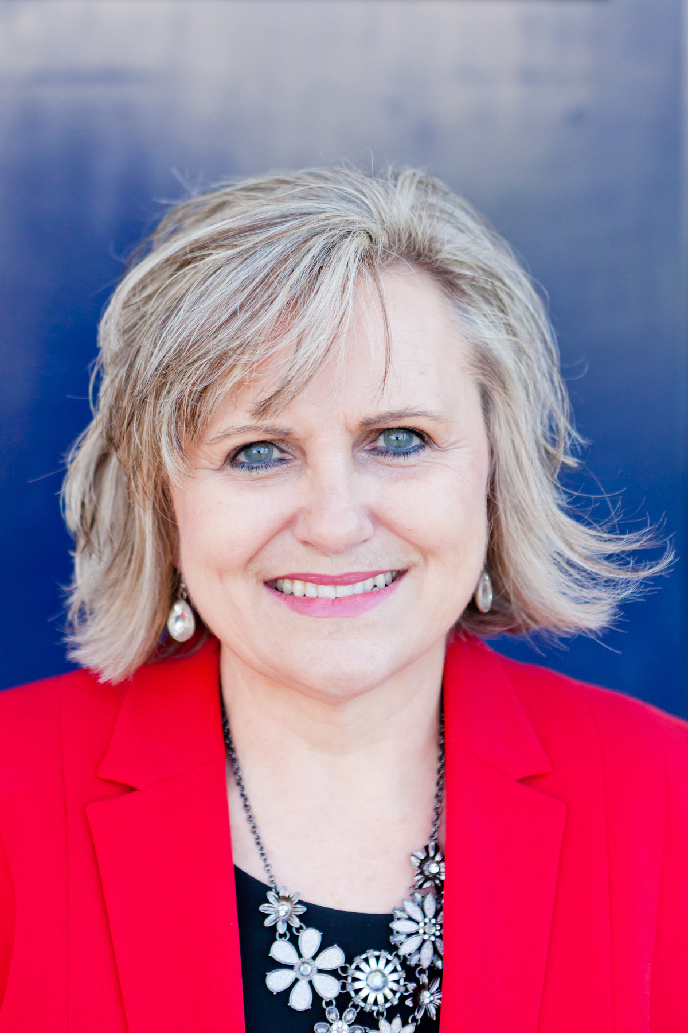
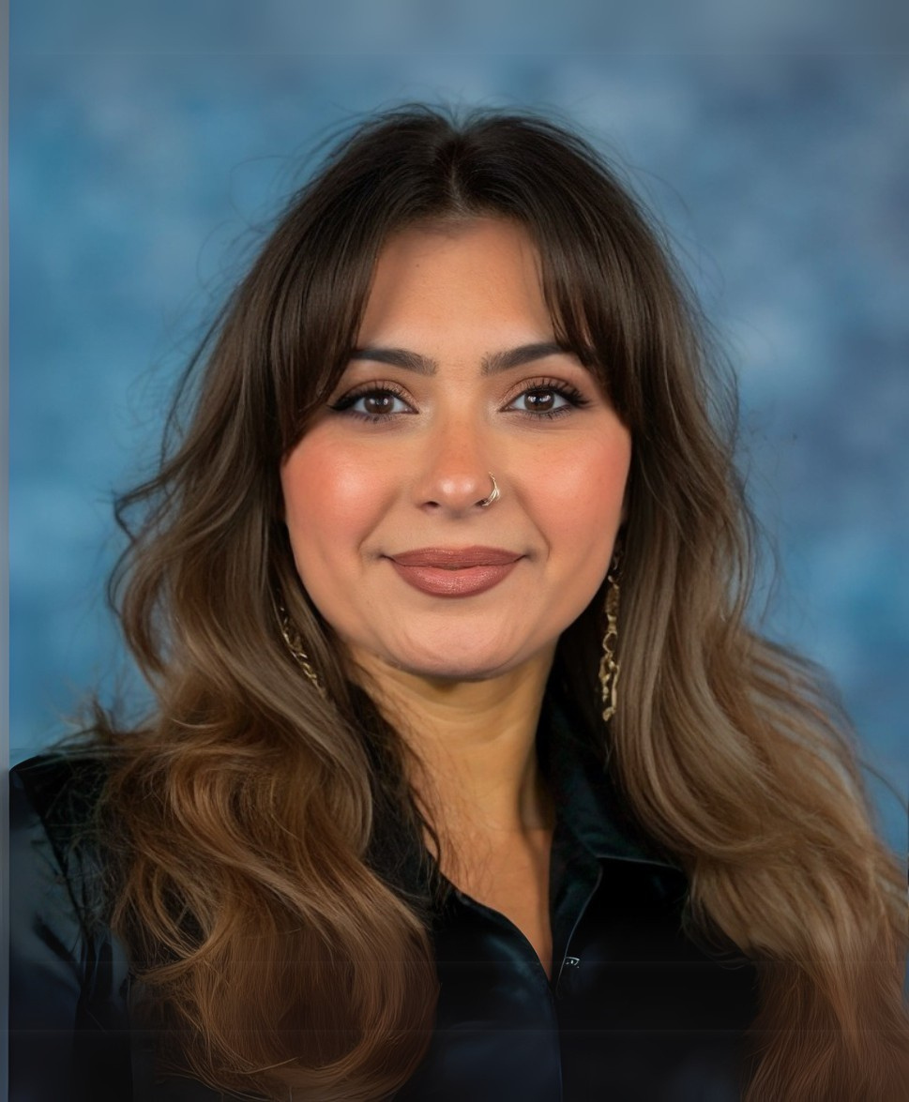
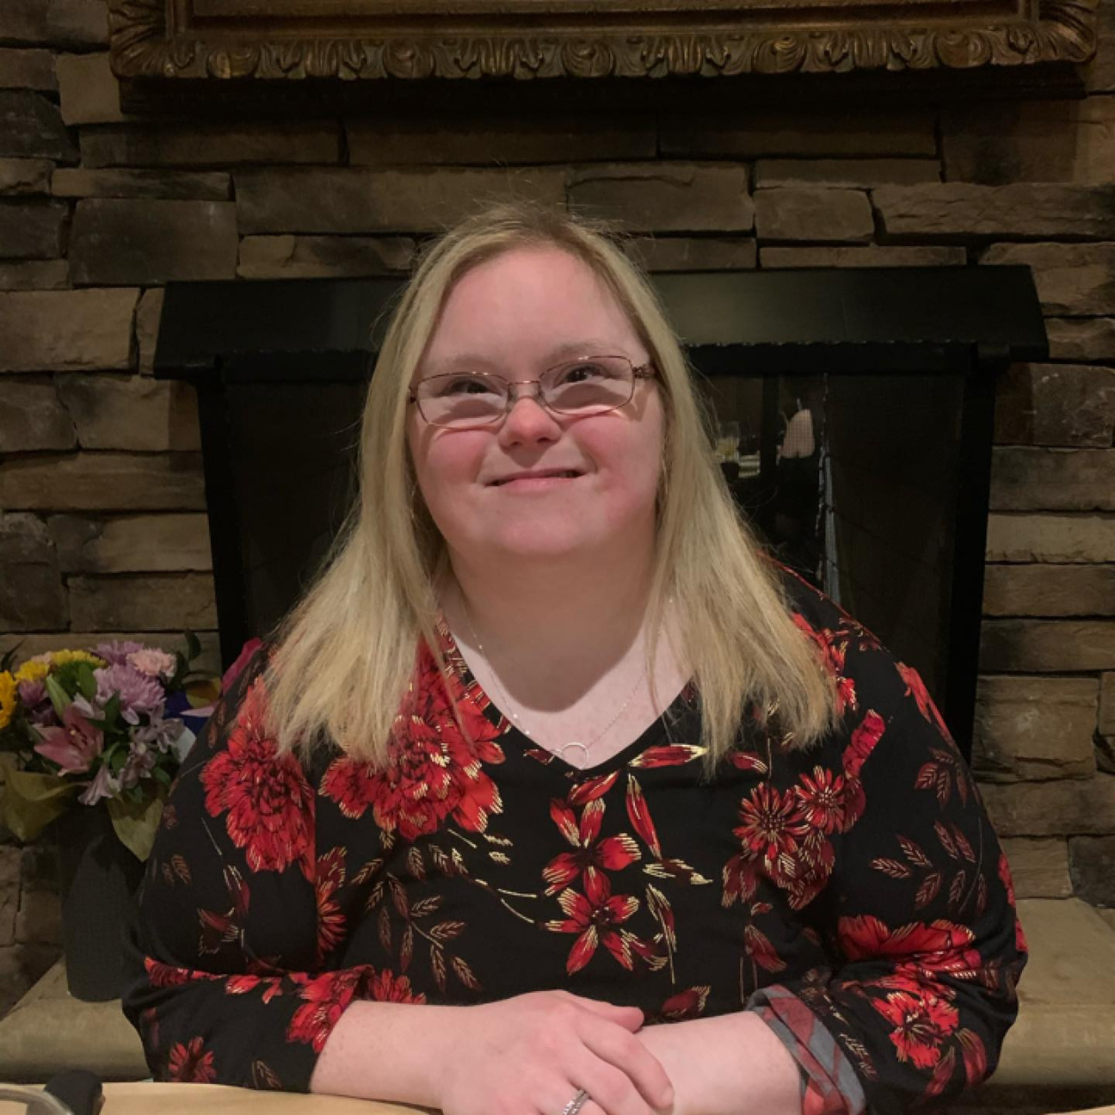
The Story Squad - Your Story is the Strategy: Making it Stick with Decision-Makers
Jawanda Mast
NDSC Grassroots Advocacy Manager
Sam Iannone
NDSC Communications Coorindator
Jessie Smart
NDSC Policy Advisory Council Member

Slide 2



NDSC DOWN SYNDROME POLICY SUMMIT — TRAINING DAY
Your Story Is the Strategy
Telling your story helps decision makers listen.
Jawanda Mast NDSC Grassroots Advocacy Manager
Sam Iannone NDSC Communications Coordinator
Jessie Smart Self-Advocate and NDSC Policy Advisory Council
Notes:
1.7.2013
1
‹#›

Slide 3

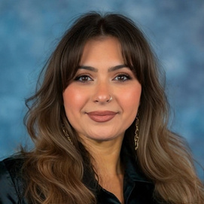

The Story Squad
Jawanda Mast
Sam Iannone
Jessie Smart
NDSC Grassroots Advocacy Manager
NDSC Communications Manager
Self-Advocate
  Manages NDAC (NDSC’s Grassroots Advocacy Program)
  Helps advocates turn everyday experience into organized, effective action on the Hill
  Everyone has a personal story that can impact change
  Mom to Rachel, who has Down syndrome
  I’m the SassySouthernGal
  College football season is the most wonderful time of the year
  Runs the NDSC Communications and Marketing Department by leading social media management, email marketing, website design, graphic design, brand management, and more.
  Board member at Down Syndrome Association of Southern New Jersey
  Sibling to Gabby with Down syndrome
  Has a cat named Paw Rudd
  Employed at the Arc NW MS and as a bookkeeper
  NDSC Policy Advisory Council, Microsoft Advisory Committee, MS Council on Developmental Disabilities; NDAC member
  Uses her experiences to help change perceptions of people with disabilities
  Completed discipleship and lay leadership training
  Qualified to serve as a minister
5
Notes:
1.7.2013
2
‹#›

Slide 4
You're Ready for This
You already put in the work. Here’s what you brought with you into today’s room:
Hill Day Logistics
Your One-Pager
The Big Asks
You know the schedule, the route, and what to expect on the Hill tomorrow.
You’ve built the leave-behind that anchors every meeting you’ll have.
You understand what’s at stake and why it matters for the Down syndrome community.
Today, we turn what you know into what you say and how you say it.
1
Notes:
1.7.2013
JBM
‹#›

Slide 5
Tips for Your Meeting
Arrive Early and Wear Your Nametag
Get there a few minutes early with your nametag visible, and introduce yourself to the staff member at the front.​
Start With Hello and Thank You
Introduce yourself and your organization, thank them, and make a local connection.
Meetings are short. Stick with the Plan.
In a larger group, not everyone will speak, so share the room. Follow your training-day plan, put self-advocates first, and move quickly to your asks and the stories behind them.​
Be Yourself. Be Specific. Listen​.
Keep it personal. Give them your one-pager, but don’t read it.​
Leave With a Next Step and Say Thank You​
Agree on a next step, then thank them in person, on social media, and with a follow-up note.​
Notes:
Add First stop Congressional Breakfast; one pagers great opportunity for follow up

Slide 6
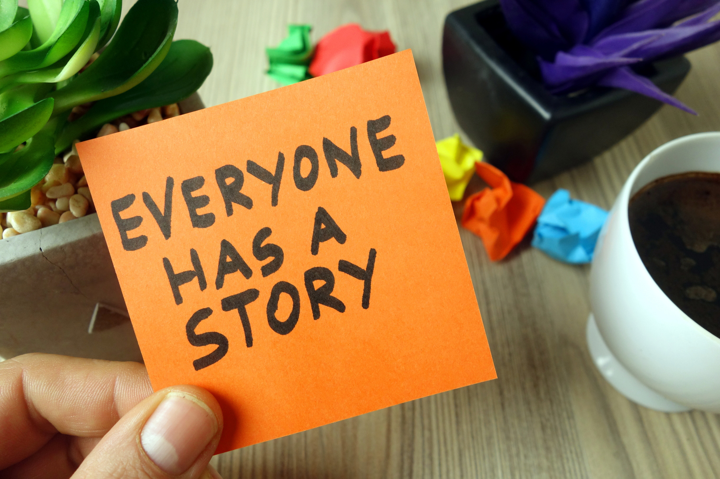
Tomorrow, you are going to walk into congressional offices with a folder, a one-pager, and your asks.
But the most important thing you are bringing into that room cannot be printed on a piece of paper.
It is your story.
Notes:
1
‹#›

Slide 7
Data Opens the Door
Your story walks through it.
Lawmakers hear many facts and numbers every day.
They remember one face, one family.
  Facts prove the problem is real.
  Explain:
    Data gives us the facts.
    Policy tells us what needs to change.
  Story makes the data personal, and personal is what people carry out of the room and vote on.​
  Stories help decision makers understand the human impact behind the policy.
  Important distinction:
    “Your story does not replace the data. Your story gives the data meaning.”
Notes:
NDSC and other sources provide data. We learn facts, but they remember the face and the family
‹#›

Slide 8

Make Your Story Stick
  Your story does not have to be complicated.
    Start with the person, not the policy.
    Make it personal and specific.
  Know your one thing.
    What is the one thing you want them to remember?
  Connect your story to your ask.
    Show why this issue matters and what you want them to do.
Notes:
1.7.2013
1
‹#›

Slide 9
SHORT
You may only have a few minutes.
SPECIFIC
Share a real person and a real moment.
PERSONAL
Tell them what happened to you or someone you know.
CONNECTED
Connect your experience to the policy.
ACTIONABLE
End with what you want them to do.
Notes:
1.7.2013
1
‹#›

Slide 10

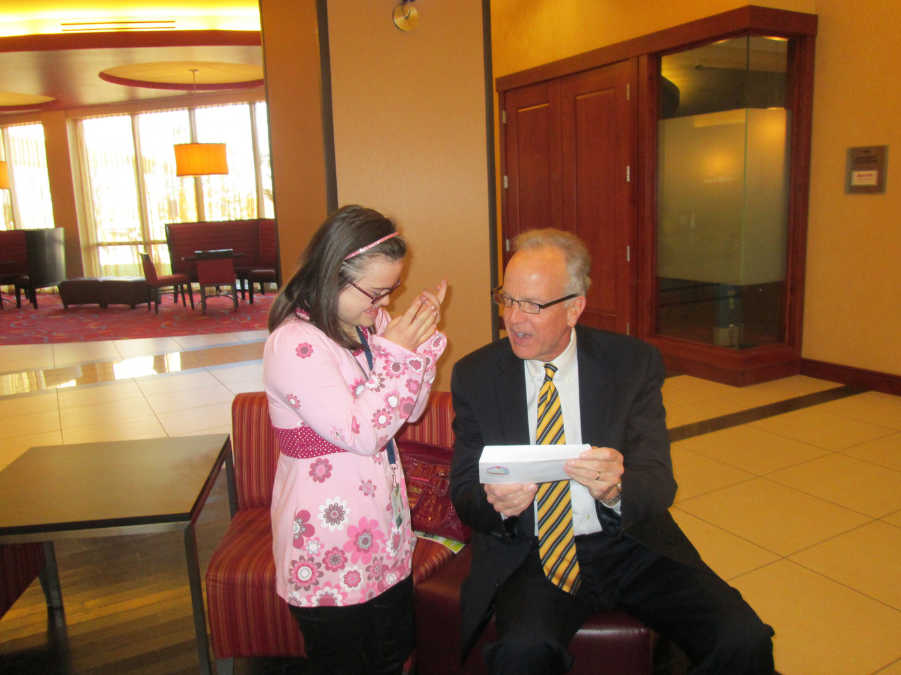
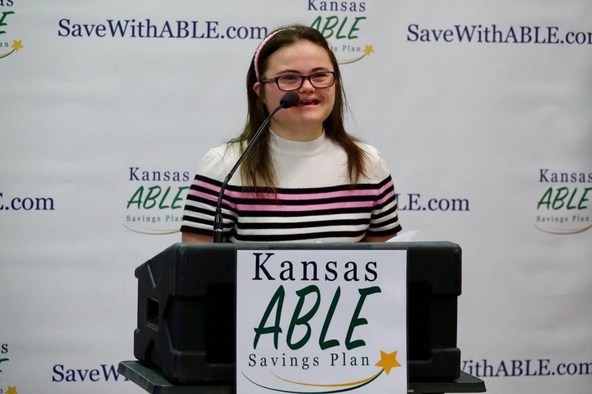
Why Rachel’s “Pink House” Story Sticks
  It makes policy personal. A complicated savings law becomes a simple story about wanting to marry, live independently, and own a home.
  It gives people something to remember. “Rachel’s Pink House” is easier to remember than a policy number or a long explanation of the ABLE Act.
  It connects a dream to action. Rachel’s dream became an advocacy message that helped keep the focus on why changing the law mattered.
  Twelve years after the law passed, the Pink House story is still part of the conversation.
A good story gives people a reason to remember the issue.

Slide 11
The “So What?” Test
Tell your story
Why does it matter?
Connect it to the policy
Make your
ask
The “So What?” turns a personal story into an advocacy story.
Notes:
1.7.2013
1
‹#›

Slide 12
Your story
+
the “So What?”
=
our Advocacy Ask
Notes:
1.7.2013
1
‹#›

Slide 13
You do not need a “perfect story”
You do not need:
You do need:
  A perfect story
  Policy expertise
  Fancy words
  A memorized speech
  Your experience
  Your voice
  Your connection to the issue
  Your ask
Tell the story that is true to you.

Slide 14
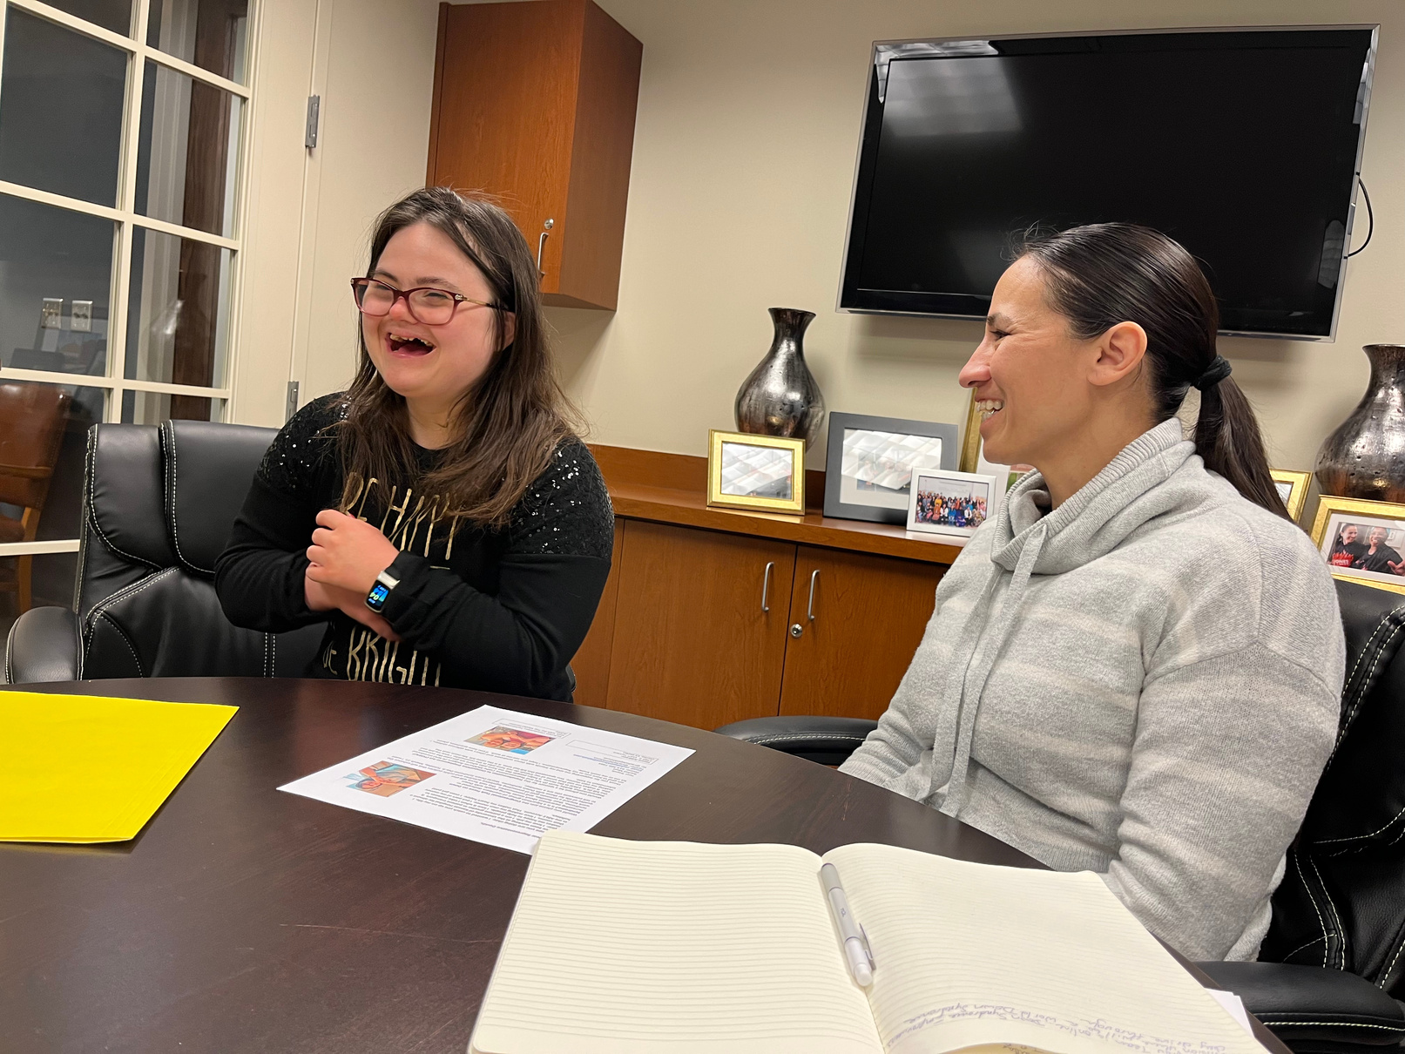
Remember: You are building a relationship.
  If you already have a relationship with the office, this is a chance to strengthen it.
  If you have not met with the office before, today is the beginning of a relationship.
  You may not get everything you ask for in one meeting, and that is okay.
  Be respectful, listen, find common ground, and leave the door open for future conversations.
  Follow up after the meeting and keep the relationship going.
Think beyond the ask. Think about the relationship you are beginning to build.

Slide 15
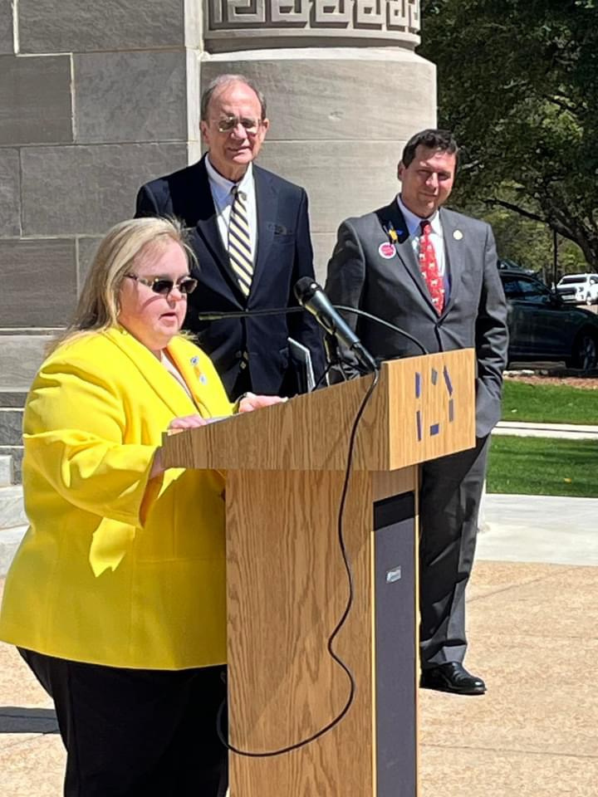
My Advocacy Journey
How I started
  Started with my Dad
  Board service is a good place to start
  Local
  NDSC
Continued Advocacy
  Spoke at the first DS Day at the Mississippi State Capitol
  Appointed to the Governor’s Council on Developmental Disabilities
  Invited to pray and speak to the Mississippi Legislature
We, as self-advocates, are the experts on our lives.

Slide 16
Why are self-advocates’ voices important?
Individuals living with Down syndrome really know what we want and need.
We have lived experience to say what needs to change to make our lives more meaningful and live our dreams.
When there is a discussion that is affecting us, we must speak out and speak up.
Notes:
Jessie
2

Slide 17

Tell Your Personal Story
  Laws and dates are good to know.
  But there is one tool that is more powerful than anything else.
It’s YOUR STORY.
  Your most powerful tool is your story! Telling an elected official how something will impact your life is powerful.
Notes:
Jessie: Now I want to tell you something important.
3

Slide 18
Build Your Story: Three Easy Steps
This is me:
Tell them your name and what is your connection to Down syndrome.
This is what’s happening:
What is happening and how it impacts you or someone you value.
This is what I need:
What is the one specific action you want this person to take? Often called “The Ask.”
Notes:
Jessie
4

Slide 19
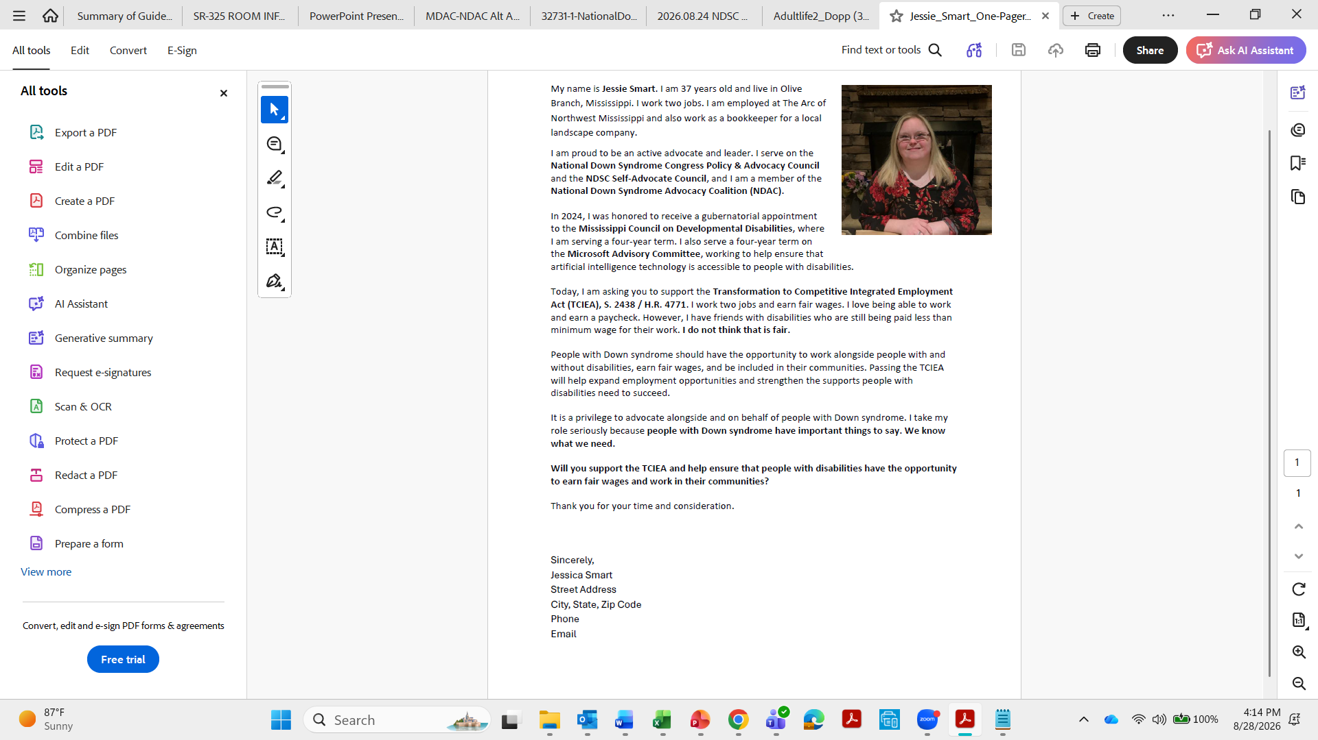
Your Story is Your Strategy
Notes:
Jessie
This is an example of my one-page leave behind. You can see my policy ask related to the TCIEA bill near the end of my one-pager. You can find this and other examples of self advocate one pagers on our website.
5

Slide 20
Jessie’s Story - Elevator Speech
  Hello, and thank you for meeting with us today.
  My name is Jessie Smart. I am a self-advocate with Down syndrome from Olive Branch, Mississippi.
  I work two jobs, and I get paid a fair wage for my work.
  But many of my friends with disabilities do not get paid a fair wage. Some get paid only a few dollars for the work they do. This happens because of an old law that lets some employers pay us less than minimum wage.
  That is not fair.
  Would you please sponsor the Transformation to Competitive Integrated Employment Act, or TCIEA. It would end that old law over time and help businesses create good, fair-paying jobs for people with disabilities.
  Wouldn't you agree that people with disabilities deserve to be treated with respect just like everyone else?
  Thank you for listening and thank you for your support.
Notes:
Jessie
6

Slide 21
Why Jessie’s Speech Works
Jessie's model focuses on TCIEA — yours doesn't have to
Jessie’s story works because it is:
  Short and to the point
  Specific to her Ask
  Personal and emotional out of concern for her friends
  Connected directly to the Ask
  Actionable steps for legislators to take
Here’s another example of an elevator speech...
Notes:
Jessie: Now Jawanda is going to break down my speech. And Sam is going to lead an activity to practice your elevator speech. to accompany.
7

Slide 22
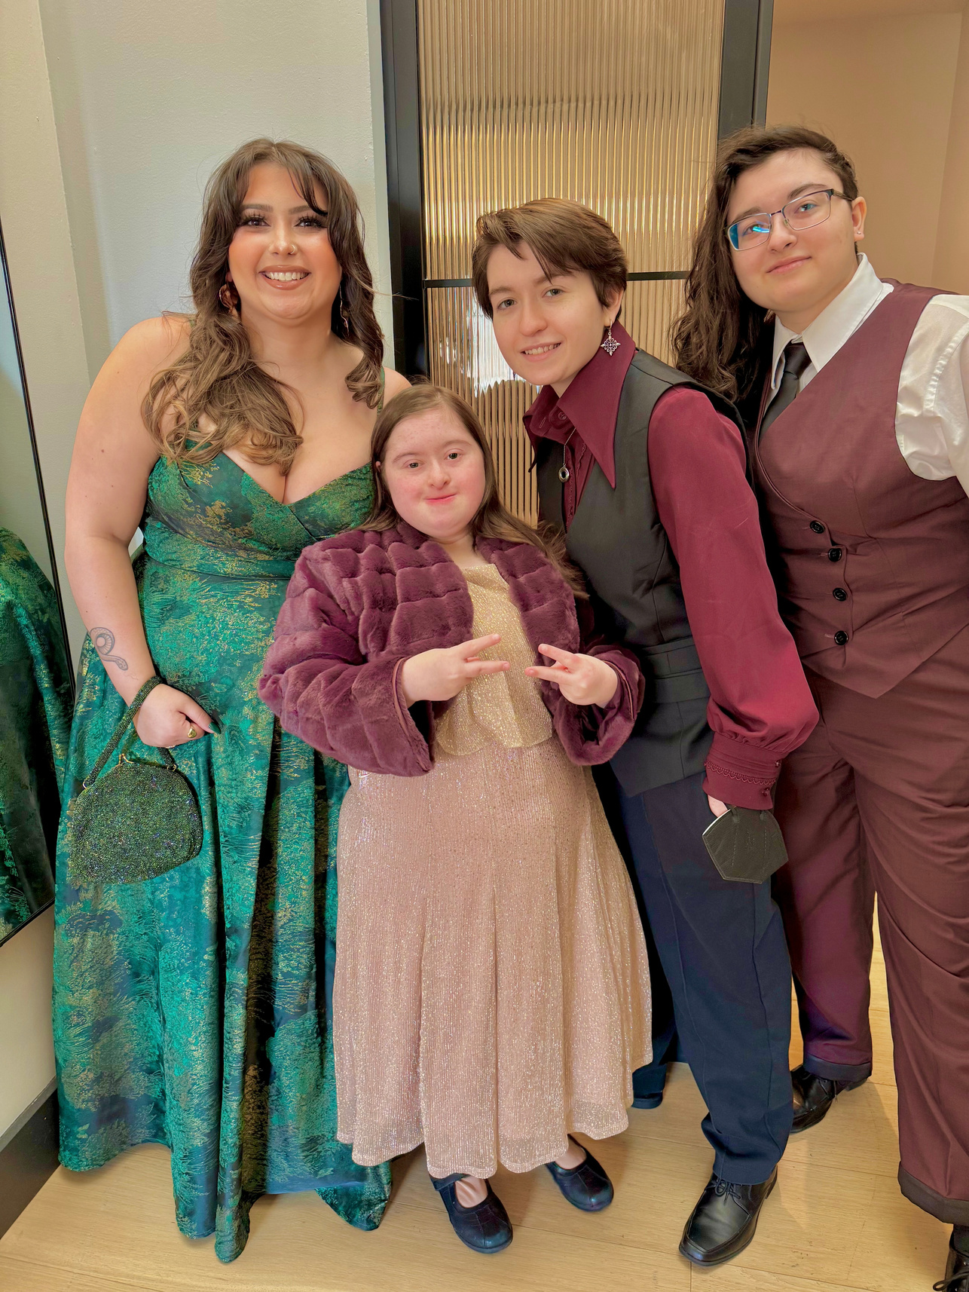
Sam’s Story - Elevator Speech
  My name is Sam Iannone. I’m the National Down Syndrome Congress Communications Coordinator and I live in New Jersey.
  My sister, Gabby, is 21 and has Down syndrome. She is medically complex, and takes many medications including an eye-sight saving medication.
  This medication is extremely expensive and Gabby needs Medicaid in order to pay for this medication.
  Gabby uses the HCBS waiver to get involved in the community through classes such as choir, art, and music.
  Her ability to be involved in the community is dependent upon the supports provided on the HCBS waiver.
  Will you please support the HCBS Access Act?
  Thank you for your support!
Notes:
Jessie
6

Slide 23
Hands-On Activity
Elevator Speech Practice
Notes:
Hold up form. Answer and help others at your table answer the questions. There you have your elevator speech.
8

Slide 24

The Not-So-Secret Secrets of
Social Media Advocacy
Notes:
Sam create handout and slide
8

Slide 25
The Not-So-Secret Secrets of
Social Media Advocacy
Gen Z’s digital screen attention span is 1.7 seconds on average
  Short-form content has made our on-screen attention spans drop significantly
  Your content should adapt to these trends
Short. Concise. Impactful.
Social media is your elevator speech for the virtual world
Notes:
Jessie: Now I want to tell you something important.
3

Slide 26
Three Must-Haves for Your Post
  Always ask for a photo with your legislator or staffers to recap the meeting
    Smiling faces of their constituents make a huge impact
    OR film a video reiterating your Ask
  Tag your legislator, not the campaign
    During campaign season, legislators typically have a separate social media account for their run. Make sure to know the difference.
    Make sure you are following the legislator, even if you disagree with them.
  Get to the point
    Your caption should hit three specific points fairly quickly:
      Thank you to your legislator
      The Ask
      How it impacts YOU
Notes:
Jessie: Now I want to tell you something important.
3

Slide 27
Identify Your Audience and Adapt
Who are you trying to reach?
For Elected Officials and Policy Makers
  Easy to digest, plain-language points
  The less words, the better
  A clear ask that is easy to agree with
  Photos showing WHO this is impacting
    OR a simple graphic that can easily be related to
  Specific stories that relate to the shared experiences of those within the Down syndrome community
  Think of the RESHARE VALUE
    Will someone look at this and immediately say, “YES! I am ON BOARD.”
Notes:
Jessie: Now I want to tell you something important.
3

Slide 28
Reshare Value
Social media is a curated archive of someone’s life
The Archives
  Social media acts as an archive of the different aspects and chapters of your life
  We strive to relate to others, so a simple like or repost can make someone feel less alone
  You don’t know who is dealing with something behind the scenes. Your reshare could open a door to the community for someone longing to find it.
Mood Board
  Think of someone’s profile as their mood board
  I repost what speaks to me and what my followers need to know about me
  A “to the point” graphic or a photo can show my followers what I’m passionate about
Notes:
Jessie: Now I want to tell you something important.
3

Slide 29
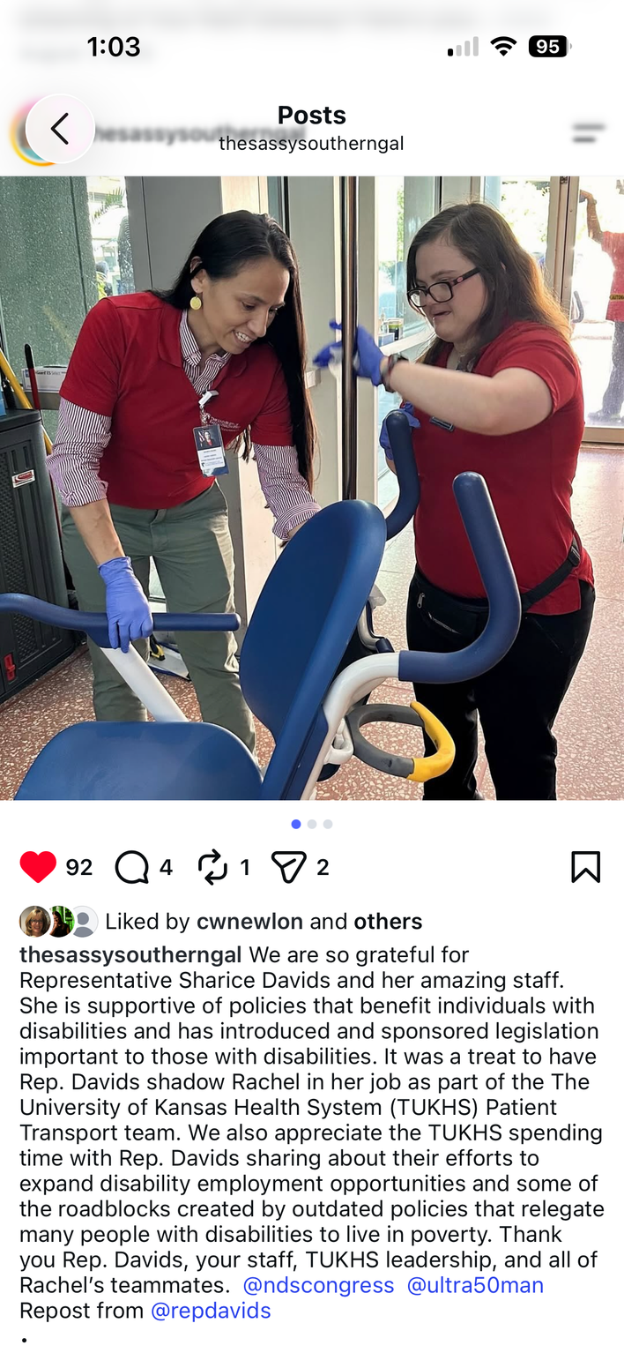
Kindness is Key
  Social media can be a nasty place, especially in the political-sphere
  AVOID
    Name calling
    Pitting sides against each other
    Shaming them for their votes
  DO
    Thank them for meeting with you
    Share how this Ask will specifically impact YOU (their constituent)
    Ask others to join your advocacy efforts
    Be respectful
Notes:
Jessie: Now I want to tell you something important.
3

Slide 30
Let’s See It In Action
Good Example
Bad Example
Thank you to Senator Cory Booker’s office for meeting with us to discuss ways to support the Down syndrome community in New Jersey!
We spoke about the SSI Penalty Elimination Act
(S. 1234), which would raise the outdated asset limit for individuals and couples with disabilities, like my sister Gabby, and allow them to save for their future. This is the beginning of a long advocacy journey, but we are happy to have our voices heard. The first step to speaking up is to SHOW UP!
Contact your own Senators to discuss this important legislation!
We had a very unproductive meeting with our local representative’s office today. We were met with young staffers instead of the elected official, who didn’t know anything about the bills we were talking about, which was the first red flag.
The second red flag? Finding out that our representative voted directly against people with disabilities. Why did we spend the time to go to their office if we are just met with kids and no one listens to us? Clearly, we were not a priority for them.
Pro tip: Do not trust this person to advocate for us.
Notes:
Jessie: Now I want to tell you something important.
3

Slide 31
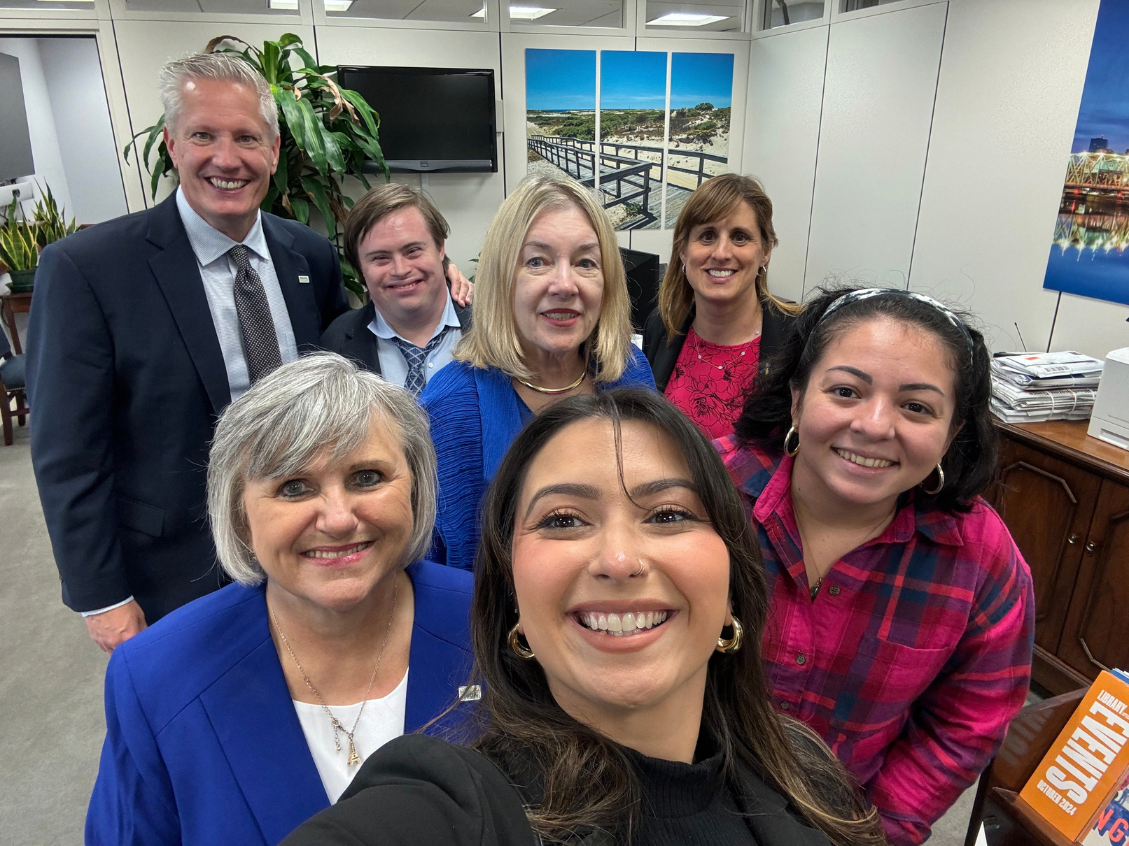
Educate, Don’t Condesate
  A made-up word for a very real point
(The verb is actually condescend, but it doesn’t rhyme)
  We are there to educate legislative offices on the impact that these Asks will have on the Down syndrome community, NOT to argue or accuse
  Relationship building is the first step to creating policy change
Notes:
Jessie: Now I want to tell you something important.
3

Slide 32
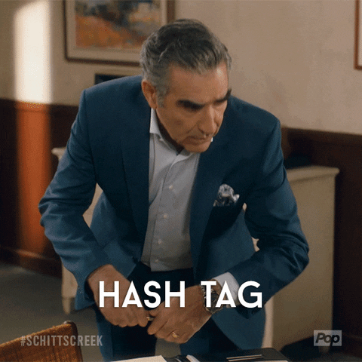
TLDR
  Get to the point!
  Grab a photo
  Tag the legislator
  Know your audience
  Be kind!!!
  Educate, Don’t Condesate
WE WANT TO SEE YOUR BEAUTIFUL POSTS!
  #NDSC
  #NDSCSummit2026
  #DSpolicysummit
Notes:
Jessie: Now I want to tell you something important.
3

Slide 33
The 4 Rs of Advocacy Relationships
A single meeting is a start. These four habits are what turn it into a relationship.
Respect
Recognition
Relationships
Realize the Power of Staff
Keep it respectful, even when you disagree.
Publicly thank officials on social media and in newsletters.
Advocacy is a long game built on people, not just votes.
Staff can matter as much as the elected official, focus on building that relationship too.
Notes:
1.7.2013
15
‹#›

Slide 34
Advocacy is a marathon, not a sprint.
No permanent friends.
No permanent enemies. ​
Notes:
1.7.2013
15
‹#›

Slide 35
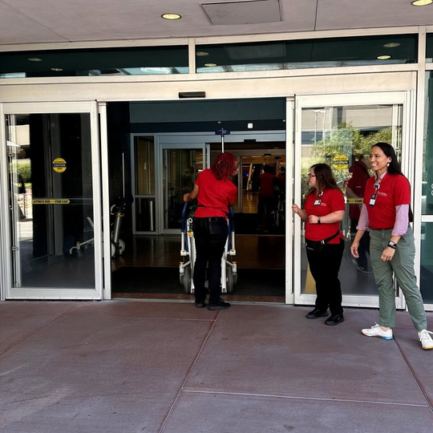
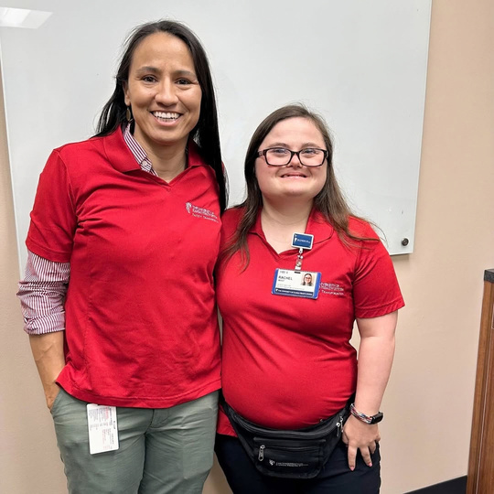
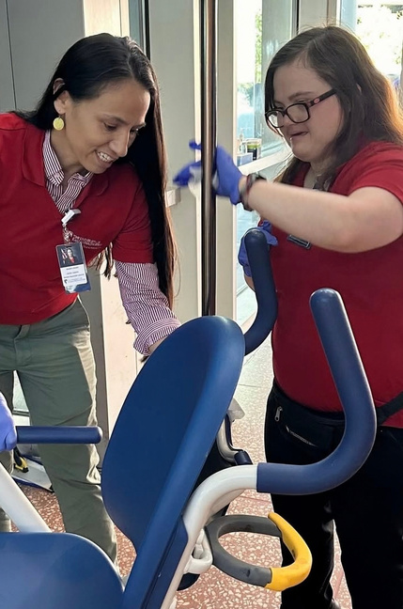
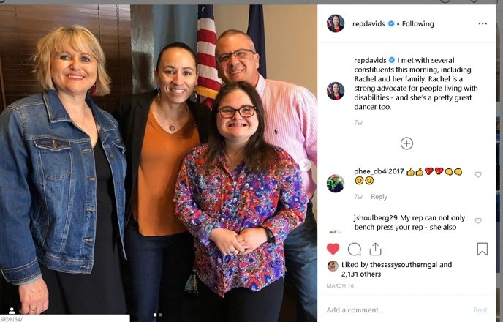
Building Relationships That
Make Advocacy Stronger
Notes:
Place holder: I want to do a version of this one at the end or just before the Tomorrow You Tell It Slide. You do not need to do everything today.
Start with:
One email
One meeting
One story
One relationship
One action
You have already taken your first action by showing up today!
27

Slide 36
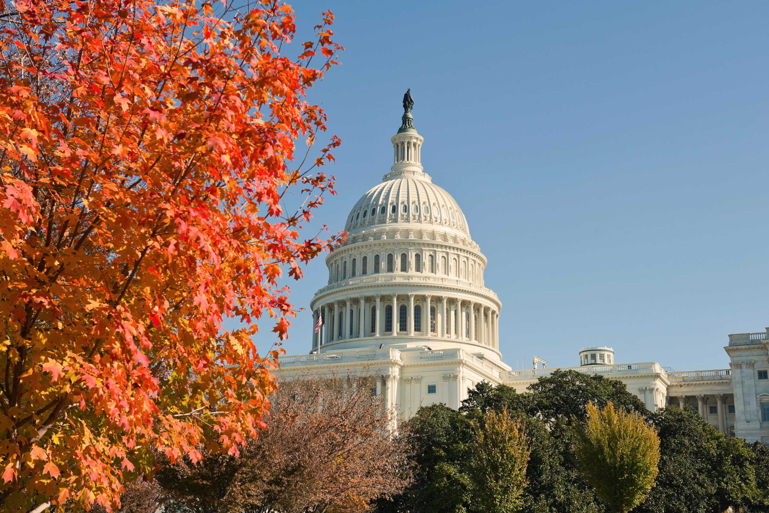
Tomorrow,
You Tell It.
You know your story.
You know your ask. You are the expert decision makers need to hear from.
See you bright and early for Hill Day.
Questions tonight?
Find Jawanda, Sam, or Jessie.
Notes:
1.7.2013
19
‹#›

