Slide 1

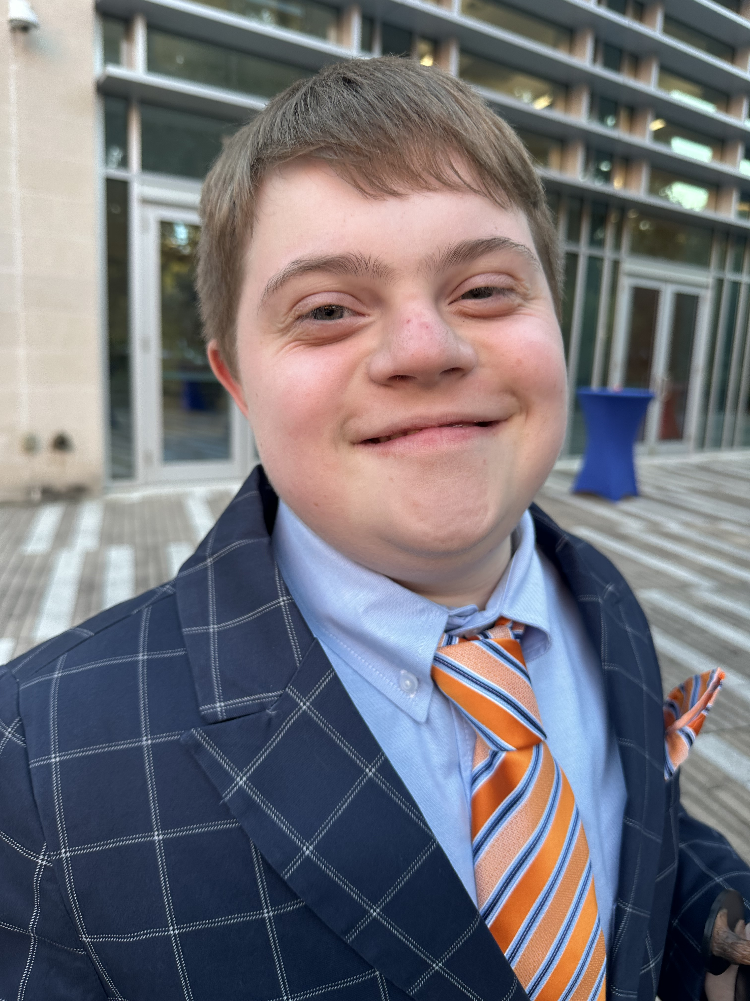

Empowering Advocacy: Harnessing AI for Impact
Julie Gerhard Rothholz
Parent Advocate
Evan Rothholz
Self-Advocate

Slide 2

How familiar are you with Artificial Intelligence (AI)?
Who has never used AI?
Who has dipped their toes into AI?
Who regularly uses AI?
Who uses AI for advocacy?

Slide 3
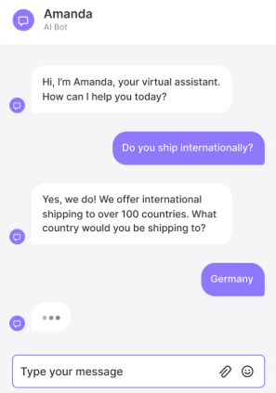
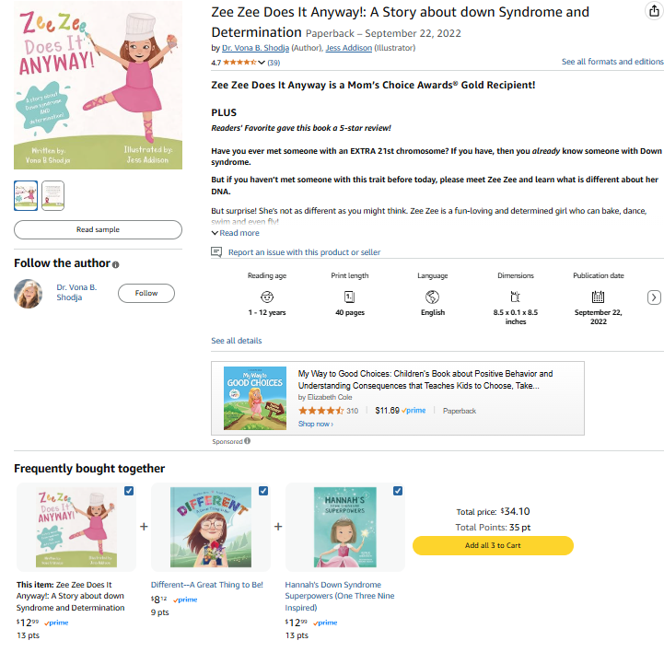


Everyday AI Examples

Slide 4
What is Artificial Intelligence (AI)?
AI is computer programs/systems that can help with writing, learning, organizing, and more.
AI uses information and patterns to predict, create, and make recommendations.
AI is a tool—just like spell check or a calculator.
Our goal is to use AI to make advocacy easier and more effective.

Slide 5
Examples of Artificial Intelligence Tools
ChatGPT: https://chatgpt.com/
Perplexity AI: https://www.perplexity.ai/
Claude: https://claude.ai/
Google Gemini: https://gemini.google.com/app
There is free access for all of these, though some have limitations to the free access.

Slide 6
Practical Uses of AI in Advocacy
Summarizing legislation
1
Developing your talking points or issue briefs
2
Creating plain language materials
3
Organizing your biography
4
Writing thank you notes and social media posts
5

Slide 7
It Starts with a Prompt
A prompt is the instructions you give to AI to guide it
Think of it as a recipe.
A prompt should contain:
A role: Tell AI who it’s acting as.
A task: What you want AI to do.
A format: What do you want your results to look like?
HINT: ask the AI to include its sources.
Review and edit your results
Review to make sure the information is correct—AI sometimes makes mistakes!
Edit the results to your preferences.

Slide 8
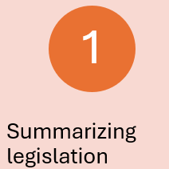
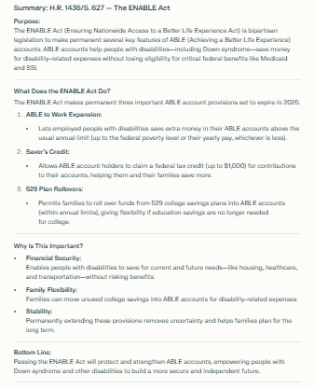
Summarizing Legislation
Role: You are an advocate going to Washington DC to advocate for people with Down syndrome. You will discuss H.R. 1436/S. 627, the ENABLE Act.
Task: Please provide a summary of the bill so that you understand the benefits for individuals with disabilities.
Format: The summary should be a 1-page document
Note: This was version 2. AI doesn’t always stick to your length restrictions!
Generated using Perplexity.

Slide 9
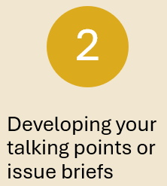
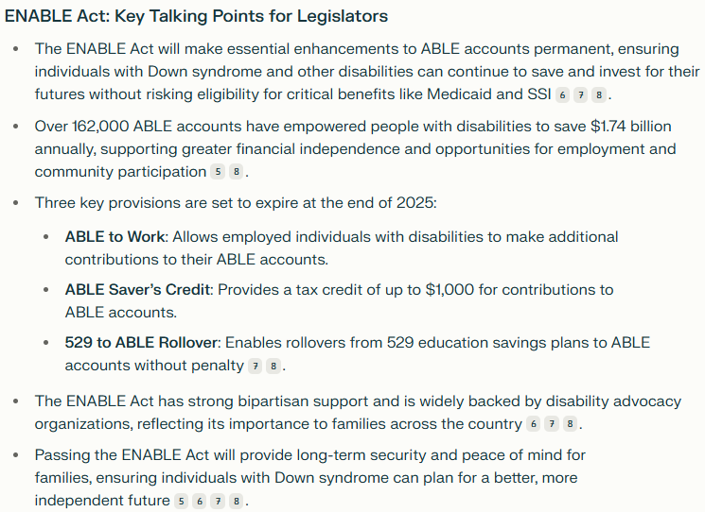
Developing Your Talking Points
Role: You are an individual visiting your legislators in Washington DC to advocate for individuals with Down syndrome, and you will be talking about the ENABLE Act
Task: Please create talking points to guide the discussion of key points with legislators
Format: the information should be presented as an overview of up to 5 key bullet points that can be presented in 1-2 minutes. You may receive questions about who sponsored the bill.
Generated using Perplexity.

Slide 10
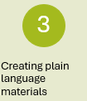
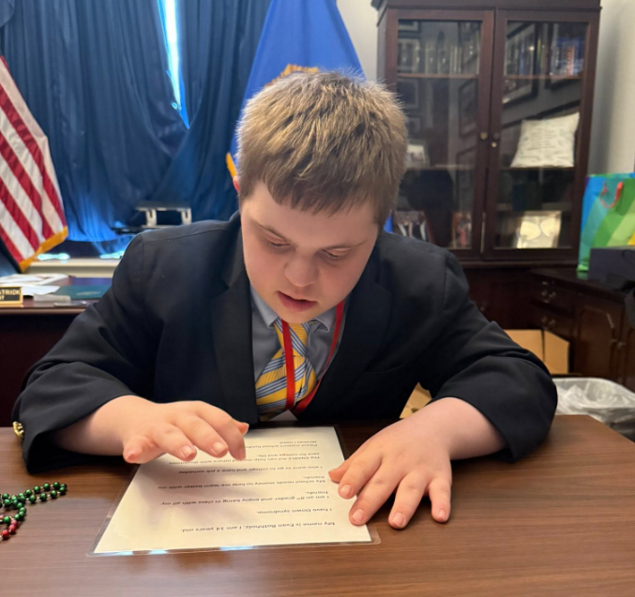
Creating Plain Language Materials
Role: You are 14-year-old 8th grader visiting your legislators in Washington DC. You enjoy learning with your typical peers.
Task: Please create a document you can use to advocate with legislators about school funding and The Enable Act (S. 627, H.R. 1436)
Format: The information should be presented as a series of short sentences written at a first to second grade level that can be easily read in 1-2 minutes by an individual who has Down syndrome and speech challenges.

Slide 11
Plain Language Material Example
My name is Evan Rothholz. I am 14 years old. I have Down syndrome. I am going into 9th grade.
I like being in class with all my friends. My school needs funding to help students like me learn with our friends.
I also want to go to college and have a job. The ENABLE Act can help me save for college and life.
Please support school funding, the ENABLE Act, and services I need.

Slide 12
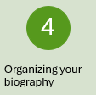
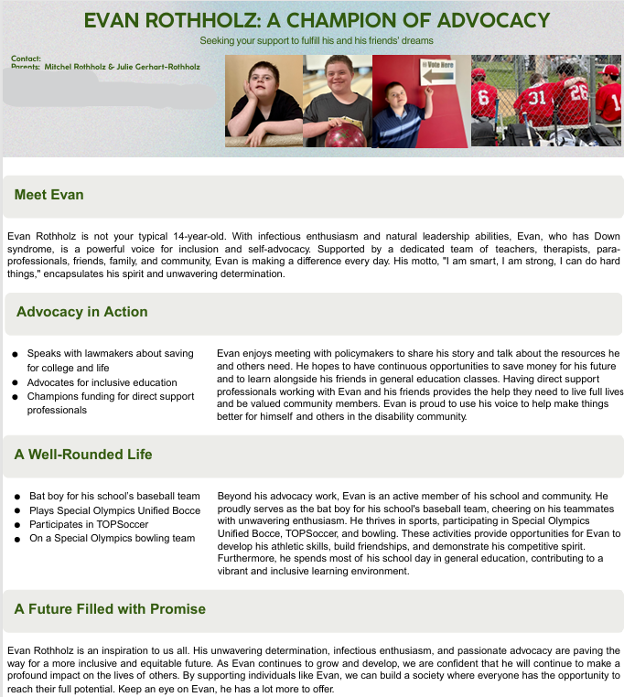
Organizing Your Biography
Goal: Create a document that shares your story in a brief, organized, memorable way.
AI can help because it:
Saves Time
Elevates clarity
Improves focus/length
Improves arrangement of information
Applications that can help:
ChatGPT, Claude, Perplexity
Canva
Generated using Canva

Slide 13
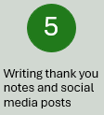
Writing Social Medial Posts and Thank You Notes
Role: You visited Washington DC with a group of advocates across your state to discuss the importance of Medical Research, The Enable Act, Medicaid Funding, and School Funding for individuals with Down syndrome or other disabilities.
Task: Please create a social media post for X/Twitter and one for Facebook thanking them for the meeting and engagement; also, create an email follow up recapping the topics you discussed and thanking them for their time and engagement.
Format: The X/Twitter post should be about 225 characters long; the Facebook post should be 2-3 sentences, and the email can be 3-4 paragraphs.
HINTS:
You can include multiple requests in one chat!
You can write the content ahead of time
Vary the wording in social media posts

Slide 14
Writing Social Media Posts and Email, Part 1
X/Twitter
@politiciansocialmediahandle Thank you for engaging with advocates in DC to discuss medical research, the ENABLE Act, Medicaid, and school funding for the Down syndrome community. Every conversation helps move these critical issues forward!
Facebook
Thank you, @politiciansocialmediahandle, for taking the time to meet with us in DC to discuss critical issues affecting the Down syndrome community, including medical research, the ENABLE Act, Medicaid, and school funding. Advocacy is strongest when we work together. Looking forward to continuing these important conversations!
Generated with Google Gemini

Slide 15
Writing Social Media Posts and Email, Part 2
Follow-Up Email (3-4 paragraphs)
Subject: Thank You for Meeting with Us
Dear [Legislator’s Name],
I want to sincerely thank you for taking the time to meet with us in Washington, D.C. to discuss the issues impacting individuals with Down syndrome. It was an honor to advocate alongside my 14-year-old child and others from across the state, emphasizing the importance of medical research, the ENABLE Act, Medicaid funding, and school resources. Your willingness to engage in these discussions means so much to our community.
As we highlighted during our meeting, continued investment in medical research will advance critical health outcomes, while the ENABLE Act will provide much-needed support for financial independence for individuals with disabilities. Preserving Medicaid funding is essential for ensuring accessible healthcare, and prioritizing school funding directly impacts educational opportunities. We appreciate your attention to these matters and your dedication to policies that uplift the Down syndrome community.
We look forward to staying connected and working together to promote positive change. Please let us know how we can support efforts to push these initiatives forward. Thank you again for your leadership and commitment to advocacy.
Best regards, [Your Name] [Your Contact Information]
Generated with Google Gemini

Slide 16
Today We Learned…
That we’re already using AI more than we thought we were!
That AI is a tool that can help us prepare for advocacy in many ways, even creating materials that make advocacy easier for advocates and self advocates.
That we can write a prompt by giving AI it’s role, a task, and a format—AND that we should check the results.
That when a self-advocate takes the stage, they’re a hard act to follow, and they tell a more effective story!

Slide 17

What Questions Can I Answer?

