Slide 1
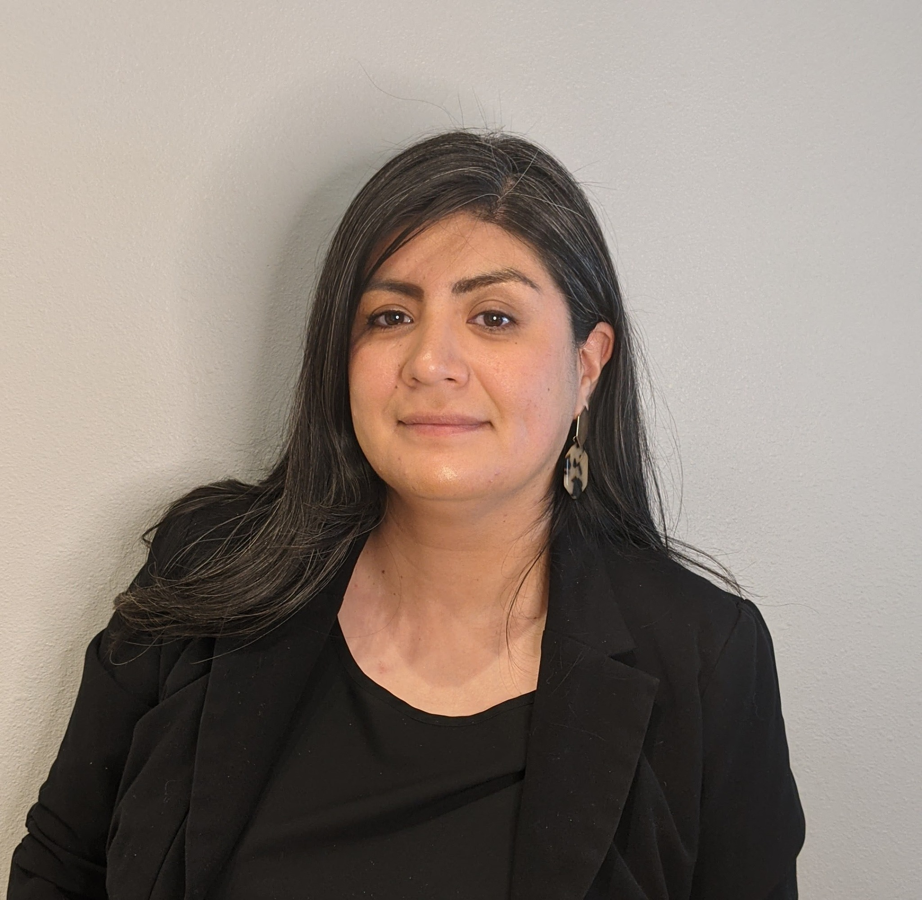
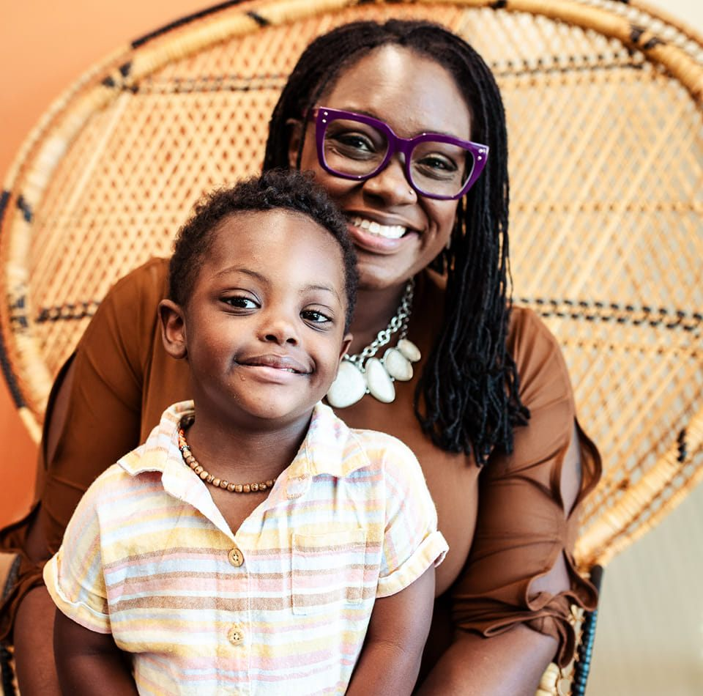

Five Ways to Engage Diverse Populations
Magaly Diaz
NDSC Multicultural Coordinator
Crystal Lotterberry
Black Down Syndrome Association Founder

Slide 2
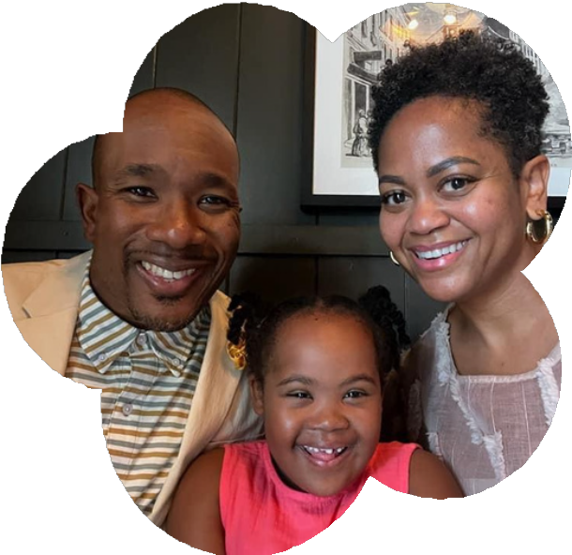
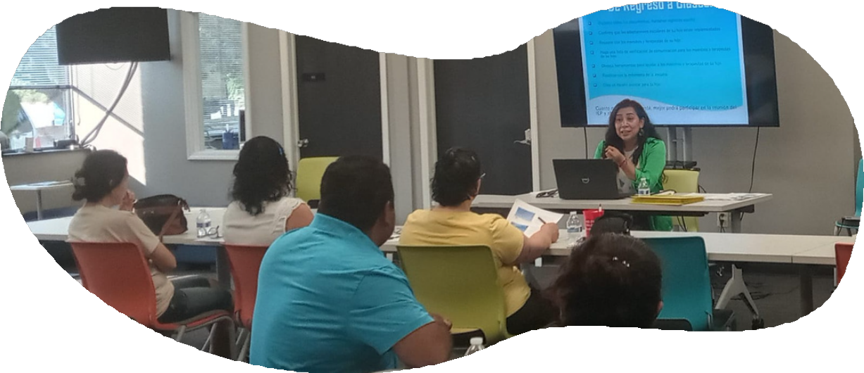

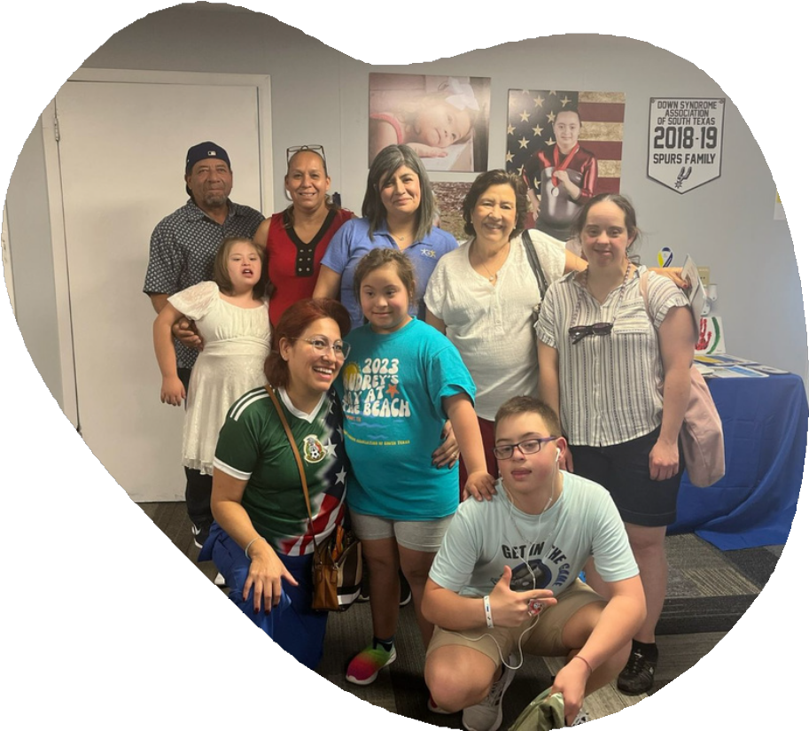
Reaching Out
and Reaching In
Effectively Engaging Diverse Populations in Advocacy

Slide 3
Identify effective outreach strategies to engage diverse and historically underserved communities.
Learning Objectives
Understand the importance of building authentic relationships by listening to and respecting the unique needs of minority families.
Explore internal practices to foster a more inclusive organizational culture, including hiring, training, and event planning.
Learn how to create culturally relevant and accessible programming to better serve diverse populations.
Develop actionable steps to bridge gaps and build trust with families from different cultural backgrounds..

Slide 4


EQUITY
EQUALITY
Generic | Adaptable
Group-focused | Individual-focused
Equal | Fair

Slide 5

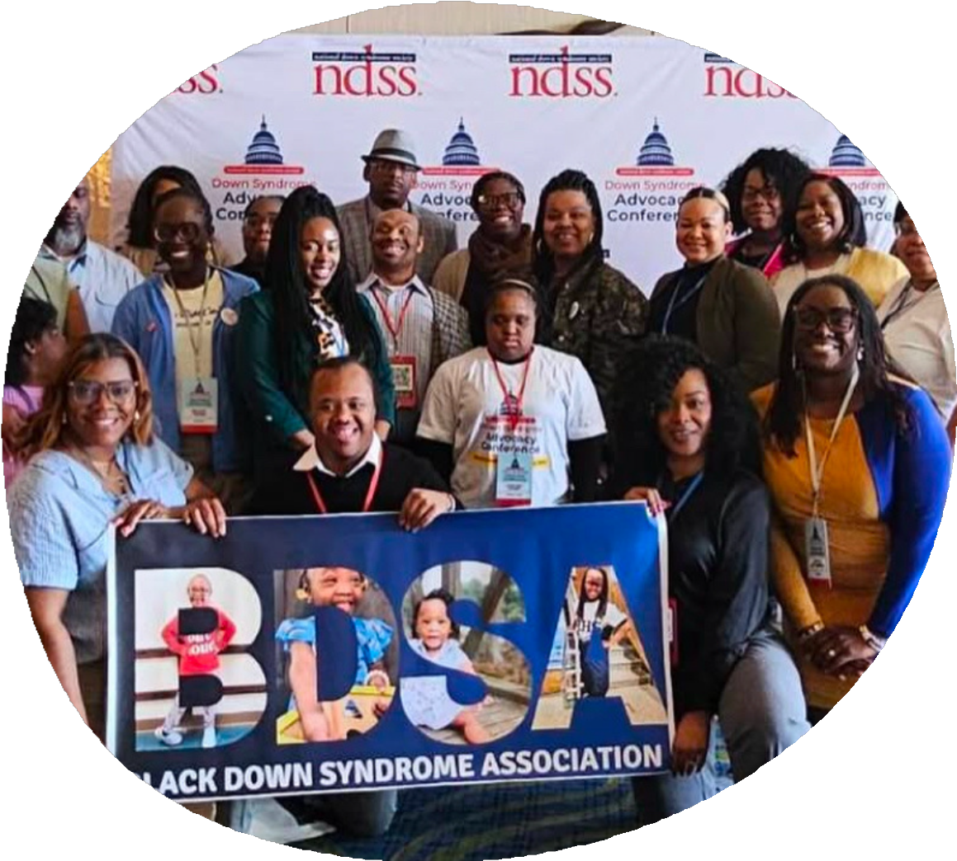

BUILDING BEYOND
Inclusion
From representation to Leadership
The importance of hiring diverse voice at every level, including leadership roles.
Equity In Action
Moving Beyond performative inclusion to implement real, systemic change within your organization.
Culturally Competent Training
Ensuring staff and volunteers understand the diverse needs of the communities they serve.
Inclusive Event Planning
How to create accessible, welcoming and cultueally relevant programs for ALL families.
Sustaining the Work
Strategies to embed equity to your orgs long term mission and impact.

Slide 6

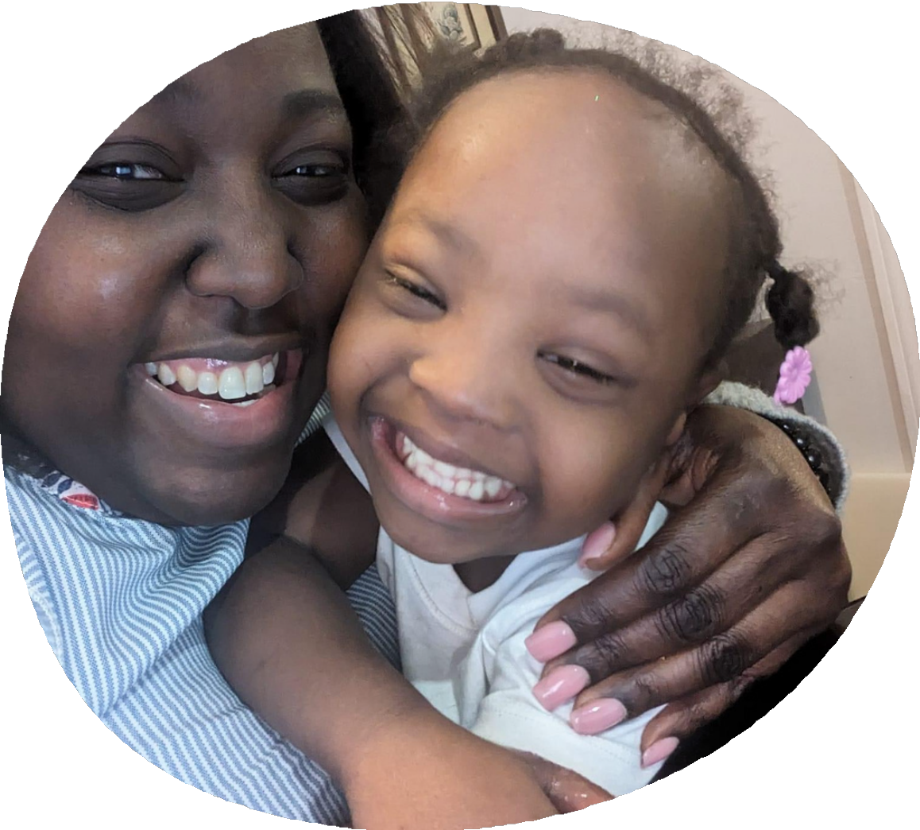

LISTENING LEARNING &
Leading
The Power of Presence Showing up consistently.
Listening First
Understand the unique experiences and needs of minority families BEFORE taking action.
Cultural Competency Matters
Respect traditions, values, and perspectives to create meaningful connections.
Beyond One Size Fits All
Tailor support, resources and outreach to truly meet families where they are.
Sustaining Relationships
Move from transactional engagement to long-term, commuinty driven partnerships.

Slide 7

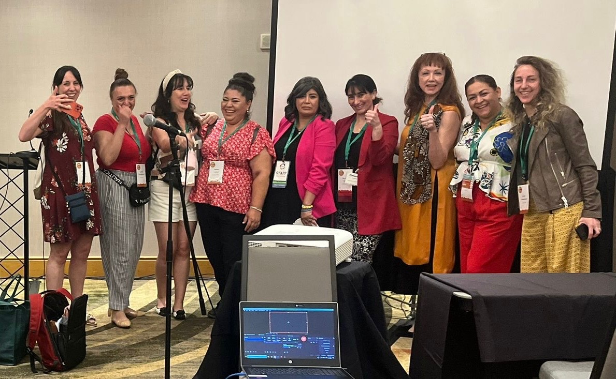

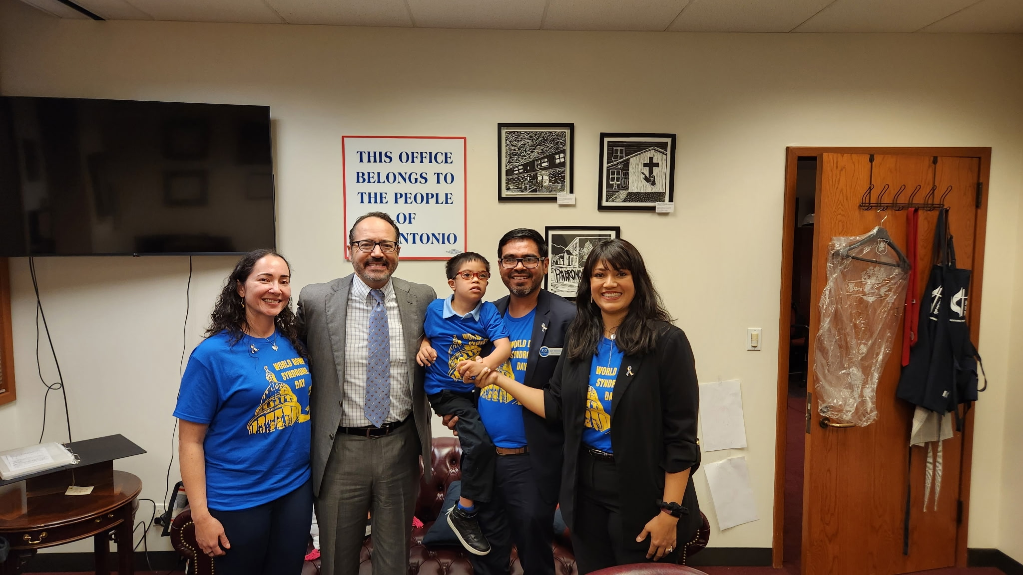
NDSC Multicultural Program Coordinator
Serve our Spanish speakers
Monthly Webinars
Spanish NDSC social media pages Monthly Spanish newsletters
DIR Committee oversees serving diverse populations

Slide 8

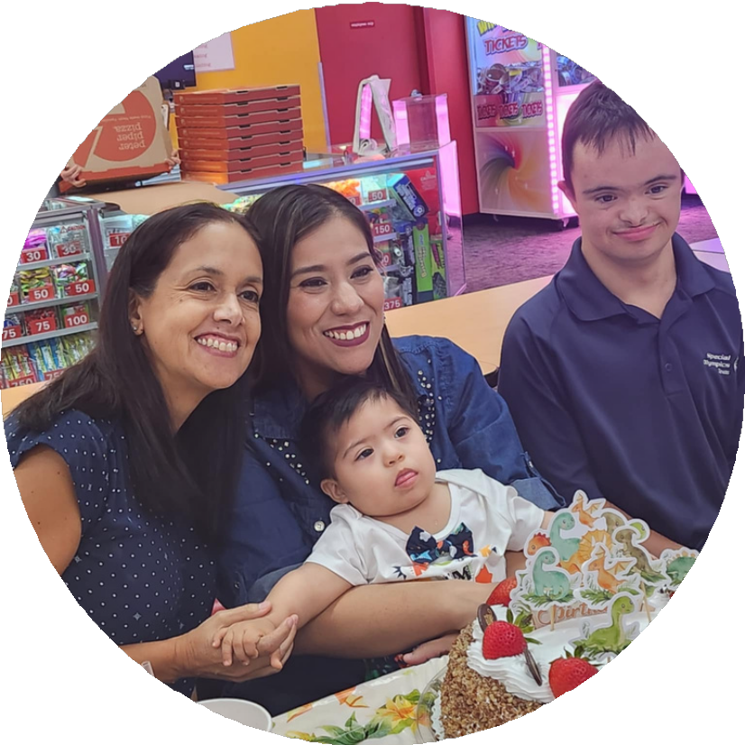
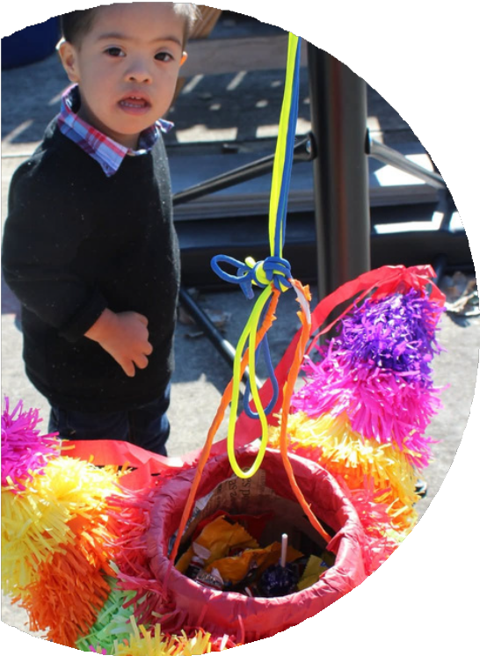
Top 5 tips to engage diverse populations
Build trust & relationships.
Community based initiatives.
Make meeting times convenient for the majority. Enlist the help of community trusted organizations.
Hispanics are not used to being asked feedback or participating.

Slide 9

Learn more about NDSC Spanish Social Media pages
Facebook: @NDSCEE
Instagram:@NDSCEE
Website: https://www.ndsccenter.org/
Email: magaly@ndsccenter.org
WhatsApp Phone #: 1(678)658-0484

Slide 10
Learn more about BDSA and follow us on
Social Media!
Facebook :@BlackDSAssociation Instagram: @blackdownsyndrome Website: https://www.blackdownsyndrome.org Email: info@blackdownsyndrome.org

