Slide 1

Using Social Media to Advocate for People with Disabilities
Jillian Benfield

Slide 2




Introduction
My name is Jillian Benfield. I’m a former journalist, turned author and mom of three. My middle child, Anderson, has Down syndrome. I have used social media to build an audience of readers for the last 10 years.
Released Jan 2023
Releasing Sept. 2025

Slide 3



Social Stats:
111,000 Followers
20,000 Followers
30,000 Subscribers

Slide 4
Not a social media expert
However, I am a storyteller.
Today, we will learn how to use the online platforms we have to tell our stories
and sprinkle in advocacy efforts for people with DS and other disabilities.

Slide 5
Myth: Social Media Isn’t Real Life
253 million in the US
73% of the US population actively uses social media.
The number of social media users in the US has been steadily increasing

Slide 6
Myth: Social Media isn’t real advocacy
Social media is the new public square
54% of U.S. adults rely on social media to get their news (Pew Research 2024)
Examples of social media campaigns that became real movements: ALS Bucket Challenge, #MeToo, #BlackLivesMatter –
When used well- social media has the power to shape opinions mobilize efforts

Slide 7
When Social Media is Used Well-
-It Informs
-It Inspires Peole to ACT

Slide 8
How to use social media as a regular person on the internet who wants to raise awareness and have influence:
No- to all policy all the time
Internet life and personality
Don’t just consume- engage
It’s one thing if you create a professional page dedicated to advocacy. But if you have a regular account- followers will tune you out if all you post about is policy concerns.
Post about other things that interest you- family pictures, funny memes, stories that move you, articles that inspire , etc.
How can you expect for people to care about the things you care about if you never interact with them? Like, comment share!

Slide 9
How to use social media as a regular person on the internet who wants to raise awareness and have influence-
Types of Posts:
Re-posting Articles
Re-Posting Memes/ Videos
Creating Original Content

Slide 10
Reposting Content:
-Don’t save photo/article and upload on your own
-Play into the algorithm - SHARE
-Once you share - summarize why this is important to you in the caption
-Use bullet points, a quote, something to get people to actually read the article/engage!

Slide 11
Re-Posting Content
-Don’t forget a “call to action” if there is one (calling your representatives, filling out an action alert, etc.)
-Before publishing- ask yourself- does this inform? Does this inspire and show people how to act?
-Tag other advocates you think would be interested and may re-share.
-Share to advocacy groups to amplify

Slide 12
Original Posts:
Be a storyteller- use emotion. Use your story and sprinkle in the facts.
-Tell why this affects YOUR family, why it matters to YOU and why it should matter to us ALL.
Have a captivating image/video that helps you tell the story
Don’t just write to YOUR audience- write as if you are on a global stage- because you are

Slide 13
Original Posts:
-Try to write the story in a way where others can see themselves in it
-Make sure your post is “public” and can be re-shared
-Call to action -Hashtags
-Tag members of your local media and/or elected officials if it applies

Slide 14
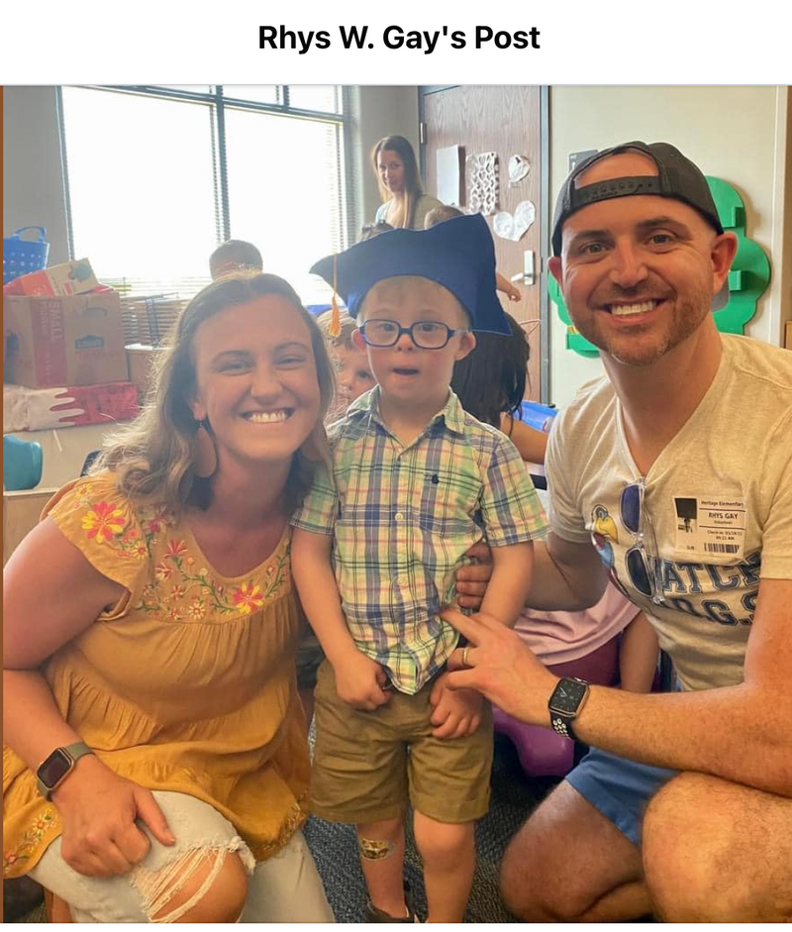
Example: Reject SB 1017
-This post by Rhys Gay received 10,000 shares on Facebook
-It received local media coverage
-And ultimately got the desired outcome of the bill being rejected

Slide 15
Full Text:
I’m Heartbroken and Angry.
As an Oklahoma father, born and raised in this great state, I’ve always been proud of our values—family, community, resilience. But today, I feel deeply hurt and ashamed. Not because Oklahoma isn’t capable of greatness, but because our leaders are actively choosing to turn their backs on the very children they claim to protect.
Senate Bill 1017, that was recently introduced by Sen. Dusty Deevers and backed by the disastrous Secretary of Education, Ryan Walters, is an attack on our kids. Plain and simple.
This bill proposes stripping physical therapy (PT), occupational therapy (OT), speech therapy, psychological services, counseling, and even basic health services like eye exams or assistive technology (like Everett’s speech device) from our public schools. It shifts the burden entirely onto families assuming every parent has the time, money, and resources to cover what schools have historically provided to ensure all children, regardless of background, can thrive in school.
Let’s be clear: This is not about budget efficiency. This is about neglect.
These services aren’t “extras” or “luxuries.” They are lifelines. They’re how a child with a speech delay learns to communicate. How a child recovering from an injury regains mobility. How a student battling depression gets through the day. How undiagnosed vision problems don’t derail an entire academic career.
Public schools don’t provide these services just because they can—they do it because it’s their responsibility to nurture the whole child, not just test scores. They do it because healthy kids learn better. They do it because families shouldn’t have to fight a broken system just to get their child the basic support they need.
I’m sick of Oklahoma politicians being proudly “pro-birth” but utterly failing to be pro-life when it matters most—when the child is actually here, needing care, love, and support.
This bill is a betrayal. It’s not who we are. Or at least, it’s not who we should be.
If you’re an Oklahoma parent, teacher, therapist, or just a human being with a heart—call your legislators. Show up. Speak out. Let’s make sure this bill doesn’t even make it out of committee.
Reject SB 1017. Protect our kids.
#NoToSB1017 #ProtectOklahomaKids #ProLifeMeansProChild

Slide 16
Why This Worked:
-Strong Opening Line- I am heartbroken and angry
Mass appeal- “As an Oklahoma father, born and raised in this great
state...” this appeals to his fellow Oklahoma citizens
The specifics- “This bill proposes stripping PT, OT, ST…”
The killer- “This is not about budget efficiency. This is about neglect.”

Slide 17
Why This Worked:
-The education: “These services aren’t just “extras” or “luxuries.” They are lifelines.”
The mass appeal: “This bill is a betrayal. It’s not who we are.”
The closer: Reject SB1017. Protect our Kids. #NotoSB1017
The picture!! It makes the conflict real and personal

Slide 18
How can you do something similar?
-Write from the heart
-Use an app to help you refine like Chat GPT
-Respond to comments to increase engagement
-Become the expert on the topic- consult with other advocates before posting

Slide 19
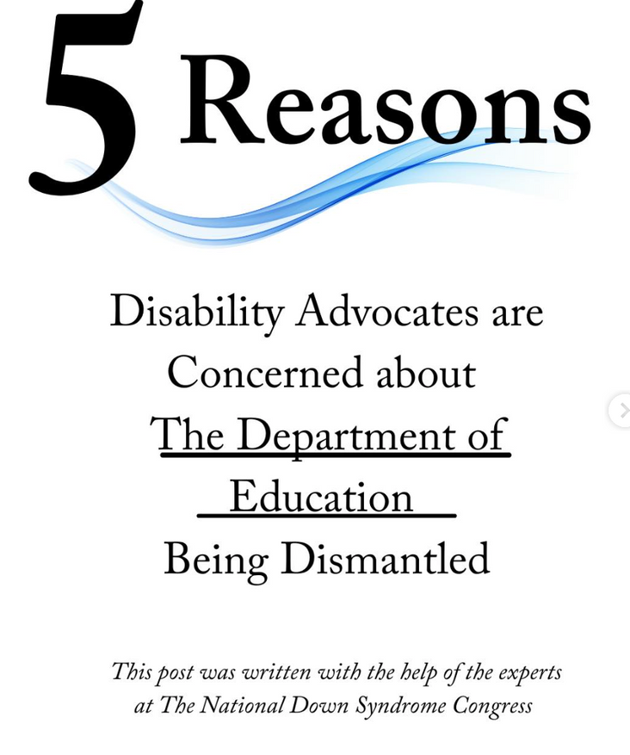
Infographic Example
If writing is not your thing- consider making an infographic.
Here is an example of one I did that was shared nearly 1,000 times on Instagram at @JillianBenfieldBlog
Link for full example: https://www.instagram.com/p/DHHpOb9zSus/?igsh=eWJiZTc3bWRtNW9l

Slide 20
Infographics:
-Use a number to hook people in
-Make points succinct as possible
-You can also use a personal picture to do this but use bullet points as your text
-Use Canva to design graphic

Slide 21
Information Based Posts
Facebook: 1 Cover graphic with bullet points in the text
Instagram: Multiple graphics with the points on the screen
Instagram/TikTok : You can also do bullet point stories over reels/tiktok videos! But make sure the points are much shorter and put more details in the captions

Slide 22
Credibility
Don’t forget there is a lot of mis-information out there these days. Be slow to share. Fact check before you hit publish!
Remember- you want to become a reliable source for your readers to depend on.

Slide 23
Final Tips
-Observe what is working for your fellow advocates when they post
-Create an emotional moment
-Storytelling is King, Facts are Queen
-Compelling images- social media is visual
-Remember- social media is SOCIAL

Slide 24
QUESTIONS?

Slide 25
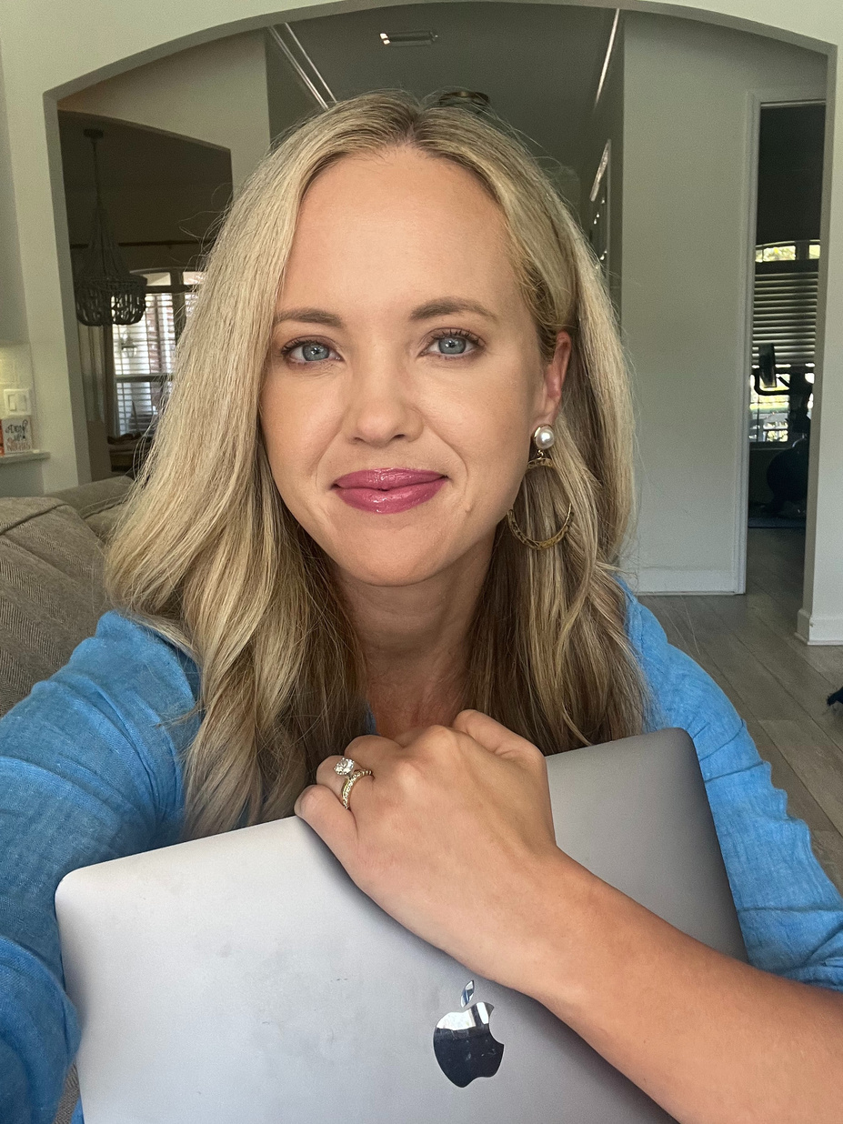
Let’s Connect
Free ebooks and email subscription: www.JillianBenfield.com
Facebook: www.Facebook.com/JillianBenfield
Instagram:
www.Instagram.com/JillianBenfieldBlog

