Slide 1

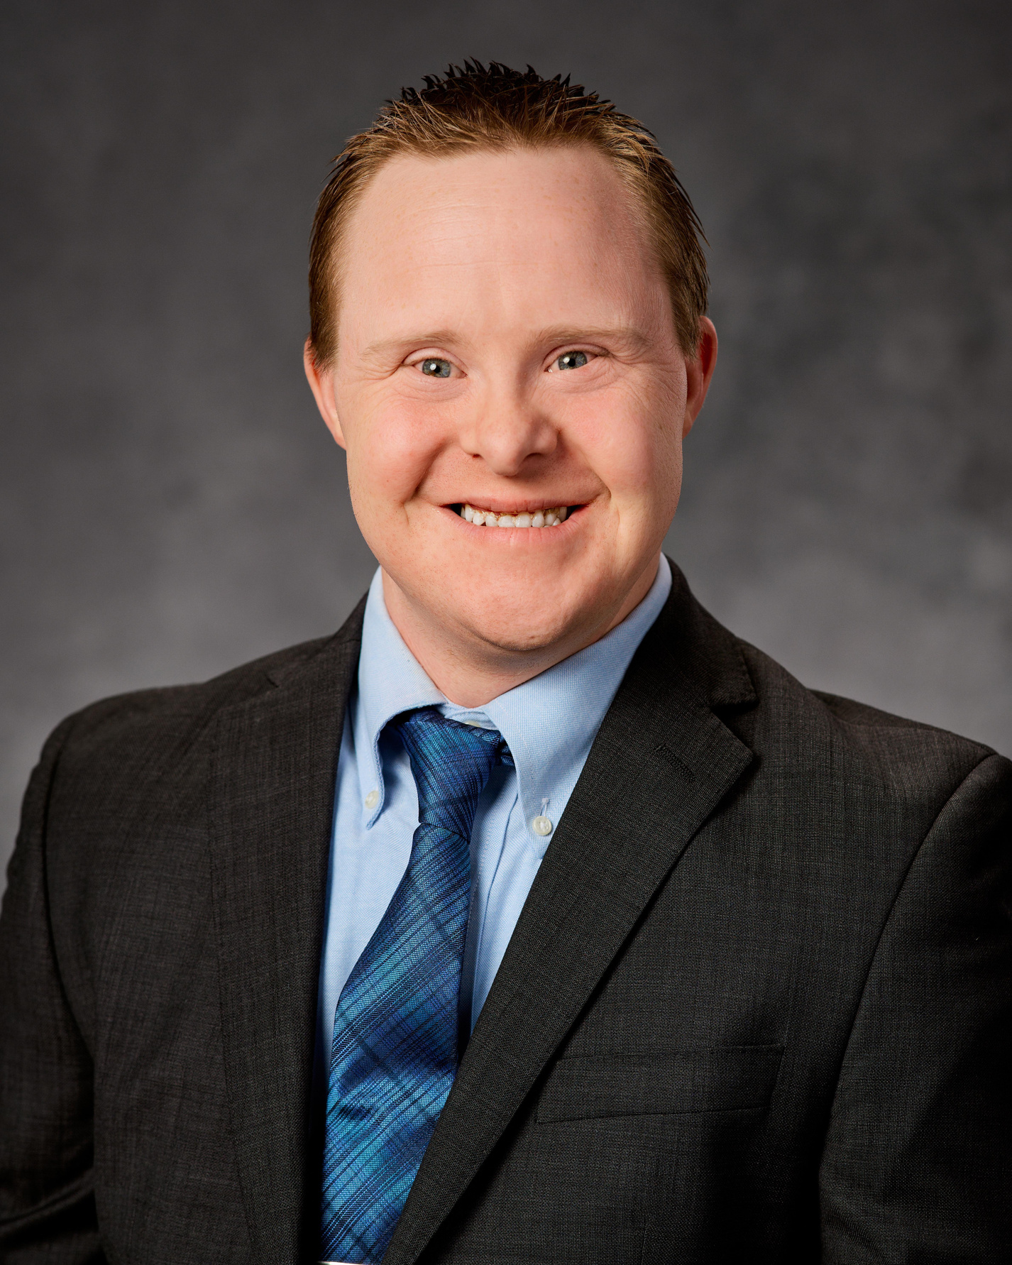
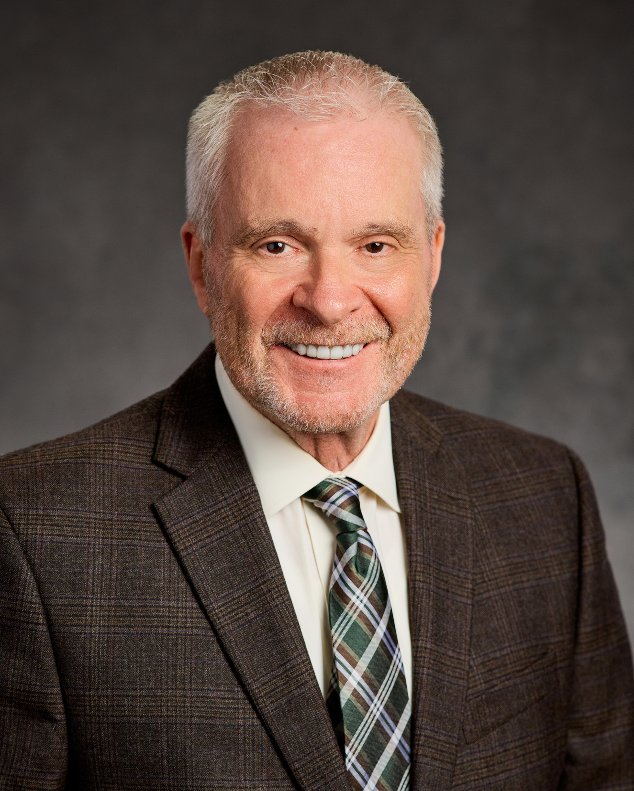
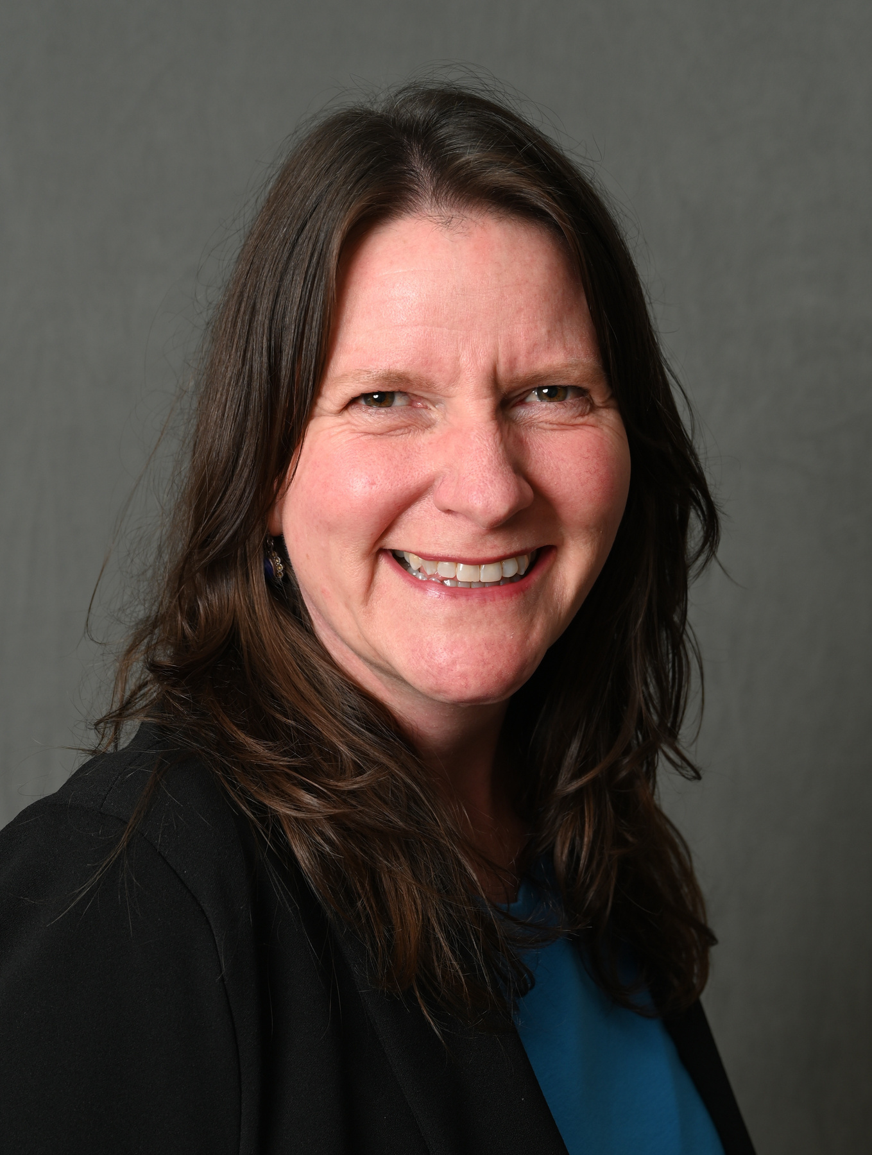
Working in the Community: Why Jobs Matter and What Needs to Change
Kyle Stumpf
Prep Cook at Pizza Ranch & Box Folder at Papa John’s
Bill Stumpf
Disability Employment Advocate
Kelly Kulzer-Reyes
California Down Syndrome Advocacy Coalition Co-Chair

Slide 2
Working in the Community: Why Jobs Matter and What Needs to Change
Kyle Stumpf - Self-Advocate, Iowa
Bill Stumpf - Parent Advocate, Iowa
Kelly Kulzer-Reyes, California Down Syndrome
Advocacy Coalition Co-Chair

Slide 3
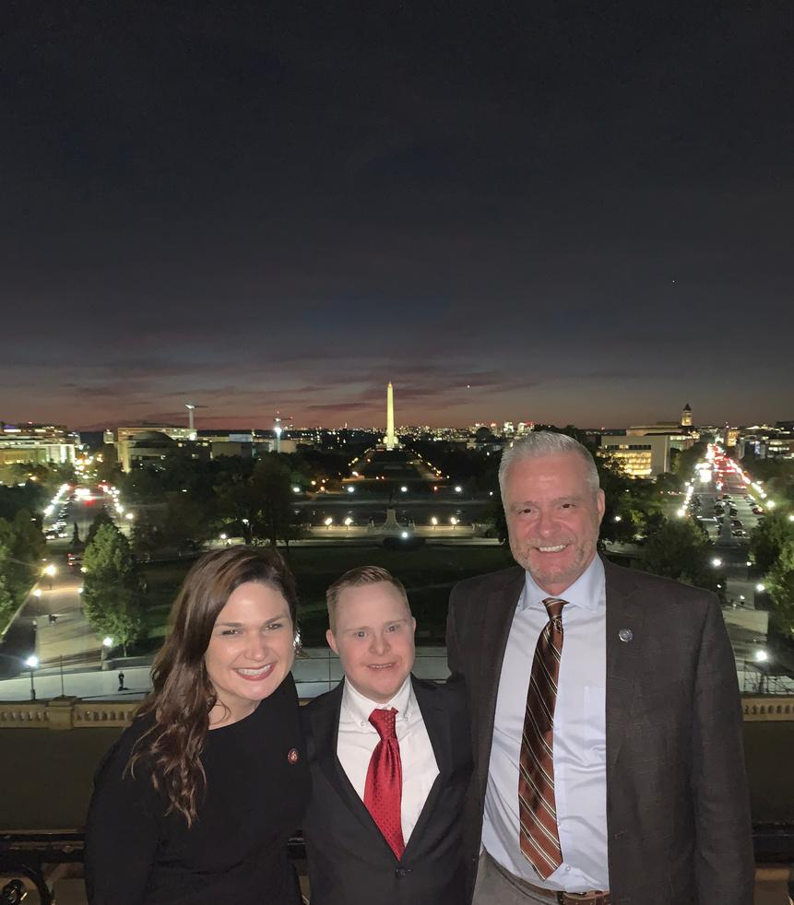
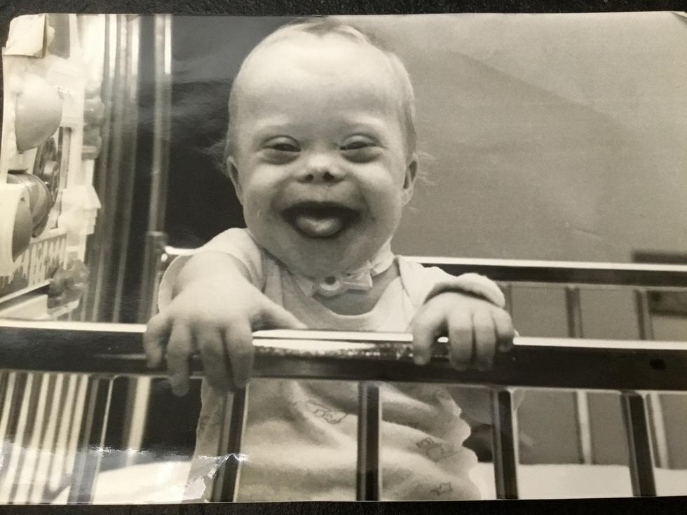
Kyle's Story
My name is Kyle Stumpf, and I live in Dubuque, Iowa.

Slide 4
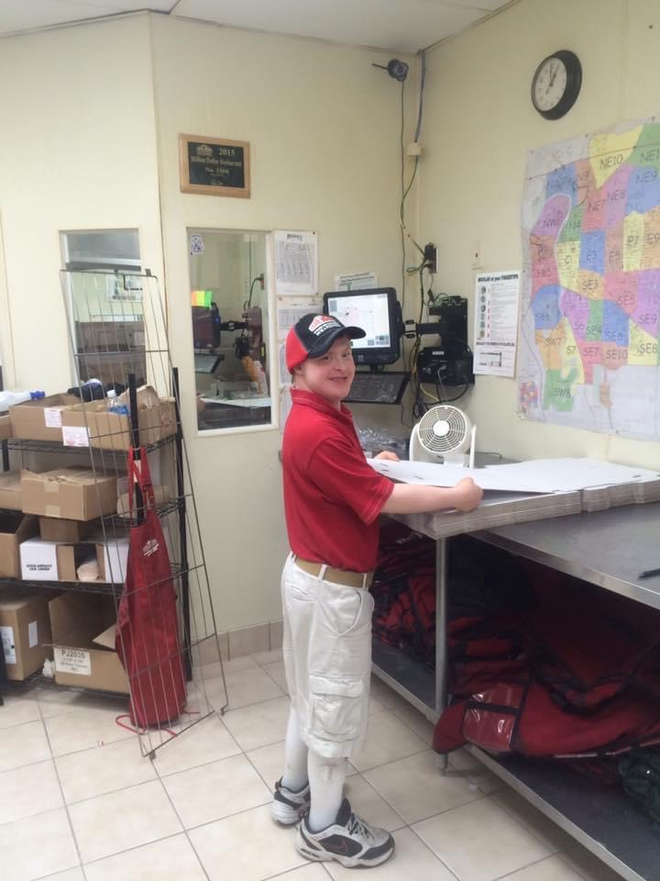
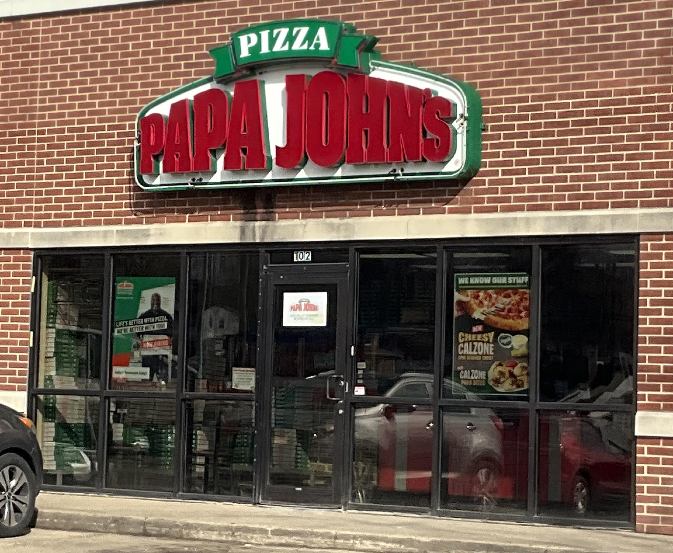
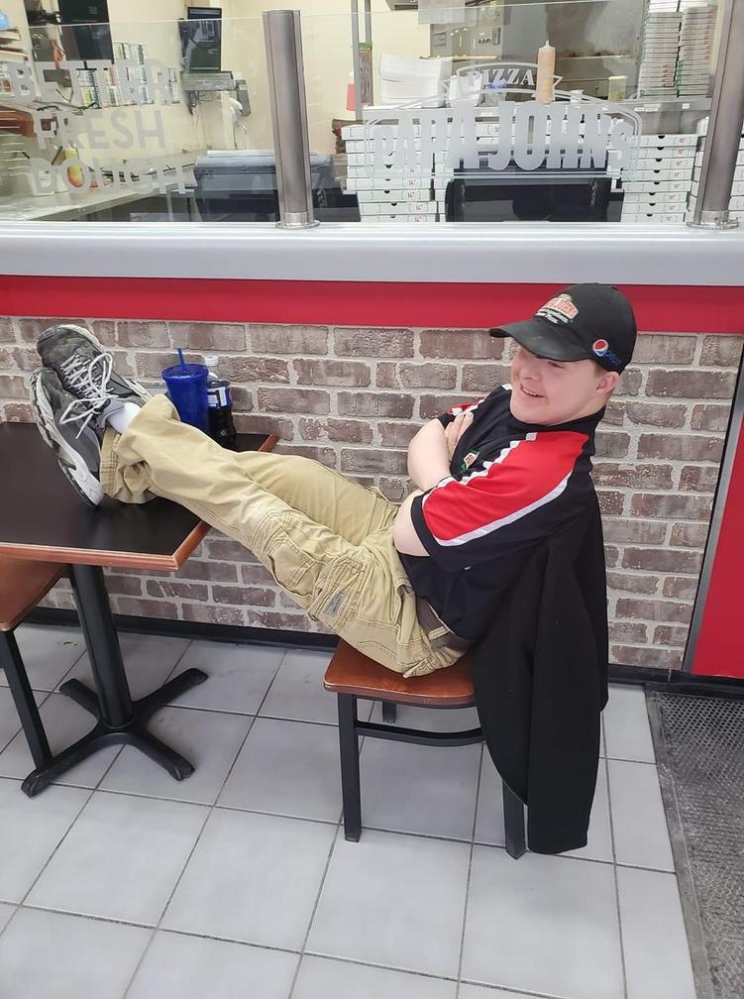
Kyle's Story
I work at Papa John's Pizza.
Notes:
I work at Papa John’s Pizza. I have worked there for over ten years.

Slide 5
Kyle’s Story
At work, I…
Fold the boxes
Clean the pans under the oven
Do light cleaning of the store and parking lot
Stock the soda cooler

Slide 6
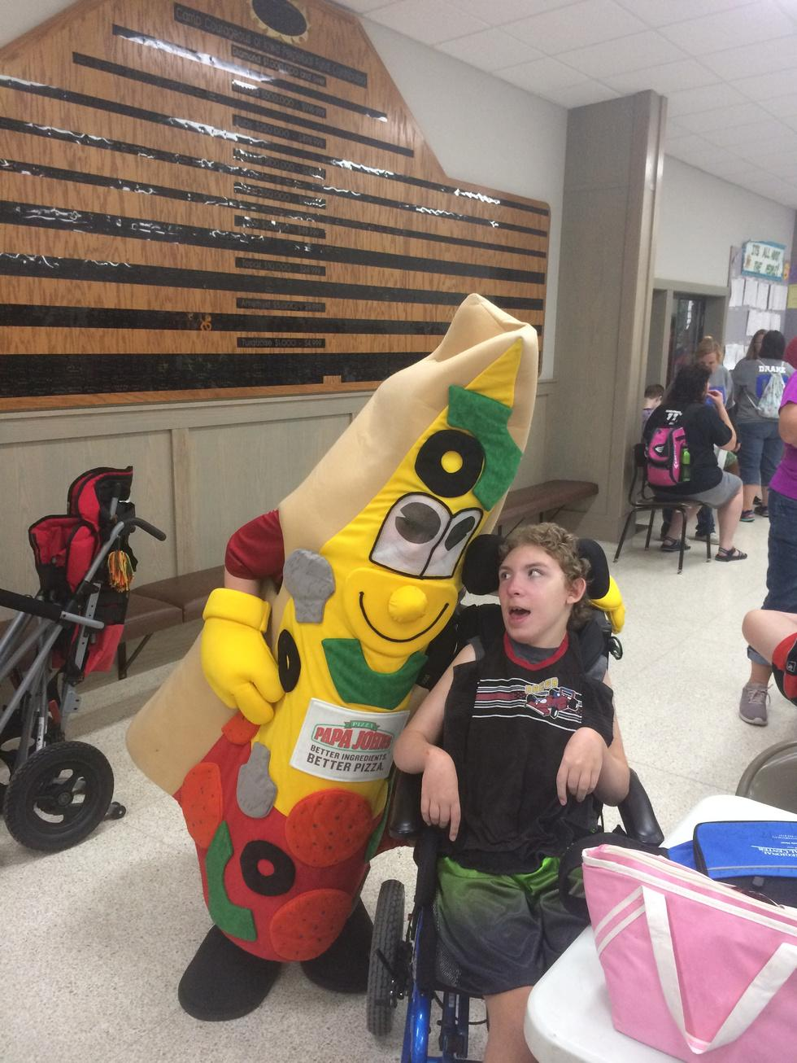
I even got to be "Mr. Slice", the Papa John's Mascot!

Slide 7
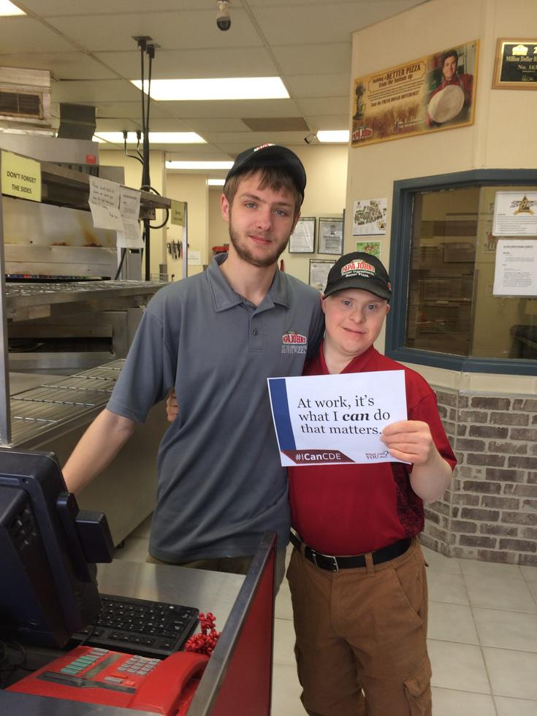
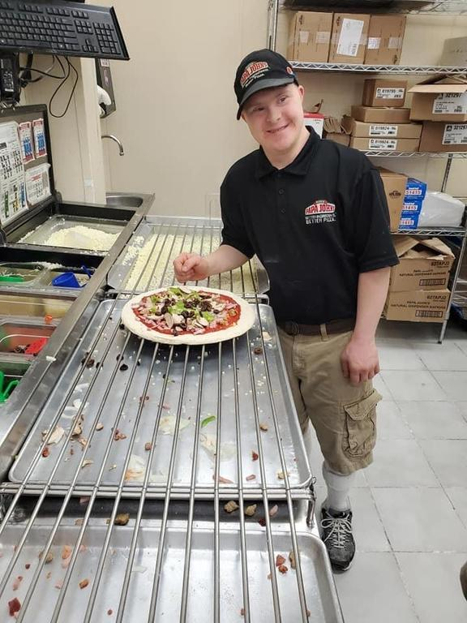
Kyle's Story
My favorite things about my job are interacting with co-workers, customers, and
performing my job duties.

Slide 8
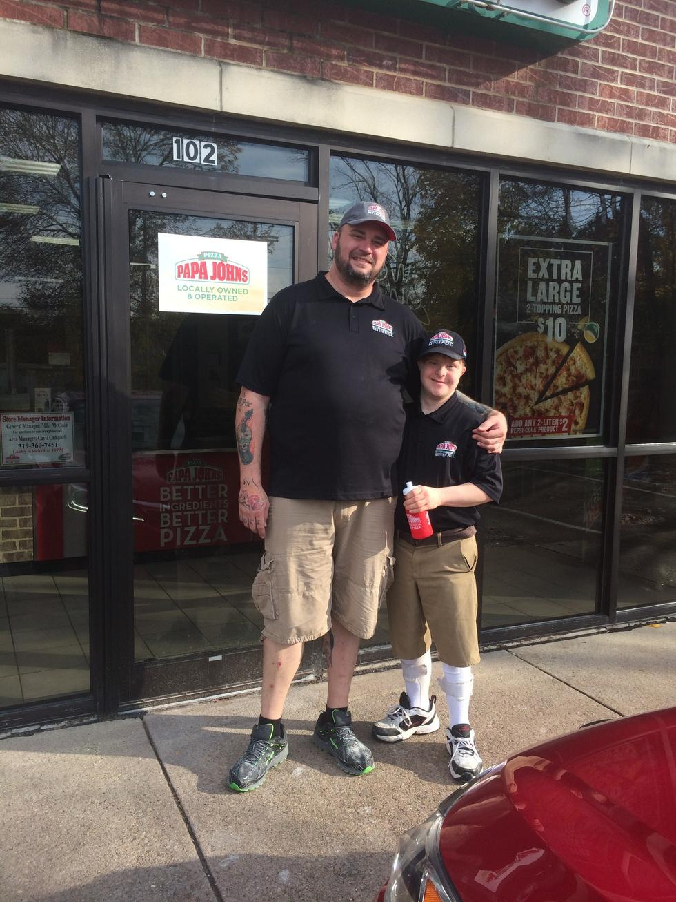
Kyle's Story
Quote from my manager:
“Having Kyle around makes for a happier work environment. He always has this contagious smile on his face. He makes co-workers want to come to work.”

Slide 9
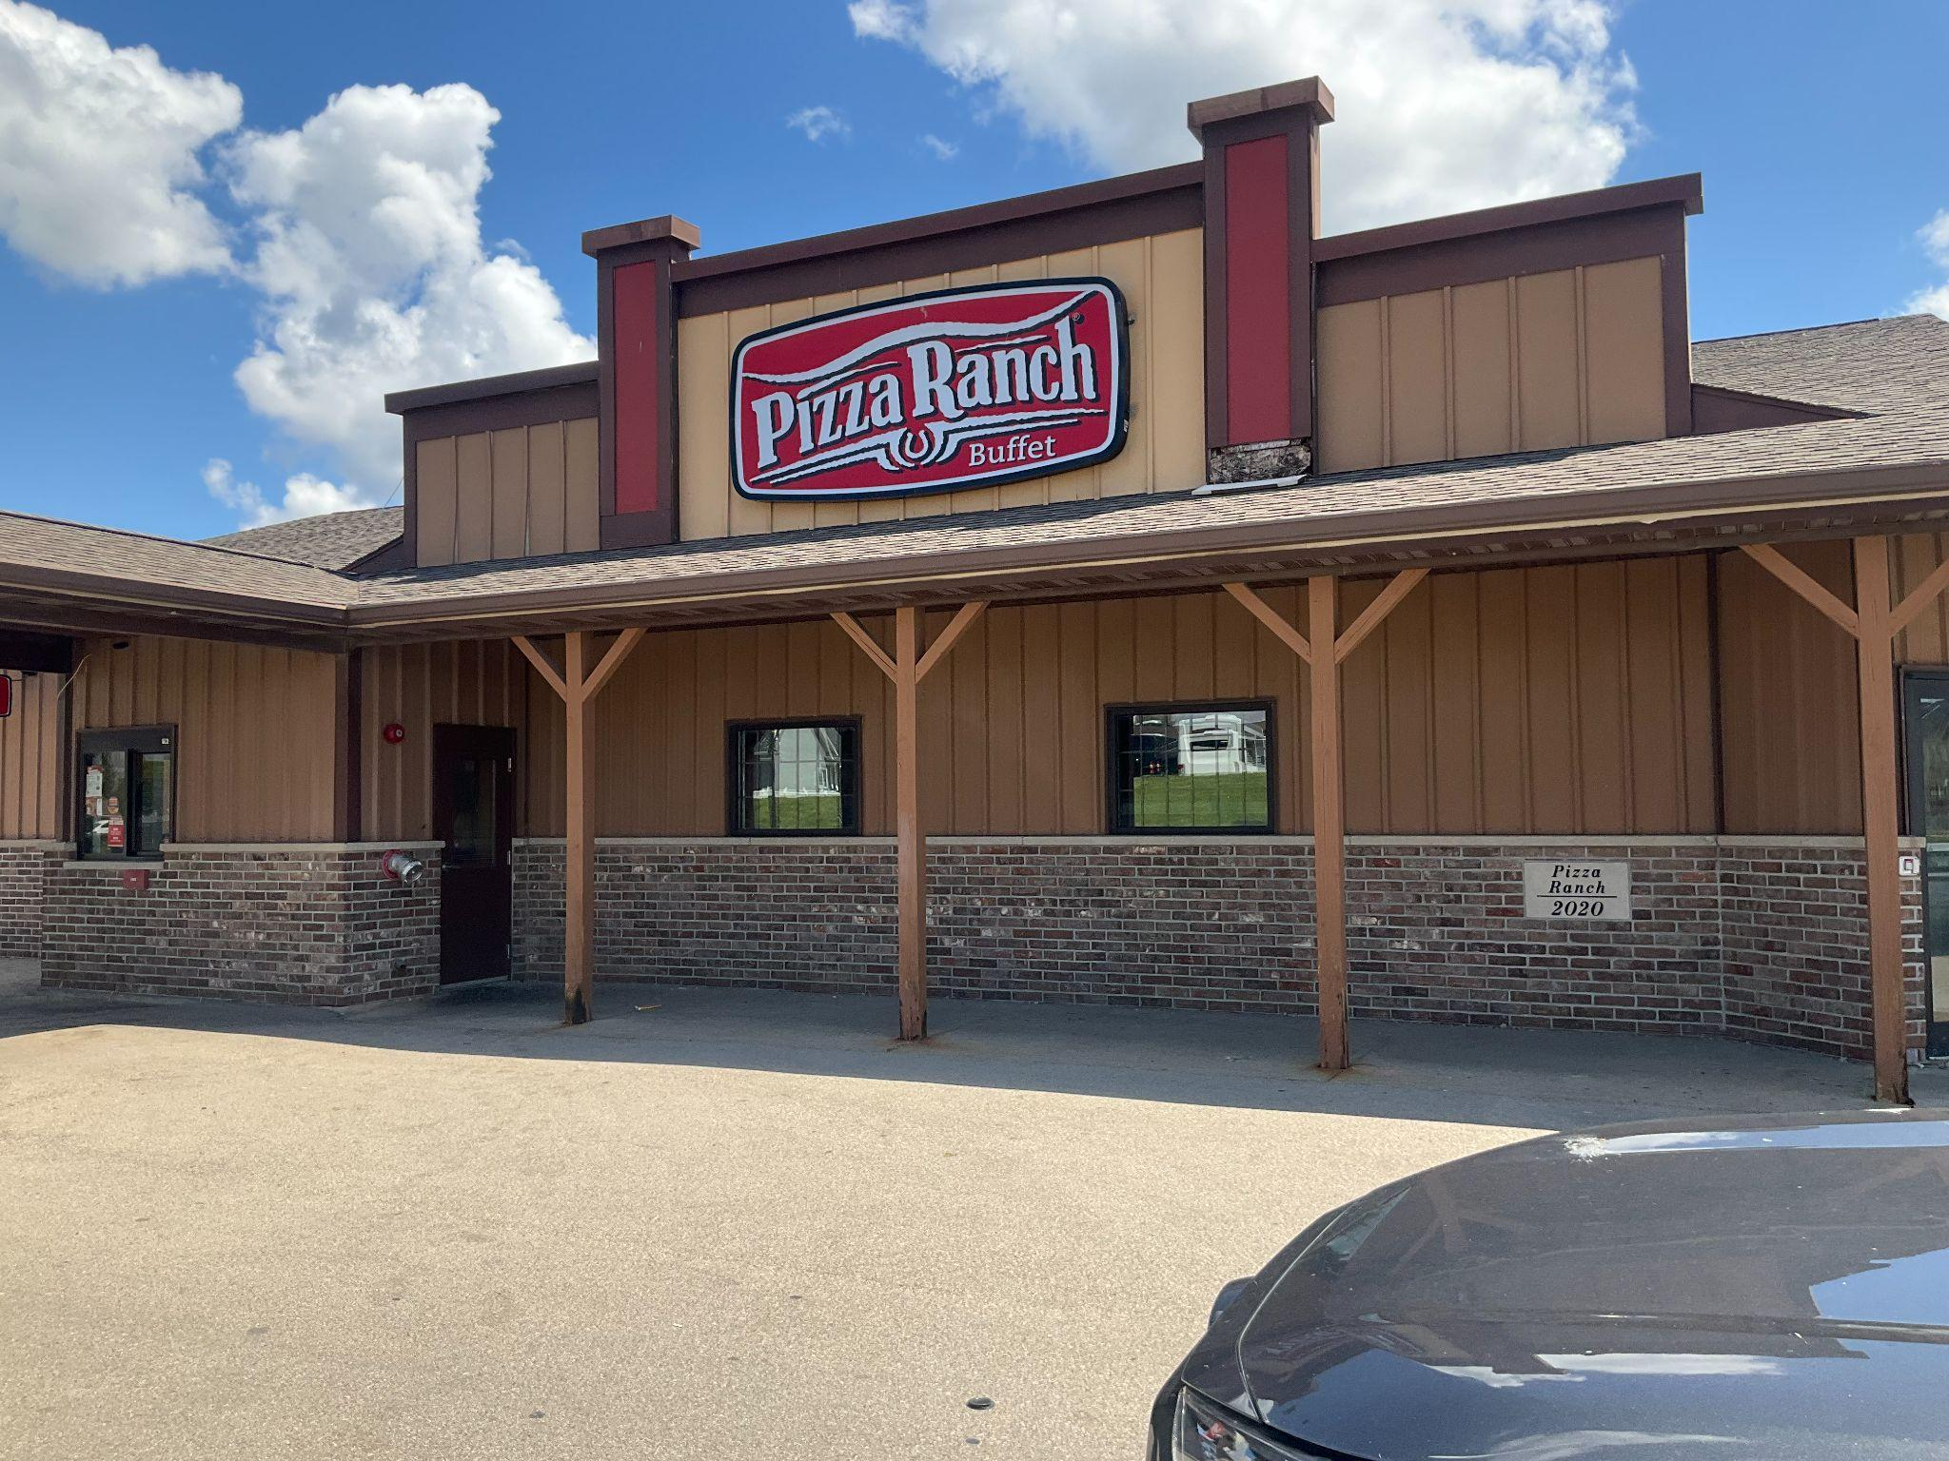
Kyle's Story
I work at Pizza Ranch.
Notes:
I work at Papa John’s Pizza. I have worked there for over ten years.

Slide 10
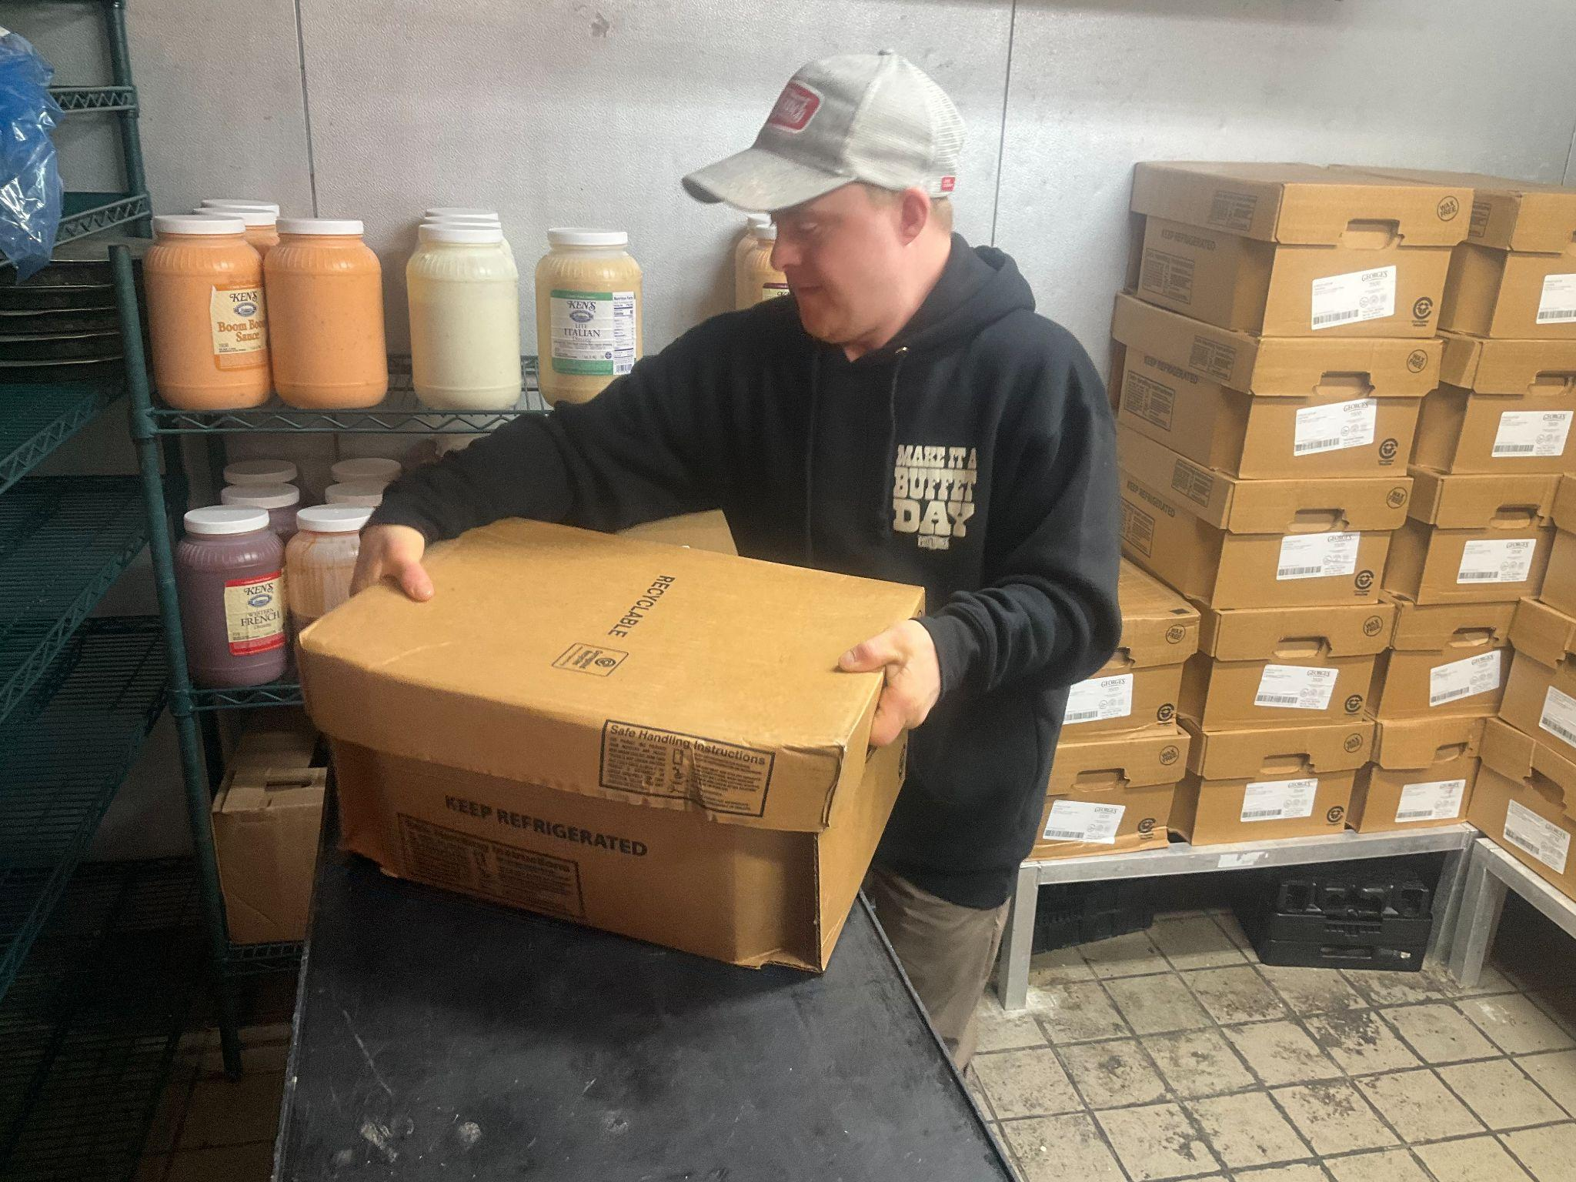
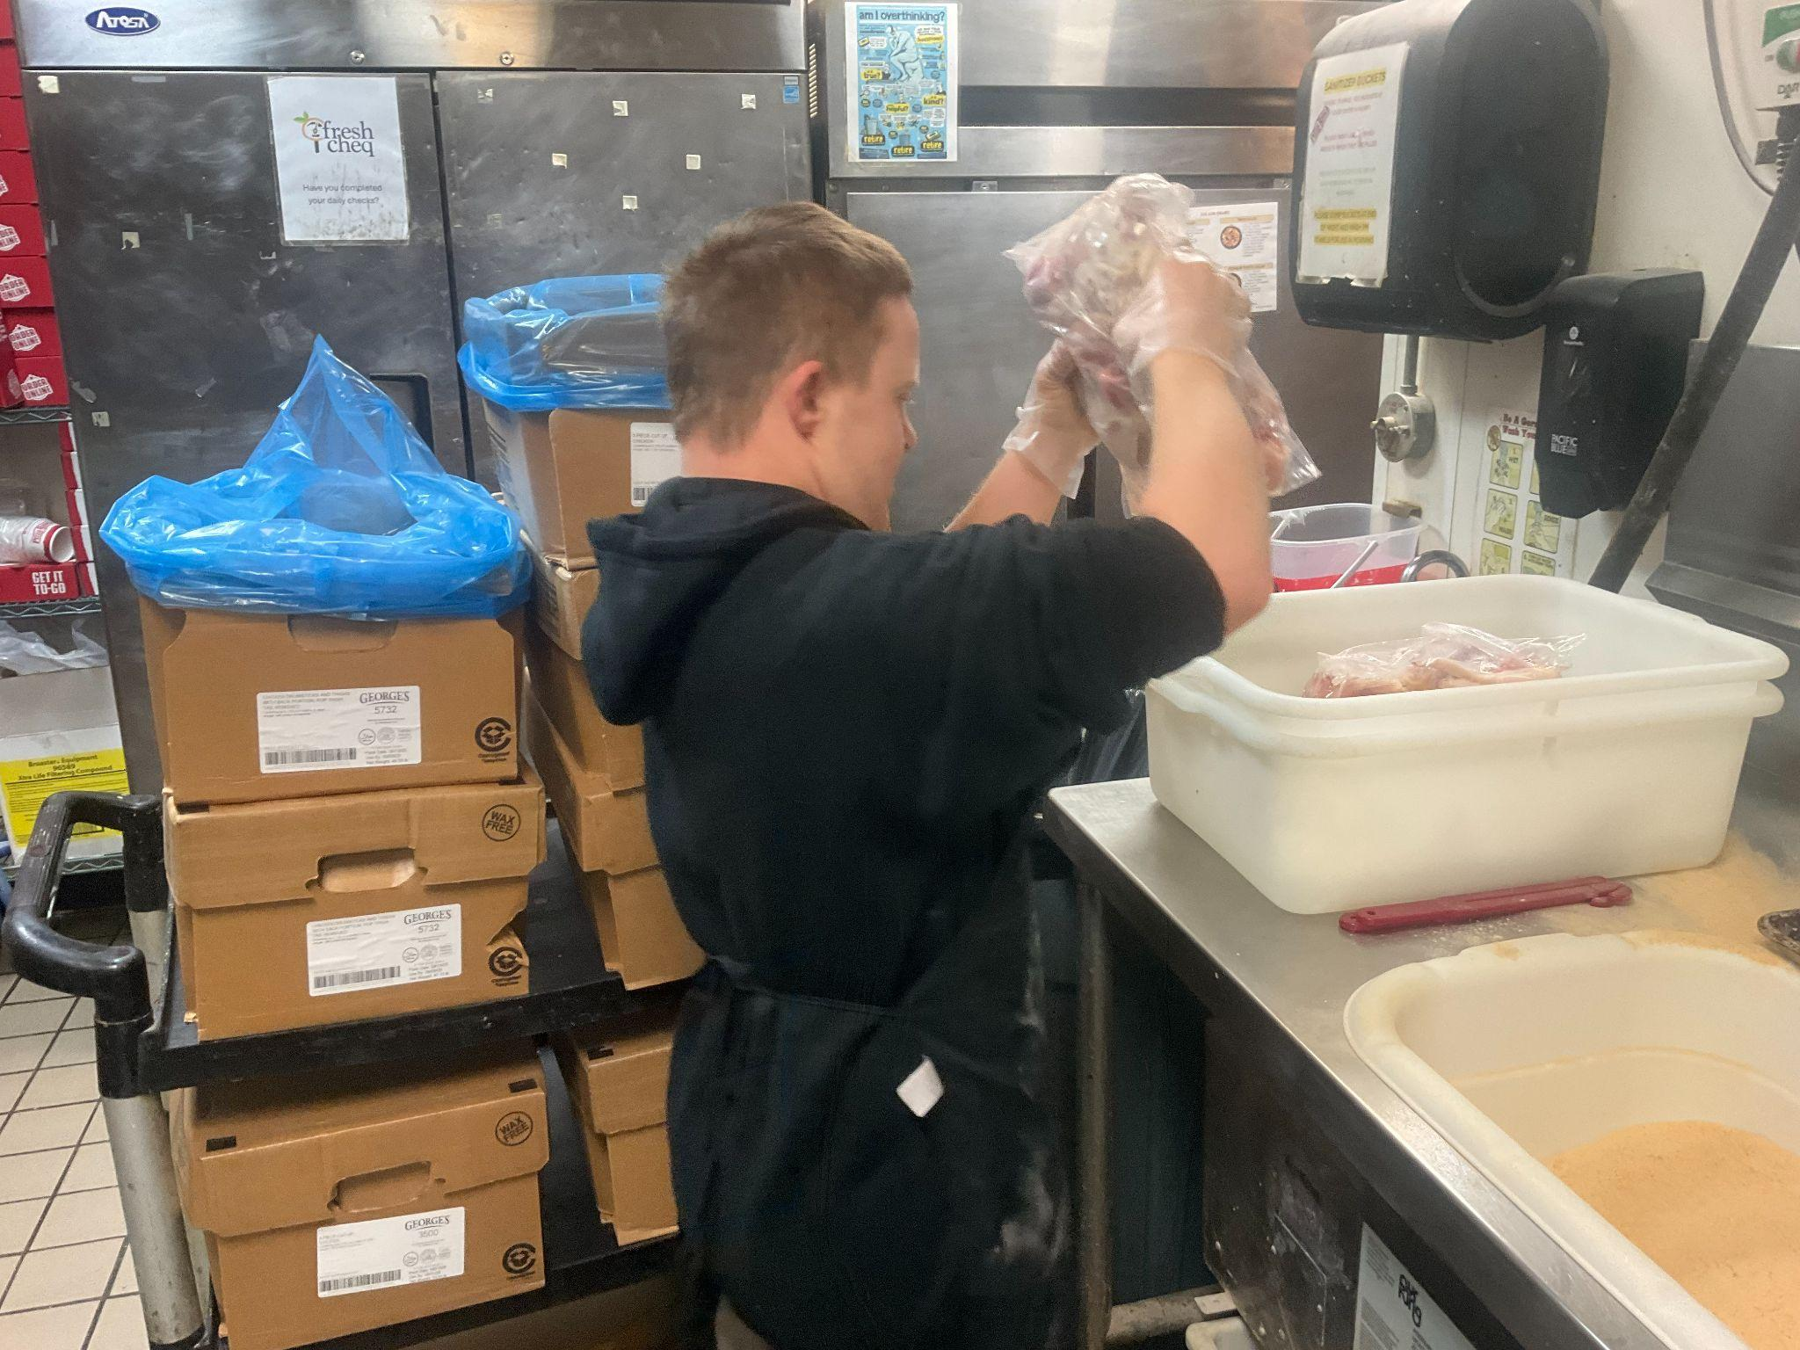
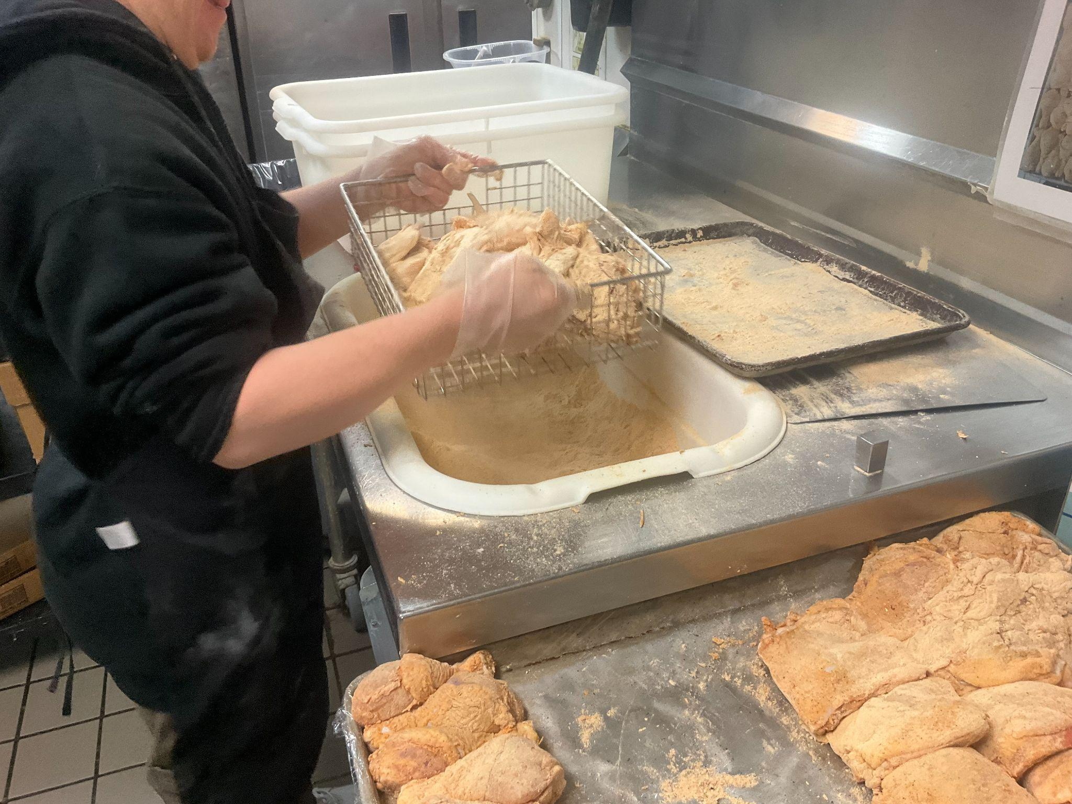
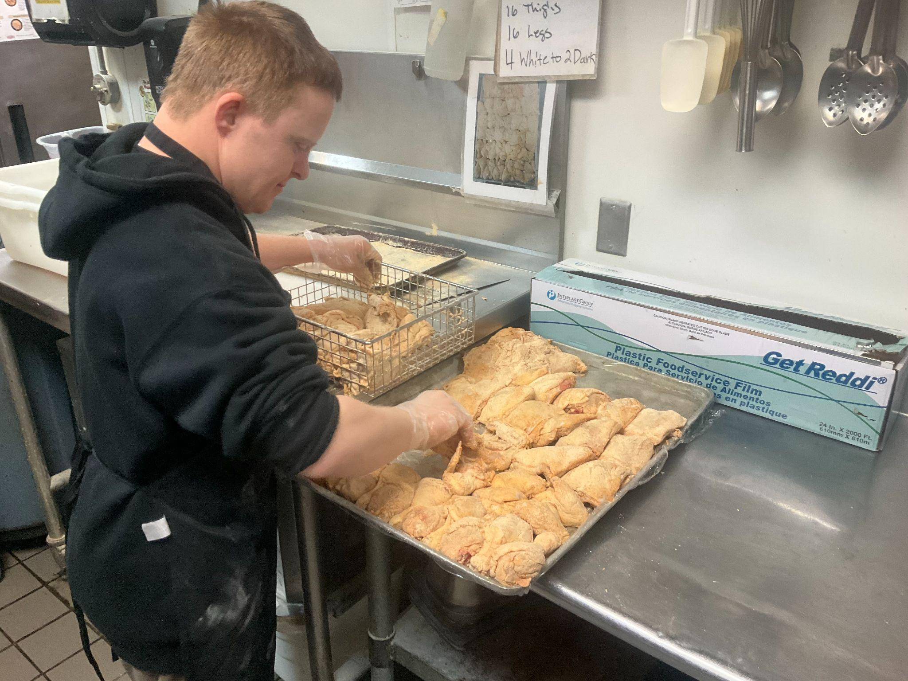
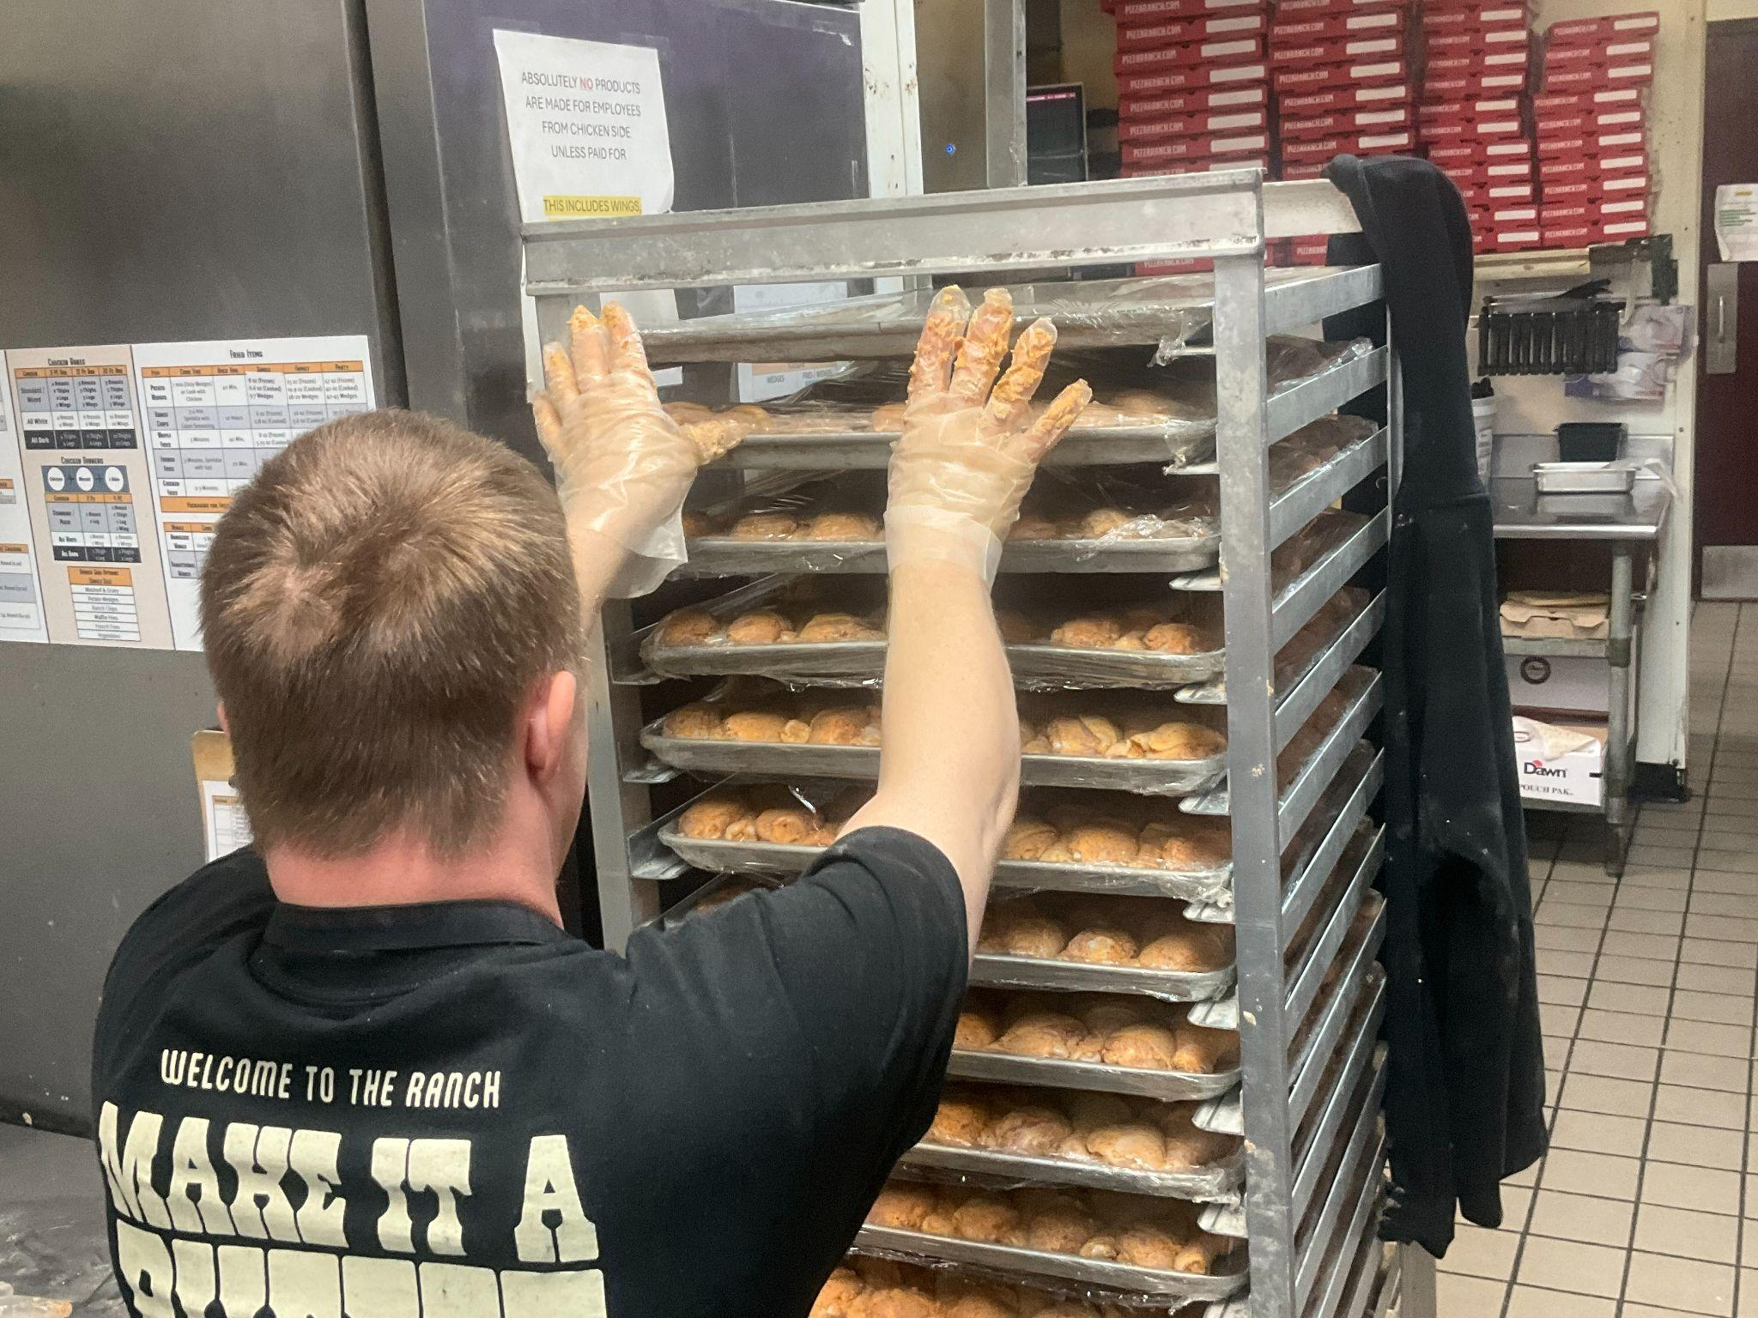
Kyle does many jobs at Pizza Ranch.

Slide 11
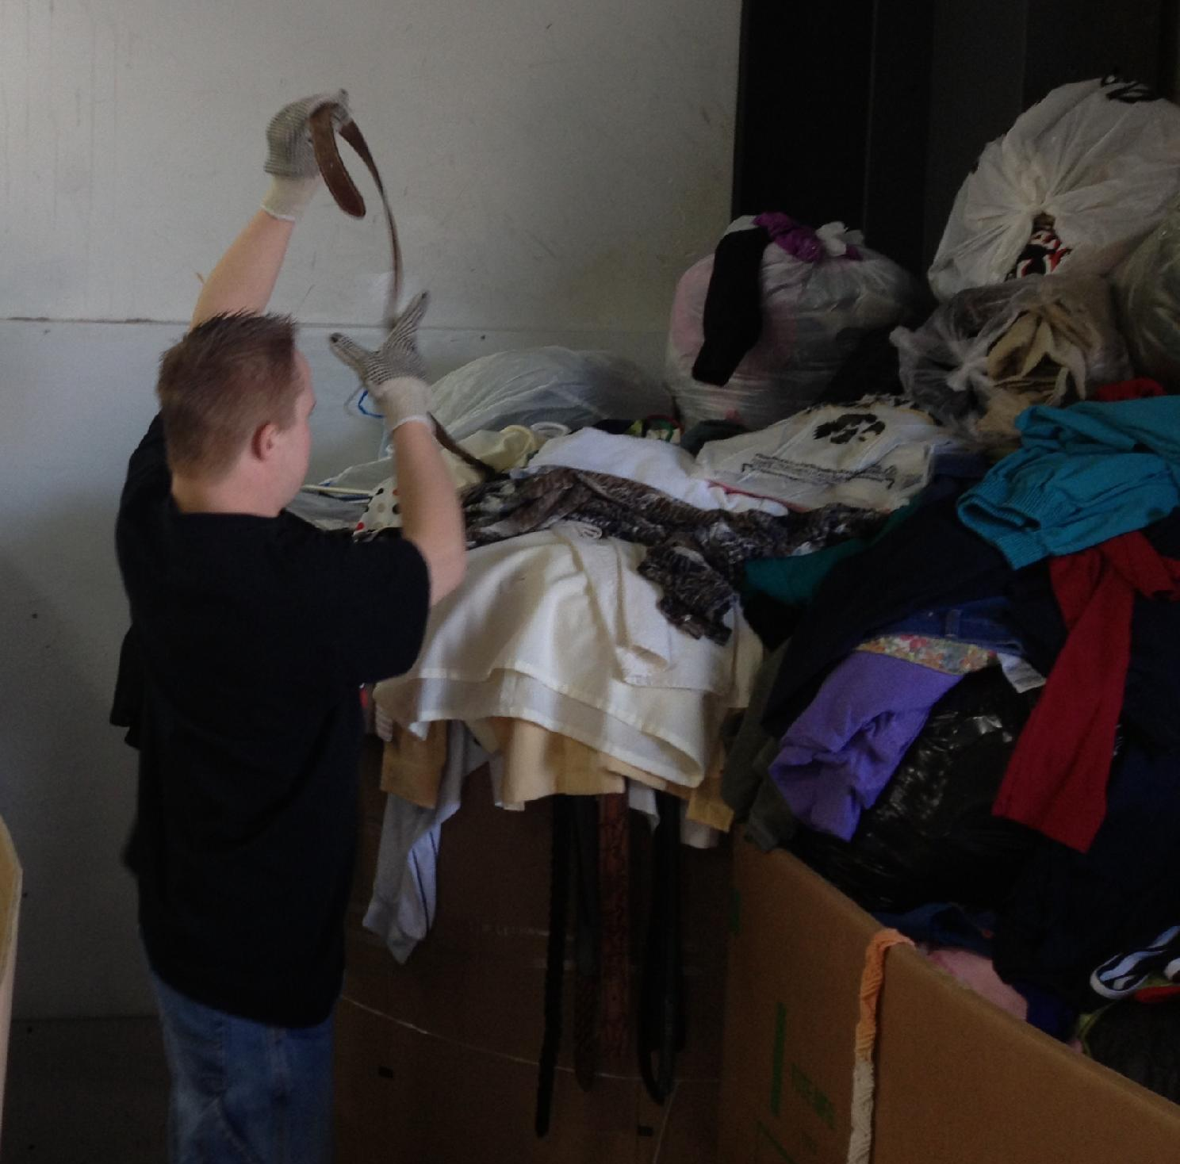
Kyle’s Sheltered Workshop Experience
Before I started my current job, I was paid $3.50 per hour to work at the Sheltered Workshop.
I am paid more than minimum wage now.
Before I started my current job, I was paid $3.50 per hour to work at the Sheltered Workshop.
I am paid more than minimum wage now.
Notes:
I am paid more than minimum wage now. Before I worked at a sheltered workshop making $3.50 per hour.

Slide 12
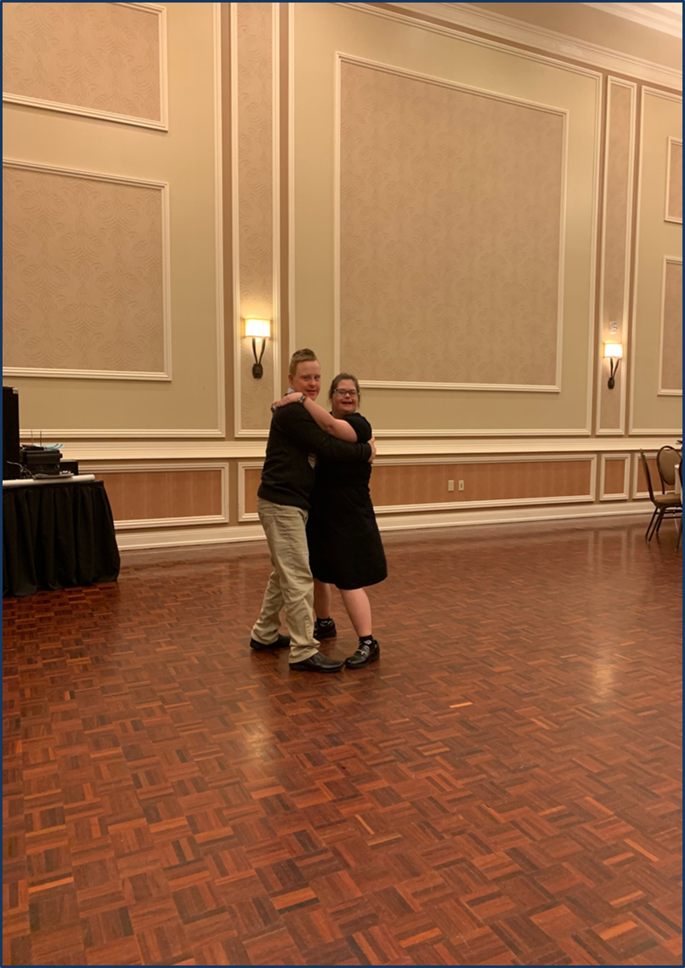
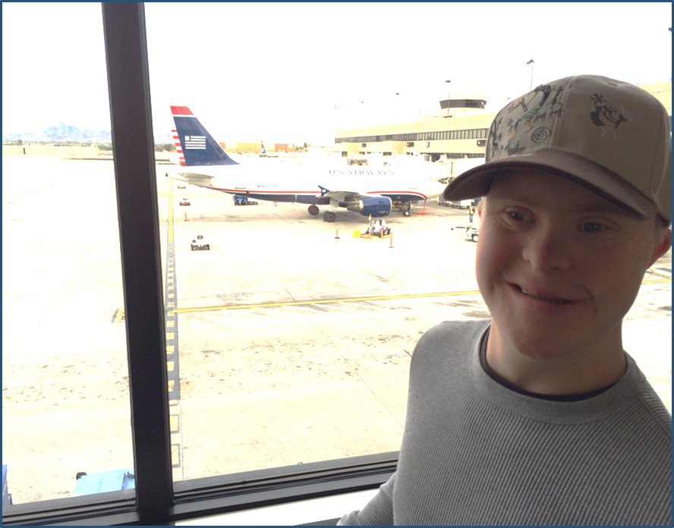
Kyle's Story
With the money I earn working, I like to:
Travel
Dance
Shop and
Go to the movies.

Slide 13
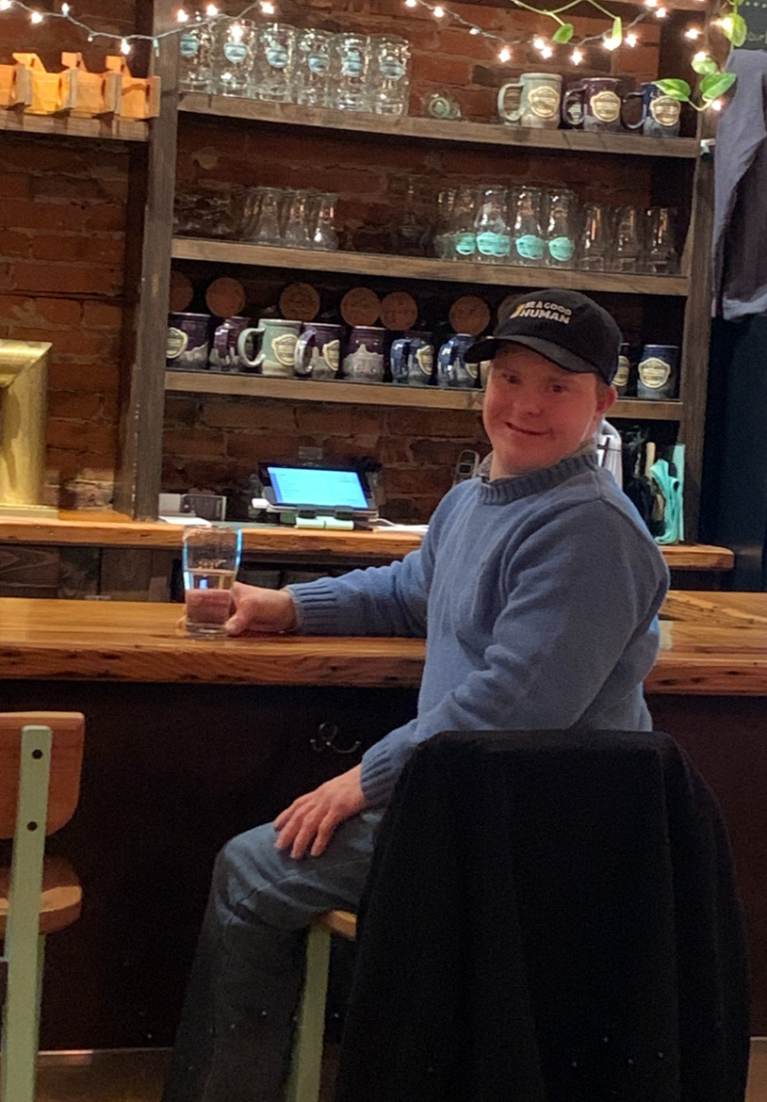
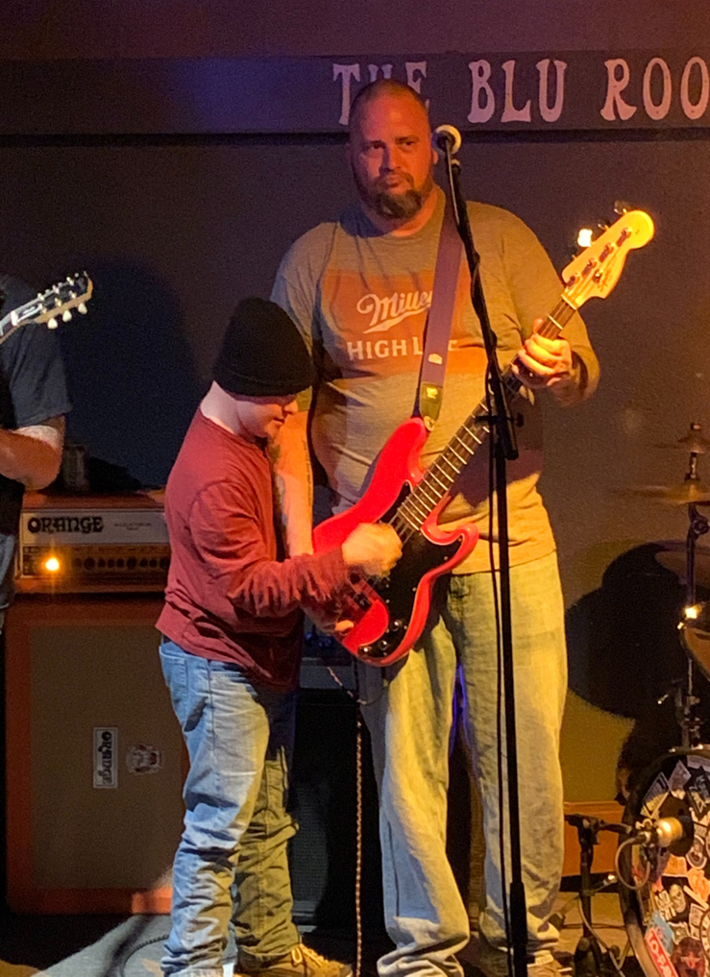
Kyle's Story
I also like to:
go out to eat
go to microbreweries and listen to live music
pretty much the same things others like to do!
I am also saving money for my future in my ABLE account.

Slide 14
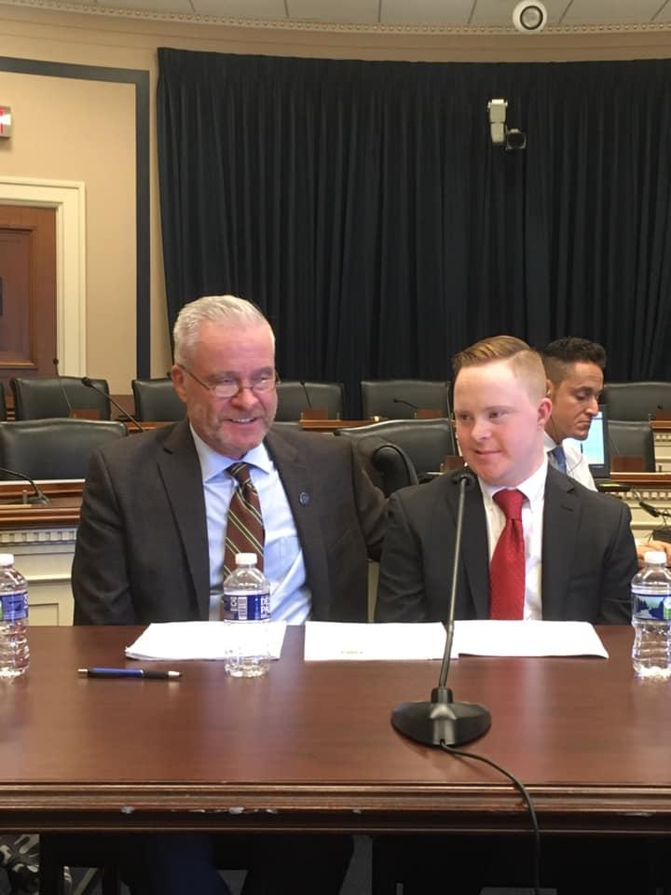
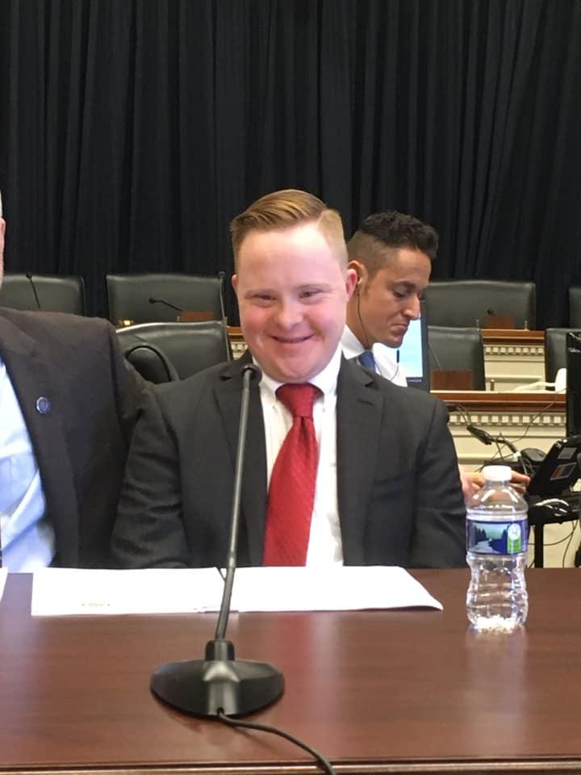
Sharing my story at the
Competitive Integrated Employment (CIE) briefing in Washington, D.C.
Notes:
A few years ago I had the opportunity to present my story at a legislative briefing in Washington DC.

Slide 15
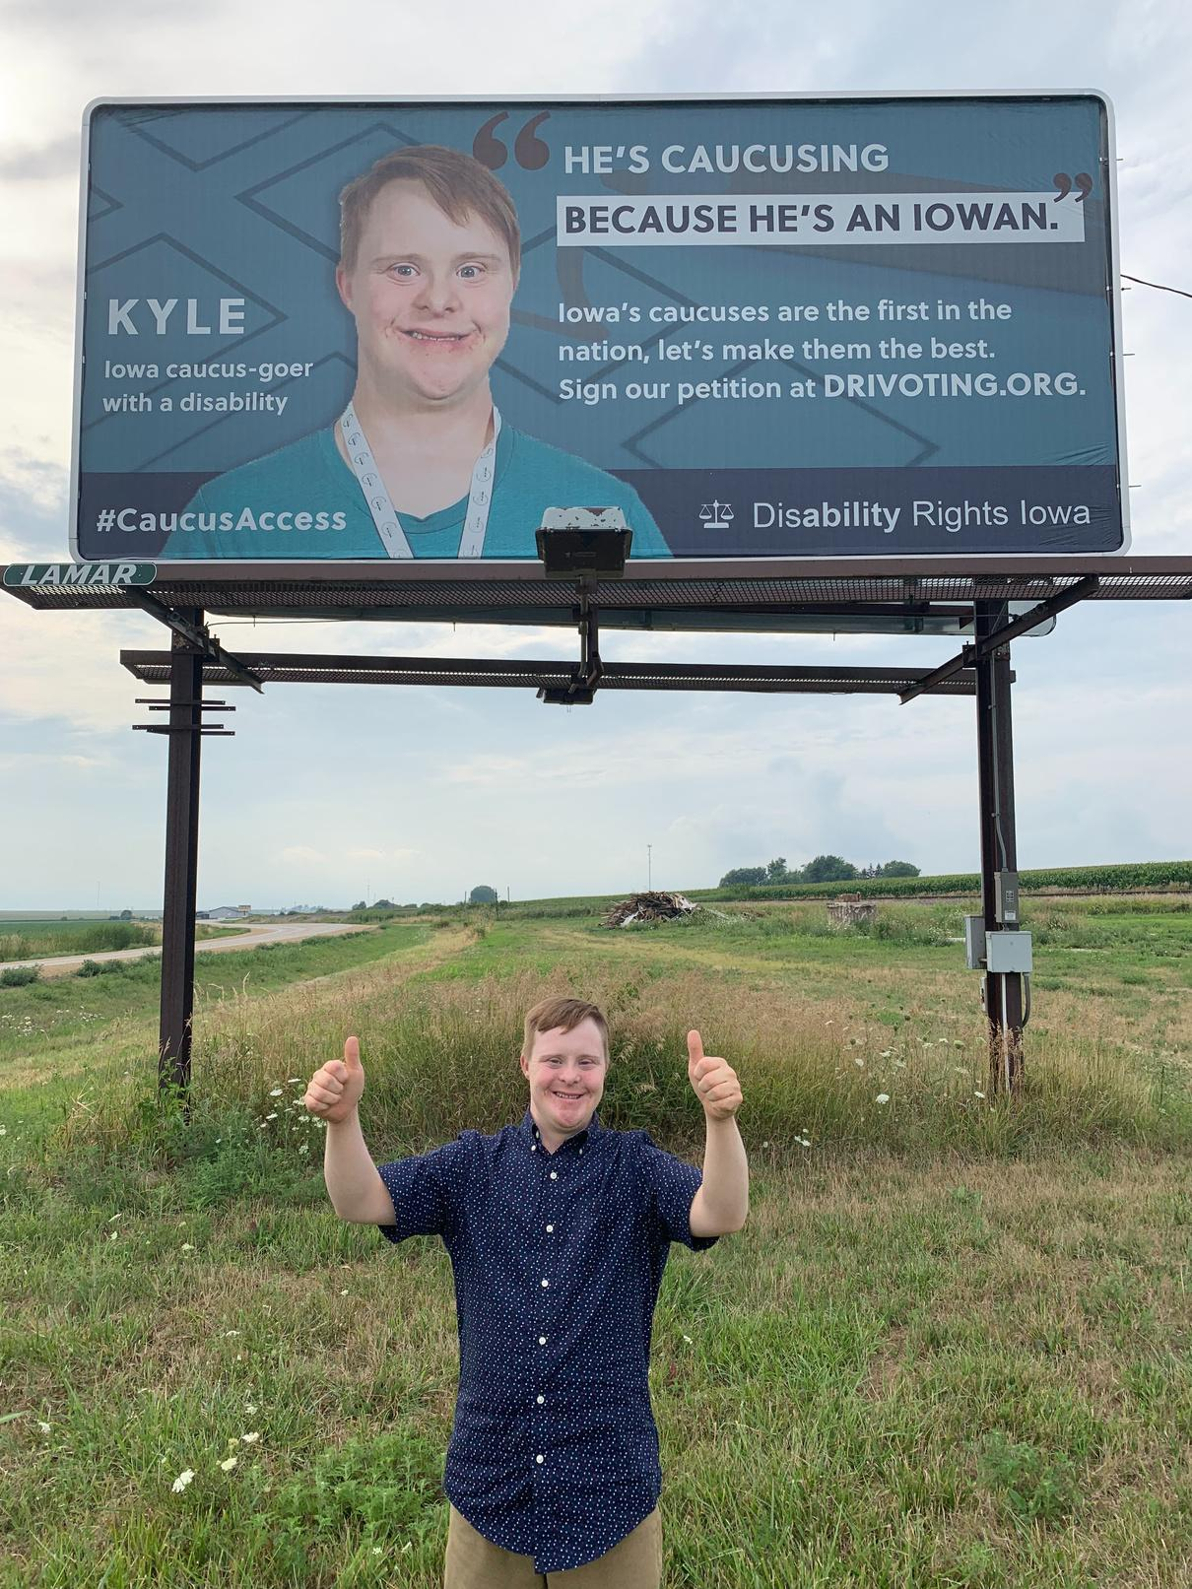

Kyle's Story
"I advocate for Competitive Integrated Employment. I support and vote for candidates that support it, too."

Slide 16
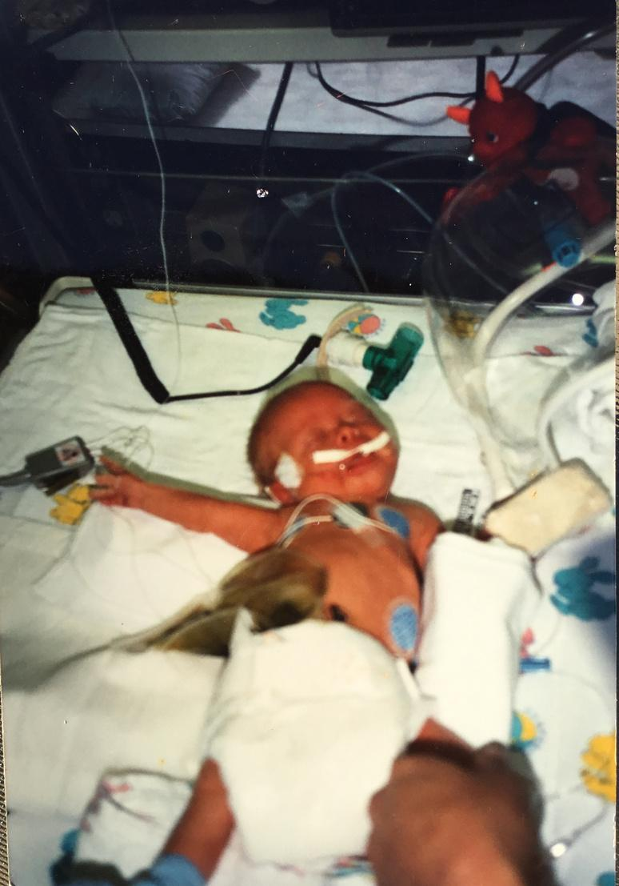
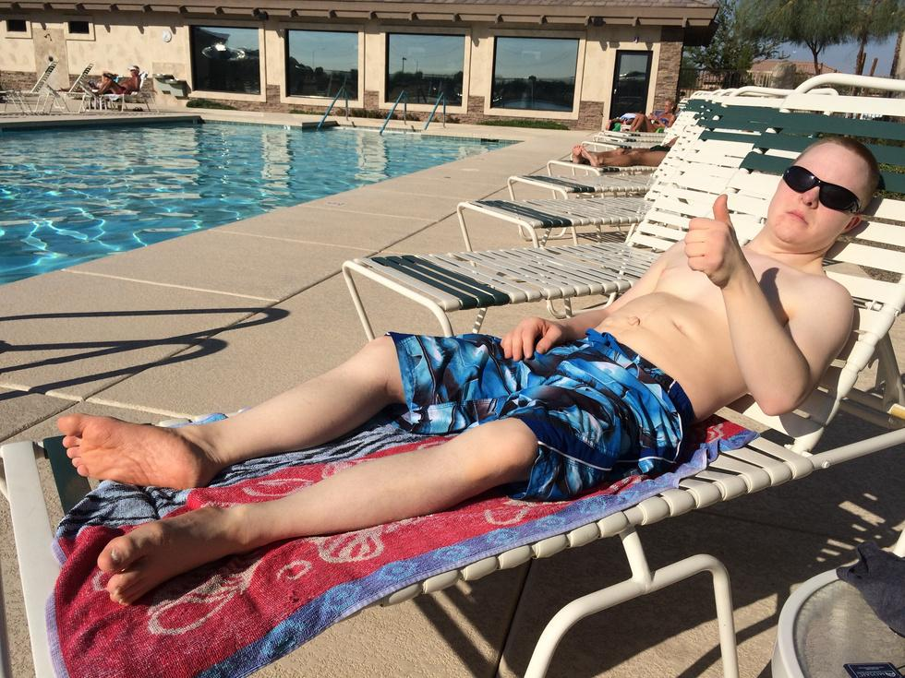
Bill's Story: Parent Perspective
Presented by Bill Stumpf

Slide 17

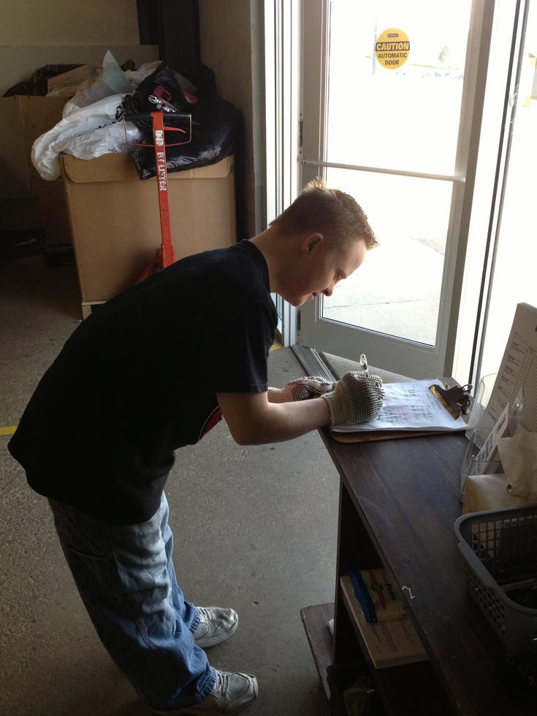
Bill's Story: Sheltered Workshop
  Pipeline to Sheltered Workshop
    Rubberstamps
    Guardianship
    Automatically go to Workshop
  Sheltered Workshop
    Complicit
    Never progressed
    Segregated
    Real employment never came up

Slide 18
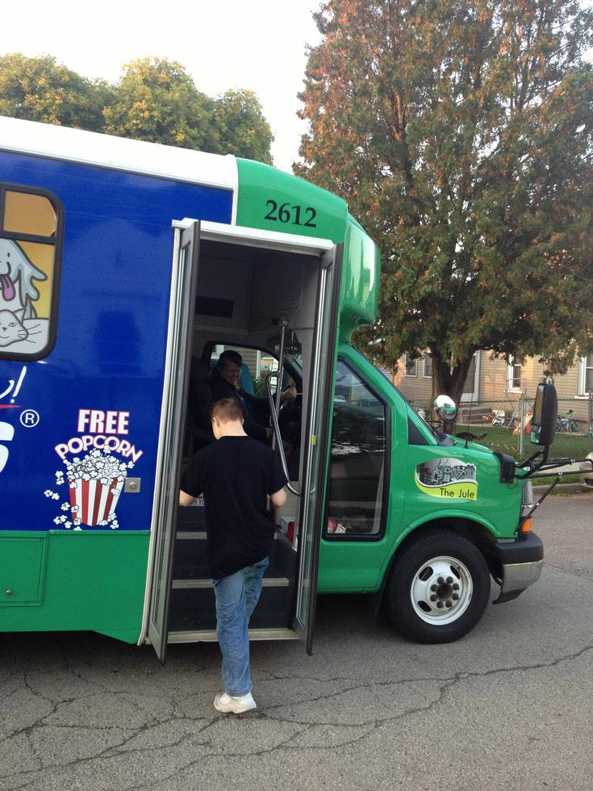
Bill's Story: Parent Perspective
  Visited work sites
  Did not totally understand his options
  Never received information on integrated settings
  Kyle settled into work at a sub-minimum wage
  From my perspective, he had something that felt meaningful, and he was paid, albeit subminimum wages.

Slide 19
Bill's Story: Parent Perspective
Getting More Involved:
  In 2013, I served on the Iowa Developmental Disabilities Council
  Learned more about Competitive Integrated Employment
  Became active in the Iowa Coalition for Integrated Employment
  Listened to webinars
  Attended conferences on various topics such as the Association of People Supporting Employment First
  Learned about Vocational Rehabilitation (aka Voc Rehab; aka Department of Rehabilitation)

Slide 20
Bill's Story: Parent Perspective
Barrier to inclusion
Realization of full potential
  I have to acknowledge I was a bit of a barrier to assisting Kyle to become employed in an integrated setting
  Not sure if schools really encouraged integrated employment as a real option.
  You have to ask a LOT of questions.
  Not being comfortable with the way things are
  Job Coaching
  Availability of effective wrap-around service
  Working with others (APSE)

Slide 21
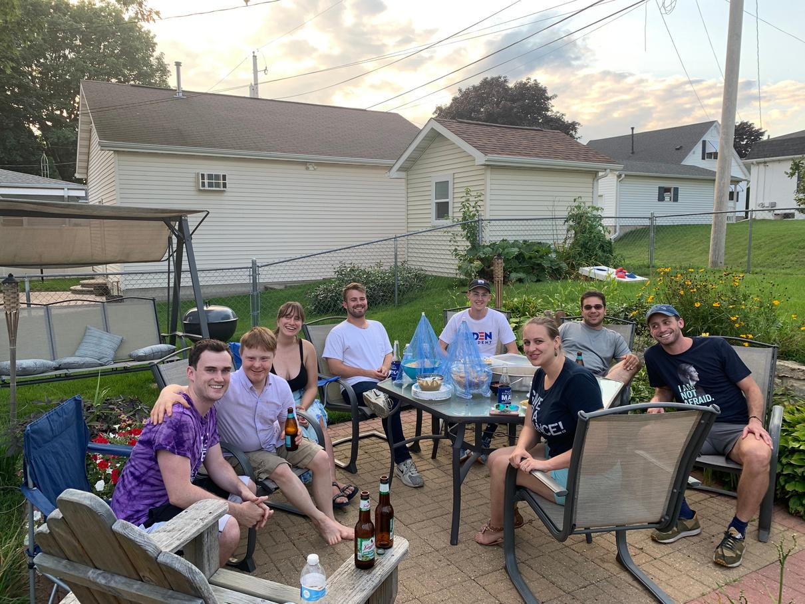
Bill's Story: Steps for Advocating
Tips for New Advocates:
  It's important to tell your story and advocate for a specific policy
  Open your doors to staffers - welcome them, educate them, and don't be offensive
  Have High Expectations

Slide 22
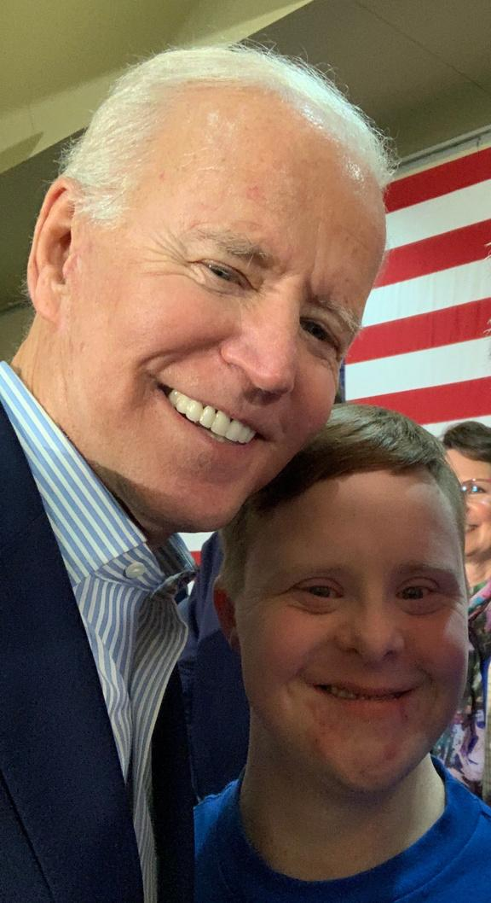
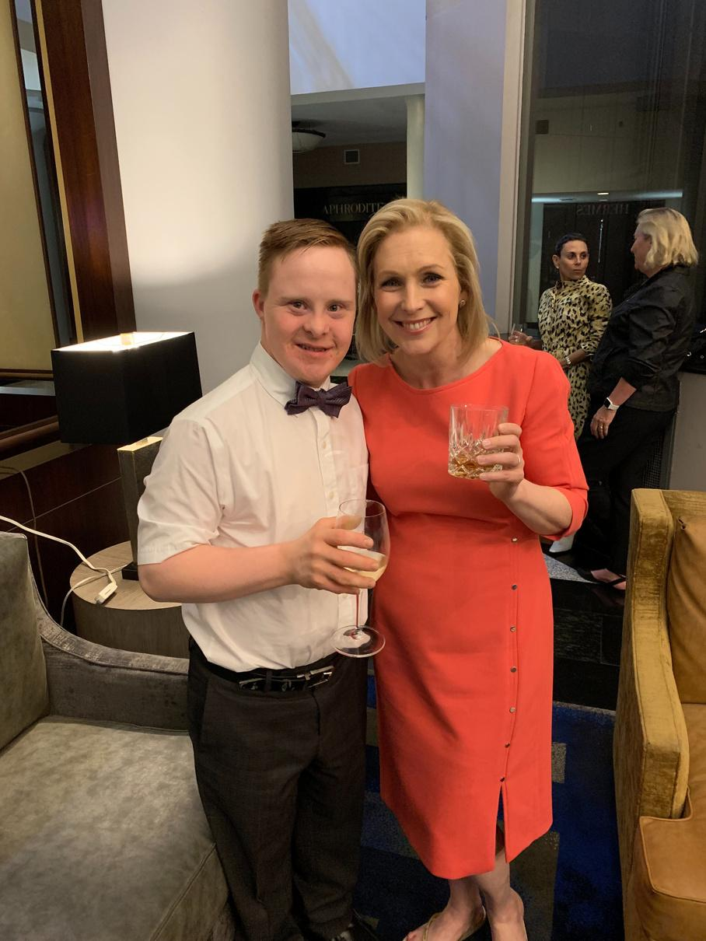
Testimony in D.C.
  Our policy focus was the Transformation to Competitive Integrated Employment Act (TCIEA)
  Telling our story
  Speaking with politicians and advocating for fair treatment in the labor force

Slide 23
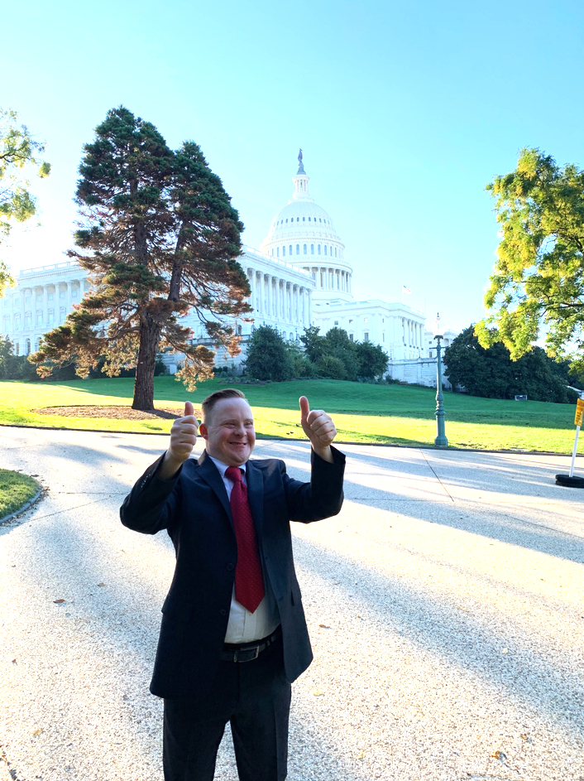
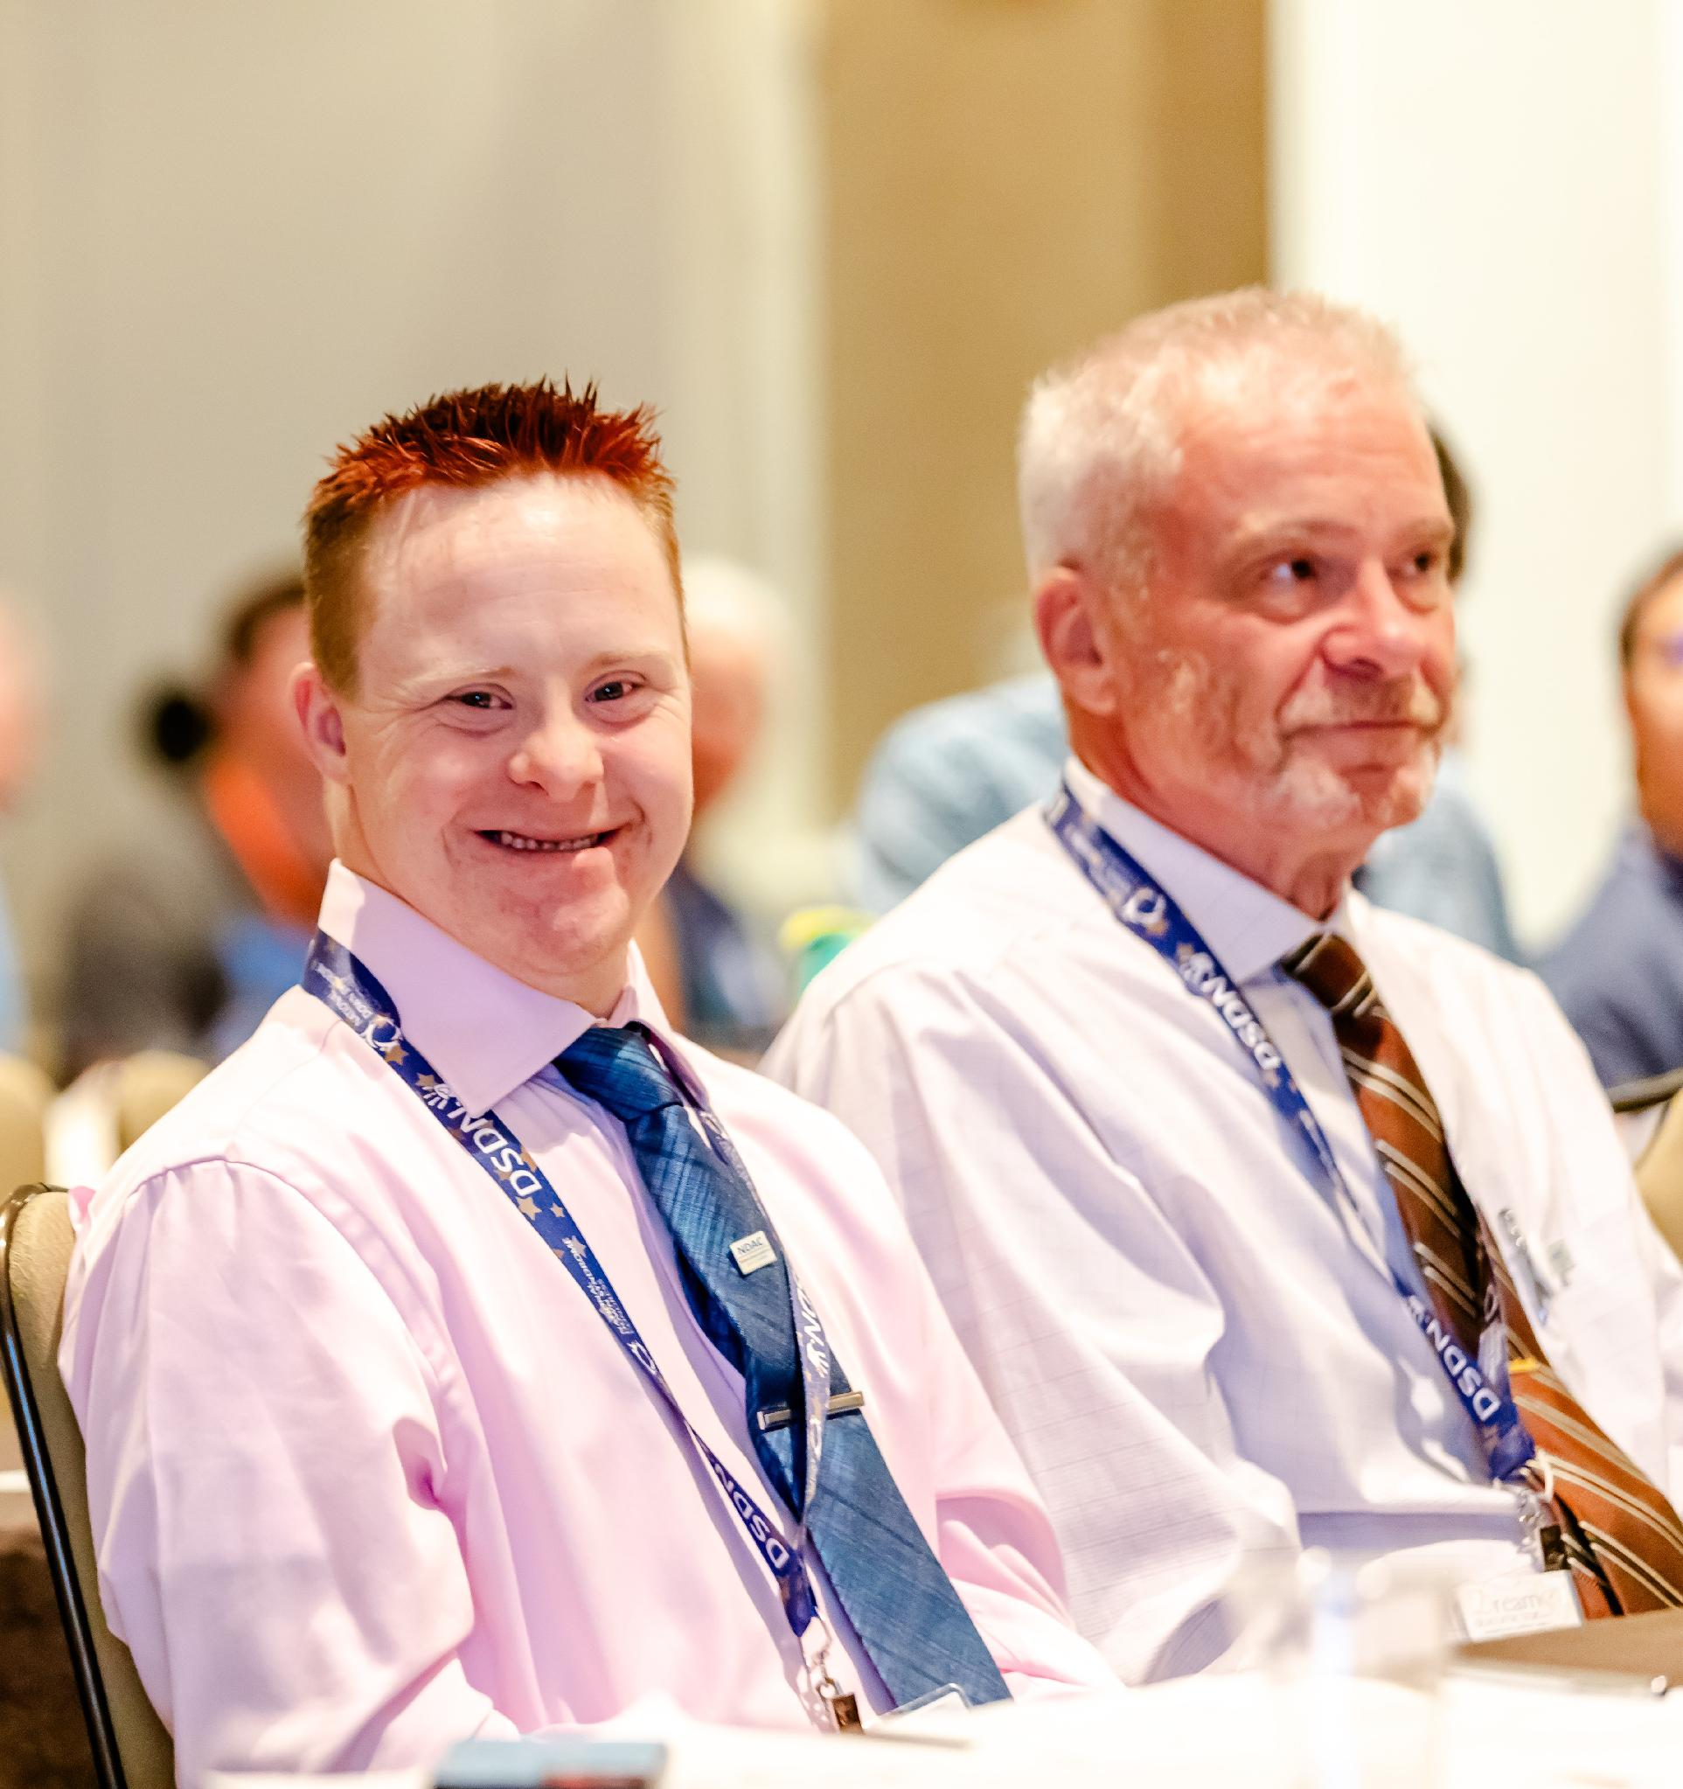
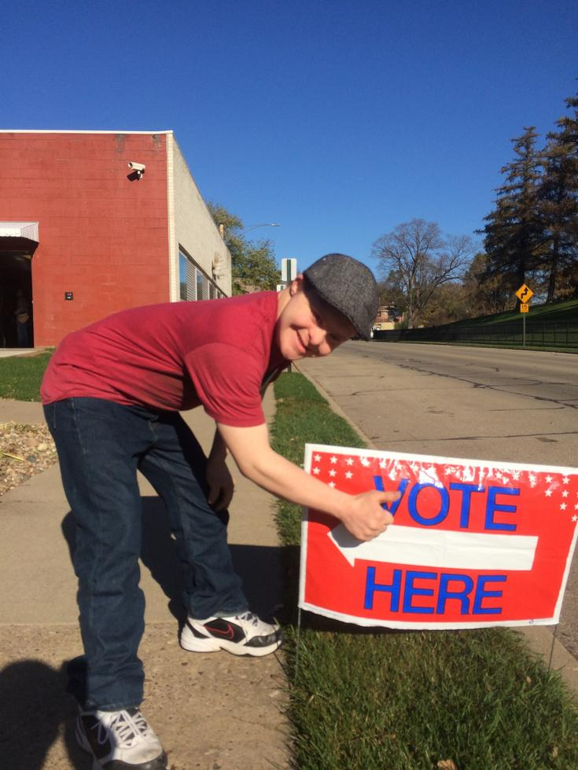
Thank you for letting me tell my story.
"Everybody Has Worth:
What That Looks Like is Different for Everybody"

Slide 24
Let’s fill the employment information gaps
But first – a tiny geography moment…

Slide 25
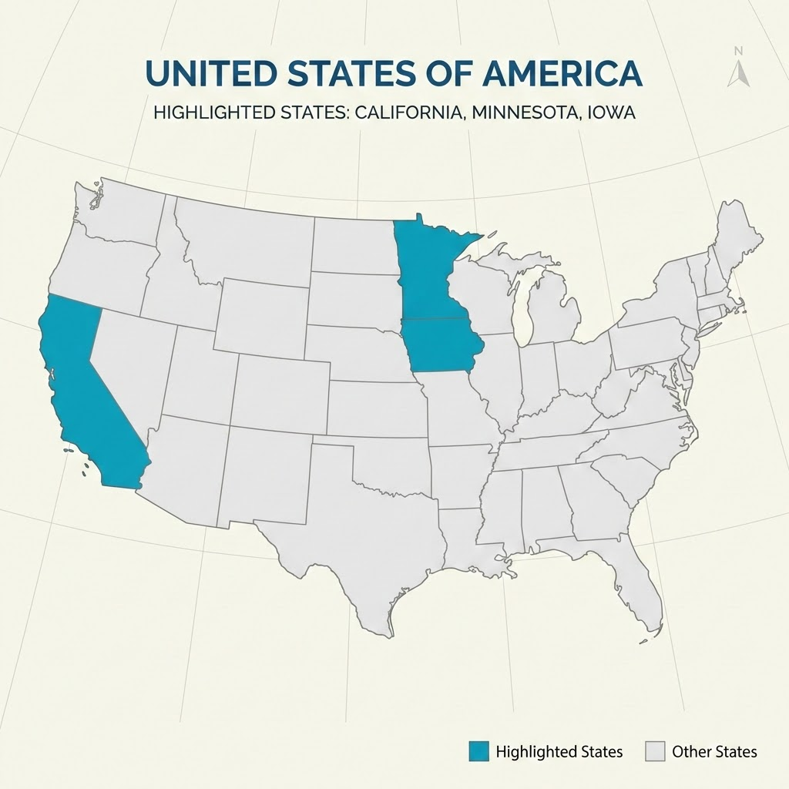
Kelly’s hometown
Sauk Rapids, Minnesota
on the Mississippi River and north of Iowa and west of Wisconsin
Kyle and Bill’s hometown: Dubuque, Iowa
Also on the Mississippi river and south of Minnesota - and west of Wisconsin and Illinois
Bakersfield, California (way over there)
Kelly’s current (and likely forever) home if she doesn’t melt.

Slide 26
Why work matters…
social connection
mental stimulation
reduction in depressive symptoms
sense of purpose
personal growth

Slide 27
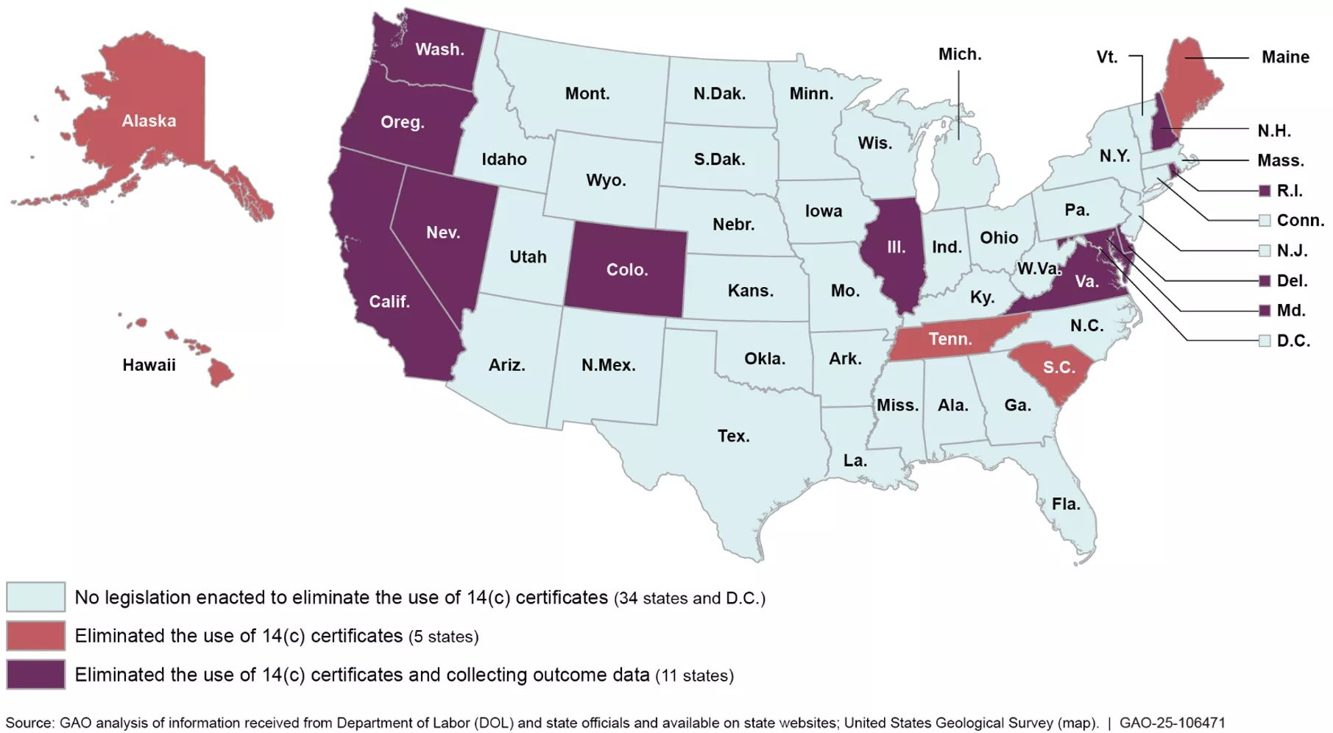
What is a 14C Certificate?
Employers apply for permission to pay workers less than the federal minimum wage. (currently $7.25/hour)
Some states have already passed legislation outlawing this practice; others have not.
Notes:
What it is and why it was created
How subminimum wage works
What sheltered workshops are
How expectations for people with disabilities have changed over time
Why many disability organizations support transitioning away from subminimum wage

Slide 28
What is a sheltered workshop?
Typically a group of workers with disabilities who work in separate/segregated settings
Often the workers receive subminimum wages for their work. (14c certificates allow workers to be paid less than the federal minimum wage.)
Notes:
What it is and why it was created
How subminimum wage works
What sheltered workshops are
How expectations for people with disabilities have changed over time
Why many disability organizations support transitioning away from subminimum wage

Slide 29
Competitive Integrated Employment (CIE)
The Workforce Innovation and Opportunity Act (WIOA) defines competitive integrated employment (CIE) as work that is performed on a full-time or part-time basis for which an individual is:
Paid at or above minimum wage and comparable to the customary rate paid by the employer to employees without disabilities performing similar duties and with similar training and experience;
Receiving the same level of benefits provided to other employees without disabilities in similar positions;
At a location where the employee interacts with other individuals without disabilities; and
Presented opportunities for advancement similar to other employees without disabilities in similar positions.
Source: Dept of Labor https://www.dol.gov/agencies/odep/program-areas/cie
Notes:
What CIE means in plain language
Working alongside people with and without disabilities
Earning at least minimum wage with the same benefits and opportunities for advancement.
Individualized supports, including supported employment and job coaching
Real-world employment examples (consider inviting attendees to briefly share where they work)

Slide 30
HR 4771/S.2438: Transformation to Competitive Integrated Employment Act (TCIEA)
To assist employers providing employment under special certificates issued under section 14(c) of the Fair Labor Standards Act of 1938 in transforming their business and program models to models that support individuals with disabilities through competitive integrated employment, to phase out the use of such special certificates, and for other purposes.
Notes:
What the bill would do
Five-year phaseout of Section 14(c)
Investments in supported employment and provider transition
Protecting individuals during the transition
Why NDSC supports a thoughtful transition that expands opportunities while ensuring no one is left behind

Slide 31
What we can do to help
We are here! We are helping.
Help our legislators understand how competitive integrated employment is good for everyone.
Include the Transformation to Competitive Integrated Employment Act in your “asks” tomorrow.
Share your story.
Notes:
Ways advocates can support Competitive Integrated Employment at the federal and state levels, including support for the TCIEA and state efforts to eliminate subminimum wage.

