Slide 1




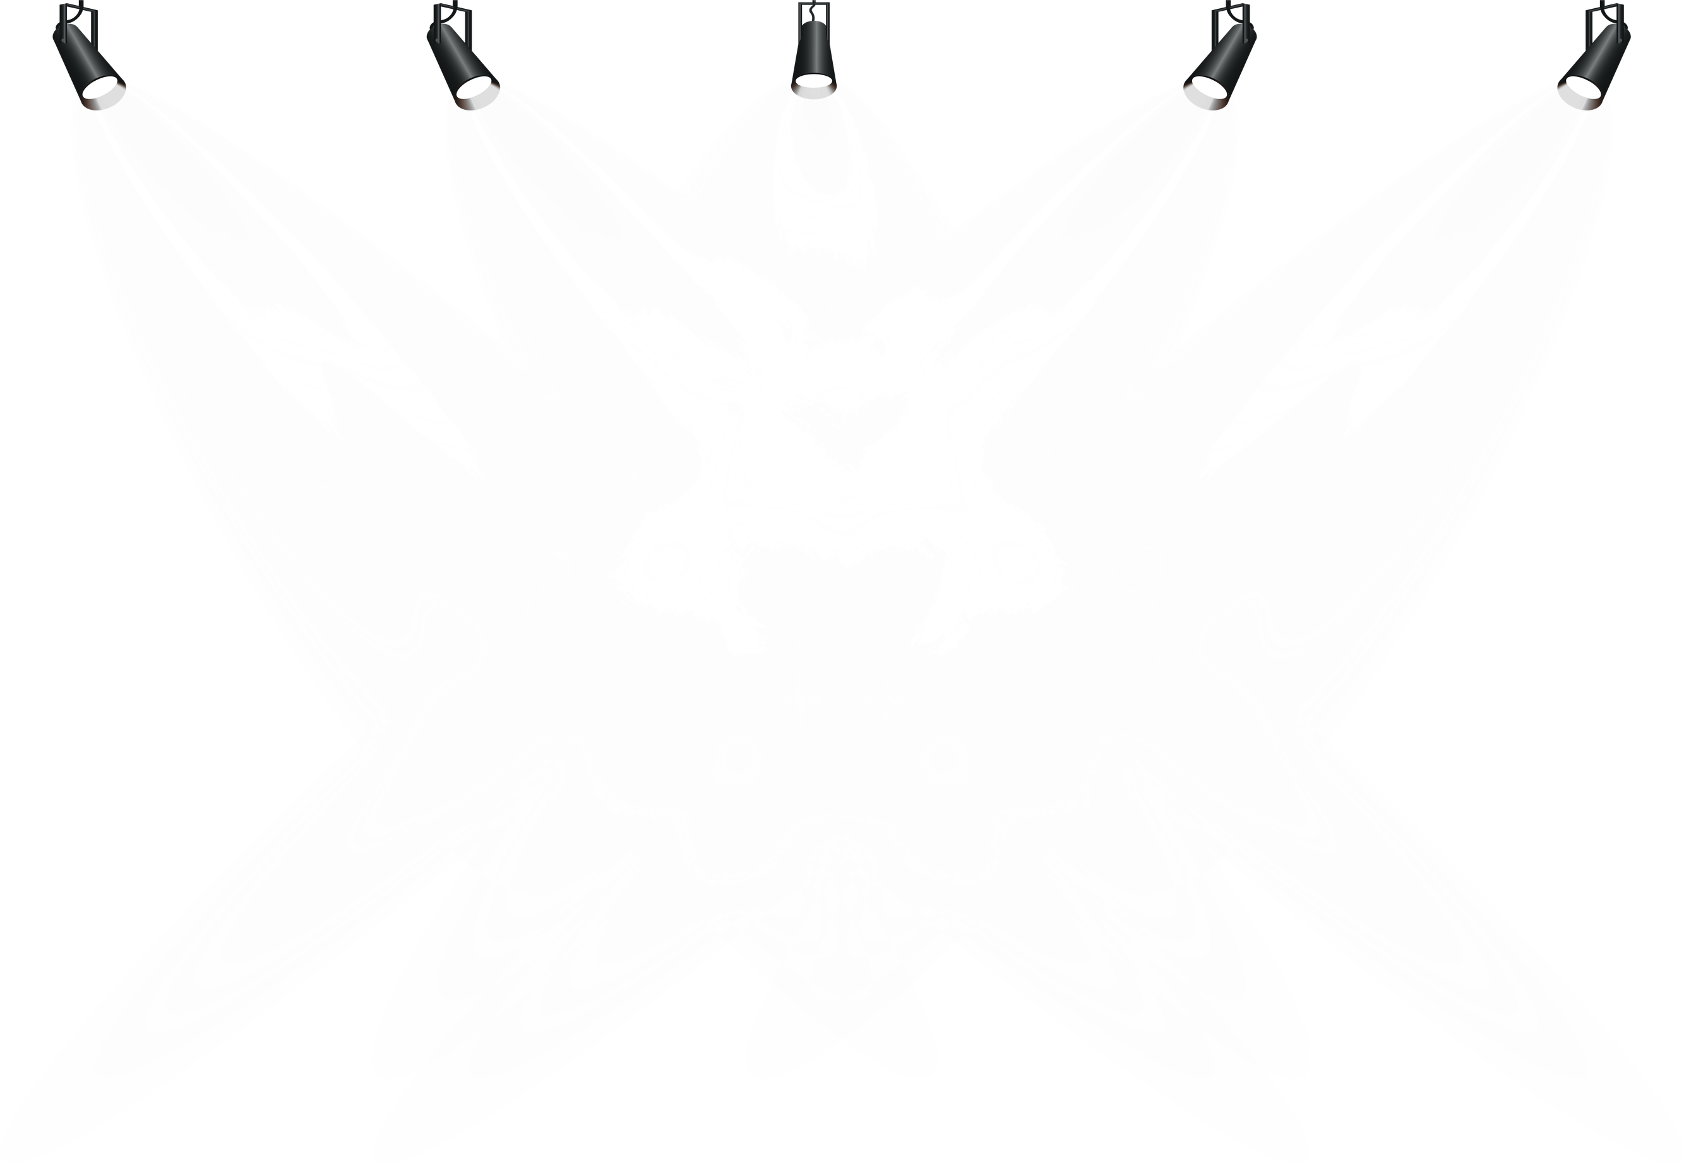
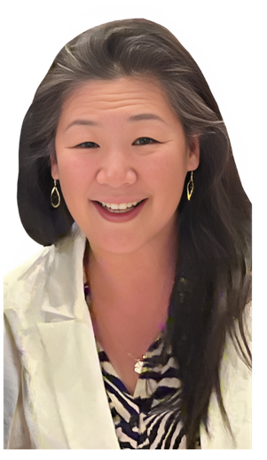
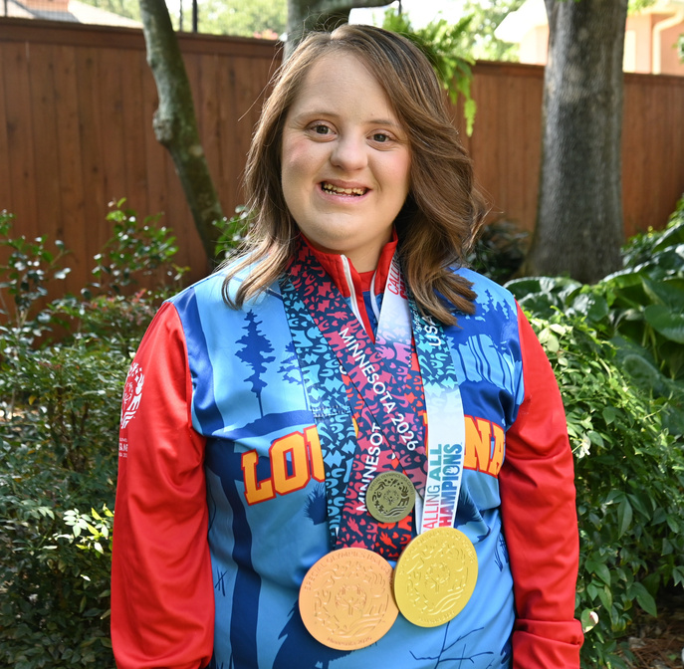
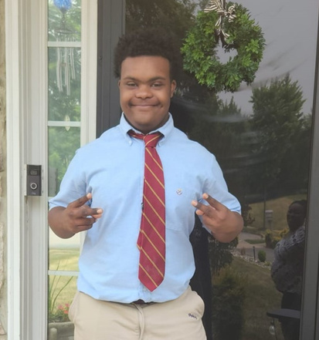
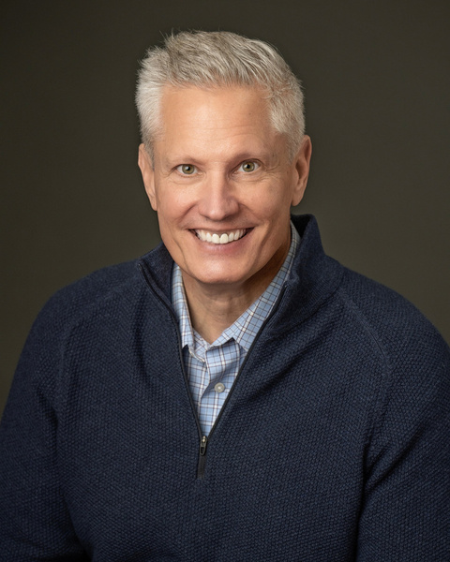
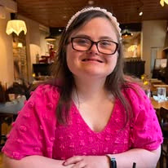
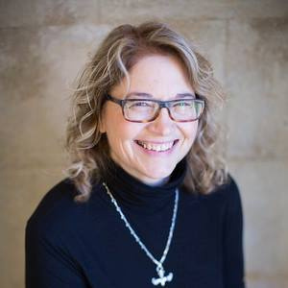


Role Play
Narrator: Jawanda Mast | Team Leader: Roxane Romanick
  Legislative Assistant: Cindy Liu | Senator: Rachel Mast
  Team Members: Jim Hudson, Hannah LaCour, Stormie Zanfordino

Slide 2
Back on Track: Lessons From a Hill Meeting Gone Wrong
Focus: Social Security (SSI) Savings Penalty Elimination Act
  A group of NDSC advocates is meeting with Senator Mast’s office to ask for support for the SSI Savings Penalty Elimination Act.
  The group arrives 20 minutes late and did not call ahead. The Legislative Assistant greets them and explains that Senator Mast is not available, so she will meet with them instead.
  The Team Leader and some of the advocates become frustrated. They point out that they have never been able to meet with the Senator. It is always “just a staff member.”
Let’s see how the meeting unfolds and if you can identify some of their mistakes.

Slide 3

Top 10 Things That Went Wrong
  They arrived 20 minutes late.
  2. They complained about meeting with a staff member.​
  3. Dress for Success​​
  4. They forgot their one pagers and leave behinds.​​​​
  5. They were not prepared with a clear plan.​​​​
  6. They did not let the self advocate tell her own story.​​​​​
  7. They were distracted and disrespectful.​​
  8. They interrupted the speaker.​​​​​​​
  9. They tried to cover too many issues.​​​​​​​​
  10. They missed the opportunity to build a relationship.​​​​​​​

Slide 4
Any Hill Meeting can be successful when advocates:
Show up prepared
Tell their story
Make a clear ask
Listen
Respect the time
Build the relationship
Thank-you
Follow up

