Slide 1

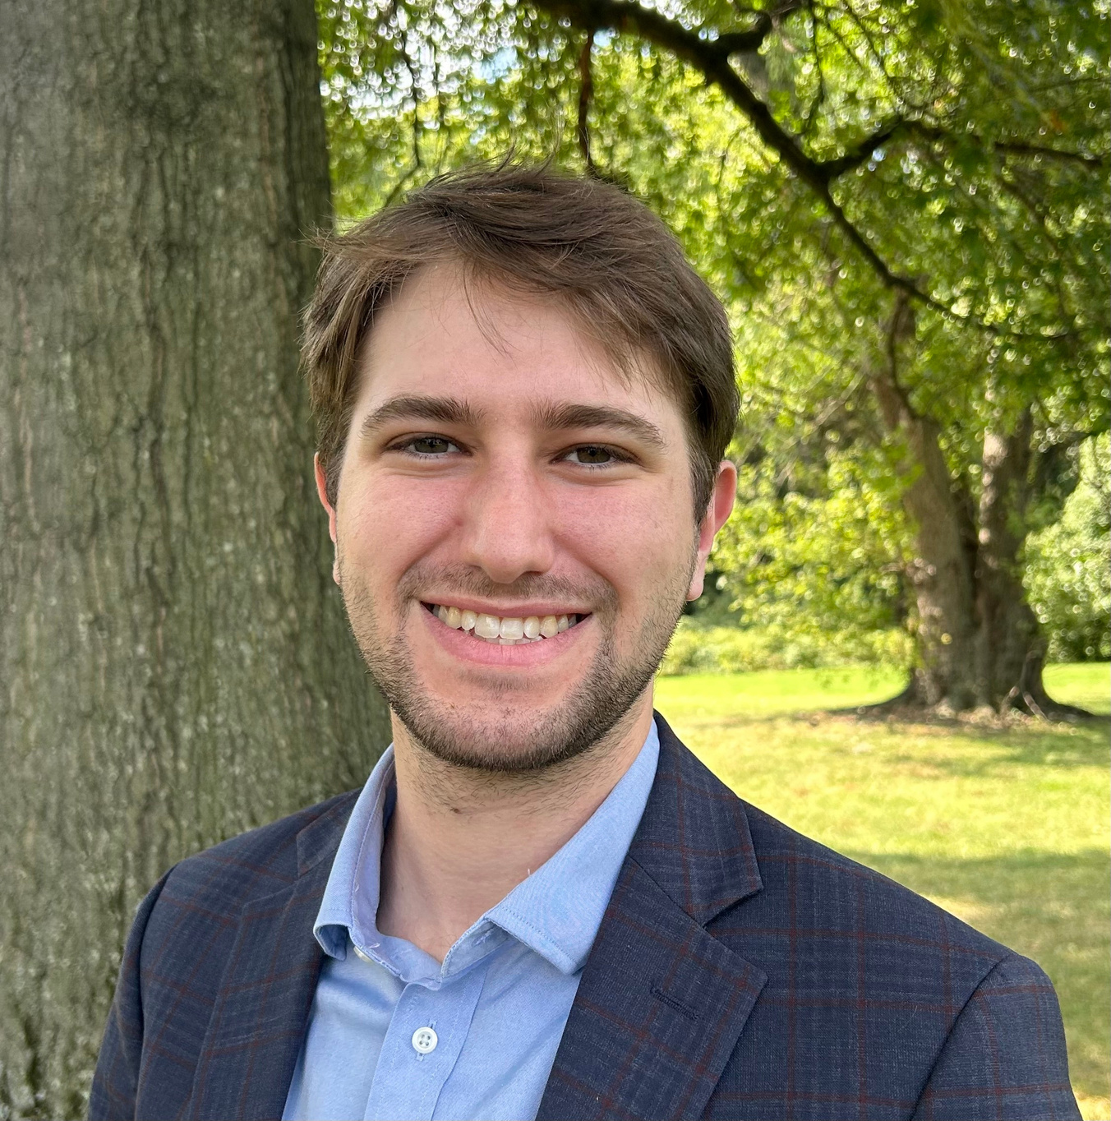
Preparing for Capitol Hill:
Logistics and Expectations
Micah Rothkopf
NDSC Policy & Advocacy Associate

Slide 2


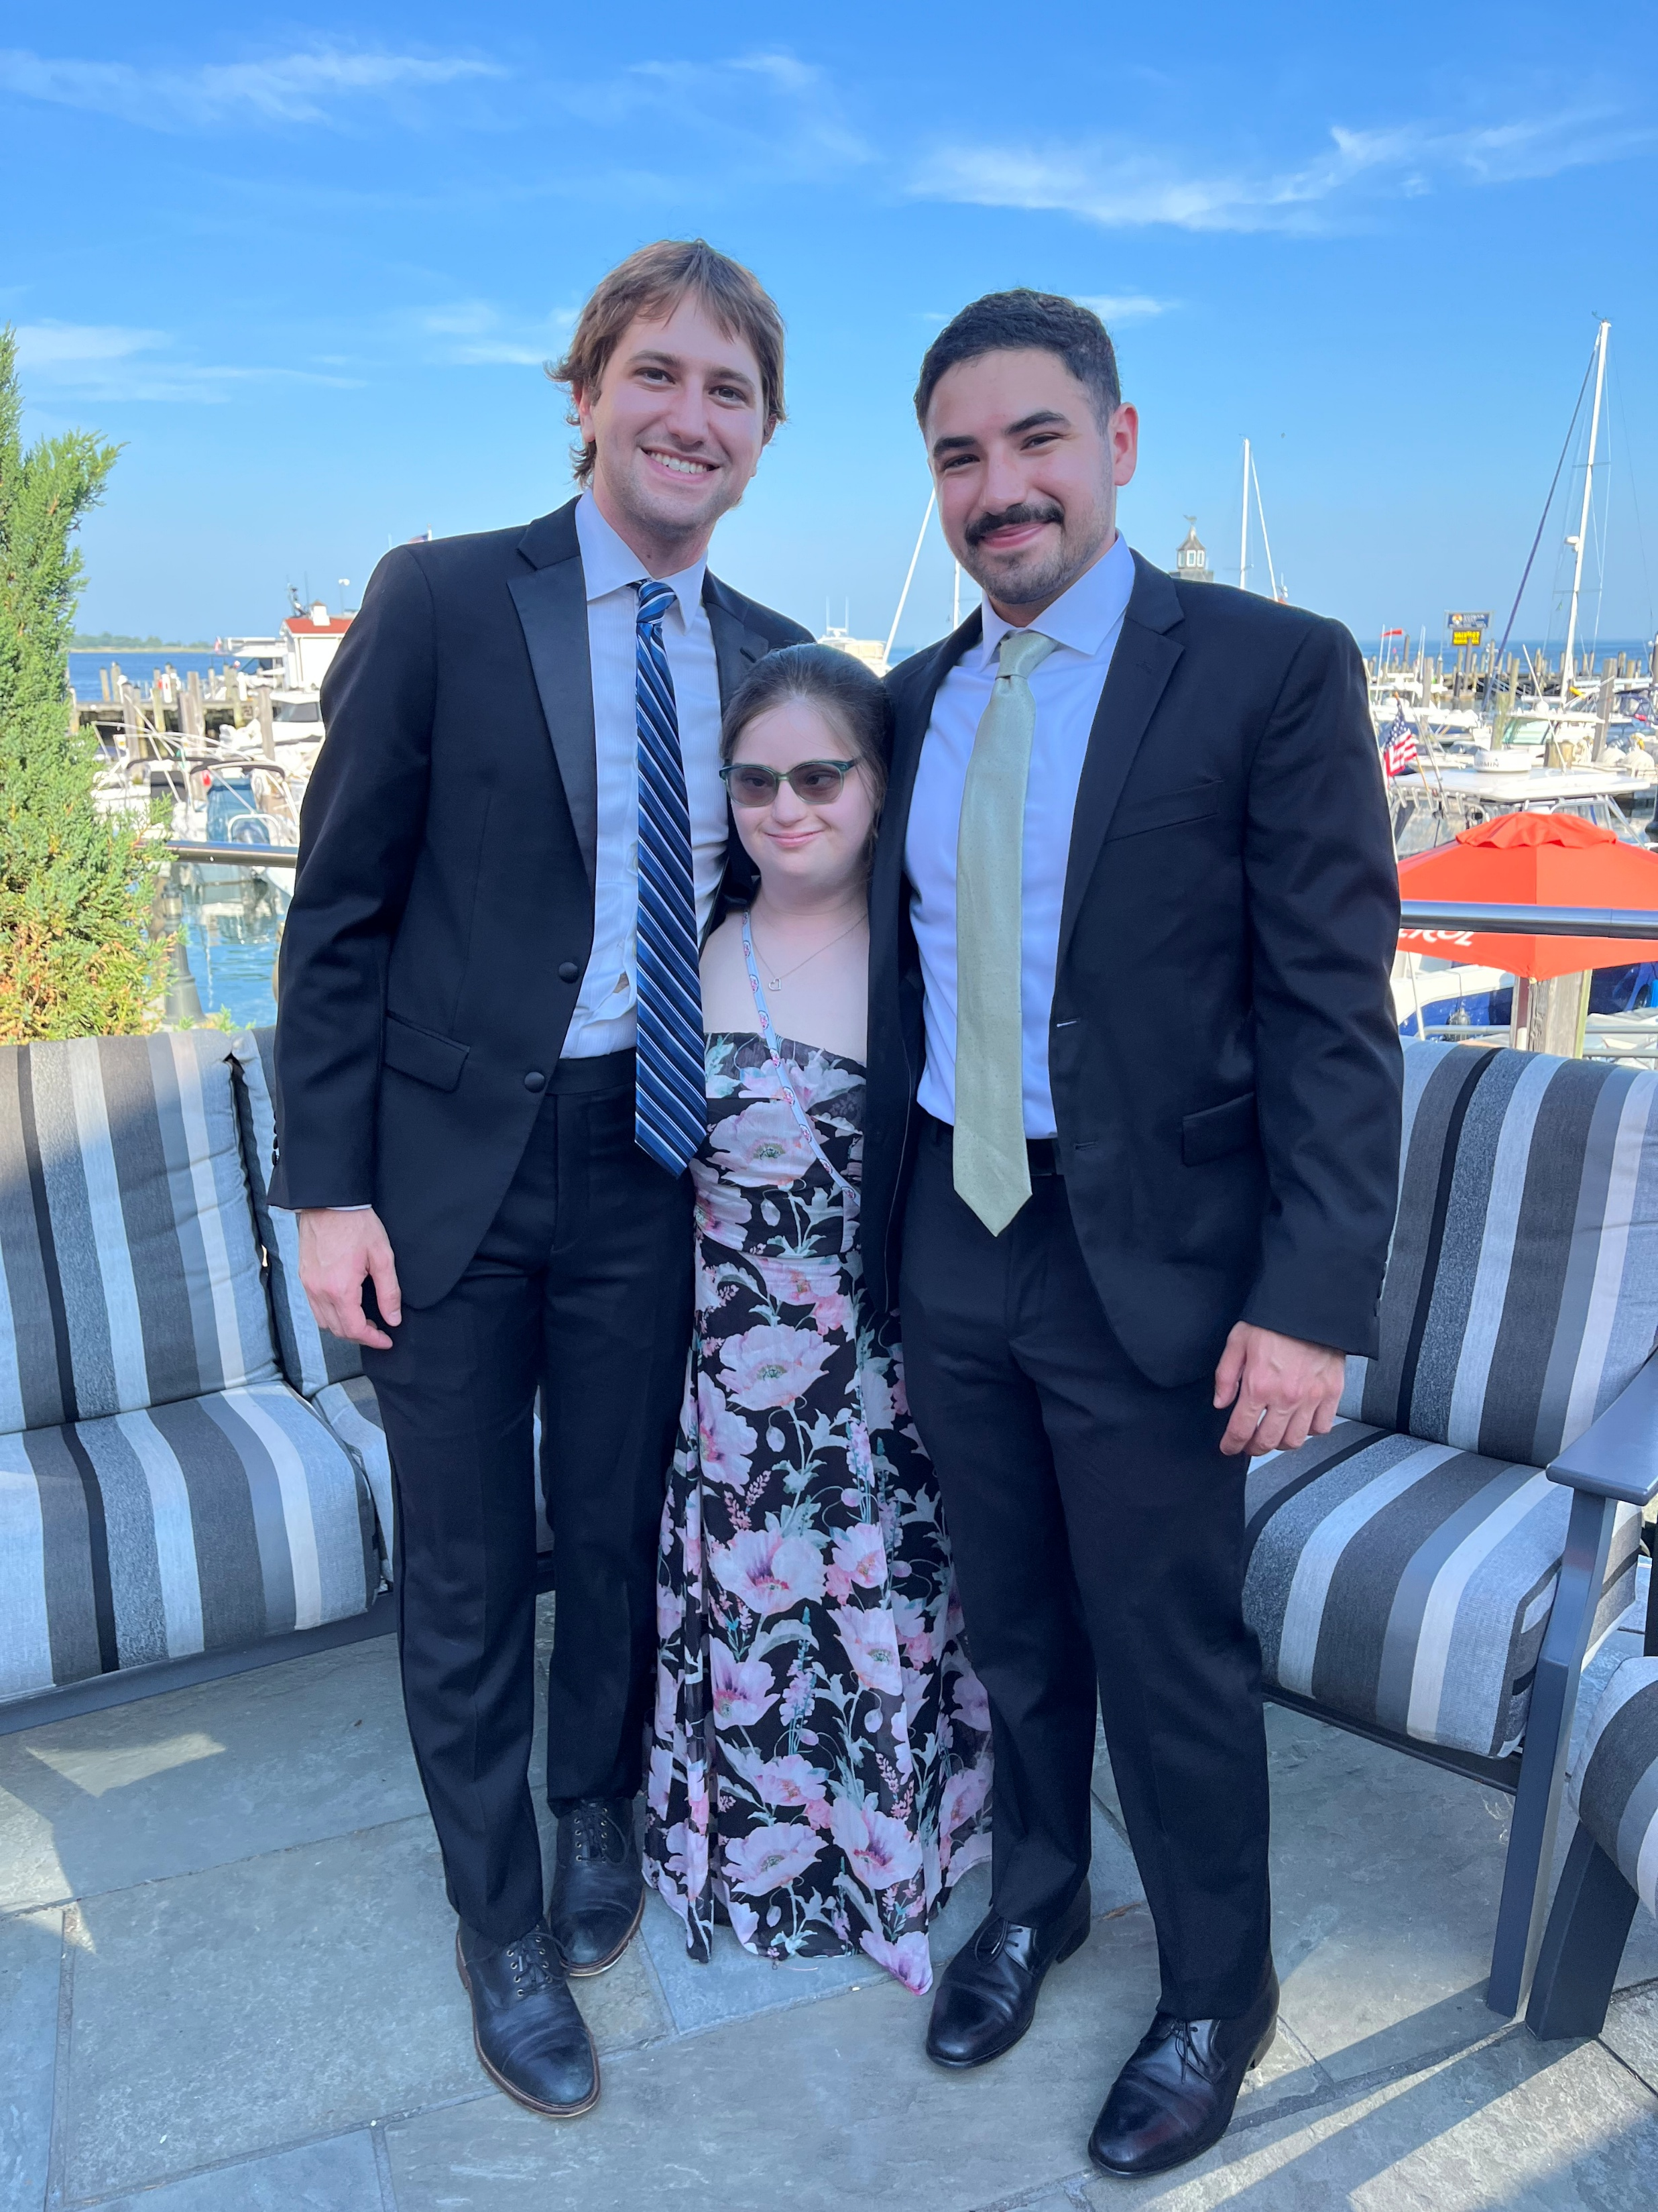

Preparing for Capitol Hill
Logistics and Expectations
Micah Rothkopf
NDSC Policy & Advocacy Associate

Slide 3
Session Agenda: Your Day on the Hill
Congressional Breakfast Reception: 8:00 – 9:30 AM
Navigating the Hill
Lunch
Packing Reminders
Team Captains
Hill Meetings
The App
Need Help?
Notes:
Emphasize that we need people at the breakfast and that it’s a really amazing opportunity to be feet from a an elected member of congress and talk directly with staff who are the engines behind policymaking

Slide 4
Glossary of “Hill” Terms
Term
Definition
The Hill /
Capitol Hill
The area around the U.S. Capitol where Congress & offices are located
Member
An elected member of Congress: either a Senator or Representative
Staffer /
Hill Staffer
A person who works for a Member of Congress
Sponsor
A Member who introduces a bill
Co-sponsor
A Member who formally supports an introduced bill
Bipartisan
Supported by Members of both political parties (Democrat & Republican)
Constituent
A person who lives in the area represented by a specific Member of Congress
Notes:
Micah

Slide 5
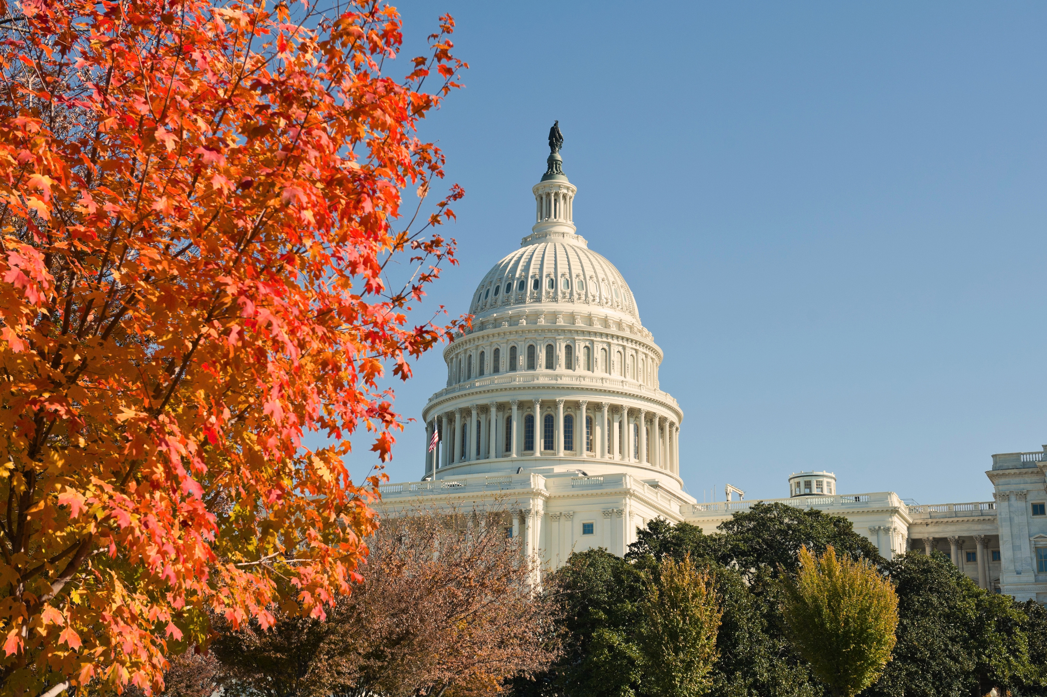
You’re
Invited!
Congressional Breakfast Reception
Sponsored by: Microsoft
Kennedy Caucus Room, SR-325
8:00 AM - 9:30 AM
Directions on your agenda
Notes:
Please plan to arrive by 8:00 AM
If you have a meeting that conflicts with the breakfast, the meeting takes priority!!!

Slide 6

Getting to the Hill: Omni to Russell
Uber/Lyft
Driving
Metro
Est. Time
20-30min
35-45min
40-50min
Parking
N/A
Union Station
N/A
Destination
Constitution Ave.
Union Station
Union Station
Connect with your Team Captain to coordinate travel plans throughout the day

Slide 7
When should
you leave?
When should
you arrive?
Uber/Lyft: 7:30 AM
Driving: 7:15 AM
Metro: 7:15 AM
Uber/Lyft: 7:45 AM
Driving: 7:45 AM
Metro: 7:45 AM
6:50 AM: Meet in the front lobby to walk to the metro or drive together; staff available to help
Notes:
Leave the hotel between 7:00 - 7:15 to get to the Hill and through security in time for the congressional breakfast

Slide 8
The Cost of a Round Trip
Uber/Lyft
Driving
Metro
Approx. Cost
$22.00
$25.00 parking + gas
$5.00 – $7.00
Union Station Parking Address:
30 Massachusetts Ave, NE, Washington, D.C. 20002

Slide 9
Taking the Metro: how to buy a pass
Online:
Apple Wallet: Buy and load passes using the Smart Trip mobile app
Google Waller: Buy and load passes on Google Wallet directly to your virtual Smart Trip card
Smart Trip account portal: Buy and add passes directly to your existing Smart Trip card (expect up to one hour for delivery)
In Person:
At any Fare Vending Machine — located in all Metro Rail stations by the faregates:
Add to an existing Smart Trip card
Buy a pass on a new Smart Trip card (+$2 new card fee)
More information here: https://www.wmata.com/pay/smart-trip.html

Slide 10
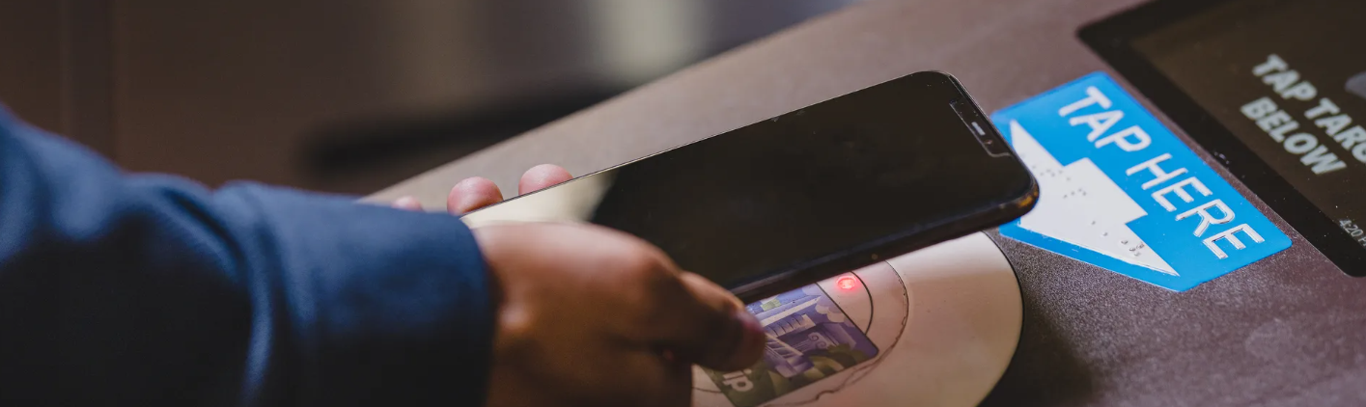
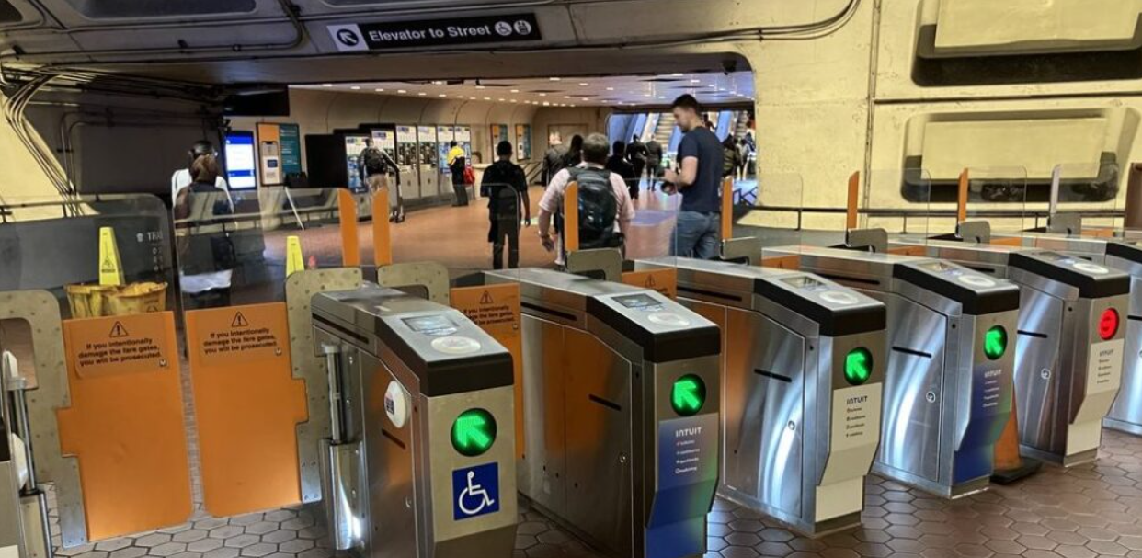
Taking the Metro: how to buy a pass

Slide 11
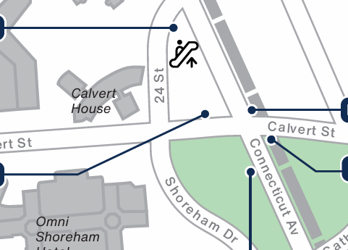
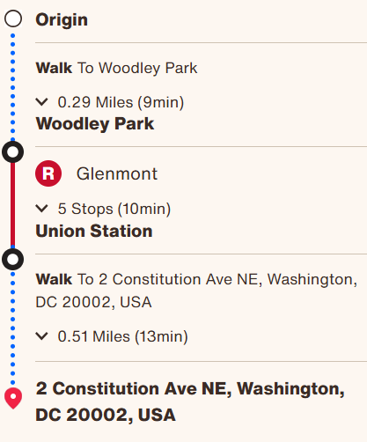
Taking the Metro

Slide 12
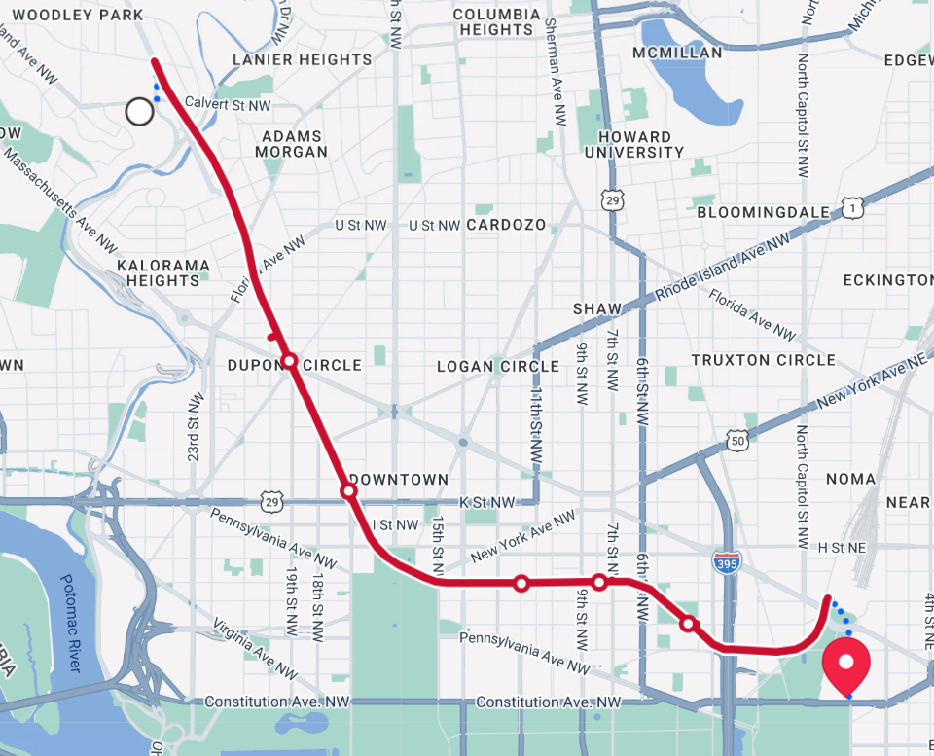
Taking the Metro

Slide 13
Taking the Metro
Towards Hotel
You are here
Towards the Hill
Shady Grove
Woodley Park
Union Station
Glenmont

Slide 14
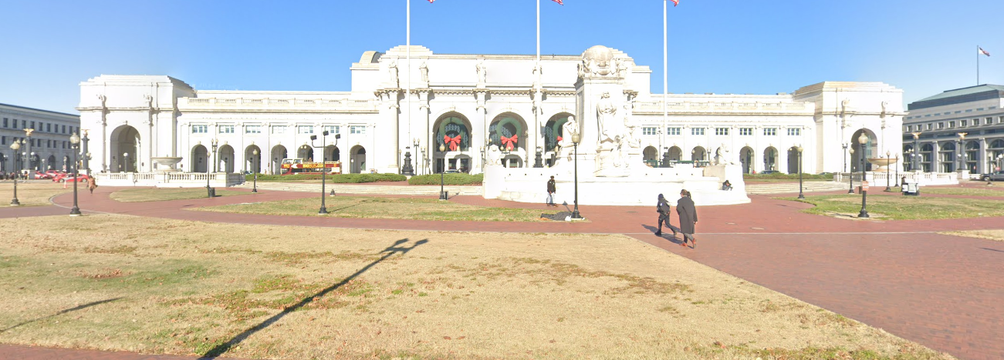
Taking the Metro: From Union Station
Exit the Metro
Exit Union Station
Walk out into the plaza

Slide 15
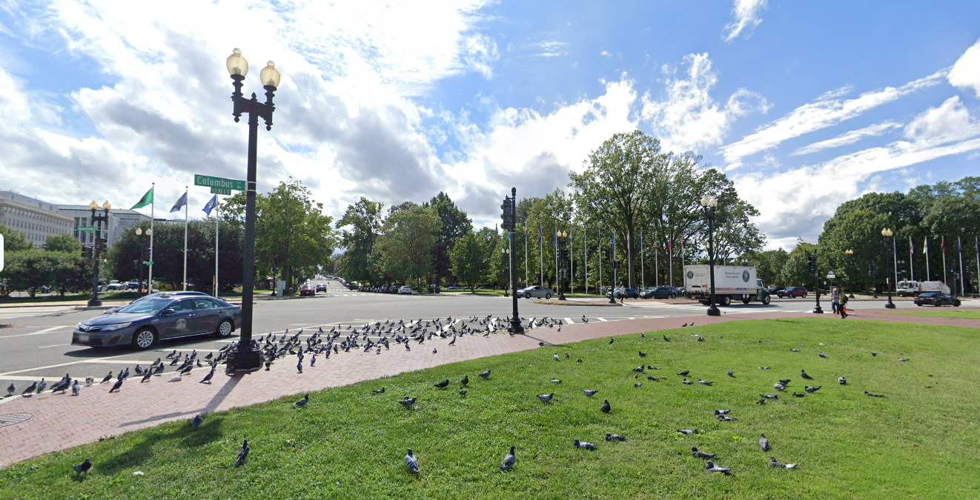
Taking the Metro: From Union Station
Exit the Metro
Exit Union Station
Walk out into the plaza
Cross the street towards First Street

Slide 16
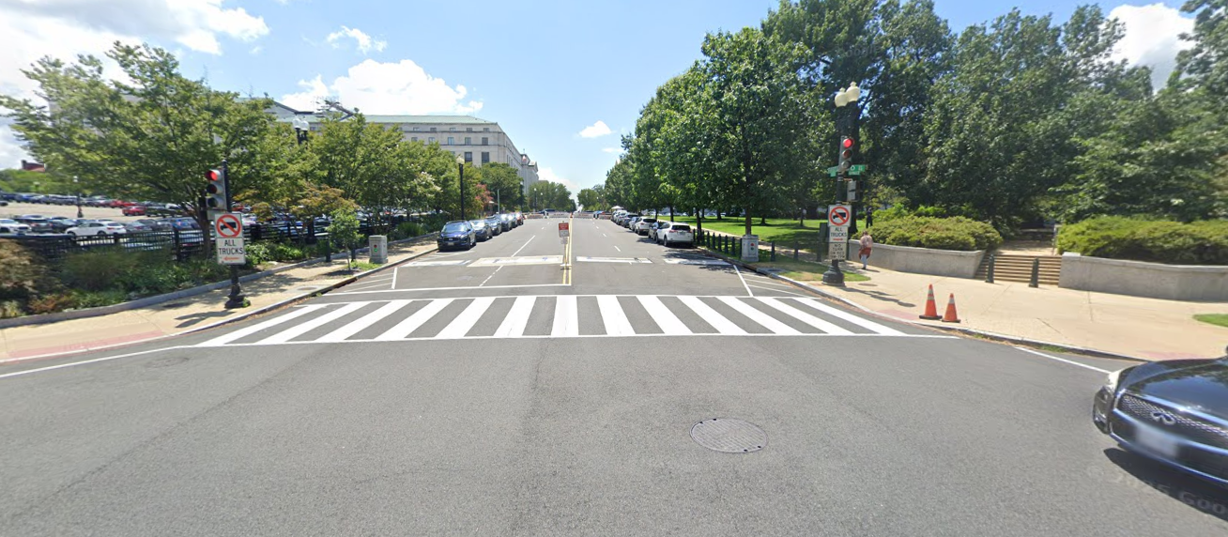
Taking the Metro: From Union Station
Exit the Metro
Exit Union Station
Walk out into the plaza
Cross the street and up First Street NE
Continue up the hill

Slide 17
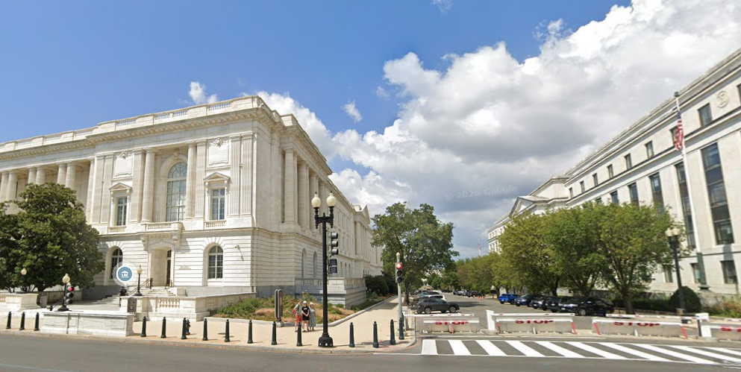
Taking the Metro: From Union Station
Exit the Metro
Exit Union Station
Walk out into the plaza
Cross the street and up First Street NE
Continue up the hill
Turn on Constitution Ave. and look for “public entrance” signs into Russell

Slide 18
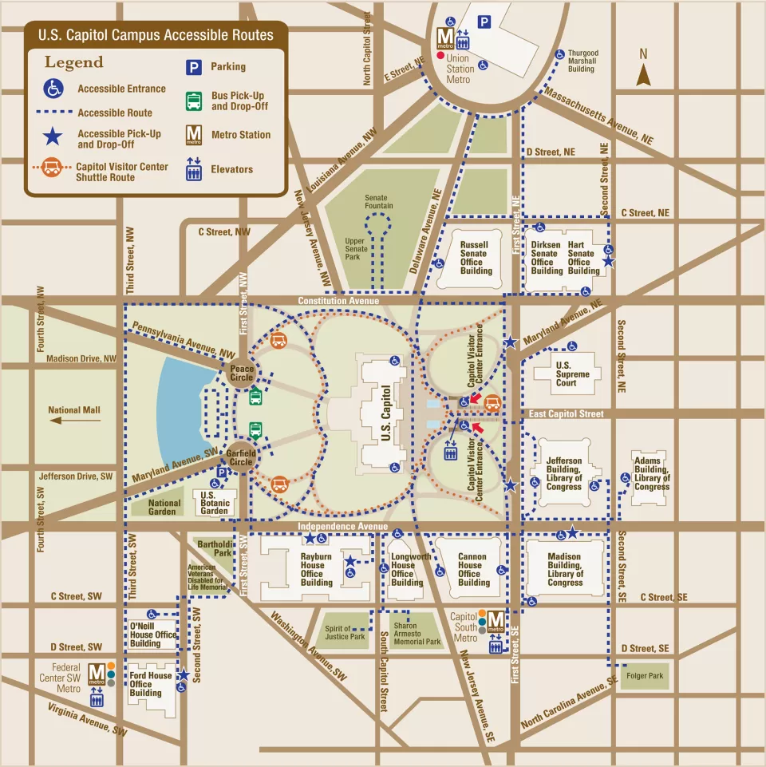
Navigating the Hill
Senate v. House side
Visitor v. Staff entrances
0.5 miles between the sides
10-20min of walking
1-2min drive
Plan for 15-30min to
get through security
Notes:
Security is just like airplane security. You’ll need to take things out of your pockets, put your bags on the conveyor belt, and walk through the metal detectors. Travel together with you group! Make sure no one is left behind!

Slide 19
Senate Side
Senate Office Buildings:
Russell Senate Office Building
Dirksen Senate Office Building
Hart Senate Office Building
Metro accessible via Union Station
Uber drop-off on Constitution Ave.
Prefixes to know:
Russell – SR
Dirksen – SD
Hart – SH
Notes:
Explain floors and prefixes. Point out that these will on the schedules

Slide 20
Senate Side
Senate Office Buildings:
Russell Senate Office Building
Dirksen Senate Office Building
Hart Senate Office Building
Metro accessible via Union Station
Uber drop-off on Constitution Ave.
Prefixes to know:
Russell – SR
Dirksen – SD
Hart – SH
Notes:
Explain floors and prefixes

Slide 21
Senate Side
Senate Office Buildings:
Russell Senate Office Building
Dirksen Senate Office Building
Hart Senate Office Building
Metro accessible via Union Station
Uber drop-off on Constitution Ave.
Prefixes to know:
Russell – SR
Dirksen – SD
Hart – SH
Notes:
Explain floors and prefixes

Slide 22
Senate Side
Senate Office Buildings:
Russell Senate Office Building
Dirksen Senate Office Building
Hart Senate Office Building
Metro accessible via Union Station
Uber drop-off on Constitution Ave.
Prefixes to know:
Russell – SR
Dirksen – SD
Hart – SH
Notes:
Explain floors and prefixes

Slide 23
Senate Side
Senate Office Buildings:
Russell Senate Office Building
Dirksen Senate Office Building
Hart Senate Office Building
Metro accessible via Union Station
Uber drop-off on Constitution Ave.
Prefixes to know:
Russell – SR
Dirksen – SD
Hart – SH
Notes:
Explain floors and prefixes

Slide 24
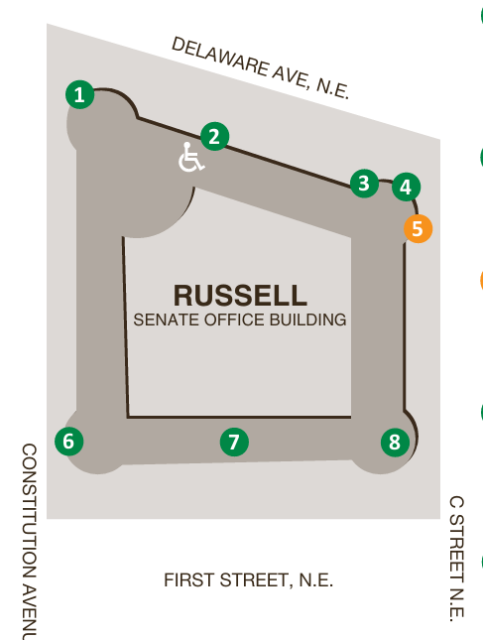
Russell Senate Office Building
Public Entrances
Staff Entrances Only
2
6
7
1
3
4
5
8
Senate Office Buildings Door Map and Hours of Operation, Effective May 2026
Notes:
Note that sometimes the entrances can be closed. You can circle the building to look for an open entrance and/or ask a guard

Slide 25
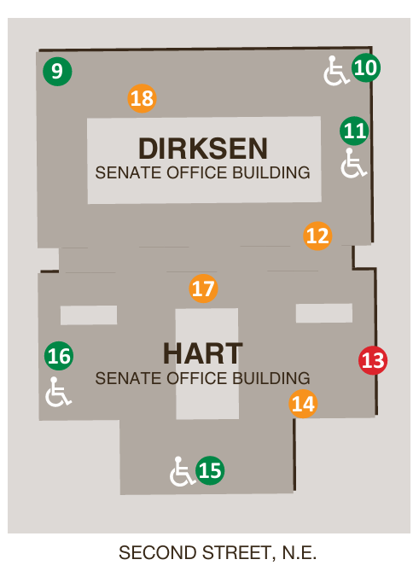
Dirksen & Hart Office Buildings
Public Entrances
Staff Entrances / Inaccessible
9
11
16
15
10
12
14
17
18
13
Senate Office Buildings Door Map and Hours of Operation, Effective May 2026
Notes:
Micah

Slide 26
House Side
House Office Buildings:
Rayburn House Office Building
Longworth House Office Building
Cannon House Office Building
Metro accessible via Capitol South
Uber drop-off on Independence Ave.
Building Numbers:
Cannon (CHOB) – 0
Longworth (LHOB) – 1
Rayburn (RHOB) – 2
Notes:
Cannon – 0
• Example: 327 CHOB is on the third floor of Cannon.
Longworth – 1
• Example: 1223 LHOB is on the second floor of Longworth.
Rayburn – 2
• Example: 2449 RHOB is on the fourth floor of Rayburn.

Slide 27
House Side
House Office Buildings:
Rayburn House Office Building
Longworth House Office Building
Cannon House Office Building
Metro accessible via Capitol South
Uber drop-off on Independence Ave.
Building Numbers:
Cannon (CHOB) – 0
Longworth (LHOB) – 1
Rayburn (RHOB) – 2
Notes:
Cannon – 0
• Example: 327 CHOB is on the third floor of Cannon.
Longworth – 1
• Example: 1223 LHOB is on the second floor of Longworth.
Rayburn – 2
• Example: 2449 RHOB is on the fourth floor of Rayburn.

Slide 28
House Side
House Office Buildings:
Rayburn House Office Building
Longworth House Office Building
Cannon House Office Building
Metro accessible via Capitol South
Uber drop-off on Independence Ave.
Building Numbers:
Cannon (CHOB) – 0
Longworth (LHOB) – 1
Rayburn (RHOB) – 2
Notes:
Cannon – 0
• Example: 327 CHOB is on the third floor of Cannon.
Longworth – 1
• Example: 1223 LHOB is on the second floor of Longworth.
Rayburn – 2
• Example: 2449 RHOB is on the fourth floor of Rayburn.

Slide 29
House Side
House Office Buildings:
Rayburn House Office Building
Longworth House Office Building
Cannon House Office Building
Metro accessible via Capitol South
Uber drop-off on Independence Ave.
Building Numbers:
Cannon (CHOB) – 0
Longworth (LHOB) – 1
Rayburn (RHOB) – 2
Notes:
Cannon – 0
• Example: 327 CHOB is on the third floor of Cannon.
Longworth – 1
• Example: 1223 LHOB is on the second floor of Longworth.
Rayburn – 2
• Example: 2449 RHOB is on the fourth floor of Rayburn.

Slide 30
House Side
House Office Buildings:
Rayburn House Office Building
Longworth House Office Building
Cannon House Office Building
Metro accessible via Capitol South
Uber drop-off on Independence Ave.
Building Numbers:
Cannon (CHOB) – 0
Longworth (LHOB) – 1
Rayburn (RHOB) – 2
Notes:
Cannon – 0
• Example: 327 CHOB is on the third floor of Cannon.
Longworth – 1
• Example: 1223 LHOB is on the second floor of Longworth.
Rayburn – 2
• Example: 2449 RHOB is on the fourth floor of Rayburn.

Slide 31
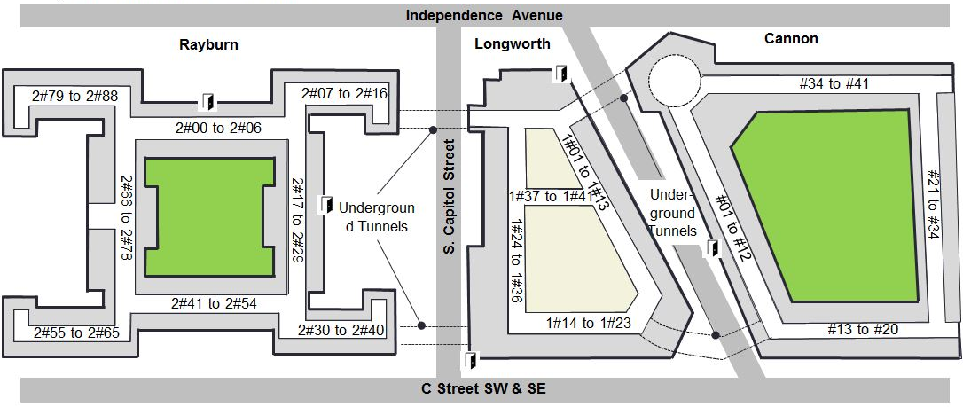
House Side
Rayburn, Longworth, and Cannon
Enter on Independence Ave.
Remember:
Always check the signs to see if it says “visitor entrance” or “staff entrance”
Remember:
You can always ask for help
Notes:
Micah

Slide 32
House Side
Rayburn, Longworth, and Cannon
Enter on Independence Ave.
Remember:
Always check the signs to see if it says “visitor entrance” or “staff entrance”
Remember:
You can always ask for help
Notes:
Micah

Slide 33
House Side
Rayburn, Longworth, and Cannon
Enter on Independence Ave.
Remember:
Always check the signs to see if it says “visitor entrance” or “staff entrance”
Remember:
You can always ask for help
Notes:
Micah

Slide 34
House Side
Rayburn, Longworth, and Cannon
Enter on Independence Ave.
Remember:
Always check the signs to see if it says “visitor entrance” or “staff entrance”
Remember:
You can always ask for help
Notes:
Micah

Slide 35
Congressional Tunnels
Between buildings
Open but can be confusing
Between Senate & House Side:
Requires an escort
Notes:
Ask a security guard if you get confused. I personally find the signage to be confusing sometimes so just ask for help

Slide 36
Congressional Tunnels
Between buildings
Open but can be confusing
Between Senate & House Side:
Requires an escort

Slide 37
Dropping Off Leave-Behinds
Have a Big Time Gap Between Meetings?
Who is Most Important?
  Stop by offices in your state with whom you don’t have a meeting.
  You can split this up.
  Team Captains have folders for the entire state.
  You’re a constituent or have a personal connection
  You’re a neighboring district or live in the same state.
  They are an influential Member (Speaker of the House, Chair of a Committee, etc.)
  Your organization serves their constituents.
Self-advocates should be given
priority to speak!

Slide 38


Where to Find Food
Food on the Senate Side
Food on the House Side
  Dirksen Cafeteria
    SDB-R7, Dirksen Basement, 7:30am – 2:30pm
  Cups & Company
    SRB-65, Russell Basement, 7:00am – 4:00pm
  Inside Scoop
    SDG-21A, Dirksen/Hart Ground Floor, 24-hours
  Longworth Cafeteria
    Longworth B223, 7:30am – 2:00pm
  Rayburn Cafeteria
    Rayburn 2063, 7:30am – 3:00pm
https://bit.ly/Dining-Options-on-Capitol-Hill
Notes:
Sometimes these places are closed or under renovation. Also say that a member of the policy team will be hanging out in a one of these places on both House and Senate side if you want to stop by between meetings with questions or just have company while eating. We will send a message on the App when we have the schedule for policy team members

Slide 39
Packing Reminders
Prohibited Items
Full list: prohibited items
Specifically noting: large bags (no bigger than personal items)
Hotel Luggage Storage
Visit concierge and store luggage at no additional cost
Things to bring
Comfortable shoes for walking!
Plan in case of rain
Stay hydrated, bring or buy a water bottle
Fully charged phone (phone charger or portable battery)
Leave behinds
Name badge

Slide 40
Identify Your Team Captain
Team Captains: Stand and wave!
Daniel Chaplin | Alabama
Cindy Liu & Kelly Kulzer-Reyes | California
Hallie Levine | Connecticut & New Hampshire
Lauren Camp Gates | Delaware
David Tolleson | Georgia & Florida
Bill Stumpf | Iowa & Missouri
Denise Rozell | Illinois & Indiana
Lena Armstrong-Strober | New Mexico & Idaho
Pat Ehrle | Louisiana
Liz Zogby | Maryland
Tiffany Williams | North Carolina
Jawanda Mast | Mississippi & Kansas
Dria Law | New Jersey
Mary Judge-Diegert | New York
Jane Gerhardt | Ohio
Katie Hough | Oklahoma
Mitch Rothholz | Pennsylvania
Roxane Romanick | North Dakota
Andre Pineda & Carol Kando-Pineda | Virginia
Notes:
Tell captains to come up to a specific table to grab the group folders!

Slide 41
Anatomy of a Hill Meeting
Meet outside the office before checking in. One person lets the front desk know the NDSC group is there for its meeting.
Thank the staffer for meeting.
Be yourself. Remember the staffer represents a Member of Congress.
Make your Ask.
Respect their time. Keep the meeting focused and on schedule.
Leave behind materials and take notes.
Connect before you go. Ask about a photo, exchange business cards, thank them again.
Upload your photos and notes to the app.
Designated person sends “Thank you.” Copy Captain and policy@ndsccenter.org
Notes:
More information about to come from your Team Huddles!! Team captains should repeat and expand on this information!

Slide 42
Immediate Assistance? Text preferred
Heather Sachs
(301) 580-8005
Jawanda Mast
(913) 940-4199
Kim Owens
(904) 699-8306
App Support
More → Support → Tap to call for immediate support
Notes:
Put these numbers in your phone now!

Slide 43
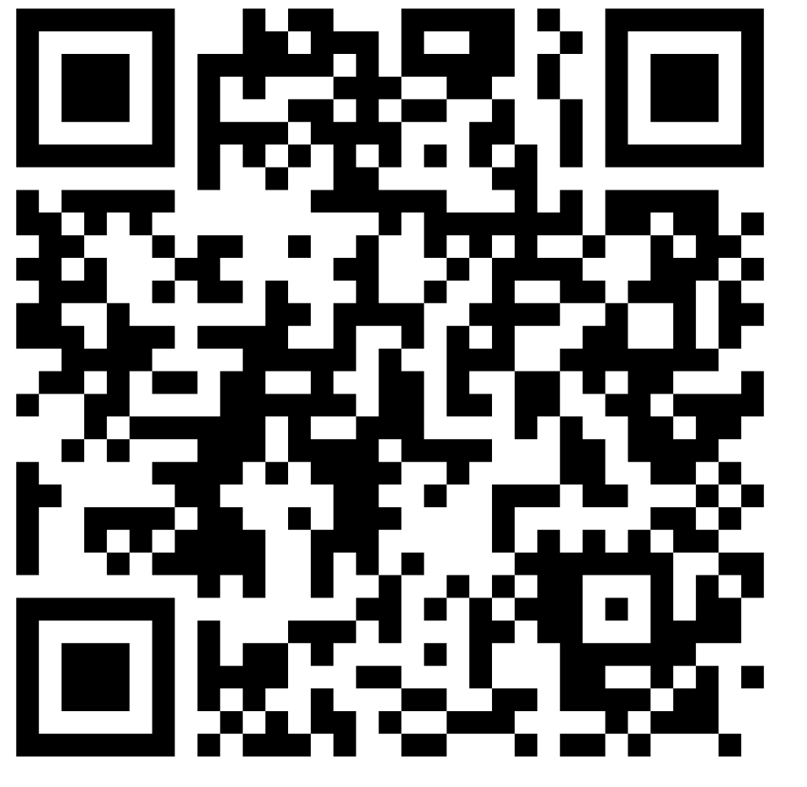
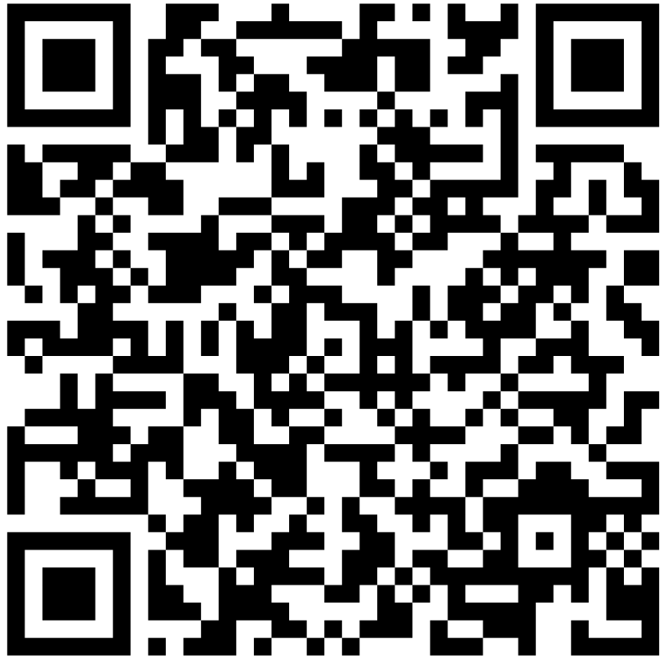
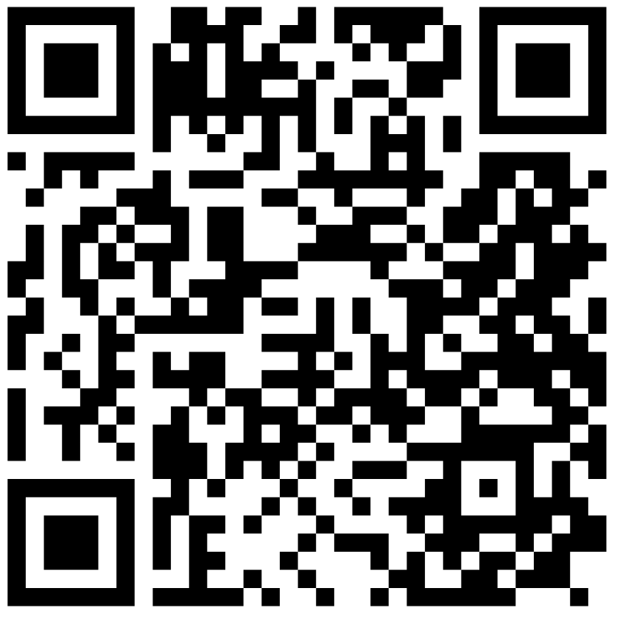
AdvocacyDay App
Take Out Your Phones – Follow Along!
Apple App Store
Google Play Store
Samsung Galaxy Store
Notes:
Micah

Slide 44
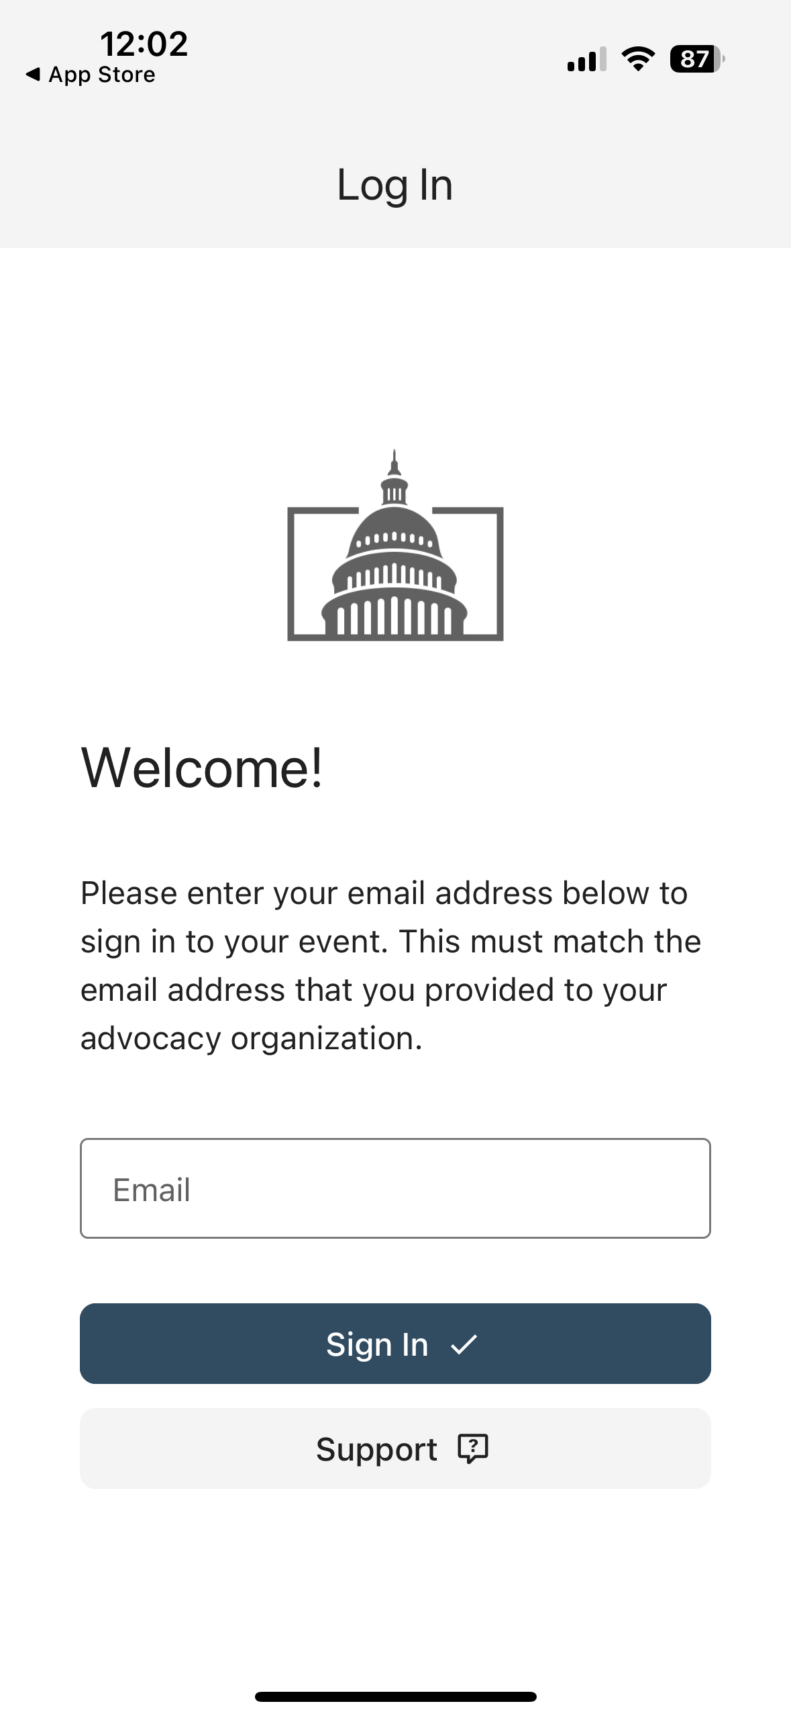
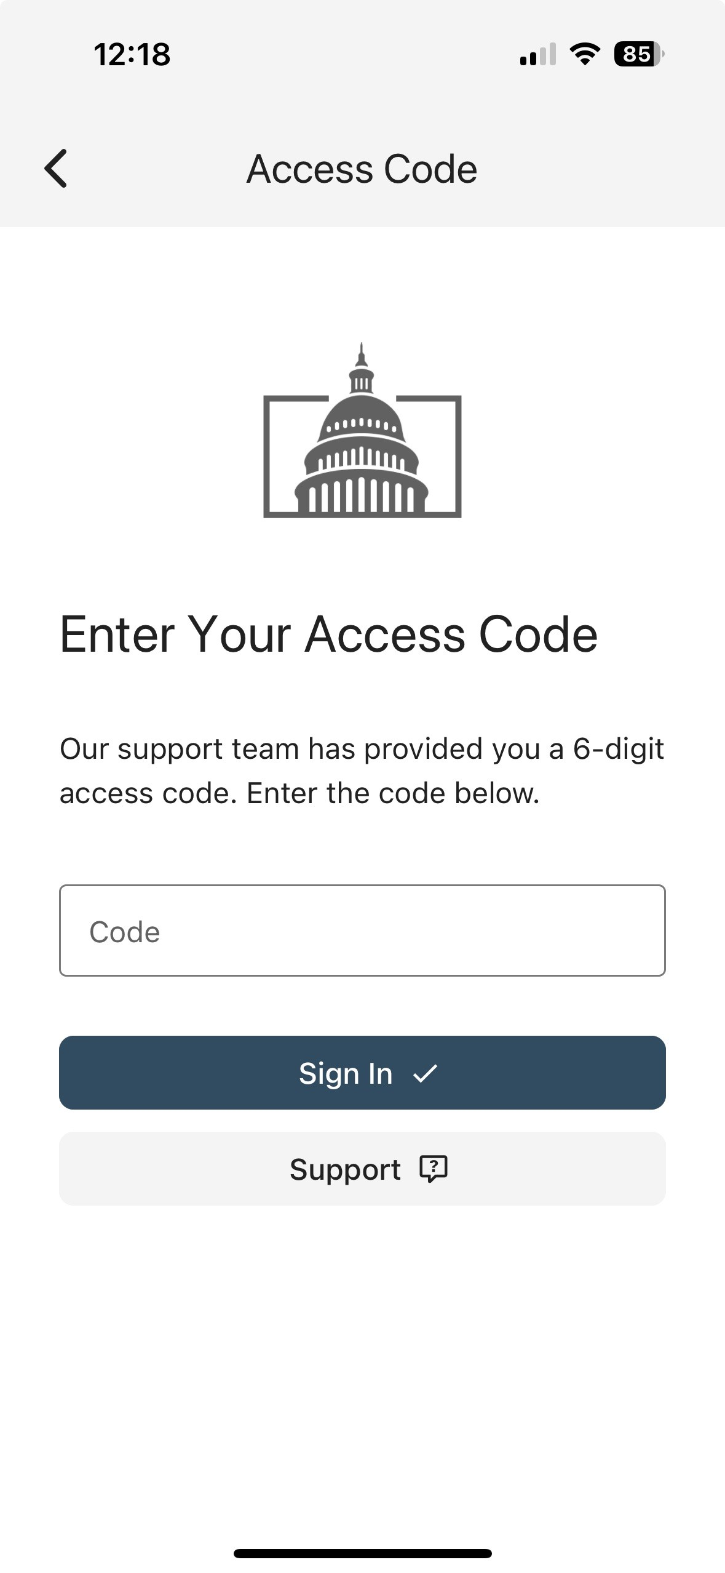
From: AdvocacyDay <noreply@advocacyassociates.com>
Date: Thu, Oct 31, 2024 at 1:46 PM
Subject: Your access code is XXXXX
To: <youremailaddress>
Hello,
Your 6-digit AdvocacyDay access code is XXXXXX
It is valid for 15 minutes.
Notes:
Micah

Slide 45
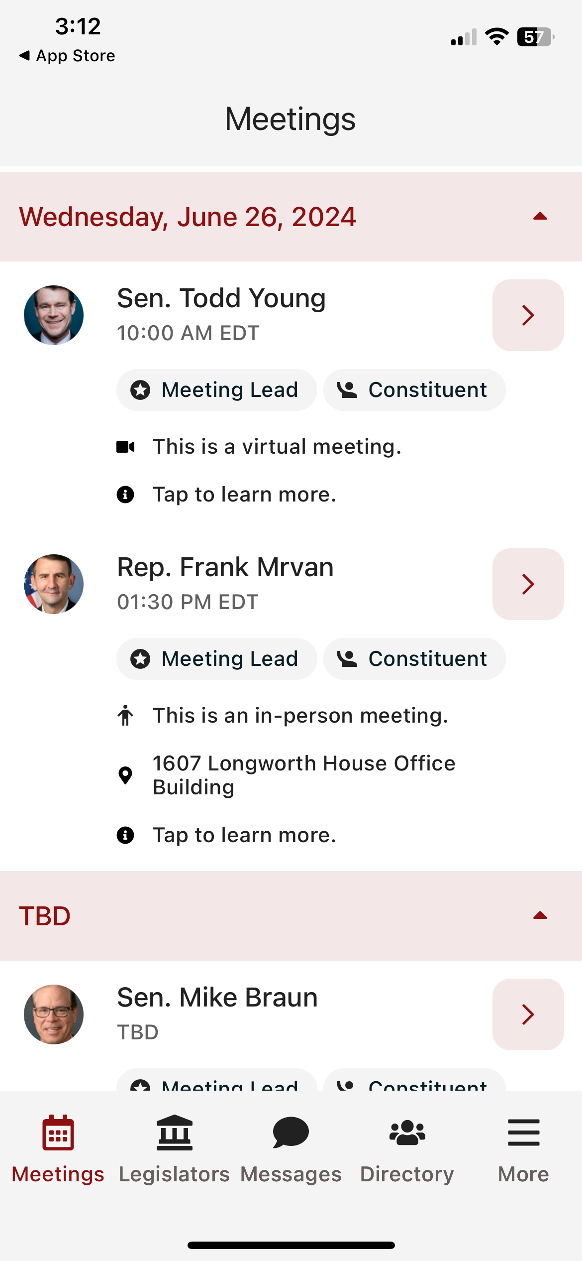
Main Schedule Page
Confirm the Member’s name
Confirm the time of your meeting
Notes:
Micah

Slide 46
Main Schedule Page
Confirm the Member’s name
Confirm the time of your meeting
Are you a constituent?
Notes:
Micah

Slide 47
Main Schedule Page
Confirm the Member’s name
Confirm the time of your meeting
Are you a constituent?
Confirm the location
Notes:
Micah

Slide 48
Main Schedule Page
Confirm the Member’s name
Confirm the time of your meeting
Are you a constituent?
Confirm the location
How much time do you have before your next meeting
Notes:
Micah

Slide 49
Main Schedule Page
Confirm the Member’s name
Confirm the time of your meeting
Are you a constituent?
Confirm the location
How much time do you have before your next meeting
Tap anywhere to learn more
Notes:
Micah

Slide 50
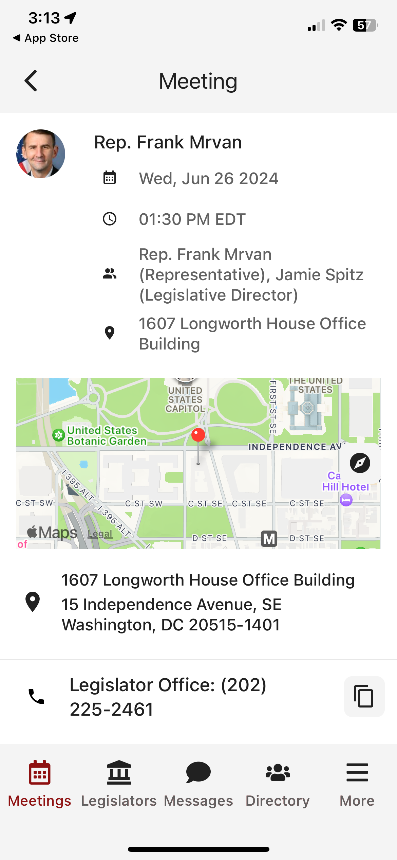
Specific Meeting Details
Date/Time/Meeting With/Location
Notes:
Micah

Slide 51
Specific Meeting Details
Date/Time/Meeting With/Location
Tap on the map to get walking directions
Notes:
Micah

Slide 52
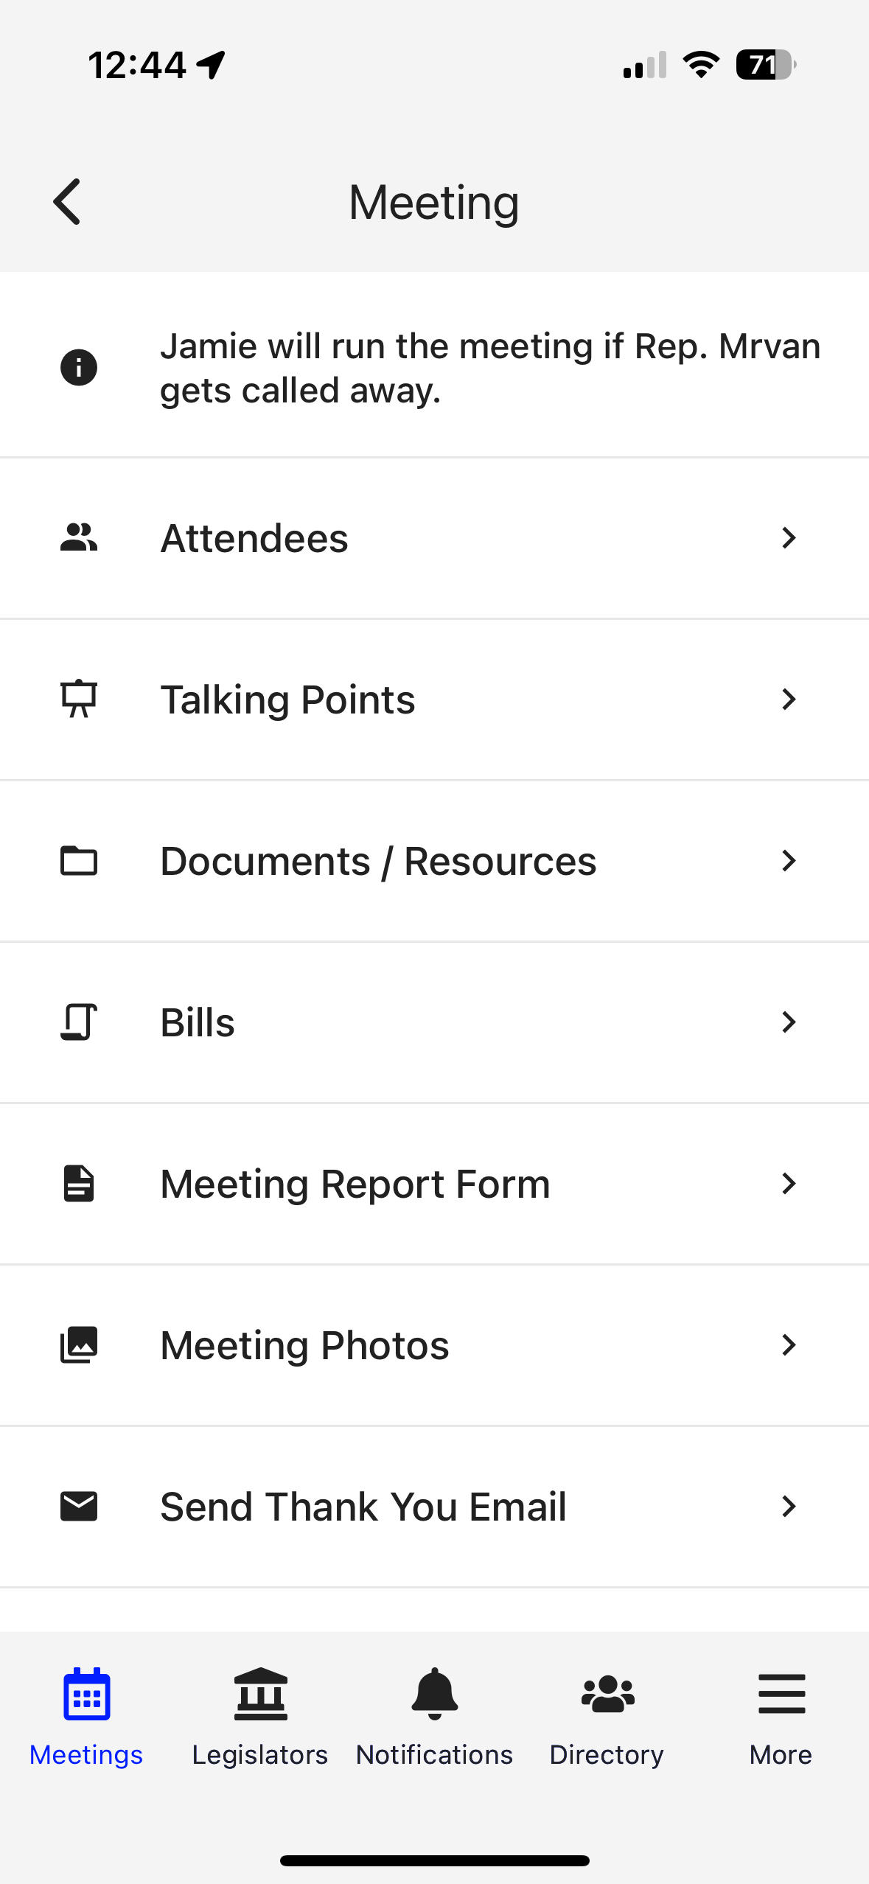
Specific Meeting Details
Date/Time/Meeting With/Location
Tap on the map to get walking directions
Scroll down for attendees/talking points/leave behinds/more
Notes:
Micah

Slide 53
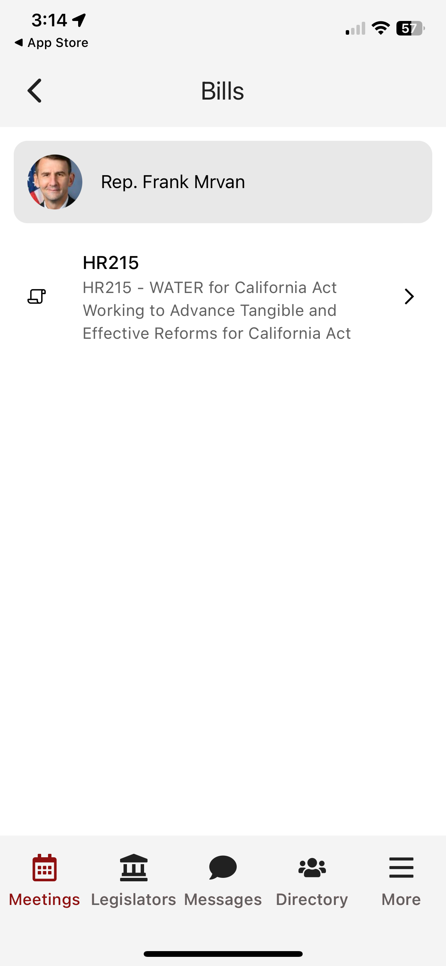

Notes:
Explain Noah’s Ark 1:1 concept
Our Bills are listed here and you can check if they are a cosponsor

Slide 54
Specific Meeting Details
Date/Time/Meeting With/Location
Tap on the map to get walking directions
Scroll down for attendees/talking points/leave behinds/more
Complete meeting report form & upload Photos
Notes:
Micah

Slide 55
Specific Meeting Details
Date/Time/Meeting With/Location
Tap on the map to get walking directions
Scroll down for attendees/talking points/leave behinds/more
Give Feedback & Submit Photos
Thank you template (always personalize)
Notes:
Micah

Slide 56
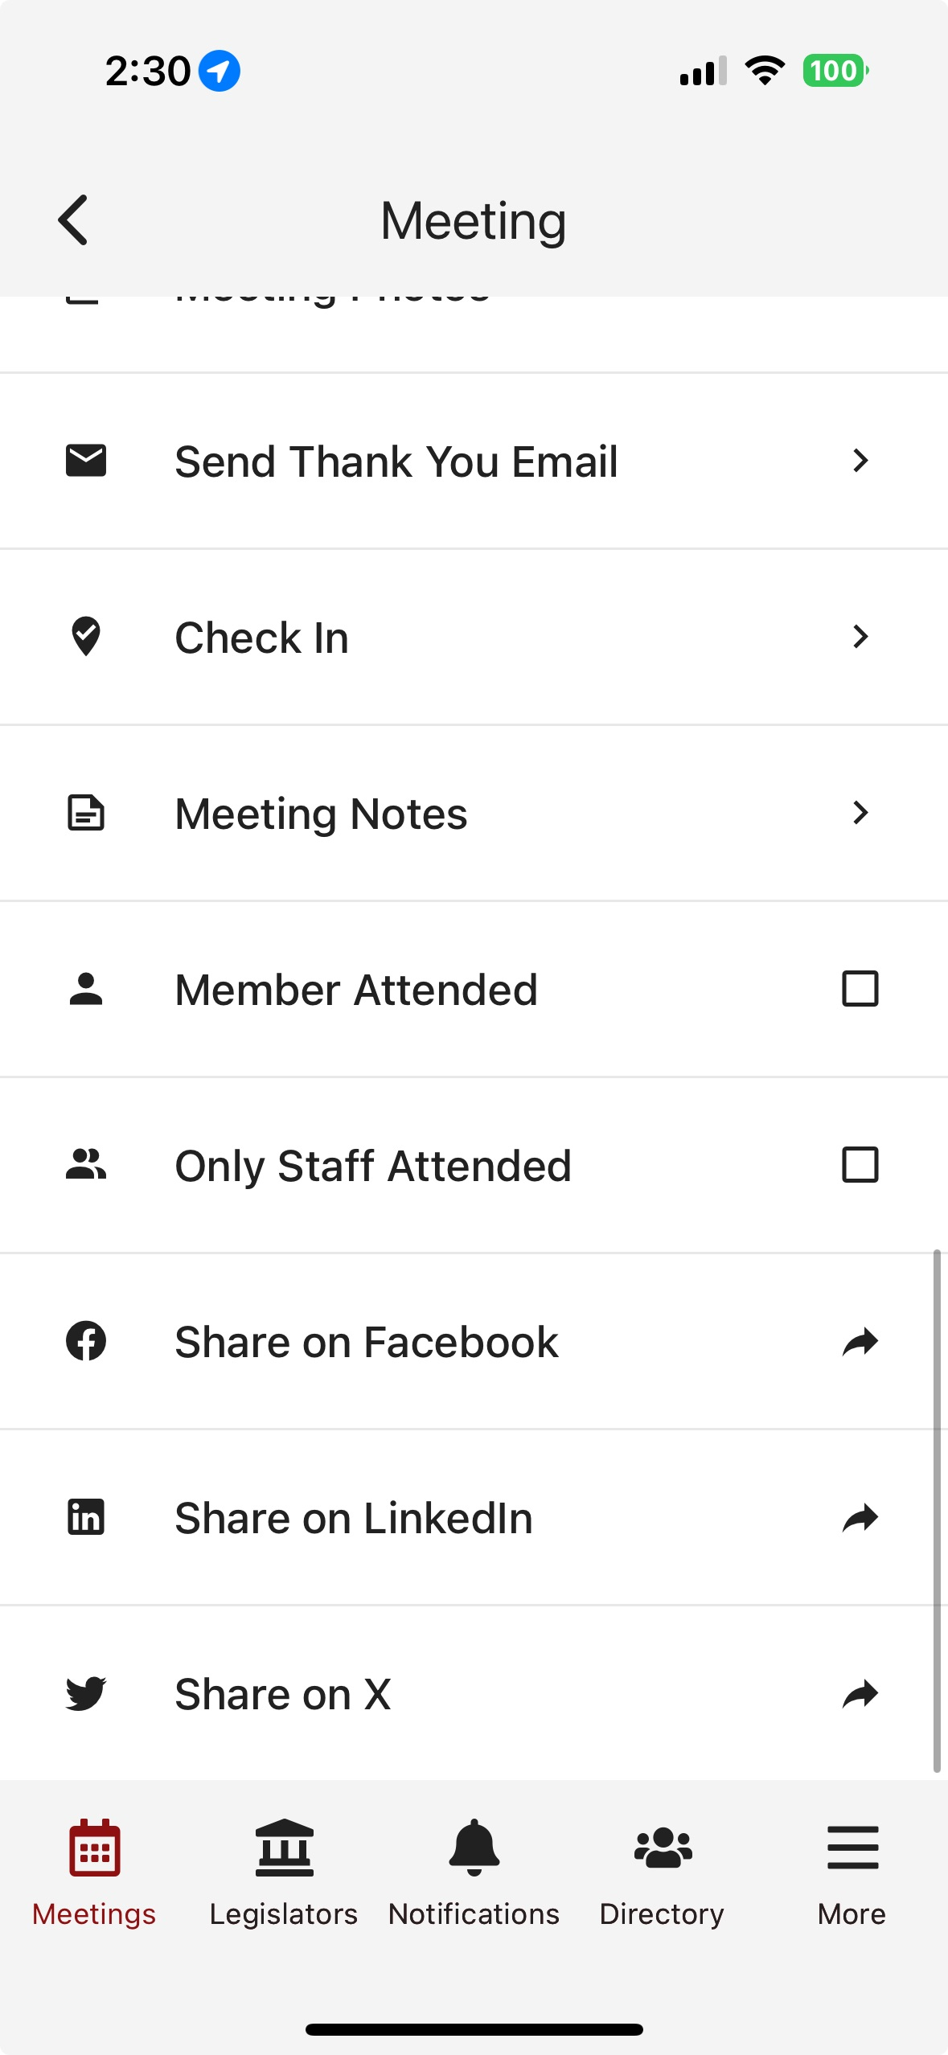
Coordinate with Other Advocates
Take meeting notes
Notes:
Micah

Slide 57
Coordinate with Other Advocates
Take meeting notes
Confirm who attended – remember, marathon, not sprint
Share your photos!
Notes:
Micah

Slide 58
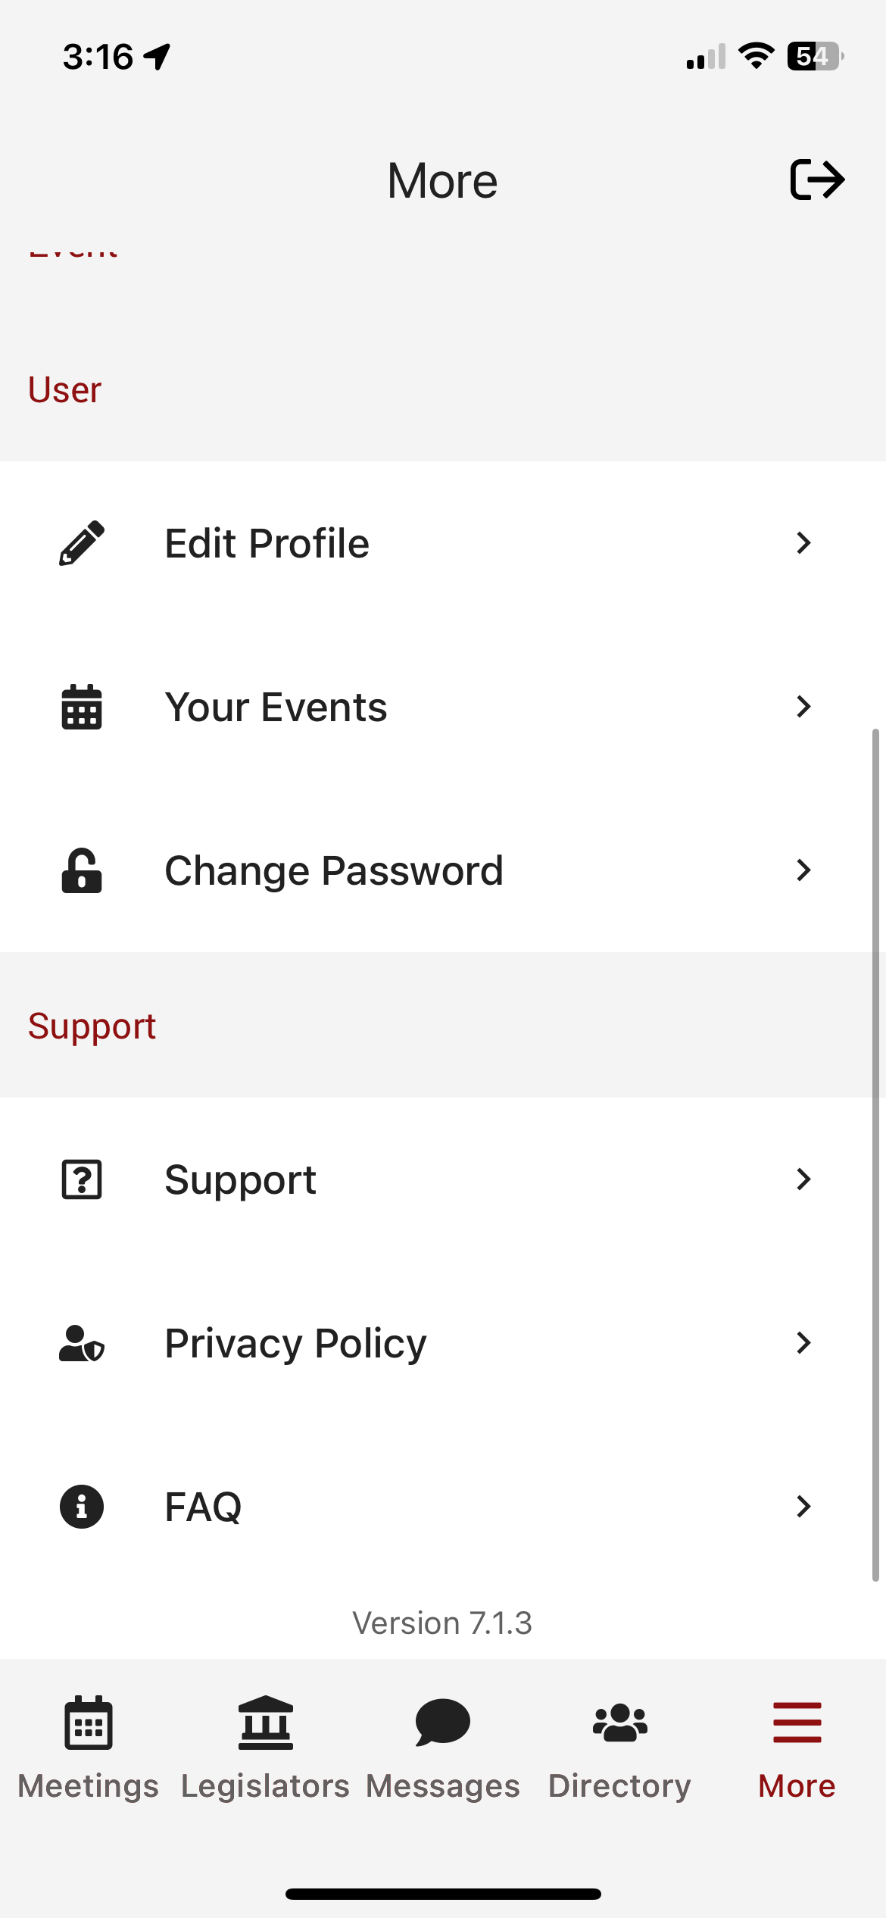
Need Help?
On-call support person
Email policy@ndsccenter.org or reach out to Heather, Jawanda, or Kim
Be ready to adapt!
Notes:
Micah

Slide 59
Final Reminders for Tomorrow
There is no wrap-up at the end of the day. Leave when you’re done with meetings. Don’t forget your luggage!
Lunch and dinner are on your own.
Coordinate your thank you notes and social posts
Treat yourself – You deserve it!
Notes:
Micah

Slide 60
Final Reminders for Today
There is no wrap-up at the end of the day. Just leave when you're ready to leave (and get an early night’s rest).
Dinner on your own.
After huddles: evening reception: 5:30 – 6:30pm.
Notes:
Micah

Slide 61


You’re Invited!
Evening Reception
Blue Terrace
5:30 PM - 6:30 PM
Dinner: On your own

Slide 62
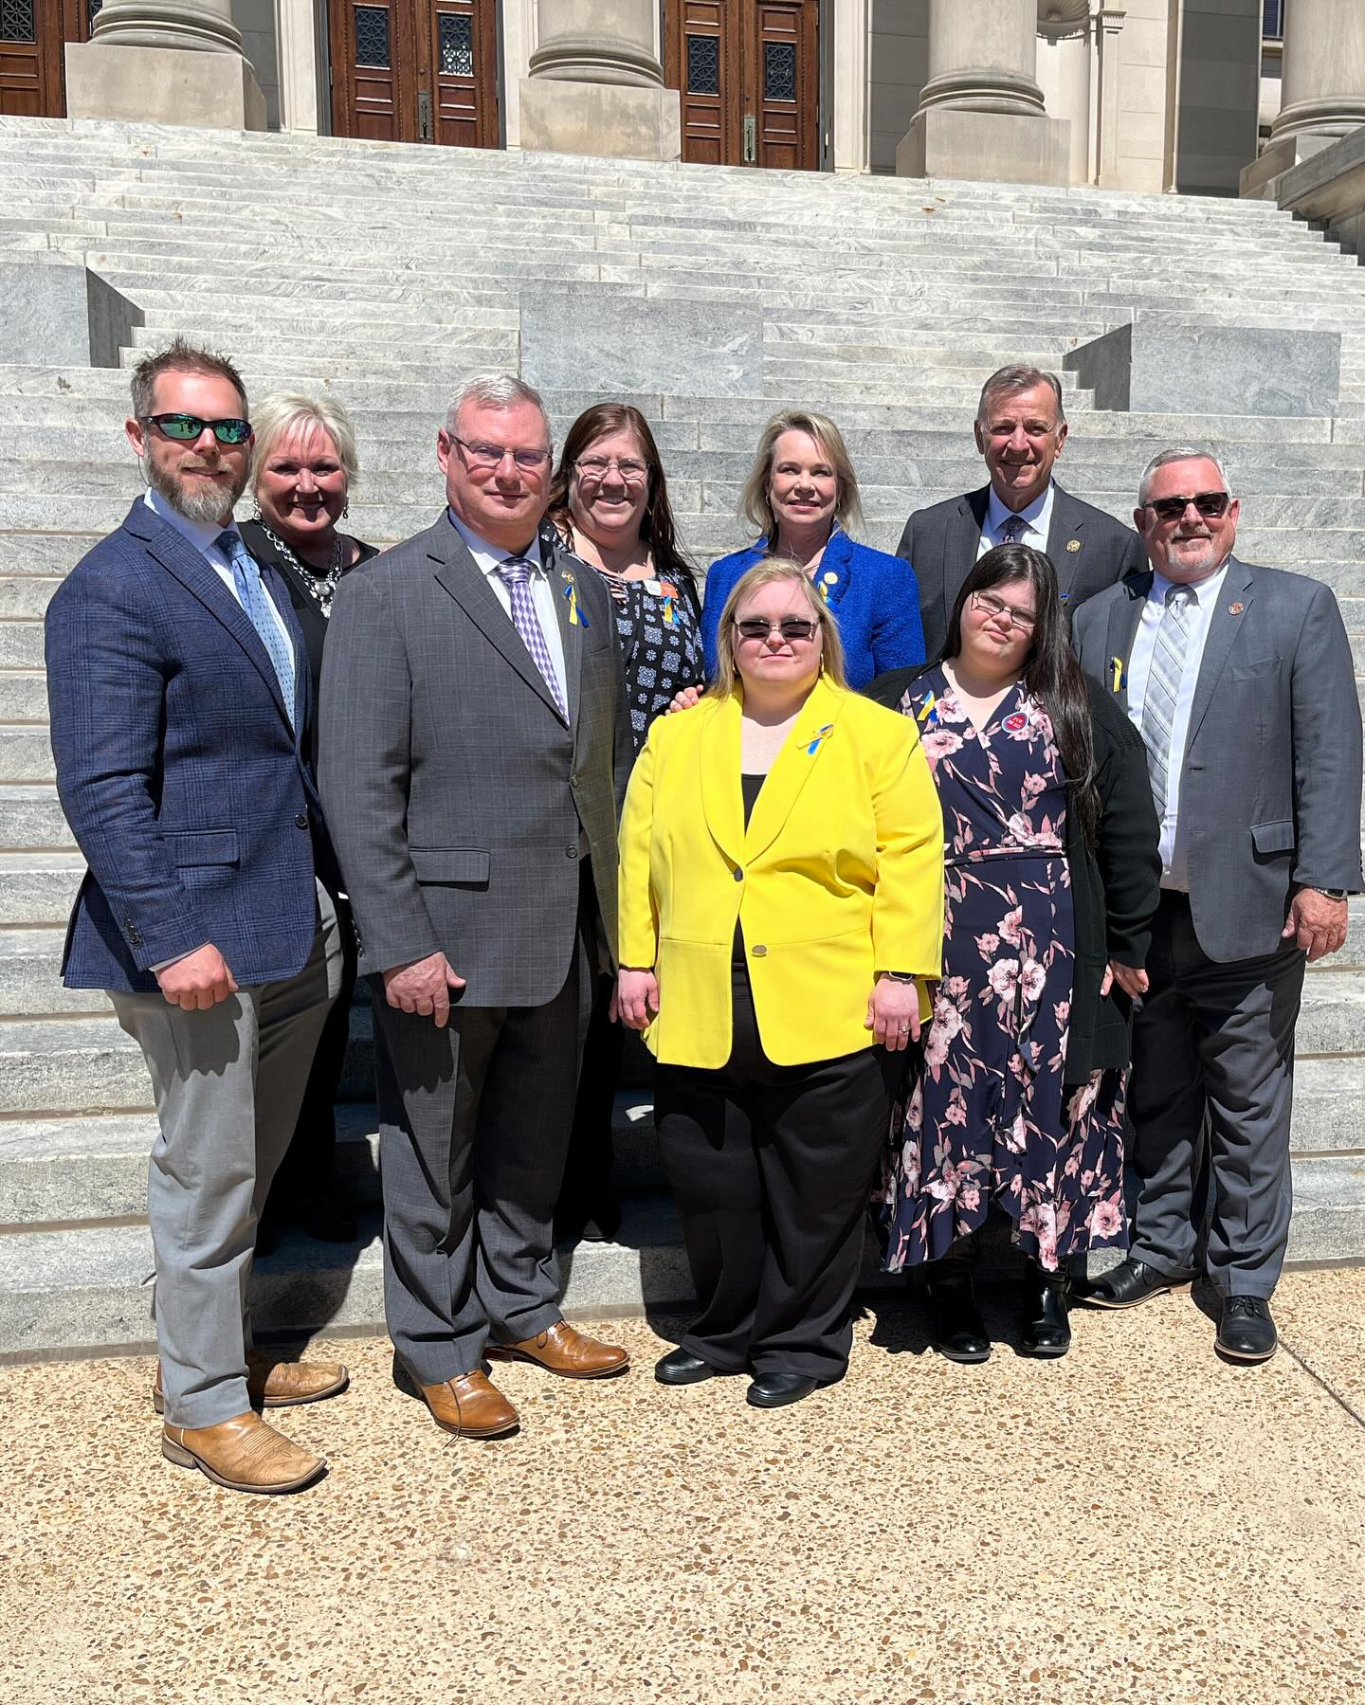
Team Planning Huddles
Team information available on tables
4:00 PM - 4:45 PM
Notes:
Teams can leave when they are finished or even earlier!

Slide 63

Thank You!
Notes:
Micah

