Slide 1



Modernizing SSI: Asset Limits, Income Limits, and Policy Reform
Rebecca D. Vallas
Chief Executive Officer, National Academy of Social Insurance (NASI)
Heather Hancock-Blackburn
Administrative Assistant in Special Education Services, Oklahoma State Department of Education

Slide 2

Outdated SSI Rules
Have Real-Life Consequences
Heather Blackburn’s story of employment, savings, independence — and love
“For me, this isn’t just policy. It affects my life and my future.”

Slide 3

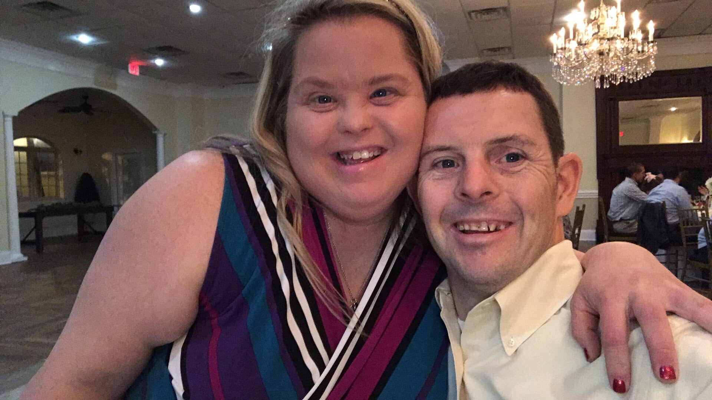
Meet Heather & Craig
A 10-year commitment separated by hundreds of miles
• Heather and Craig both have Down syndrome.
• They have considered themselves married and committed to one another as husband and wife for 10 years.
• Heather lives in Oklahoma. Craig lives in New Orleans.
• They want what other couples want: to share a home, daily life, responsibilities and a future together.
Heather Blackburn | SSI Modernization & Marriage Penalty

Slide 4
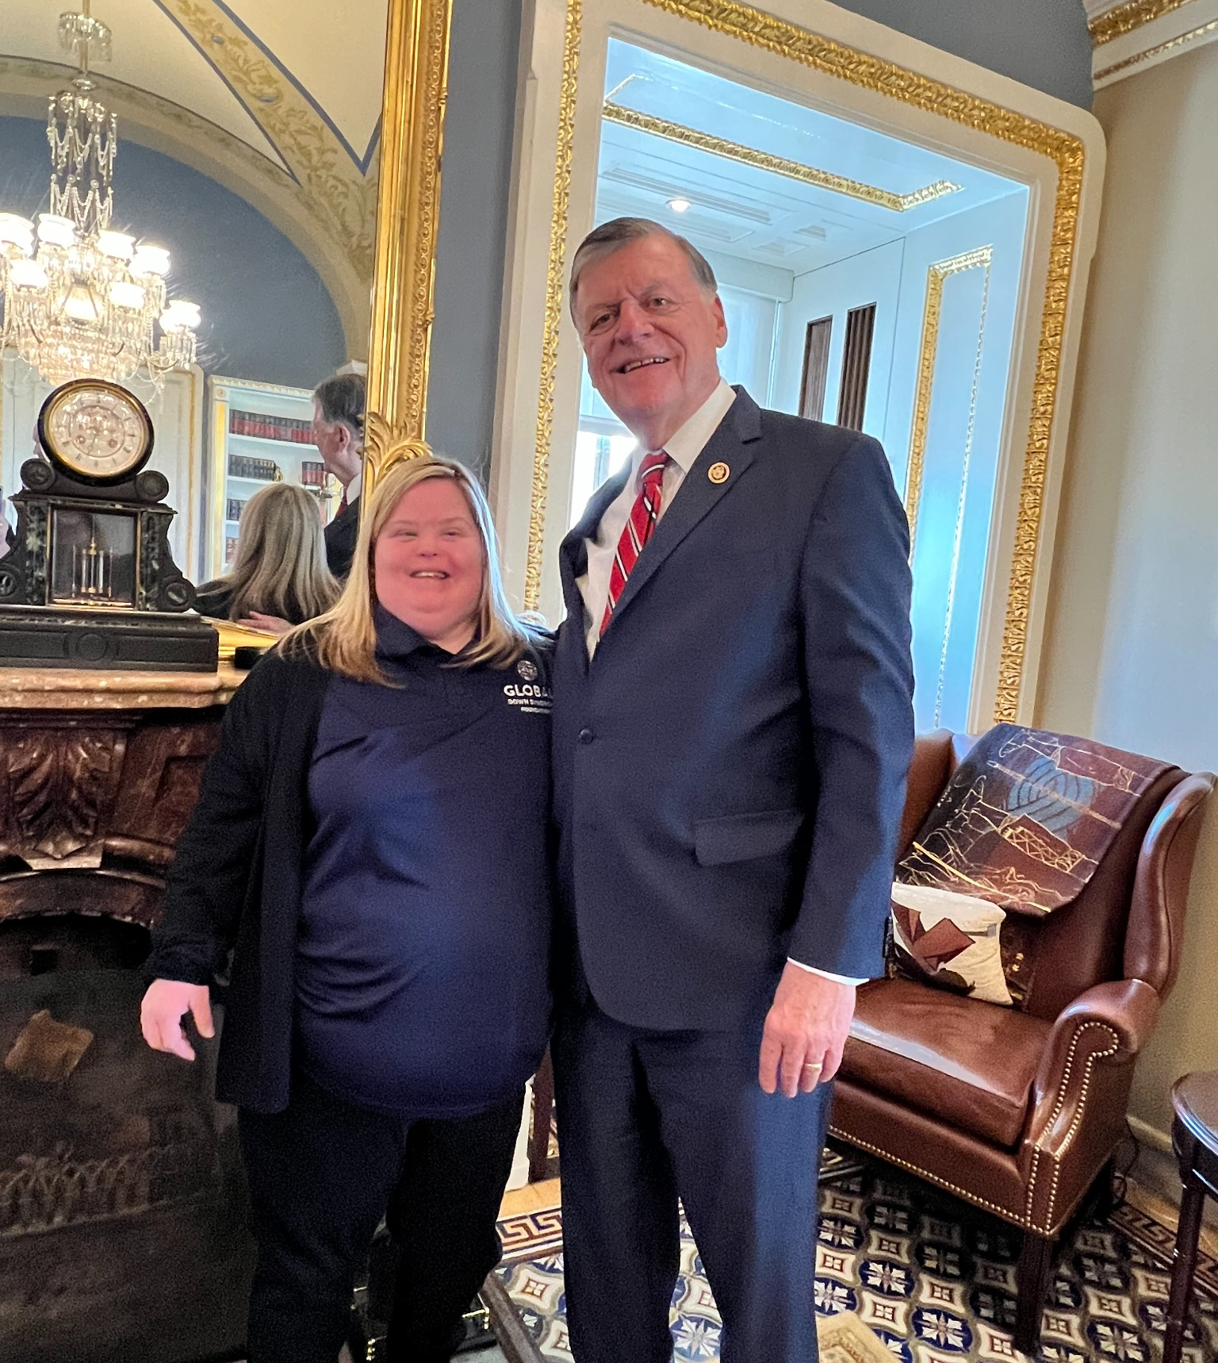
SSI Rules Discourage Financial Independence
$2,000
$3,000
Individual
asset limit
Couple
asset limit
• People with disabilities are encouraged to work, save and become more independent — but SSI rules can penalize them for doing exactly that.
• Saving for transportation costs, housing, emergencies or the future can become a benefits concern.
Current SSI resource limits: $2,000 individual / $3,000 couple

Slide 5

The Marriage Penalty Is Personal
• For most couples, marriage is a decision about love and building a life together.
• For Heather and Craig, it also means calculating what could happen to the benefits and financial support they depend on.
• Two people with disabilities can face reduced SSI support and a lower combined asset limit when treated as a married couple.
• That can make living together financially harder than remaining apart.
“I shouldn’t have to choose between the person I love and the financial support I need.”
Heather Blackburn | SSI Modernization & Marriage Penalty

Slide 6
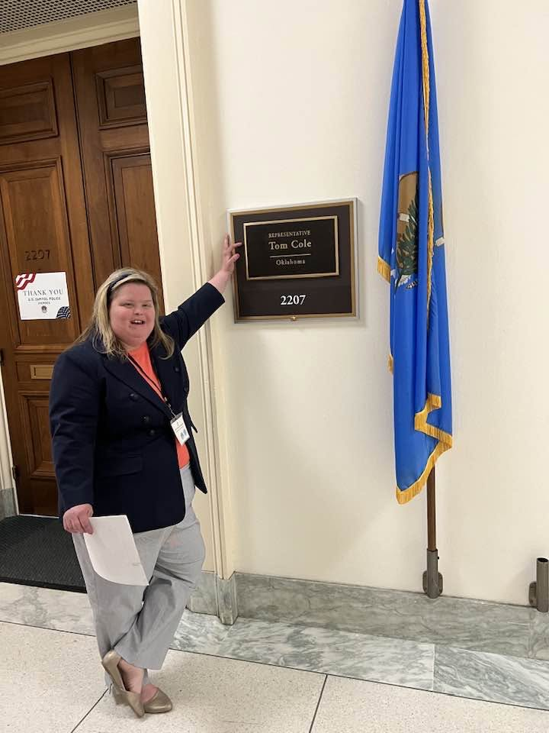
What Independence Should Mean
• The opportunity to work without being afraid of success.
• The ability to save for emergencies, housing, transportation and the future.
• The freedom to make adult decisions and build greater financial security.
• The same opportunity to fall in love, marry and live with your spouse as anyone else.
Heather Blackburn | SSI Modernization & Marriage Penalty

Slide 7

Modernize SSI. End the Marriage Penalty.
• Update outdated SSI rules so they support employment, savings and independence.
• Stop forcing people with disabilities to choose between essential financial security and marriage.
• See the people behind the policy — people like Heather and Craig.
OUR ASK:
  Please support the SSI Savings Penalty Elimination Act (S. 1234/H.R. 2540).
WHY?
  This bill would let people with disabilities save more money without losing SSI. It would also update the savings limits each year and make the rules fairer for married couples. People with Down syndrome should be able to save for emergencies, housing, and their future.

Slide 8

“People with Down syndrome deserve the opportunity to build our own lives.
And for me, that life includes Craig.”

Slide 9


September 2026
It’s Time to Update
Supplemental Security Income
Rebecca Vallas
National Academy of Social Insurance

Slide 10




Who We Are
The National Academy of Social Insurance is a nonprofit, nonpartisan policy shop and organizing hub made up of the nation’s leading experts on social insurance. We seek to increase public understanding of how social insurance contributes to economic security.

Slide 11
SSI’s Rules Haven't Kept Up
SSI provides income support to people with disabilities and older adults with limited income and resources.
Many SSI rules were created decades ago and have not been updated to reflect today's economy.
Outdated policies can make it harder for people with disabilities to work, save, marry, and build financial security.

Slide 12
SSI vs. Social Security Disability Insurance (SSDI)
SSI | SSDI
Need-based program | Insurance program
Based on financial need | Based on work history
Strict income & asset limits | No asset limits
Usually linked to Medicaid | Usually linked to Medicare after waiting period
Benefits generally lower | Benefits based on earnings history

Slide 13
SSI, Medicaid, & Home and Community-Based Services
SSI eligibility frequently provides access to:
  Health care through Medicaid
  Long-Term Services and Supports
  Home and Community-Based Services (HCBS)
    Personal care attendants
    Day and community services
Notes:
“For many, SSI is about more than the monthly check – it’s about access to services that support independence and community living.”

Slide 14
SSI’s Rules Are Hard to Understand and Hard to Follow
Recipients may need to report:
  Income
  Financial resources
  Living arrangements
  Changes in work or work hours
  Marital status

Slide 15
SSI’s Rules Are Hard to Understand and Hard to Follow
Consequences:
  Administrative burden on individuals and families.
  Risk of overpayments, repaid through smaller future benefits.
  Stress and uncertainty.
  Time spent on accessing benefits, rather than pursuing education, employment, or engagement with the community.

Slide 16
Overall…
SSI Modernization Is Urgently Needed
Notes:
4 Teams:
Build awareness → Social Media
Create a Letter Campaign
Start a Petition
Talk to your legislators

Slide 17
Let’s Discuss!
Legislative Priorities
Notes:
4 Teams:
Build awareness → Social Media
Create a Letter Campaign
Start a Petition
Talk to your legislators

Slide 18
SSI Savings Penalty Elimination Act
Raises outdated asset limits
  For individuals: $2,000 → $10,000
  For couples: $3,000 → $20,000
Eliminates the marriage penalty
New asset limits grow over time (following inflation)
Encourages saving and financial independence
Bipartisan support in Congress

Slide 19
Why Aren’t We Addressing Income Limits?
SSI benefits are reduced if you earn income above:
  $65 for income earned from work
  $20 for income from other sources (like Social Security benefits)
These limits were set in 1972 and have not been adjusted since
Above these limits, benefits are reduced by 50¢ for every $1 earned
Notes:
The federal benefit rate takes an individual to just 75% of the federal poverty line. Several proposals, including the SSI Restoration Act, would boost SSI’s federal benefit rate to ensure SSI provides enough to at least protect its beneficiaries from living below the austere federal poverty line. Such a reform would restore President Nixon’s original intent in signing SSI into law of ensuring older and disabled people do not have to “subsist on below-poverty-level incomes.” And as Congress considers options for Social Security solvency, it would also alleviate pressure on the trust funds.

Slide 20
Why Aren’t We Addressing Income Limits?
Why are SSI’s rules discouraging work, when ideally the program would encourage work?
Updating the income rules would allow beneficiaries to work modestly without losing their SSI benefits.
Notes:
The federal benefit rate takes an individual to just 75% of the federal poverty line. Several proposals, including the SSI Restoration Act, would boost SSI’s federal benefit rate to ensure SSI provides enough to at least protect its beneficiaries from living below the austere federal poverty line. Such a reform would restore President Nixon’s original intent in signing SSI into law of ensuring older and disabled people do not have to “subsist on below-poverty-level incomes.” And as Congress considers options for Social Security solvency, it would also alleviate pressure on the trust funds.

Slide 21
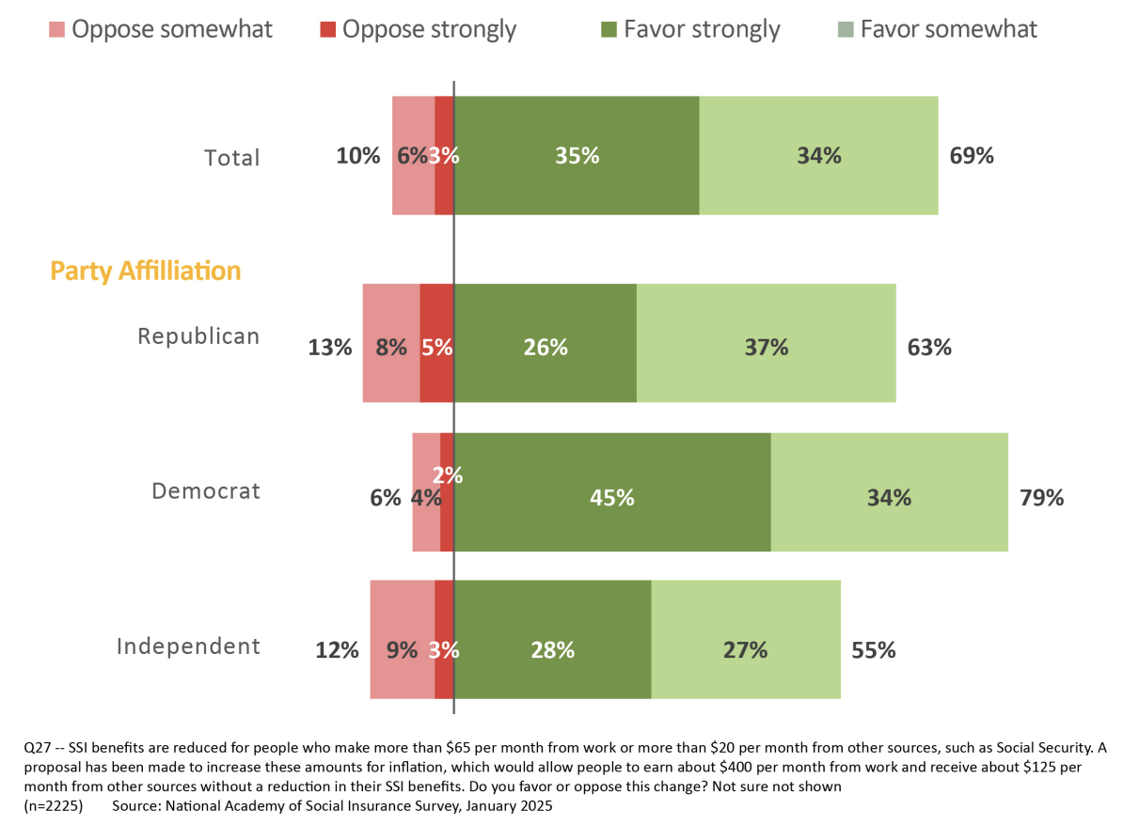
Americans’ Views on Updating Income Rules

Slide 22
Other Fixes
Raise SSI benefit levels
  Maximum SSI benefit = 75% of the Federal Poverty Level (just $994 per month)
Fix SSI’s other marriage penalties
  Benefits are reduced for a married couple vs. two unmarried adults
Notes:
The federal benefit rate takes an individual to just 75% of the federal poverty line. Several proposals, including the SSI Restoration Act, would boost SSI’s federal benefit rate to ensure SSI provides enough to at least protect its beneficiaries from living below the outdated federal poverty line.
Such a reform would restore President Nixon’s original intent in signing SSI into law of ensuring older and disabled people do not have to “subsist on below-poverty-level incomes.”

Slide 23
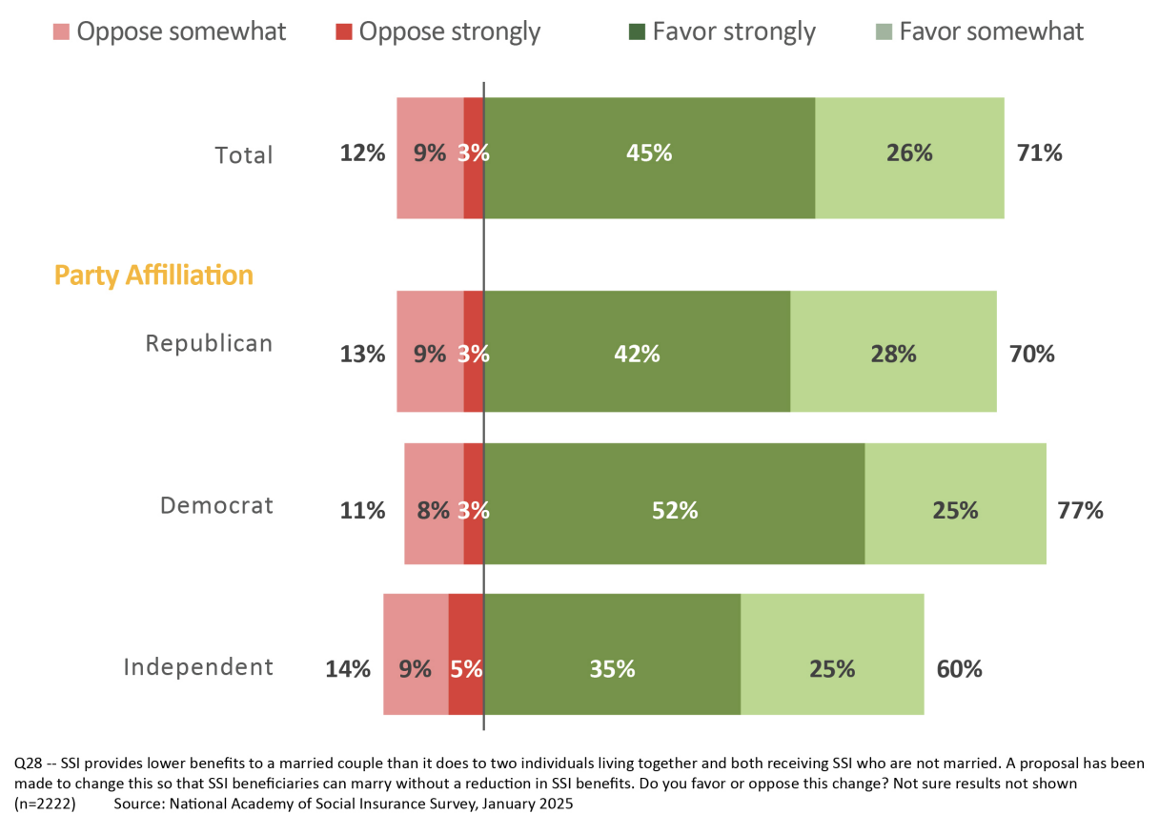
Americans’ Views on Eliminating Marriage Penalties

Slide 24
SSI Restoration Act
This bill would:
  Raise asset limits
  Eliminate the marriage penalty
  Update the income rules
  Increase SSI benefits across the board
  Bring in U.S. territories
Notes:
The federal benefit rate takes an individual to just 75% of the federal poverty line. Several proposals, including the SSI Restoration Act, would boost SSI’s federal benefit rate to ensure SSI provides enough to at least protect its beneficiaries from living below the outdated federal poverty line.
Such a reform would restore President Nixon’s original intent in signing SSI into law of ensuring older and disabled people do not have to “subsist on below-poverty-level incomes.”

Slide 25
How Can You Make a Difference?
Share Your Story
Educate Your Members of Congress
Partner With Advocacy Organizations
Notes:
Share Your Story
Explain how SSI rules affect daily life.
Describe challenges caused by asset limits, work disincentives, marriage penalties, or reporting requirements.
Engage your MoC
Schedule meetings with district and state offices.
Attend town halls and community events.
Use Grassroots Advocacy
Call congressional offices.
Send emails and letters.
Partner w/ Advocacy Orgs
Join disability advocacy networks.
Work with national, state, and local organizations.

