Slide 1




Understanding SSI: Saving, Working, and Keeping Benefits
Kathleen Romig
Senior Fellow, Center on Budget and Policy Priorities (CBPP)
Opal Foster
President, Parents of Children with Down syndrome (PODS) or Prince George’s County MD
Jeremiah Foster
“Chef Jeremiah”

Slide 2
Understanding SSI:
Saving, Working and
Keeping Benefits
Kathleen Romig – Senior Fellow, Center on Budget
and Policy Priorities (CBPP)
Jeremiah Foster – Self-Advocate, Maryland
Opal Foster – President, PODS of PGC
Parents of Children with Down Syndrome of
Prince George’s County, Maryland

Slide 3

The Big Ask
Please cosponsor and support the SSI Savings Penalty Elimination Act (S. 1234/H.R. 2540)
to raise SSI's asset limits to $10,000/$20,000 and permanently index them to inflation.
Notes:
Stephanie kick us off!

Slide 4
Why?
Let people with disabilities WORK, SAVE & BUILD
A FUTURE.
Notes:
Stephanie kick us off!

Slide 5


My Name is Jeremiah Foster
AKA “Chef Jeremiah”
  I want to be a chef one day
  I love cooking
  I am part of the CCC Program
  I love bowling, music and art
  I enjoy hanging out with my friends
Notes:
Heather

Slide 6
My Name is Jeremiah Foster
AKA “Chef Jeremiah”
I’m a part of :
  Best Buddies
  Camp PALS
  Camp Accomplish
  KEEN Kids
  PODS of PGC
  DSNMC
  and other organizations
Notes:
Heather

Slide 7
My name is Jeremiah Foster.
AKA “Chef Jeremiah”
I receive $667 in SSI each month.
That money helps me:
  Contribute to my family’s mortgage
  Help with our food budget
  Build savings for my future in my MD ABLE Account
Notes:
Heather

Slide 8
But saving can create a problem.
  Today, SSI’s federal resource limit is only $2,000 for an individual — a limit that has remained unchanged since 1989.
  I have an MD ABLE account, where I am currently setting aside $100 each month.
Notes:
Heather

Slide 9
WHY IT MATTERS
I want to work.
I want to contribute.
I want to save.
I want to build my future.
Saving for my future should not
put my SSI at risk.
Notes:
Stephanie kick us off!

Slide 10

LET ME SAVE FOR MY FUTURE.
I’m not asking for a handout.
I’m asking for a chance to build a life.
My name is Jeremiah Foster.
AKA “Chef Jeremiah.”
WHY IT MATTERS
Notes:
Stephanie kick us off!

Slide 11
“I want to save for my future.
I shouldn't have to choose between saving money and keeping the support I need.”
WHY IT MATTERS
Notes:
Stephanie kick us off!

Slide 12
Chef Jeremiah on Social Media
YouTube Channel:
@opalfoster6021
TikTok:
@opalfoster395
WHY IT MATTERS
Notes:
Stephanie kick us off!

Slide 13

My Name is Opal Foster
(Proud Mom of Chef Jeremiah)
  Presidents of PODS of Prince George’s County, MD
  Parent-Advocate
  Part time Educator
  Freelancer Graphic Designer
  Involved in DSNMC and other organizations in the DS Community
Notes:
Heather

Slide 14
My Name is Opal Foster
(Proud Mom of Chef Jeremiah)
  Jeremiah’s (PSP) Personal Supports Provider
  I use this income to pay our mortgage, utilities, food, travel to Jeremiah’s activities and other expenses
Notes:
Heather

Slide 15

About me
25 years working on Social Security
Worked at Social Security Administration HQ
Mom of two sons

Slide 16
Background on SSI and Social Security for People with Down Syndrome

Slide 17
What is SSI & who qualifies?
Supplemental Security Income (SSI) provides monthly cash assistance to disabled or older people who have little income and few assets.
SSI helps people of all ages:
    Children with disabilities (only federal income support program for kids)
    Adults with disabilities
    Older people (65+)
SSI is for people with little to no income or savings

Slide 18
SSI is important for people with Down Syndrome
Income support
  Up to $994/month plus possible state supplement
  People with IDD, including Down Syndrome, make up more than half of SSI kids and more than a quarter of SSI adults
Pathway to Medicaid
  In most states, SSI beneficiaries are automatically eligible for Medicaid.
  Some children who don’t meet SSI’s financial criteria can get Medicaid with a disability determination from SSA (e.g., Katie Beckett waiver)
  Medicaid supports home- and community-based services, such as personal and attendant care services.
  Medicaid also covers wheelchairs, lifts, and supportive housing services.

Slide 19
Social Security provides benefits to adults with Down Syndrome, too
Social Security Disability Insurance (SSDI)
  Provides disabled worker benefits for adults with disabilities.
  Eligibility is based on past work: Must have had at least 10 years of work (fewer for younger applicants).
Children of Social Security beneficiaries can also get benefits if they are disabled adults (or minors).
  They can qualify if their parents are retired, deceased, or disabled.
  Called “childhood disability benefits” or “disabled adult child” benefits.

Slide 20
Social Security Disability Insurance (SSDI) & SSI: Similarities
The same medical eligibility rules: Must have serious physical/mental health condition, expected to last over a year or result in death
The same work eligibility rules: Cannot earn more than $1,690 per month
A similar process for applying: Contact SSA, fill out application, provide medical records
Similar (long!) wait times for a decision: Over 6 months for initial decision, typically at least another year for an appeal
Some people receive both SSDI & SSI

Slide 21
How SSI Affects Choices About Saving and Working

Slide 22
SSI has very low limits on savings
SSI has very low limits on savings: up to $2,000 for individuals or $3,000 for couples/married parents, including savings, checking, investments, retirement, etc.
The savings and income of parents and spouses count, too: For minor children and married people, SSA counts their resources against the limits. Once a child turns 18, they stop. Many families apply at age 18.

Slide 23
SSI has low limits on income, too
SSI has low limits on income:
The exact amount varies, but typically a person cannot earn more than about $2,000 per month at maximum.
most beneficiaries have little to no other income.
A small amount of income is exempted:
The first $65 of earnings, and half after that
The first $20 of other income (including Social Security)

Slide 24
How work affects SSI benefits
SSI benefits are reduced if you earn more than $65 per month. After that, benefits are reduced by 50 cents for every dollar you earn until you lose eligibility.
SSDI beneficiaries face an earnings “cliff”: If they earn more than $1,690 per month, they lose eligibility.
It’s important to report any changes in earnings promptly. Otherwise your benefit amount will be wrong, and you might lose your benefits or owe SSA money.
Overpayments are very common for working disability beneficiaries. Waivers and payment plans are available if you ask.

Slide 25
SSI has complex rules for marriage & living, too
In SSI, your spouse’s income and resources count against you
SSI recipients who marry each other face penalties: lower benefits and lower savings limits.
Disabled people who marry can’t get Social Security “childhood disability benefits” (CDB) if their parents die, become disabled, or retire.
SSI beneficiaries who receive support with shelter (including living with parents) face complex rules, which can reduce their benefits by 1/3. Often drafting a rental agreement can help.

Slide 26
Tips for SSI/Social Security Beneficiaries

Slide 27
Tips for accessing SSA service
Set up a mySocialSecurity account online and use it when possible. Waits for phone and in-person service can be long.
If you call, do it early in the day and later in the week/month, when wait times are shortest. Lines open at 8 am.
Book an appointment. Call ahead to make an in-person and telephone appointment. Do it early because the wait is often a month or two.
Seek help from an attorney or representative for disability appeals and navigating complex rules. Free assistance is available.

Slide 28
Tips for saving more on SSI
Open an ABLE account:
Up to $100,000 is exempt from SSI and Medicaid savings limits
Can be spent on: Housing, food, transportation, education, health care, employment support, assistive technology, and more
Tax-advantaged
Can be rolled over from 529 college savings accounts
Set up a Special Needs Trust
Exempt from SSI and Medicaid savings limits
Spending more restrictive (e.g., cannot be used for housing and food)
Many variations (individual or pooled, first-party or third-party, for estate planning or during life)
Should arrange with a lawyer

Slide 29
Tips for protecting benefits
Set up a rental agreement. If an SSI recipient lives with family or others rent-free or below standard costs, SSA reduces their benefits by up to 1/3. Setting up a formal agreement to pay rent can avoid these cuts. A lawyer can help.
Consider SNAP benefits to help pay for groceries. If a person meets income and resource requirements, they qualify for SNAP. And if a person purchases and prepares food separately from their roommates or family members, only their own income counts. Work requirements don’t apply to disability beneficiaries.

Slide 30
Advocacy Opportunity:
Raise SSI Savings Limits

Slide 31
The SSI Savings Penalty Elimination Act
Would update savings limits for SSI:
Raise them to $10,000 (or $20,000 for a couple)
Index to inflation
Eliminate marriage penalty in limit
Would make a real difference:
Can save more for living expenses, emergencies, future needs
More people would qualify; fewer would be suspended/terminated; fewer overpayments
Bipartisan bill with a real chance:
Led by outgoing Senator Bill Cassidy (R-LA), pushing to pass by year’s end

Slide 32

Thank You
Kathleen Romig
kromig@cbpp.org
www.cbpp.org
202.408.1080

Slide 33

Mini
Break
3:15 –
3:20
Snacks available until 3:20

Slide 34

Preparing for Capitol Hill:
Logistics and Expectations
Micah Rothkopf
NDSC Policy & Advocacy Associate

Slide 35



Preparing for Capitol Hill
Logistics and Expectations
Micah Rothkopf
NDSC Policy & Advocacy Associate

Slide 36
Session Agenda: Your Day on the Hill
Congressional Breakfast Reception: 8:00 – 9:30 AM
Navigating the Hill
Lunch
Packing Reminders
Team Captains
Hill Meetings
The App
Need Help?
Notes:
Emphasize that we need people at the breakfast and that it’s a really amazing opportunity to be feet from a an elected member of congress and talk directly with staff who are the engines behind policymaking

Slide 37
Glossary of “Hill” Terms
Term
Definition
The Hill /
Capitol Hill
The area around the U.S. Capitol where Congress & offices are located
Member
An elected member of Congress: either a Senator or Representative
Staffer /
Hill Staffer
A person who works for a Member of Congress
Sponsor
A Member who introduces a bill
Co-sponsor
A Member who formally supports an introduced bill
Bipartisan
Supported by Members of both political parties (Democrat & Republican)
Constituent
A person who lives in the area represented by a specific Member of Congress
Notes:
Micah

Slide 38

You’re
Invited!
Congressional Breakfast Reception
Sponsored by: Microsoft
Kennedy Caucus Room, SR-325
8:00 AM - 9:30 AM
Directions on your agenda
Notes:
Please plan to arrive by 8:00 AM
If you have a meeting that conflicts with the breakfast, the meeting takes priority!!!

Slide 39

Getting to the Hill: Omni to Russell
Uber/Lyft
Driving
Metro
Est. Time
20-30min
35-45min
40-50min
Parking
N/A
Union Station
N/A
Destination
Constitution Ave.
Union Station
Union Station
Connect with your Team Captain to coordinate travel plans throughout the day

Slide 40
When should
you leave?
When should
you arrive?
Uber/Lyft: 7:30 AM
Driving: 7:15 AM
Metro: 7:15 AM
Uber/Lyft: 7:45 AM
Driving: 7:45 AM
Metro: 7:45 AM
6:50 AM: Meet in the front lobby to walk to the metro or drive together; staff available to help
Notes:
Leave the hotel between 7:00 - 7:15 to get to the Hill and through security in time for the congressional breakfast

Slide 41
The Cost of a Round Trip
Uber/Lyft
Driving
Metro
Approx. Cost
$22.00
$25.00 parking + gas
$5.00 – $7.00
Union Station Parking Address:
30 Massachusetts Ave, NE, Washington, D.C. 20002

Slide 42
Taking the Metro: how to buy a pass
Online:
Apple Wallet: Buy and load passes using the Smart Trip mobile app
Google Waller: Buy and load passes on Google Wallet directly to your virtual Smart Trip card
Smart Trip account portal: Buy and add passes directly to your existing Smart Trip card (expect up to one hour for delivery)
In Person:
At any Fare Vending Machine — located in all Metro Rail stations by the faregates:
Add to an existing Smart Trip card
Buy a pass on a new Smart Trip card (+$2 new card fee)
More information here: https://www.wmata.com/pay/smart-trip.html

Slide 43

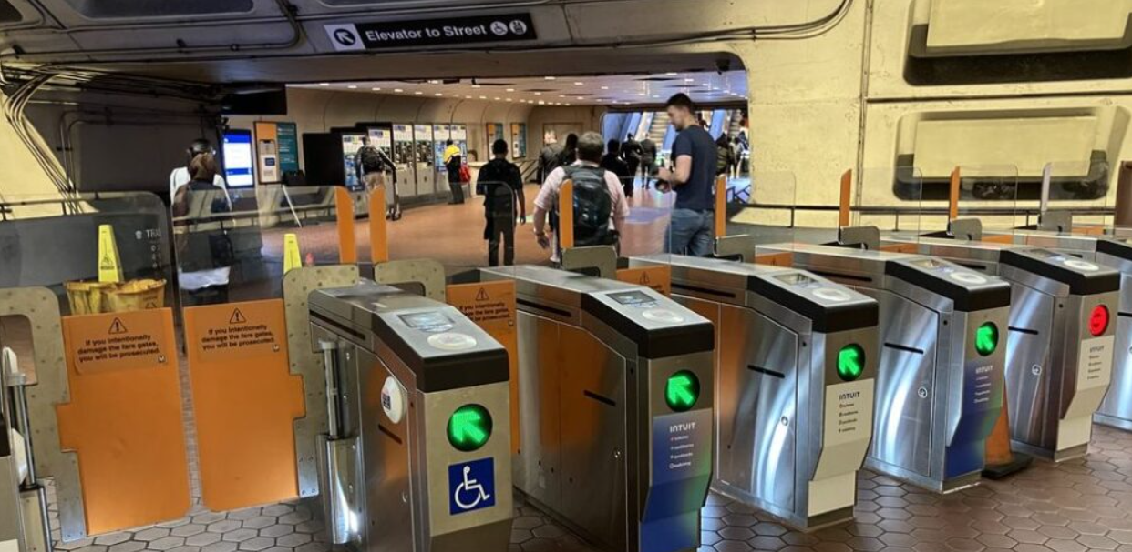
Taking the Metro: how to buy a pass

Slide 44
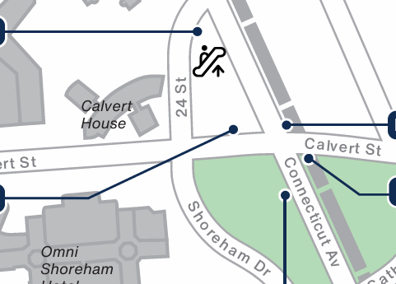
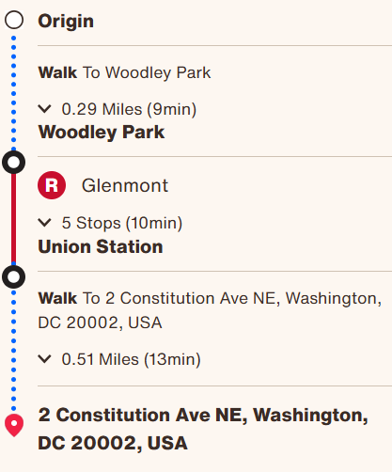
Taking the Metro

Slide 45
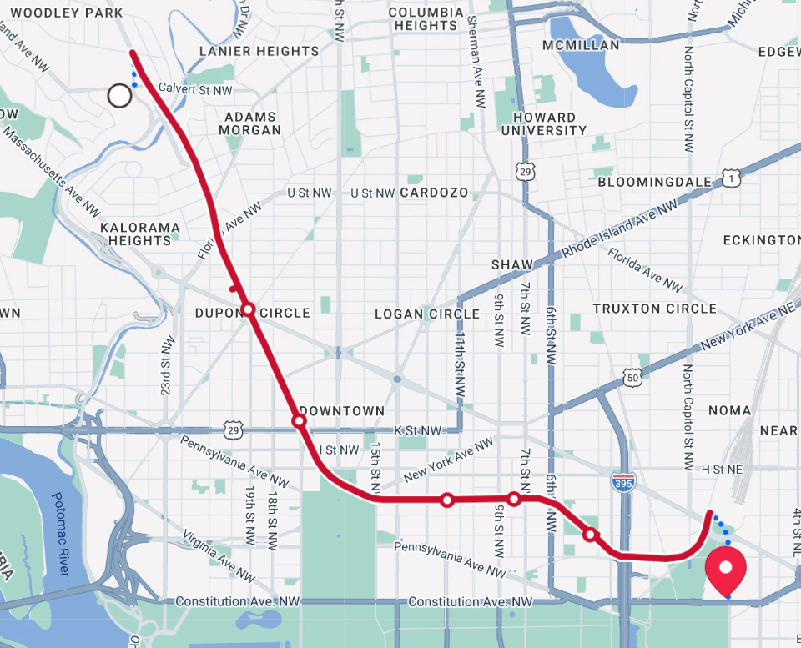
Taking the Metro

Slide 46
Taking the Metro
Towards Hotel
You are here
Towards the Hill
Shady Grove
Woodley Park
Union Station
Glenmont

Slide 47

Taking the Metro: From Union Station
Exit the Metro
Exit Union Station
Walk out into the plaza

Slide 48
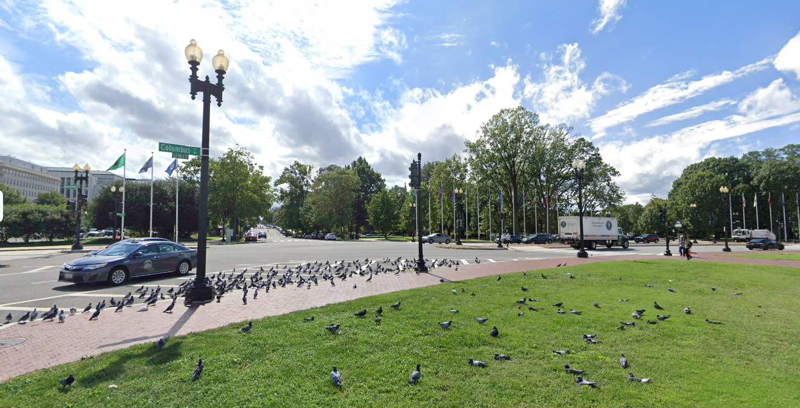
Taking the Metro: From Union Station
Exit the Metro
Exit Union Station
Walk out into the plaza
Cross the street towards First Street

Slide 49
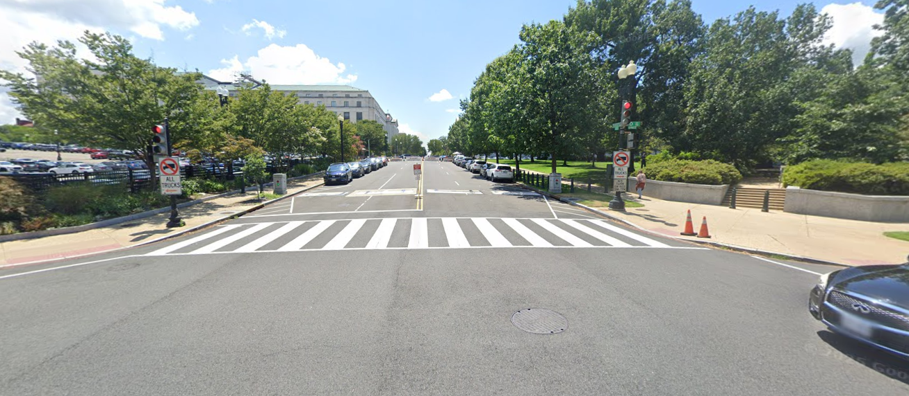
Taking the Metro: From Union Station
Exit the Metro
Exit Union Station
Walk out into the plaza
Cross the street and up First Street NE
Continue up the hill

Slide 50

Taking the Metro: From Union Station
Exit the Metro
Exit Union Station
Walk out into the plaza
Cross the street and up First Street NE
Continue up the hill
Turn on Constitution Ave. and look for “public entrance” signs into Russell

Slide 51
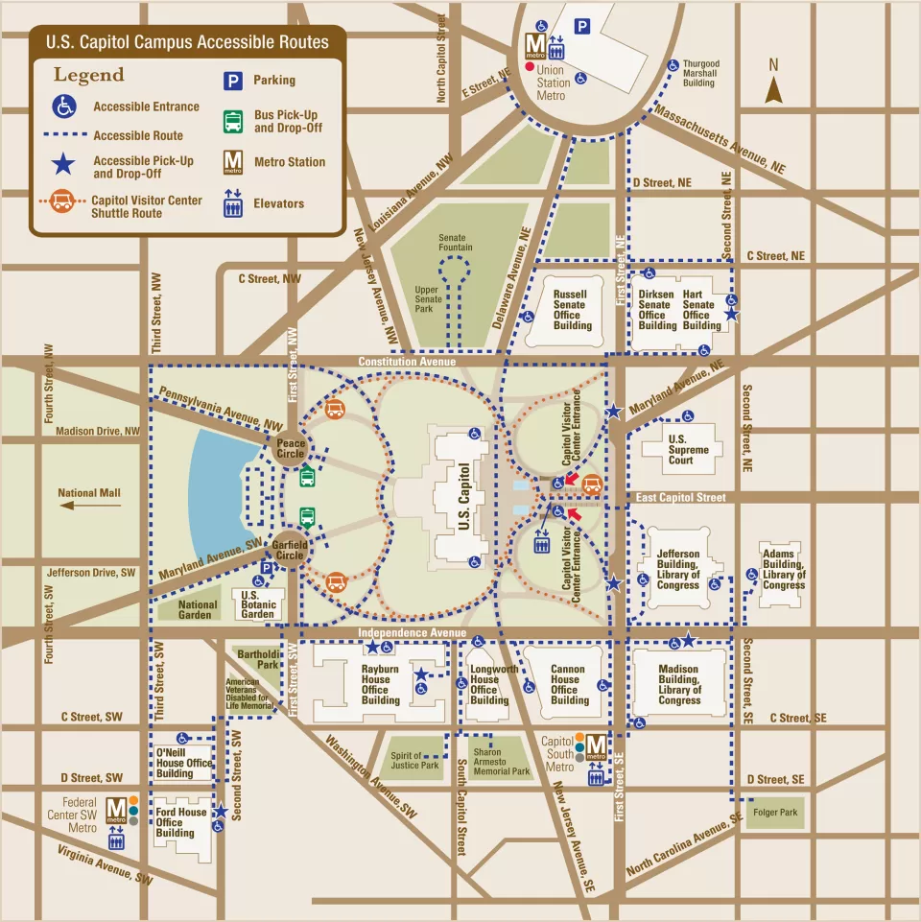
Navigating the Hill
Senate v. House side
Visitor v. Staff entrances
0.5 miles between the sides
10-20min of walking
1-2min drive
Plan for 15-30min to
get through security
Notes:
Security is just like airplane security. You’ll need to take things out of your pockets, put your bags on the conveyor belt, and walk through the metal detectors. Travel together with you group! Make sure no one is left behind!

Slide 52
Senate Side
Senate Office Buildings:
Russell Senate Office Building
Dirksen Senate Office Building
Hart Senate Office Building
Metro accessible via Union Station
Uber drop-off on Constitution Ave.
Prefixes to know:
Russell – SR
Dirksen – SD
Hart – SH
Notes:
Explain floors and prefixes. Point out that these will on the schedules

Slide 53
Senate Side
Senate Office Buildings:
Russell Senate Office Building
Dirksen Senate Office Building
Hart Senate Office Building
Metro accessible via Union Station
Uber drop-off on Constitution Ave.
Prefixes to know:
Russell – SR
Dirksen – SD
Hart – SH
Notes:
Explain floors and prefixes

Slide 54
Senate Side
Senate Office Buildings:
Russell Senate Office Building
Dirksen Senate Office Building
Hart Senate Office Building
Metro accessible via Union Station
Uber drop-off on Constitution Ave.
Prefixes to know:
Russell – SR
Dirksen – SD
Hart – SH
Notes:
Explain floors and prefixes

Slide 55
Senate Side
Senate Office Buildings:
Russell Senate Office Building
Dirksen Senate Office Building
Hart Senate Office Building
Metro accessible via Union Station
Uber drop-off on Constitution Ave.
Prefixes to know:
Russell – SR
Dirksen – SD
Hart – SH
Notes:
Explain floors and prefixes

Slide 56
Senate Side
Senate Office Buildings:
Russell Senate Office Building
Dirksen Senate Office Building
Hart Senate Office Building
Metro accessible via Union Station
Uber drop-off on Constitution Ave.
Prefixes to know:
Russell – SR
Dirksen – SD
Hart – SH
Notes:
Explain floors and prefixes

Slide 57
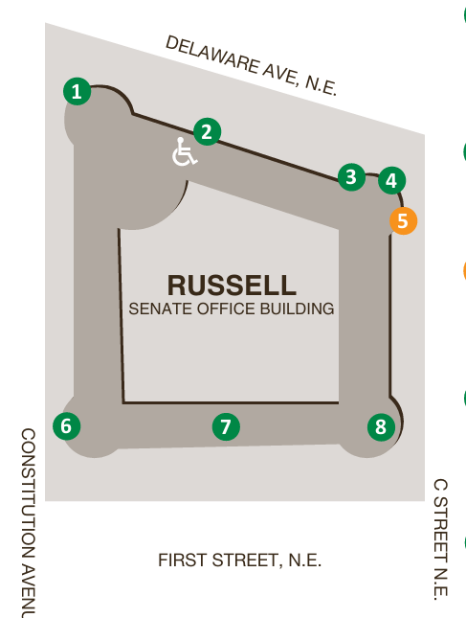
Russell Senate Office Building
Public Entrances
Staff Entrances Only
2
6
7
1
3
4
5
8
Senate Office Buildings Door Map and Hours of Operation, Effective May 2026
Notes:
Note that sometimes the entrances can be closed. You can circle the building to look for an open entrance and/or ask a guard

Slide 58
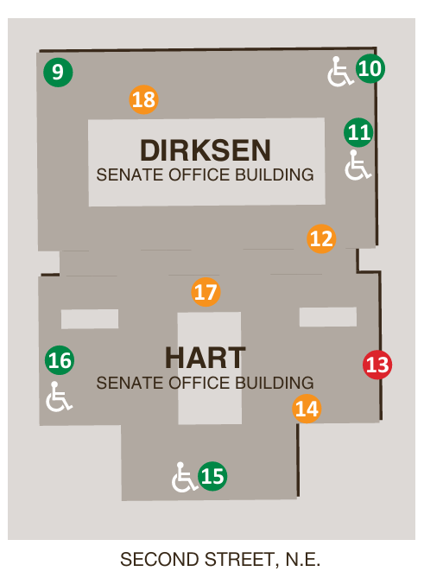
Dirksen & Hart Office Buildings
Public Entrances
Staff Entrances / Inaccessible
9
11
16
15
10
12
14
17
18
13
Senate Office Buildings Door Map and Hours of Operation, Effective May 2026
Notes:
Micah

Slide 59
House Side
House Office Buildings:
Rayburn House Office Building
Longworth House Office Building
Cannon House Office Building
Metro accessible via Capitol South
Uber drop-off on Independence Ave.
Building Numbers:
Cannon (CHOB) – 0
Longworth (LHOB) – 1
Rayburn (RHOB) – 2
Notes:
Cannon – 0
• Example: 327 CHOB is on the third floor of Cannon.
Longworth – 1
• Example: 1223 LHOB is on the second floor of Longworth.
Rayburn – 2
• Example: 2449 RHOB is on the fourth floor of Rayburn.

Slide 60
House Side
House Office Buildings:
Rayburn House Office Building
Longworth House Office Building
Cannon House Office Building
Metro accessible via Capitol South
Uber drop-off on Independence Ave.
Building Numbers:
Cannon (CHOB) – 0
Longworth (LHOB) – 1
Rayburn (RHOB) – 2
Notes:
Cannon – 0
• Example: 327 CHOB is on the third floor of Cannon.
Longworth – 1
• Example: 1223 LHOB is on the second floor of Longworth.
Rayburn – 2
• Example: 2449 RHOB is on the fourth floor of Rayburn.

Slide 61
House Side
House Office Buildings:
Rayburn House Office Building
Longworth House Office Building
Cannon House Office Building
Metro accessible via Capitol South
Uber drop-off on Independence Ave.
Building Numbers:
Cannon (CHOB) – 0
Longworth (LHOB) – 1
Rayburn (RHOB) – 2
Notes:
Cannon – 0
• Example: 327 CHOB is on the third floor of Cannon.
Longworth – 1
• Example: 1223 LHOB is on the second floor of Longworth.
Rayburn – 2
• Example: 2449 RHOB is on the fourth floor of Rayburn.

Slide 62
House Side
House Office Buildings:
Rayburn House Office Building
Longworth House Office Building
Cannon House Office Building
Metro accessible via Capitol South
Uber drop-off on Independence Ave.
Building Numbers:
Cannon (CHOB) – 0
Longworth (LHOB) – 1
Rayburn (RHOB) – 2
Notes:
Cannon – 0
• Example: 327 CHOB is on the third floor of Cannon.
Longworth – 1
• Example: 1223 LHOB is on the second floor of Longworth.
Rayburn – 2
• Example: 2449 RHOB is on the fourth floor of Rayburn.

Slide 63
House Side
House Office Buildings:
Rayburn House Office Building
Longworth House Office Building
Cannon House Office Building
Metro accessible via Capitol South
Uber drop-off on Independence Ave.
Building Numbers:
Cannon (CHOB) – 0
Longworth (LHOB) – 1
Rayburn (RHOB) – 2
Notes:
Cannon – 0
• Example: 327 CHOB is on the third floor of Cannon.
Longworth – 1
• Example: 1223 LHOB is on the second floor of Longworth.
Rayburn – 2
• Example: 2449 RHOB is on the fourth floor of Rayburn.

Slide 64
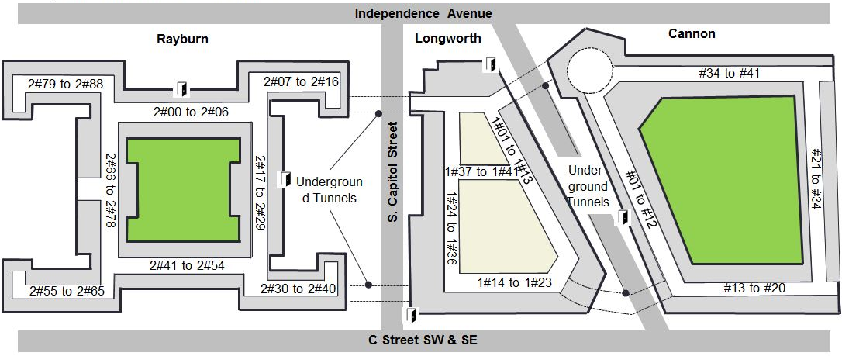
House Side
Rayburn, Longworth, and Cannon
Enter on Independence Ave.
Remember:
Always check the signs to see if it says “visitor entrance” or “staff entrance”
Remember:
You can always ask for help
Notes:
Micah

Slide 65
House Side
Rayburn, Longworth, and Cannon
Enter on Independence Ave.
Remember:
Always check the signs to see if it says “visitor entrance” or “staff entrance”
Remember:
You can always ask for help
Notes:
Micah

Slide 66
House Side
Rayburn, Longworth, and Cannon
Enter on Independence Ave.
Remember:
Always check the signs to see if it says “visitor entrance” or “staff entrance”
Remember:
You can always ask for help
Notes:
Micah

Slide 67
House Side
Rayburn, Longworth, and Cannon
Enter on Independence Ave.
Remember:
Always check the signs to see if it says “visitor entrance” or “staff entrance”
Remember:
You can always ask for help
Notes:
Micah

Slide 68
Congressional Tunnels
Between buildings
Open but can be confusing
Between Senate & House Side:
Requires an escort
Notes:
Ask a security guard if you get confused. I personally find the signage to be confusing sometimes so just ask for help

Slide 69
Congressional Tunnels
Between buildings
Open but can be confusing
Between Senate & House Side:
Requires an escort

Slide 70
Dropping Off Leave-Behinds
Have a Big Time Gap Between Meetings?
Who is Most Important?
  Stop by offices in your state with whom you don’t have a meeting.
  You can split this up.
  Team Captains have folders for the entire state.
  You’re a constituent or have a personal connection
  You’re a neighboring district or live in the same state.
  They are an influential Member (Speaker of the House, Chair of a Committee, etc.)
  Your organization serves their constituents.
Self-advocates should be given
priority to speak!

Slide 71


Where to Find Food
Food on the Senate Side
Food on the House Side
  Dirksen Cafeteria
    SDB-R7, Dirksen Basement, 7:30am – 2:30pm
  Cups & Company
    SRB-65, Russell Basement, 7:00am – 4:00pm
  Inside Scoop
    SDG-21A, Dirksen/Hart Ground Floor, 24-hours
  Longworth Cafeteria
    Longworth B223, 7:30am – 2:00pm
  Rayburn Cafeteria
    Rayburn 2063, 7:30am – 3:00pm
https://bit.ly/Dining-Options-on-Capitol-Hill
Notes:
Sometimes these places are closed or under renovation. Also say that a member of the policy team will be hanging out in a one of these places on both House and Senate side if you want to stop by between meetings with questions or just have company while eating. We will send a message on the App when we have the schedule for policy team members

Slide 72
Packing Reminders
Prohibited Items
Full list: prohibited items
Specifically noting: large bags (no bigger than personal items)
Hotel Luggage Storage
Visit concierge and store luggage at no additional cost
Things to bring
Comfortable shoes for walking!
Plan in case of rain
Stay hydrated, bring or buy a water bottle
Fully charged phone (phone charger or portable battery)
Leave behinds
Name badge

Slide 73
Identify Your Team Captain
Team Captains: Stand and wave!
Daniel Chaplin | Alabama
Cindy Liu & Kelly Kulzer-Reyes | California
Hallie Levine | Connecticut & New Hampshire
Lauren Camp Gates | Delaware
David Tolleson | Georgia & Florida
Bill Stumpf | Iowa & Missouri
Denise Rozell | Illinois & Indiana
Lena Armstrong-Strober | New Mexico & Idaho
Pat Ehrle | Louisiana
Liz Zogby | Maryland
Tiffany Williams | North Carolina
Jawanda Mast | Mississippi & Kansas
Dria Law | New Jersey
Mary Judge-Diegert | New York
Jane Gerhardt | Ohio
Katie Hough | Oklahoma
Mitch Rothholz | Pennsylvania
Roxane Romanick | North Dakota
Andre Pineda & Carol Kando-Pineda | Virginia
Notes:
Tell captains to come up to a specific table to grab the group folders!

Slide 74
Anatomy of a Hill Meeting
Meet outside the office before checking in. One person lets the front desk know the NDSC group is there for its meeting.
Thank the staffer for meeting.
Be yourself. Remember the staffer represents a Member of Congress.
Make your Ask.
Respect their time. Keep the meeting focused and on schedule.
Leave behind materials and take notes.
Connect before you go. Ask about a photo, exchange business cards, thank them again.
Upload your photos and notes to the app.
Designated person sends “Thank you.” Copy Captain and policy@ndsccenter.org
Notes:
More information about to come from your Team Huddles!! Team captains should repeat and expand on this information!

Slide 75
Immediate Assistance? Text preferred
Heather Sachs
(301) 580-8005
Jawanda Mast
(913) 940-4199
Kim Owens
(904) 699-8306
App Support
More → Support → Tap to call for immediate support
Notes:
Put these numbers in your phone now!

Slide 76
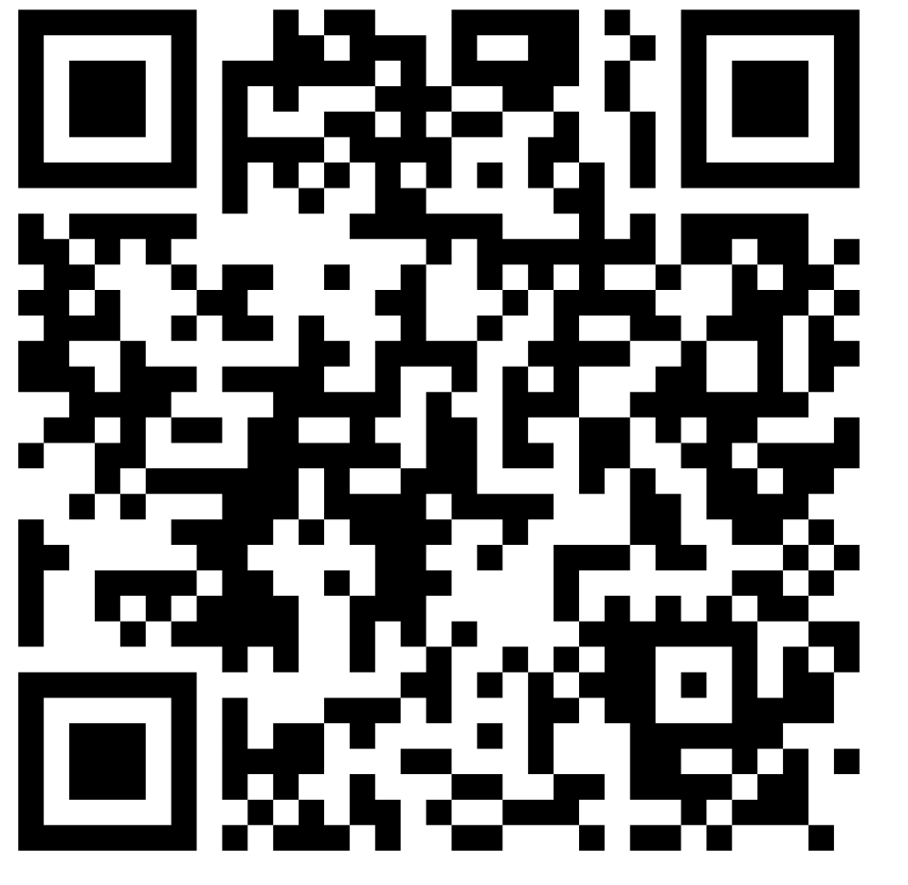
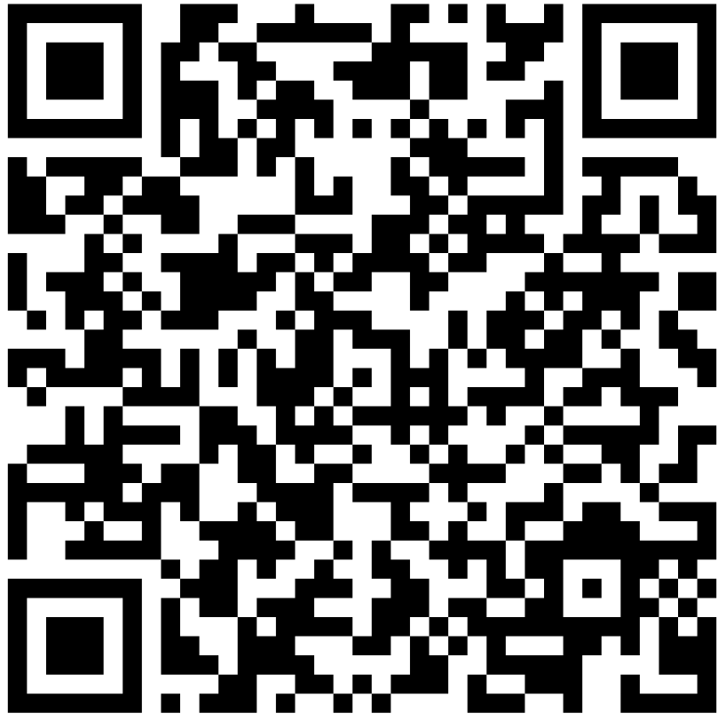
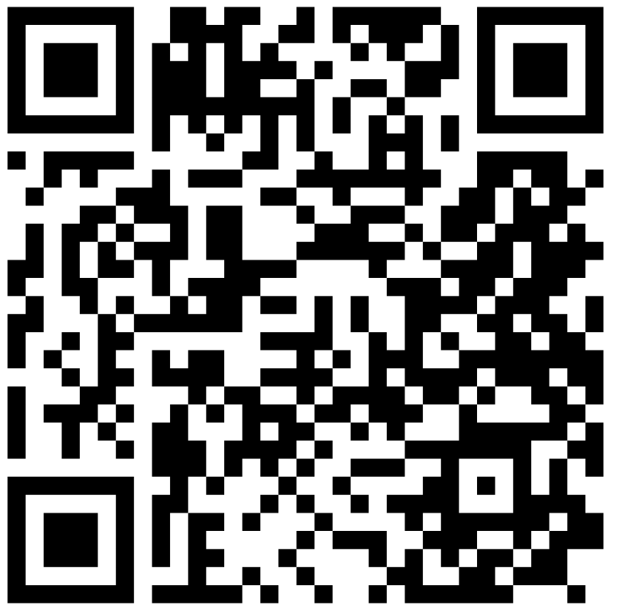
AdvocacyDay App
Take Out Your Phones – Follow Along!
Apple App Store
Google Play Store
Samsung Galaxy Store
Notes:
Micah

Slide 77
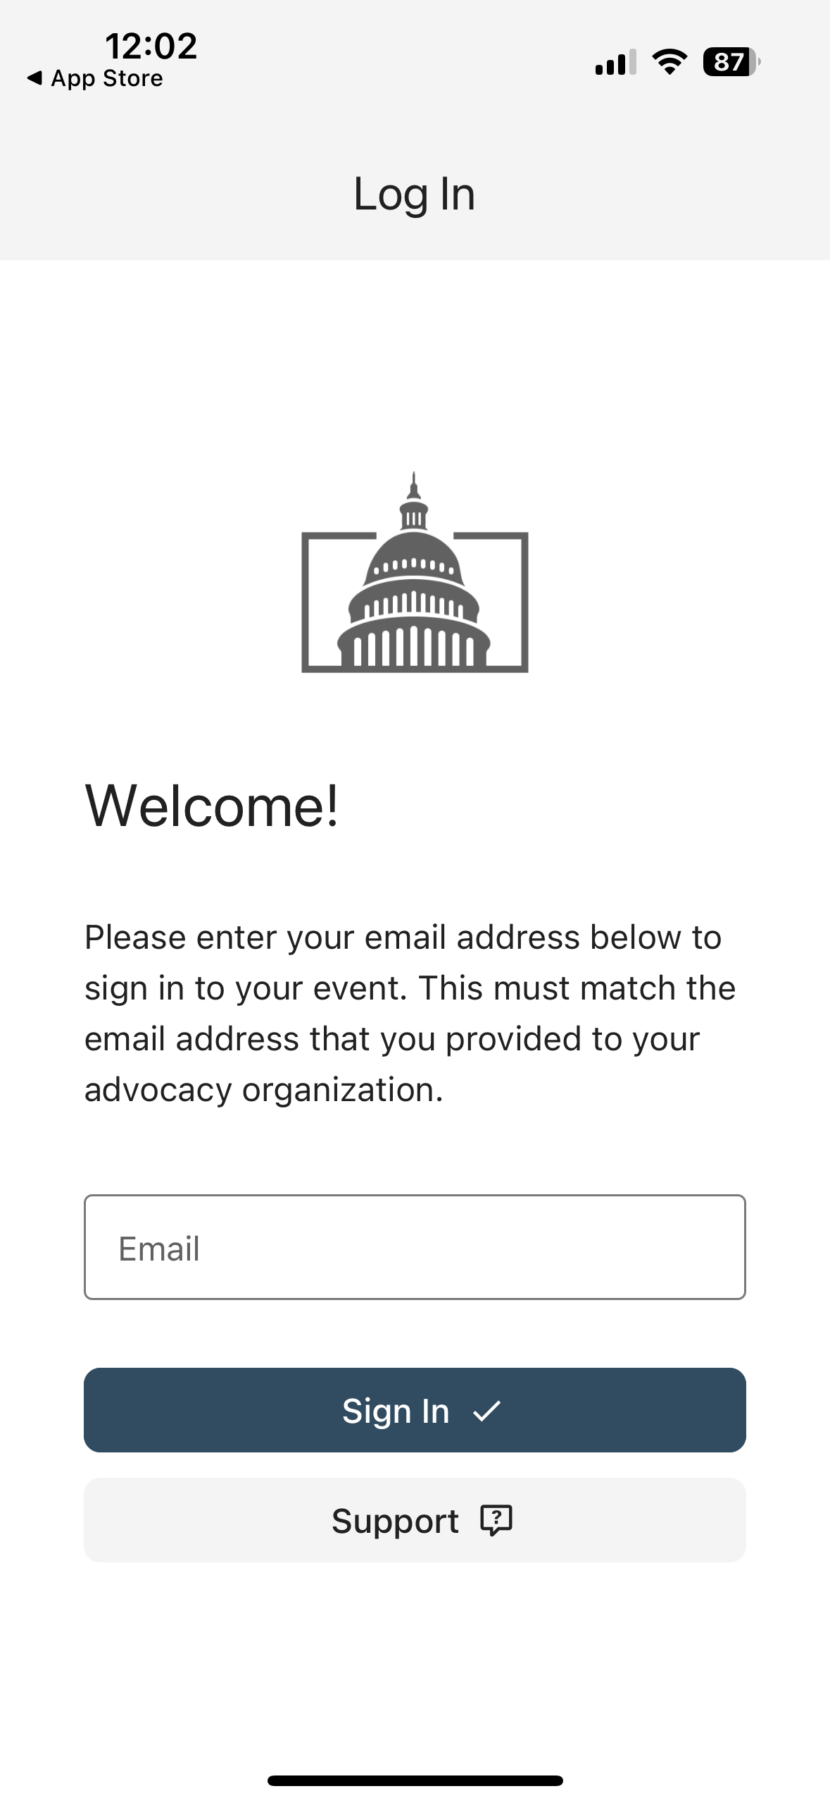
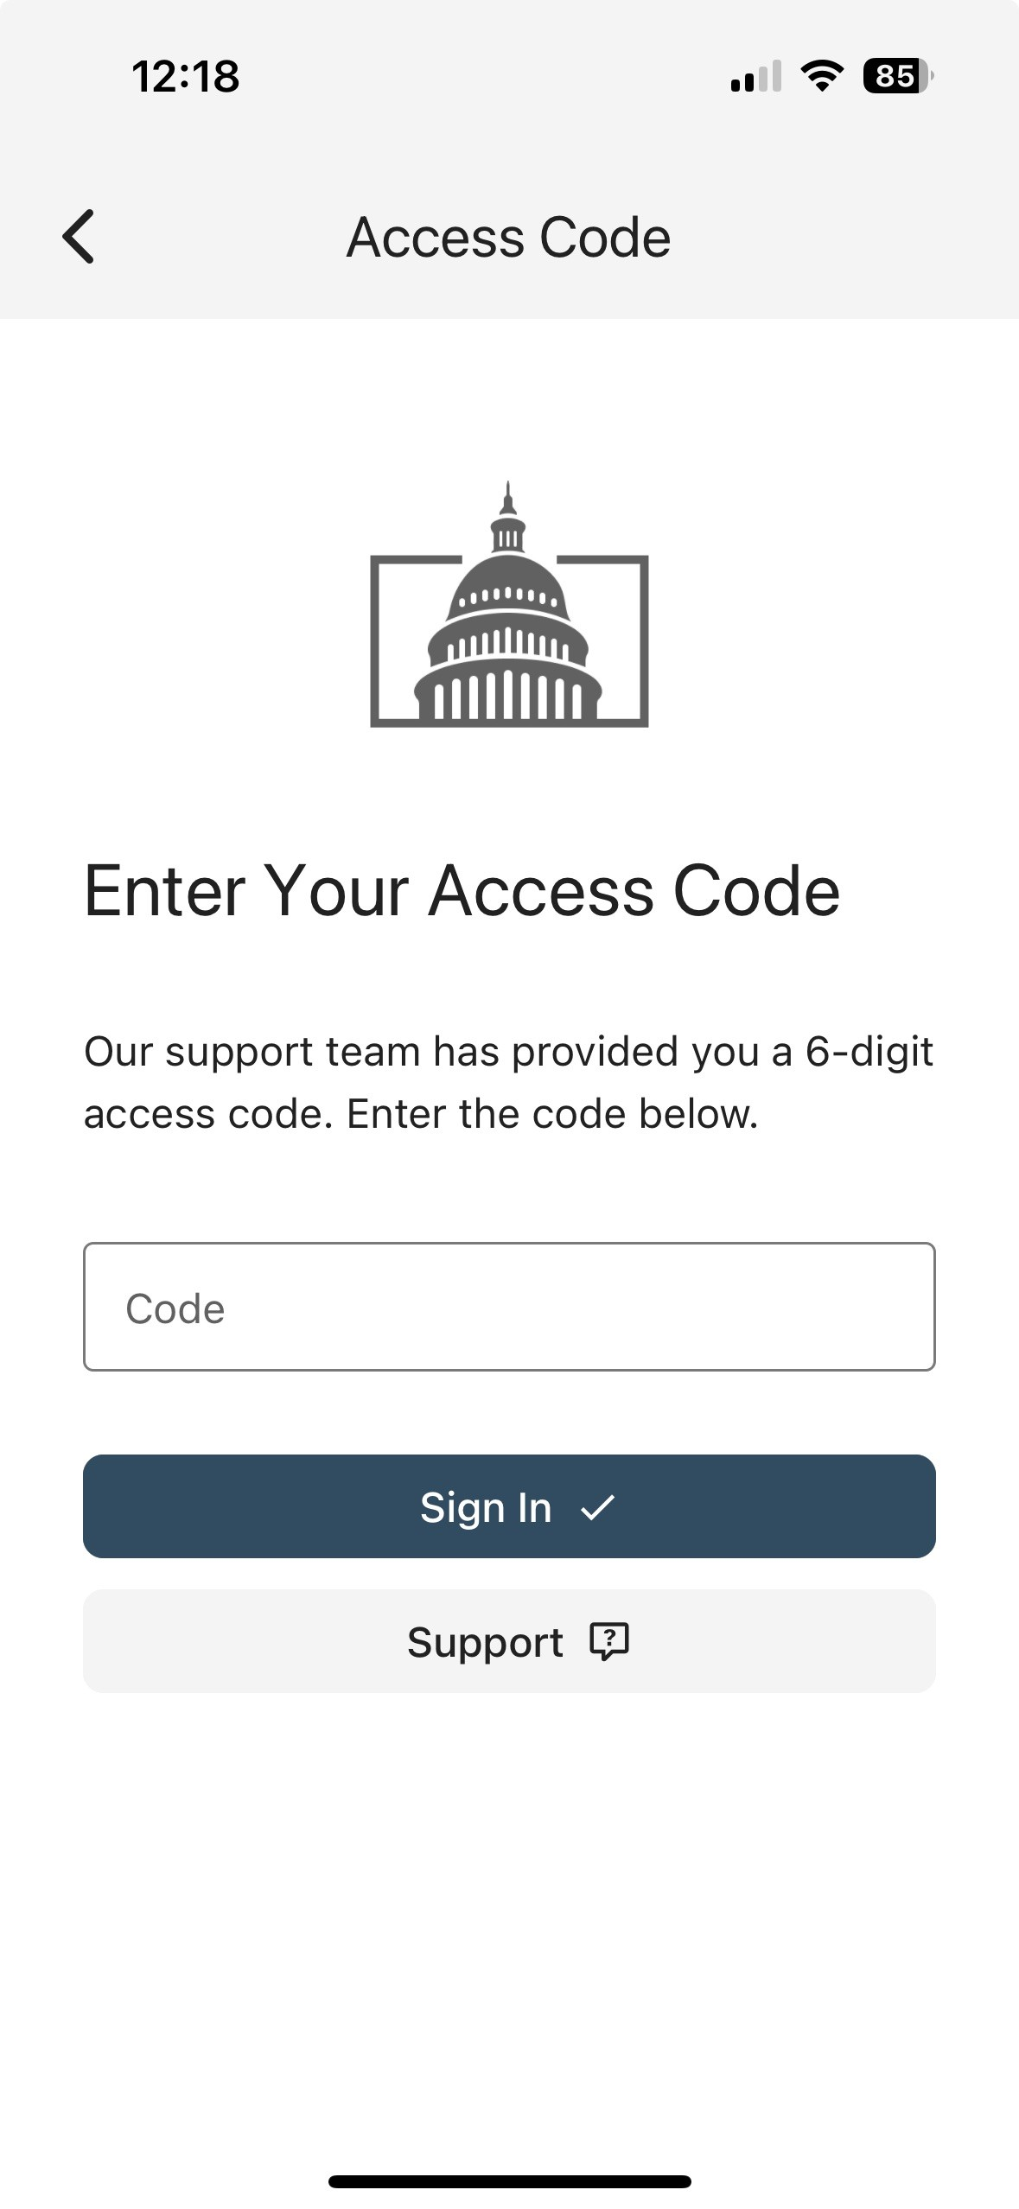
From: AdvocacyDay <noreply@advocacyassociates.com>
Date: Thu, Oct 31, 2024 at 1:46 PM
Subject: Your access code is XXXXX
To: <youremailaddress>
Hello,
Your 6-digit AdvocacyDay access code is XXXXXX
It is valid for 15 minutes.
Notes:
Micah

Slide 78
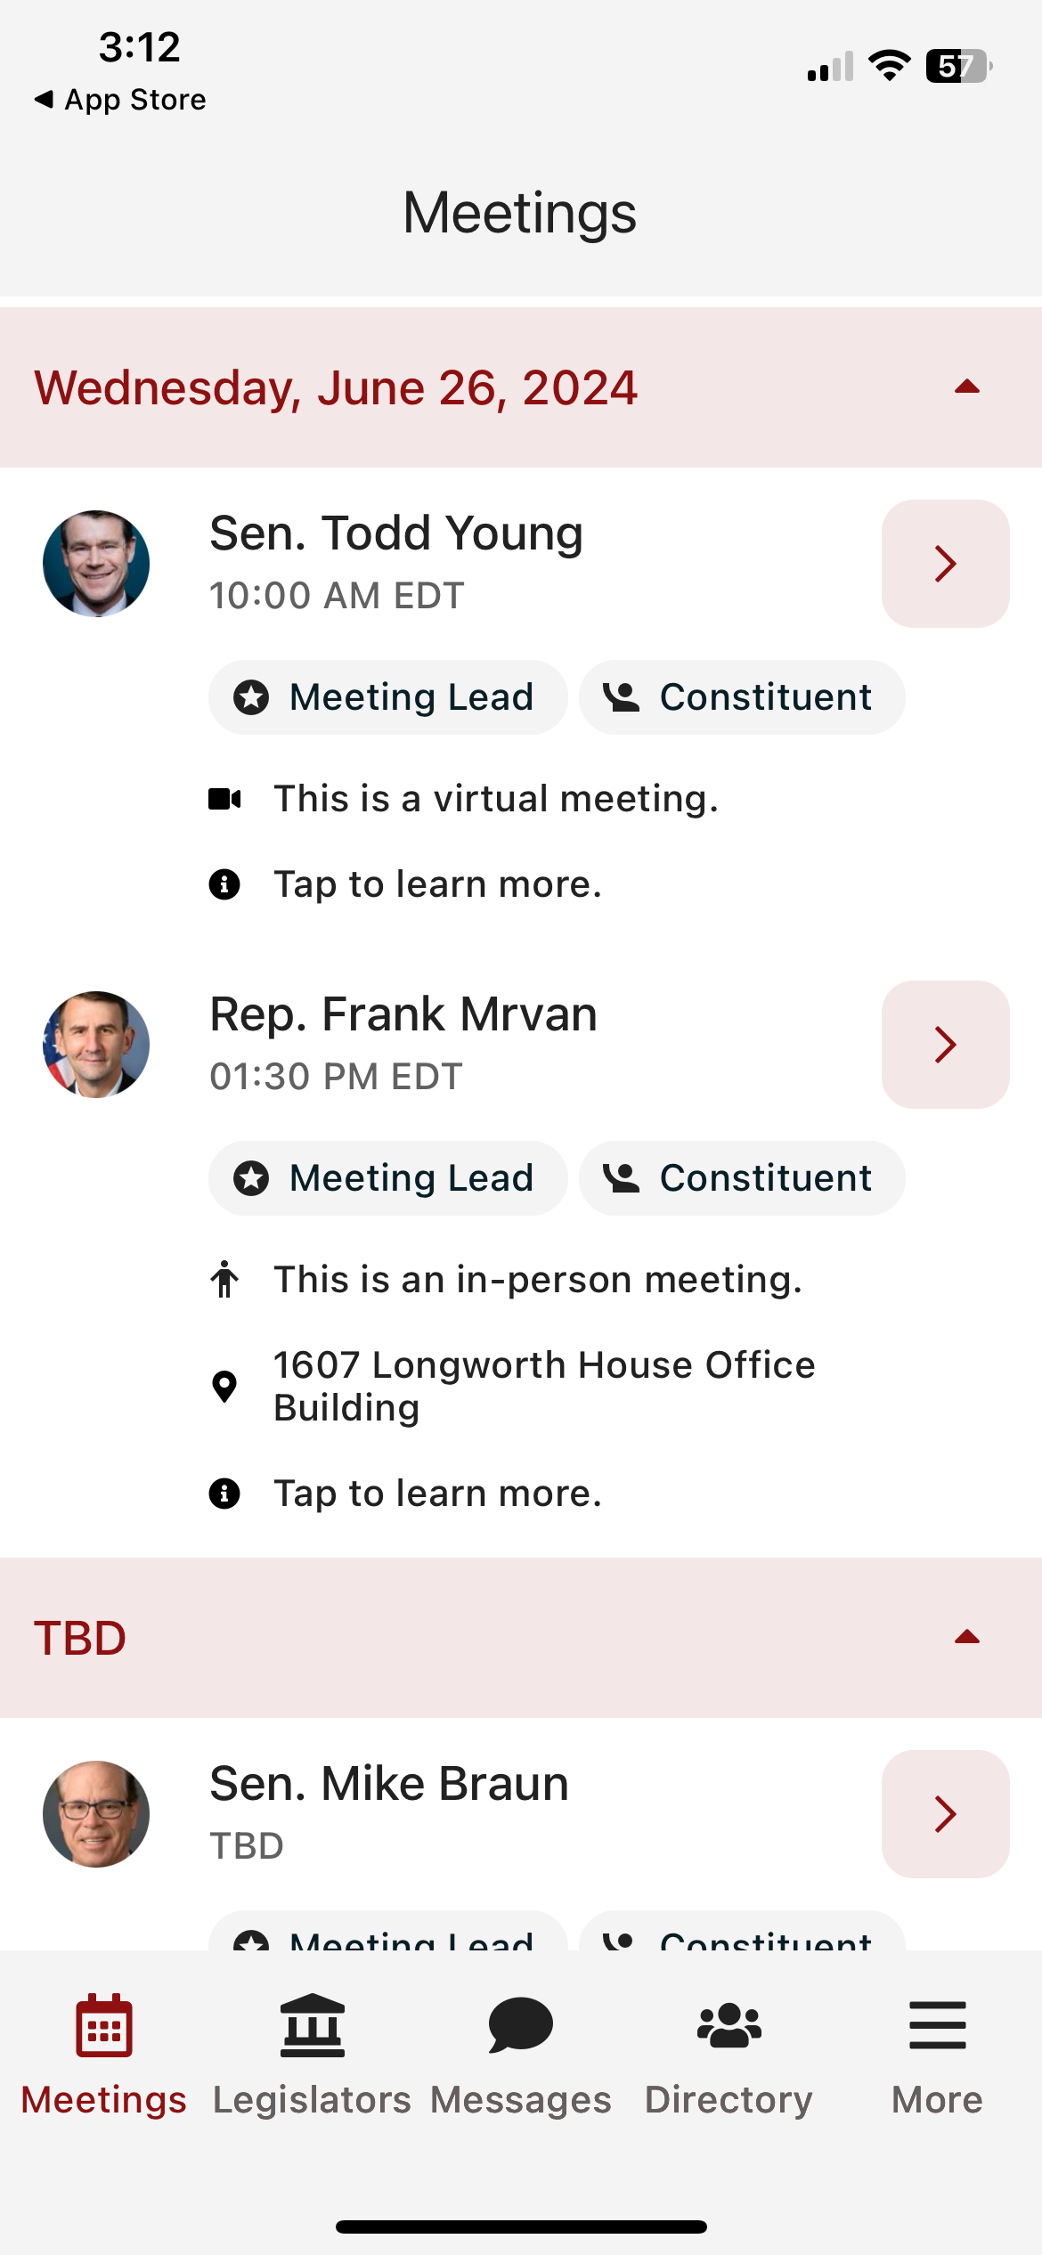
Main Schedule Page
Confirm the Member’s name
Confirm the time of your meeting
Notes:
Micah

Slide 79
Main Schedule Page
Confirm the Member’s name
Confirm the time of your meeting
Are you a constituent?
Notes:
Micah

Slide 80
Main Schedule Page
Confirm the Member’s name
Confirm the time of your meeting
Are you a constituent?
Confirm the location
Notes:
Micah

Slide 81
Main Schedule Page
Confirm the Member’s name
Confirm the time of your meeting
Are you a constituent?
Confirm the location
How much time do you have before your next meeting
Notes:
Micah

Slide 82
Main Schedule Page
Confirm the Member’s name
Confirm the time of your meeting
Are you a constituent?
Confirm the location
How much time do you have before your next meeting
Tap anywhere to learn more
Notes:
Micah

Slide 83
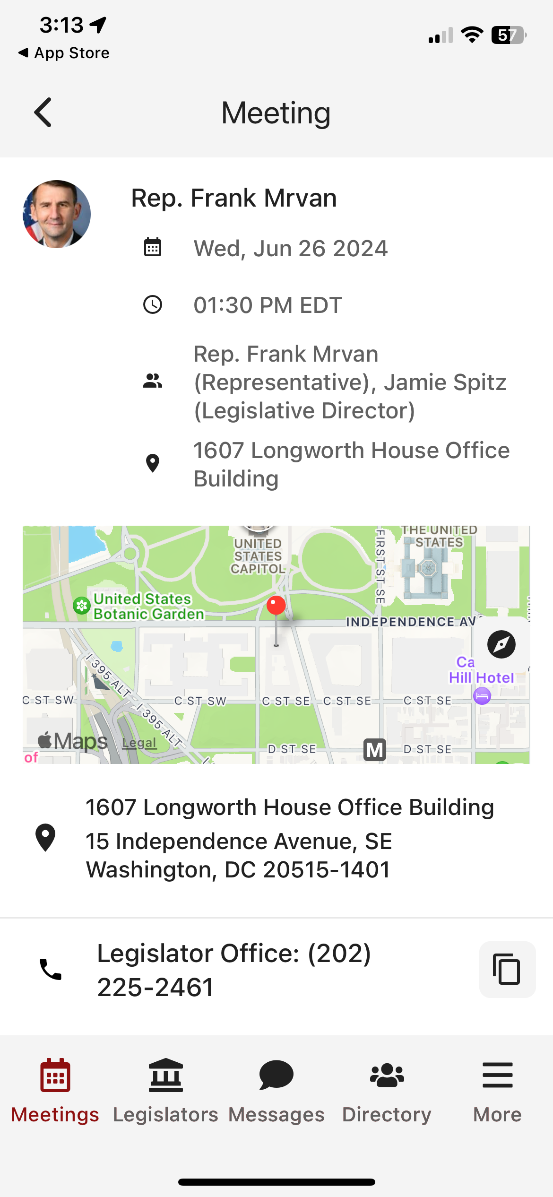
Specific Meeting Details
Date/Time/Meeting With/Location
Notes:
Micah

Slide 84
Specific Meeting Details
Date/Time/Meeting With/Location
Tap on the map to get walking directions
Notes:
Micah

Slide 85
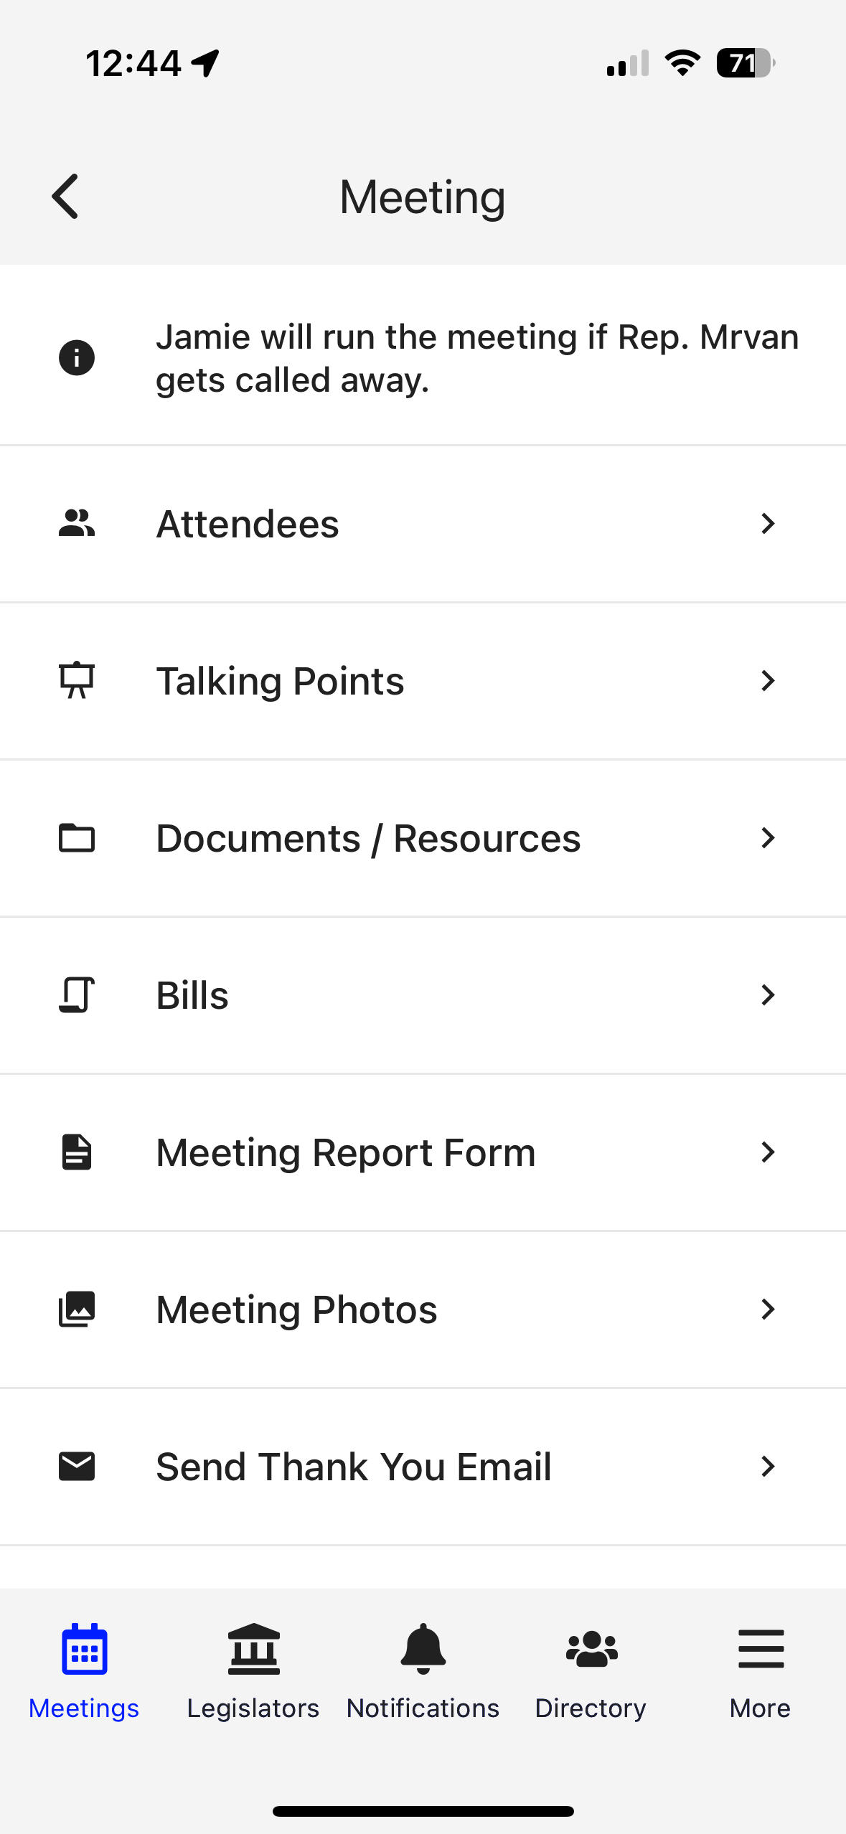
Specific Meeting Details
Date/Time/Meeting With/Location
Tap on the map to get walking directions
Scroll down for attendees/talking points/leave behinds/more
Notes:
Micah

Slide 86
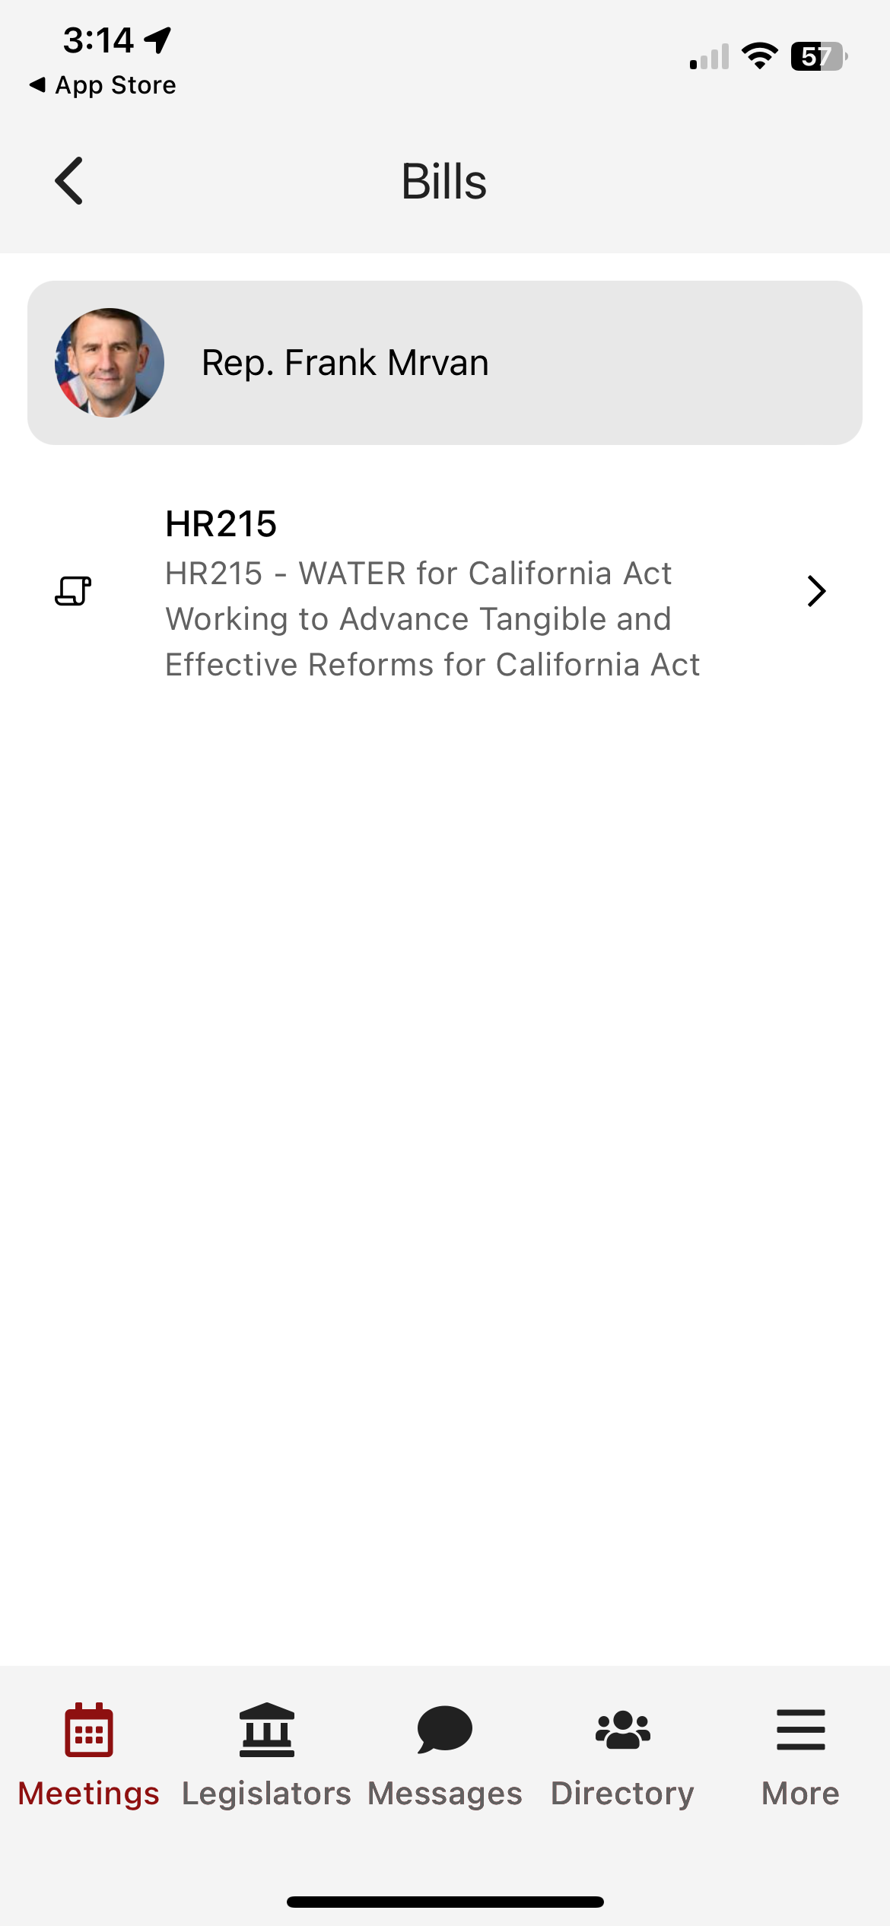

Notes:
Explain Noah’s Ark 1:1 concept
Our Bills are listed here and you can check if they are a cosponsor

Slide 87
Specific Meeting Details
Date/Time/Meeting With/Location
Tap on the map to get walking directions
Scroll down for attendees/talking points/leave behinds/more
Complete meeting report form & upload Photos
Notes:
Micah

Slide 88
Specific Meeting Details
Date/Time/Meeting With/Location
Tap on the map to get walking directions
Scroll down for attendees/talking points/leave behinds/more
Give Feedback & Submit Photos
Thank you template (always personalize)
Notes:
Micah

Slide 89
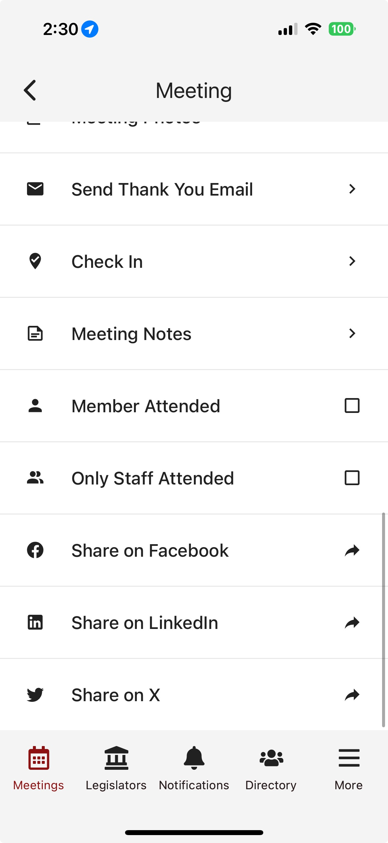
Coordinate with Other Advocates
Take meeting notes
Notes:
Micah

Slide 90
Coordinate with Other Advocates
Take meeting notes
Confirm who attended – remember, marathon, not sprint
Share your photos!
Notes:
Micah

Slide 91
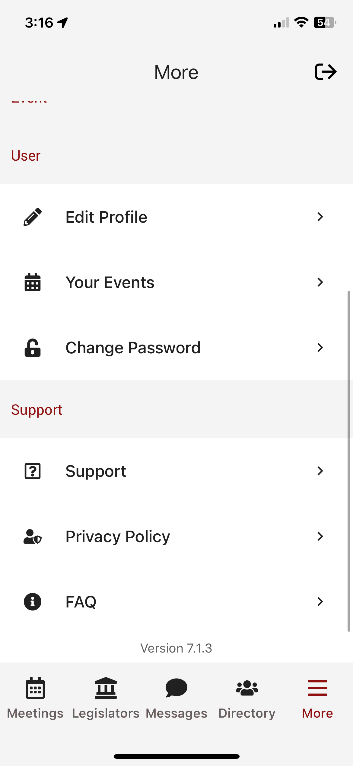
Need Help?
On-call support person
Email policy@ndsccenter.org or reach out to Heather, Jawanda, or Kim
Be ready to adapt!
Notes:
Micah

Slide 92
Final Reminders for Tomorrow
There is no wrap-up at the end of the day. Leave when you’re done with meetings. Don’t forget your luggage!
Lunch and dinner are on your own.
Coordinate your thank you notes and social posts
Treat yourself – You deserve it!
Notes:
Micah

Slide 93
Final Reminders for Today
There is no wrap-up at the end of the day. Just leave when you're ready to leave (and get an early night’s rest).
Dinner on your own.
After huddles: evening reception: 5:30 – 6:30pm.
Notes:
Micah

Slide 94


You’re Invited!
Evening Reception
Blue Terrace
5:30 PM - 6:30 PM
Dinner: On your own

Slide 95
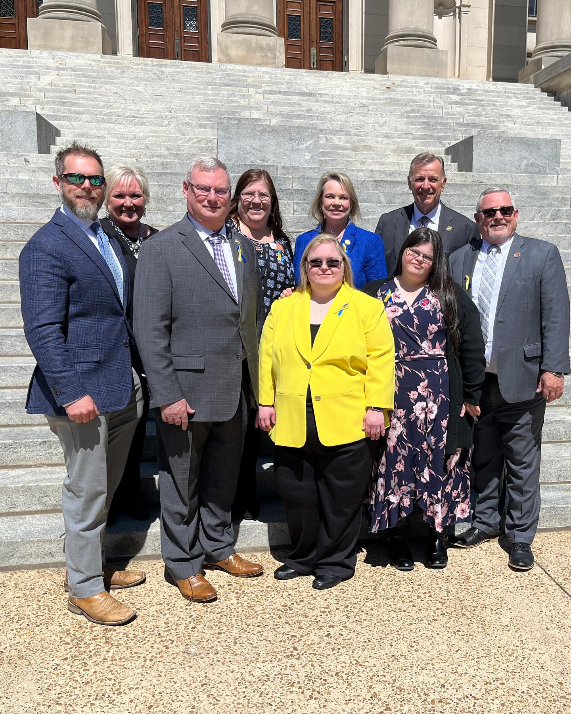
Team Planning Huddles
Team information available on tables
4:00 PM - 4:45 PM
Notes:
Teams can leave when they are finished or even earlier!

Slide 96
Thank You!
Notes:
Micah

Slide 97










Thank you to our sponsors
Run for Opportunity by Jack and Bret Bowerman
Supported by:

