Slide 1

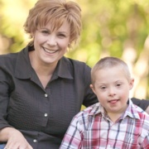
Enabling Connections: How You Can Build & Sustain Relationships with Elected Officials
Alecia Talbott
Down Syndrome Association of Middle Tennessee Executive Director

Slide 2
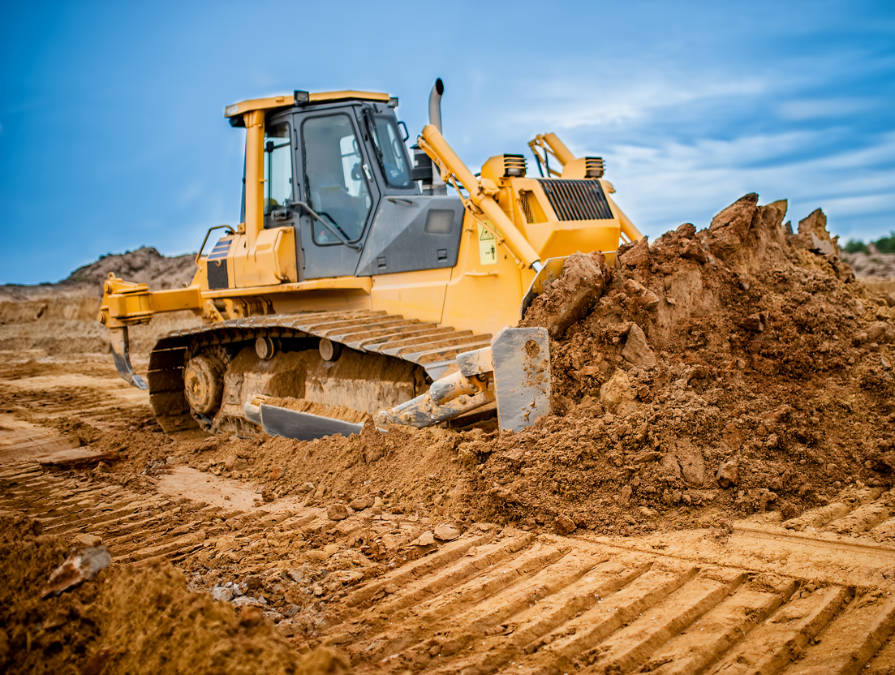
Build & Grow YOUR Advocacy Program
Notes:
Advocacy and relationships and successful, sustainable programs are built and NOT overnight. Start slow. Start with something simple to realize a relatively quick win that you can promote.

Slide 3
Successful Advocacy Programs
Built with passion & are active
Secure organization leadership excitement
Recruit & involve families & self-advocates
Collaborate with partners
Make it easy to advocate
Creative
Flexible & patient
Notes:
And just like a construction project, they start small and build over time.

Slide 4
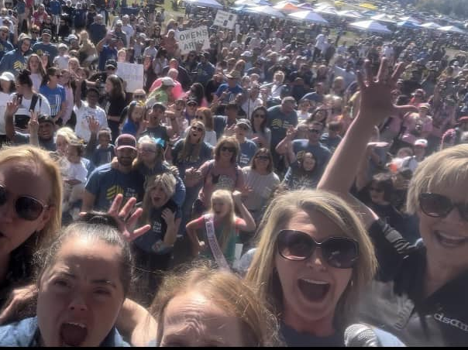
It Takes a Village
Notes:
It truly does take a village for a successful advocacy program, and that village needs to be passionate, enthusiastic & cooperative.

Slide 5
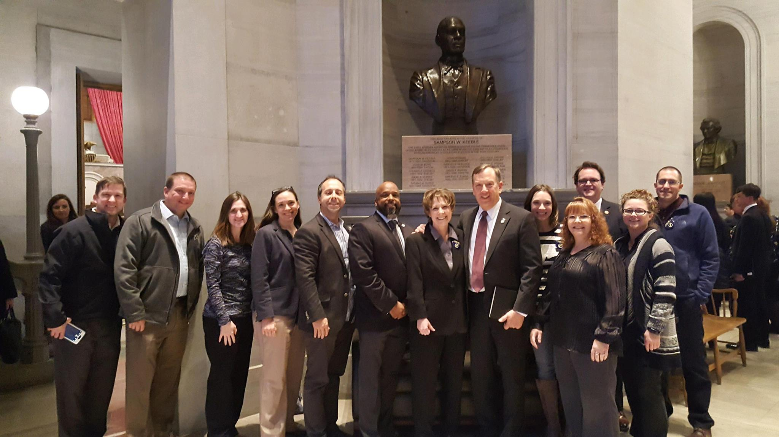
Energize the Board of Directors
Notes:
And it starts from the top down.

Slide 6
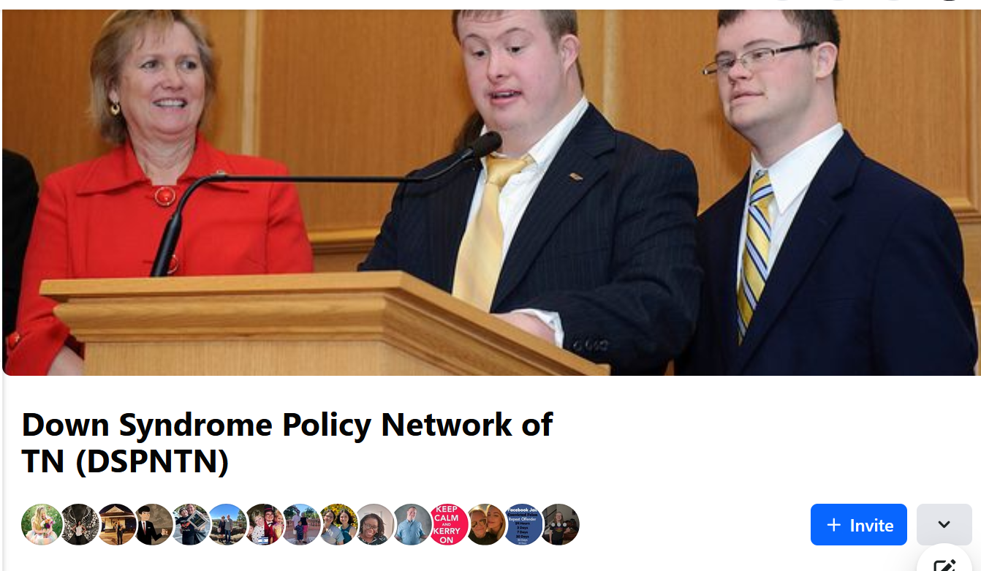
Excite, Empower & Activate Families
Notes:
State-wide advocacy programs help to bring more people to your efforts. At dsamt, we have a license plate program, with funds from the sale of those going towards state-wide advocacy.

Slide 7
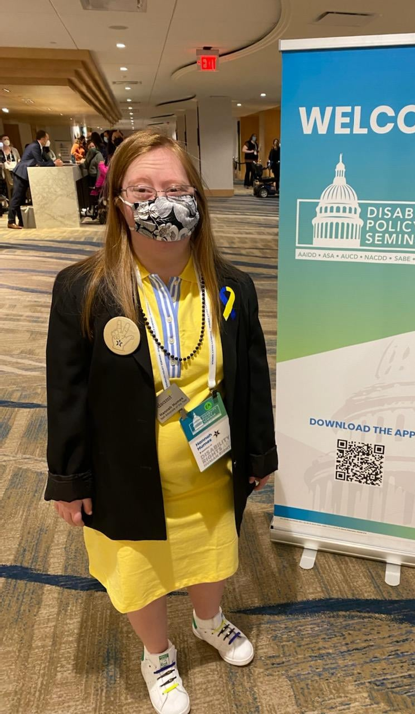
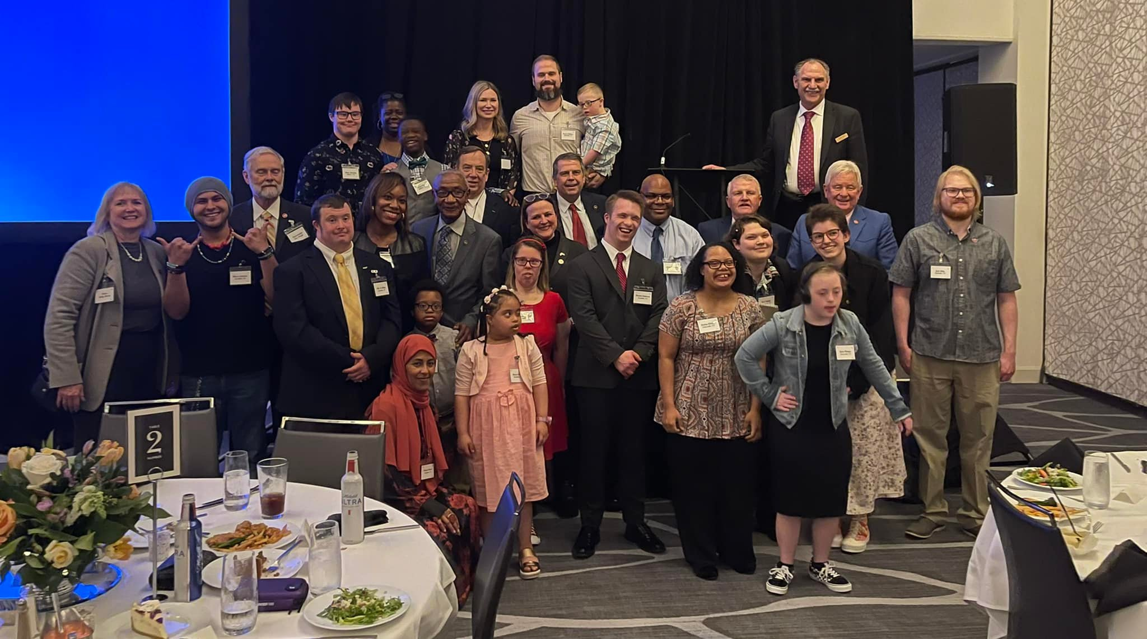
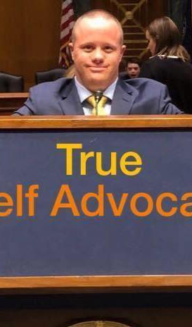
Self-Advocate Involvement

Slide 8
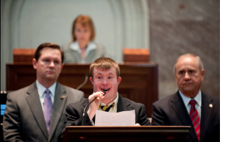
Testify

Slide 9




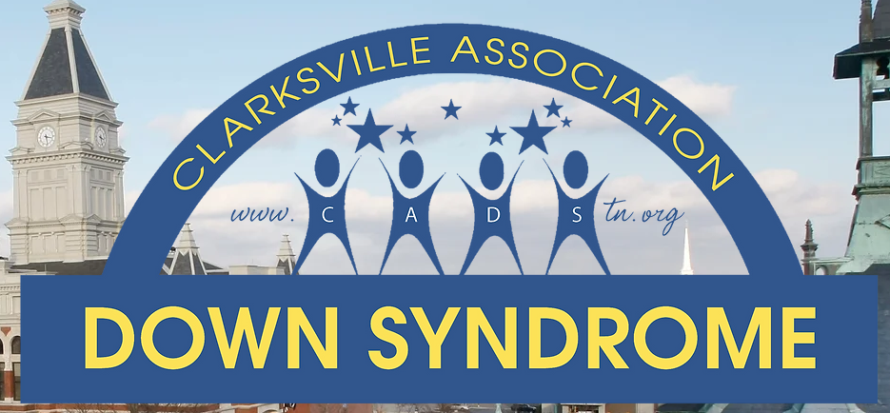


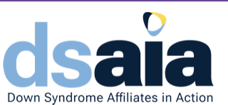



Create Advocacy Partnerships & Collaborate
Notes:
We are all more powerful together. Learn from those who have done good things. Don’t recreate the wheel.

Slide 10
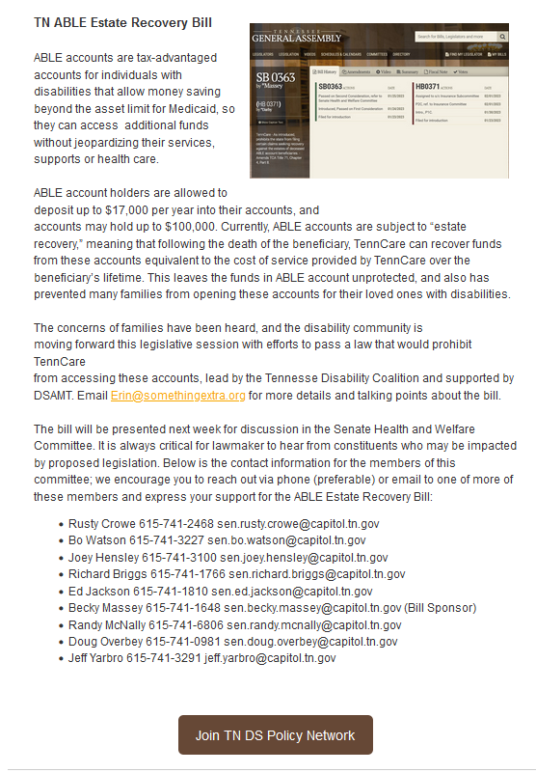
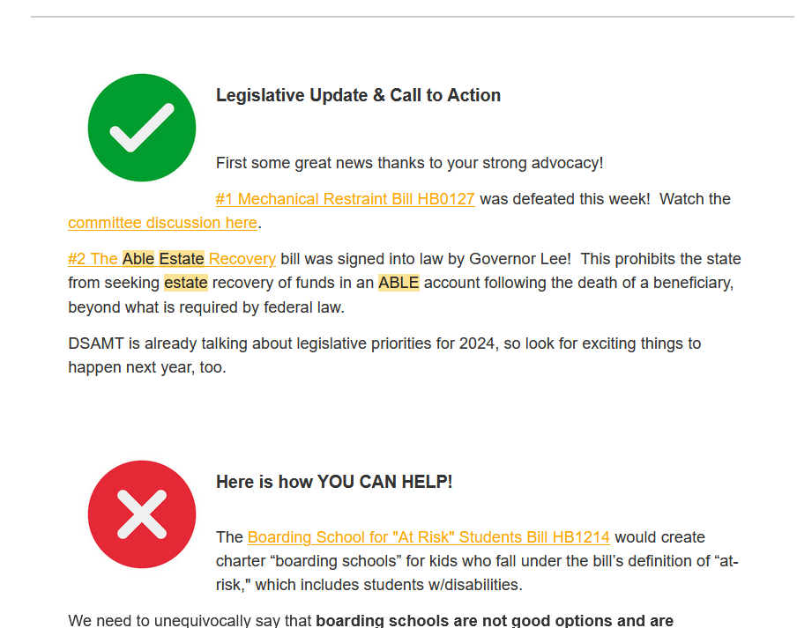
Make it Easy
Notes:
Provide the details in simply language for families.

Slide 11
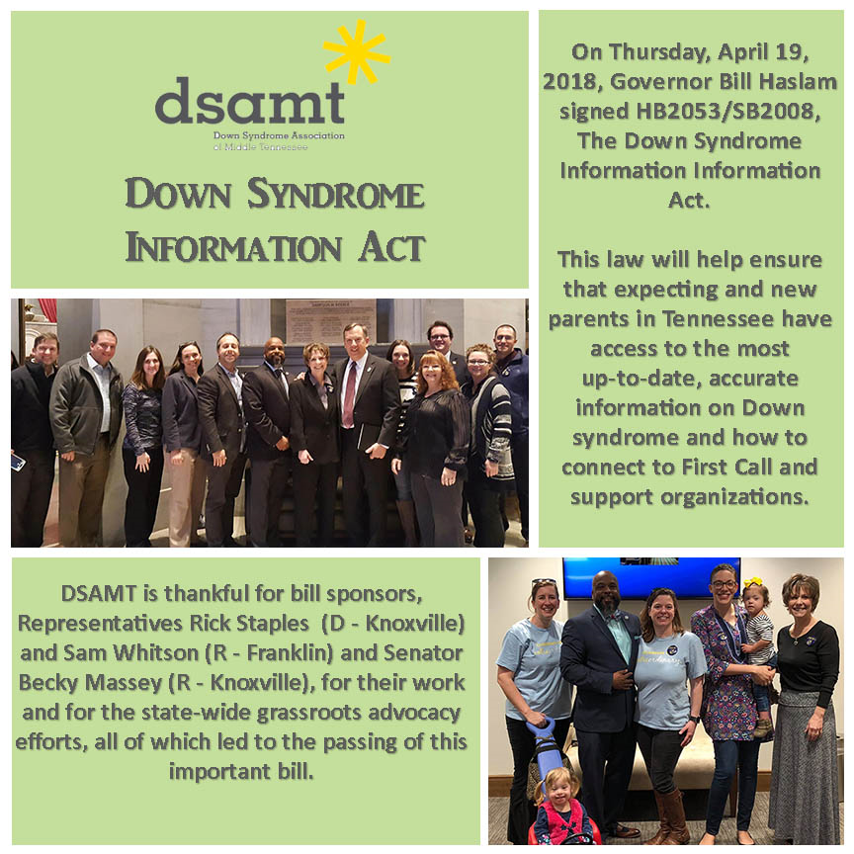
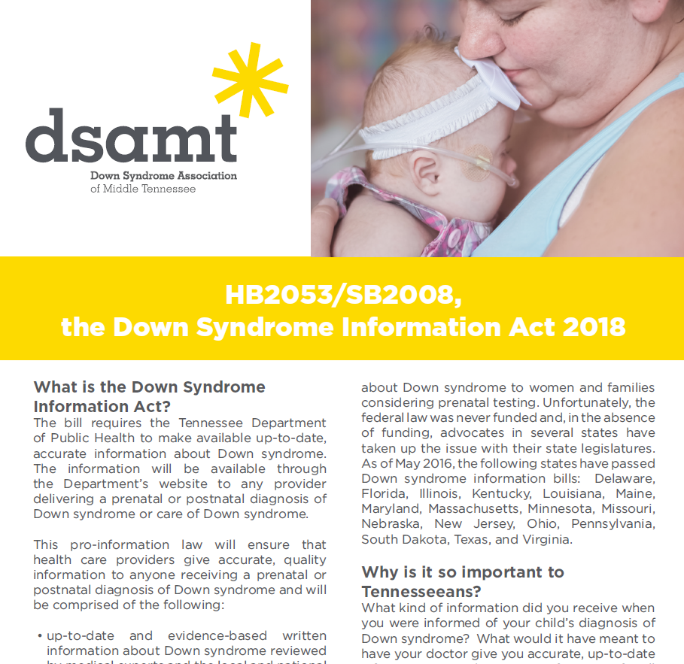
More Samples

Slide 12
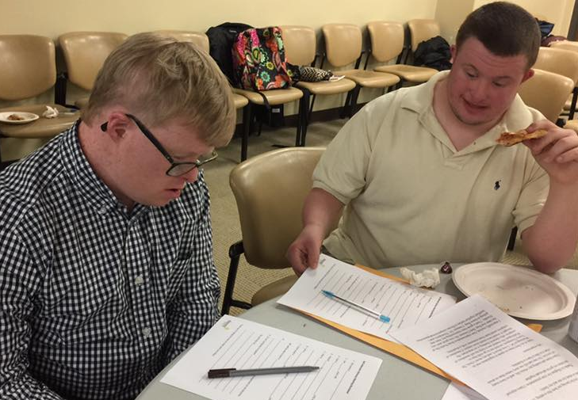
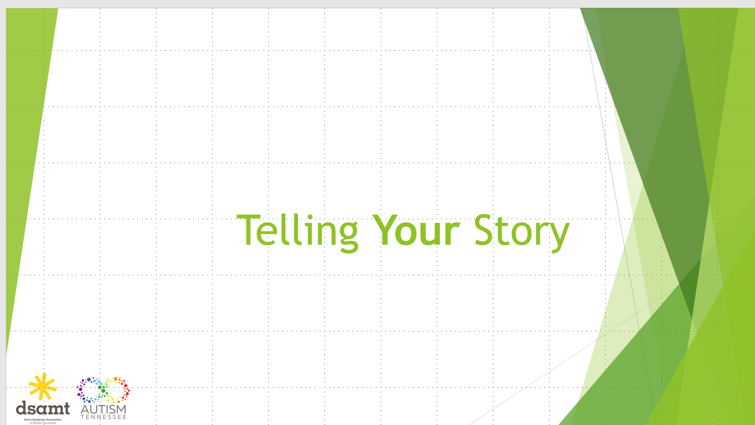
Training to Advocate Through Storytelling

Slide 13
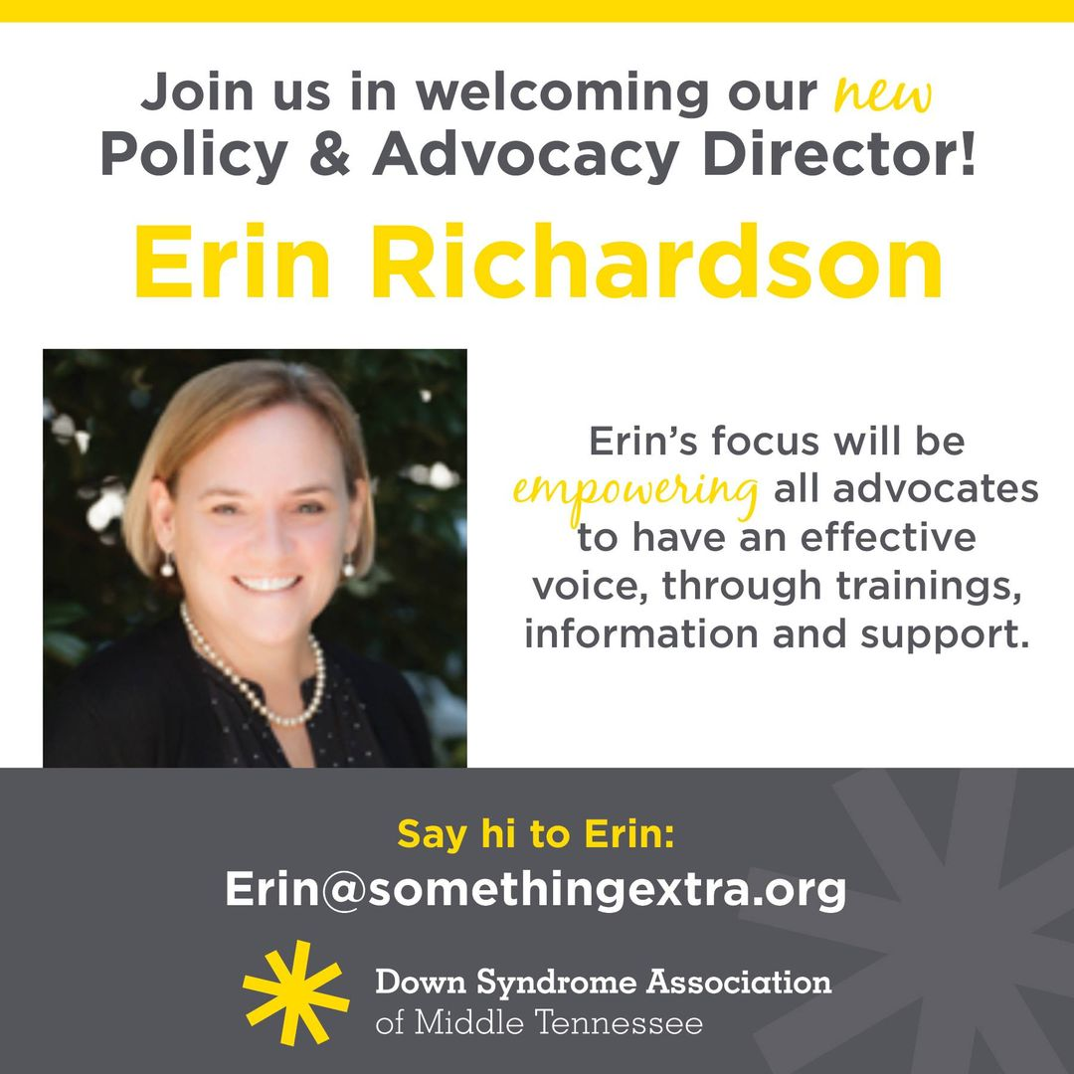
Take it to the Next Level
Notes:
If you are here from a DSA, our advocacy efforts skyrocketed after we had dedicated staff for advocacy.

Slide 14

Get Creative
Notes:
It truly does take a village for a successful advocacy program, and that village needs to be passionate, enthusiastic & cooperative.

Slide 15
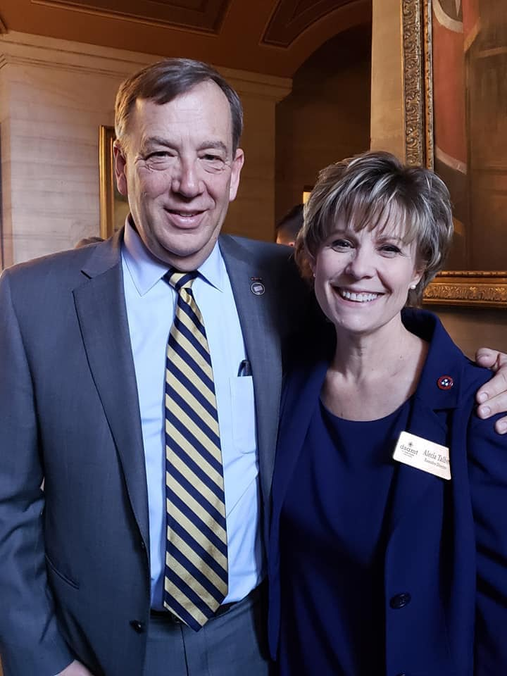
Leverage Legislative Relationships
Notes:
Once relationships are created, you can leverage those in your advocacy efforts. This wonderful grandfather of a child with DS became a huge supporter of our advocacy efforts, improving our success.

Slide 16
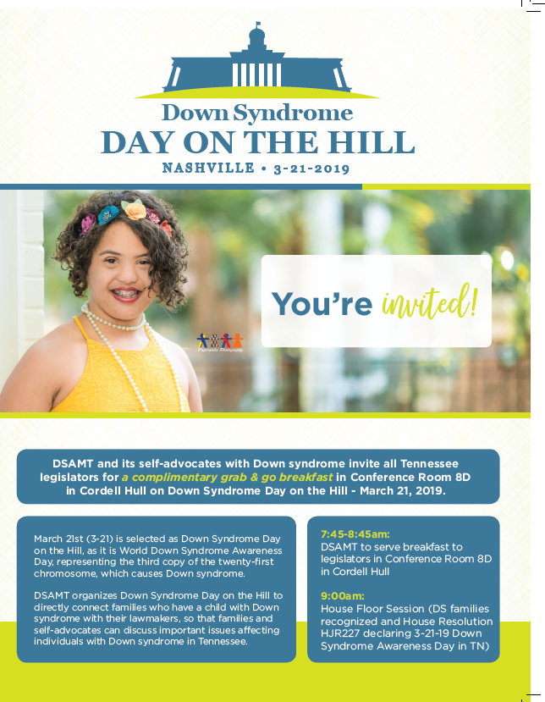


Down Syndrome & Disability Day on the Hill
Notes:
Breakfast was very successful w/lots of talk & attendance! We got families to come then be in house chambers for DS Day.

Slide 17
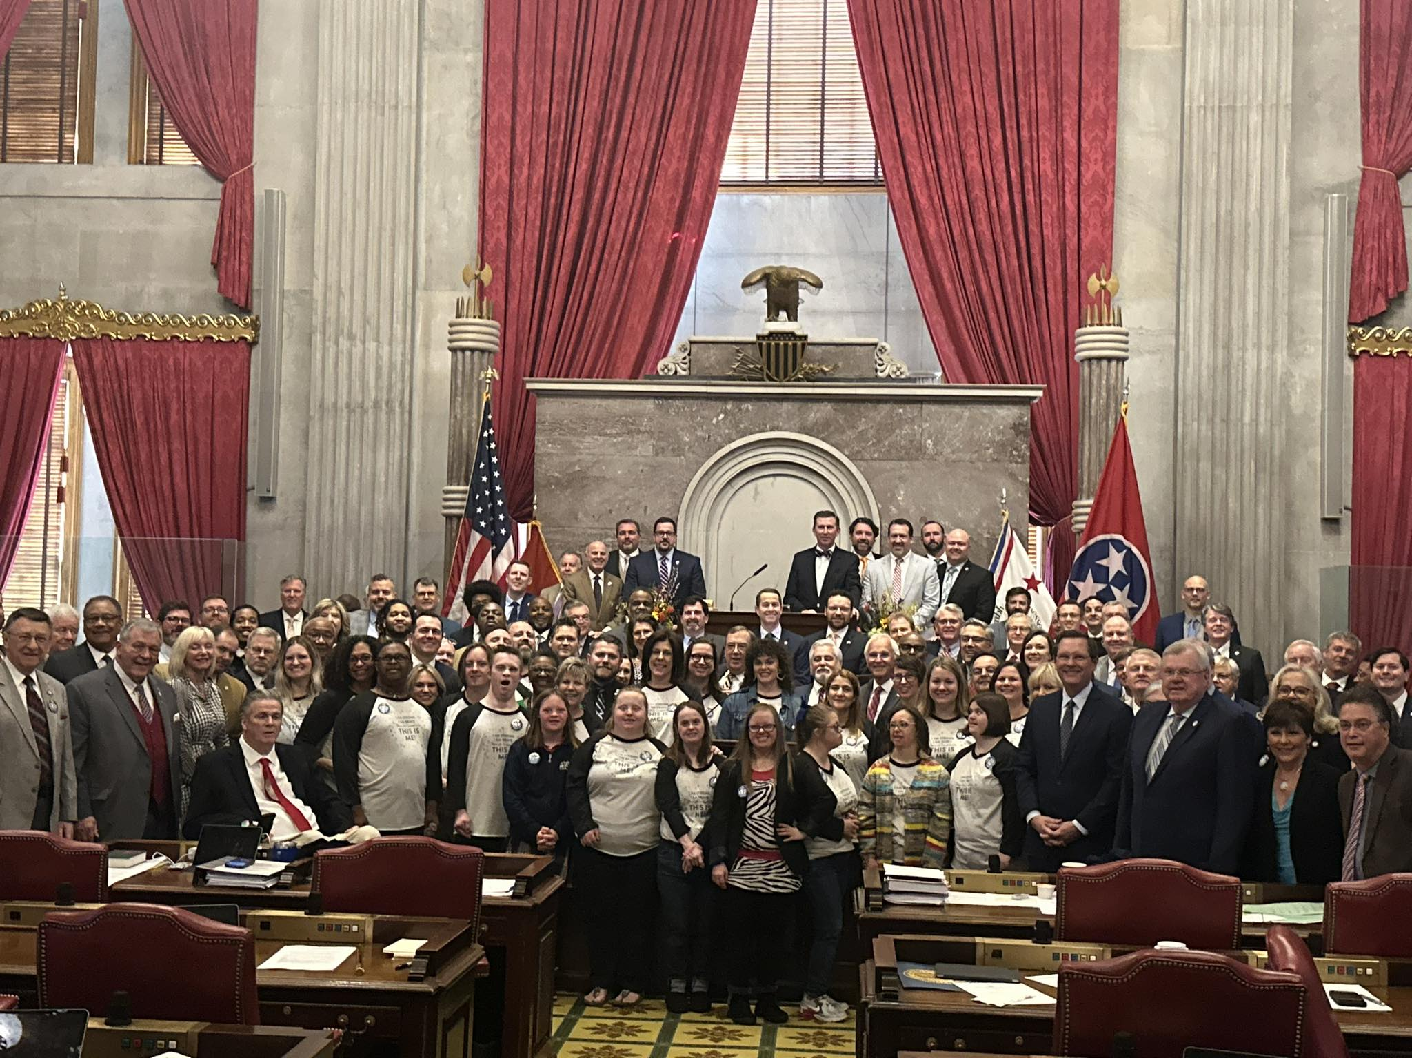
Down Syndrome & Disability Day on the Hill
Notes:
One of the most successful events was for 3-21. We partnered with a professional choral group, and sang with them on the house floor (just after the reading of the resolution naming 3-21 DS awareness day in TN). Standing ovation. The speaker of the house actually (we believe for the 1st time ever) invited every member of the house on the floor for a photo.

Slide 18
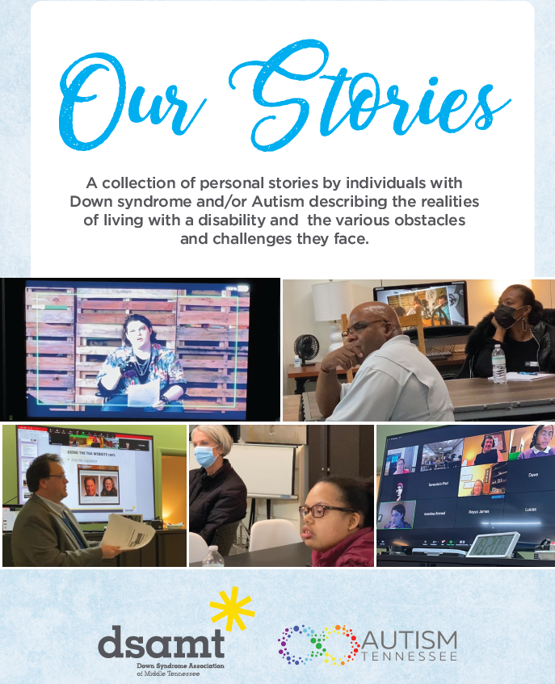
Our Stories

Slide 19
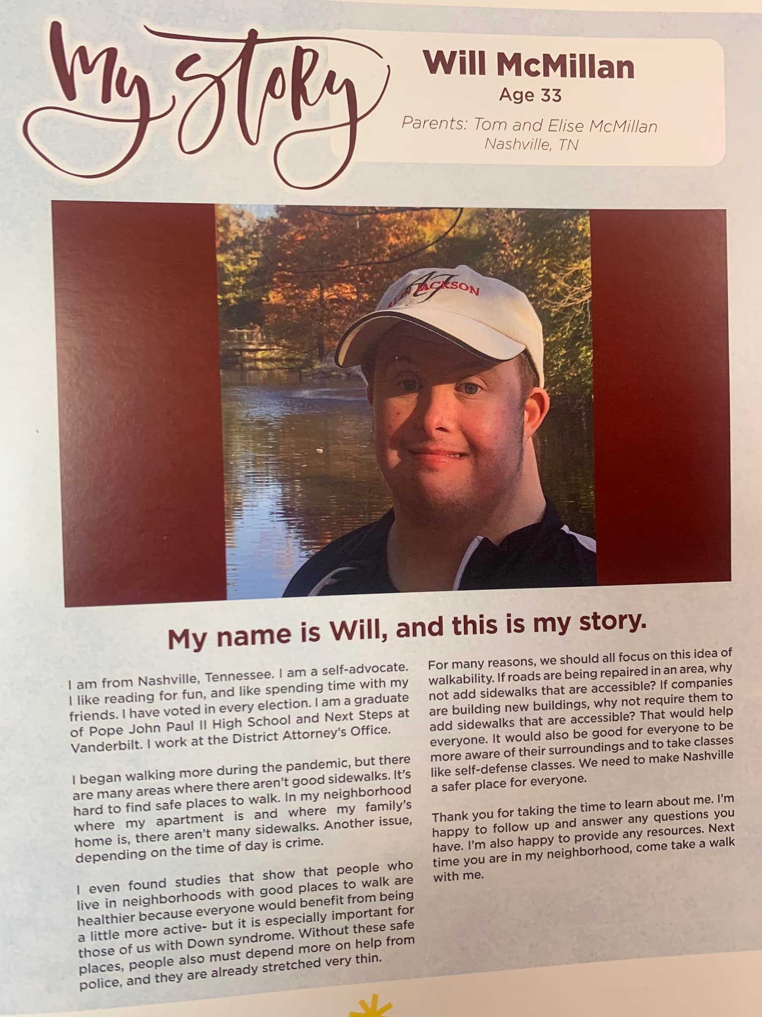
The Stories
https://somethingextra.org/programs/advocacy/our-stories/

Slide 20
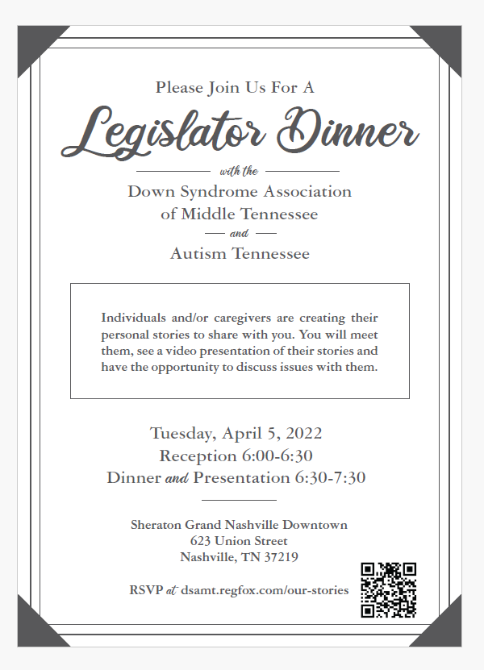
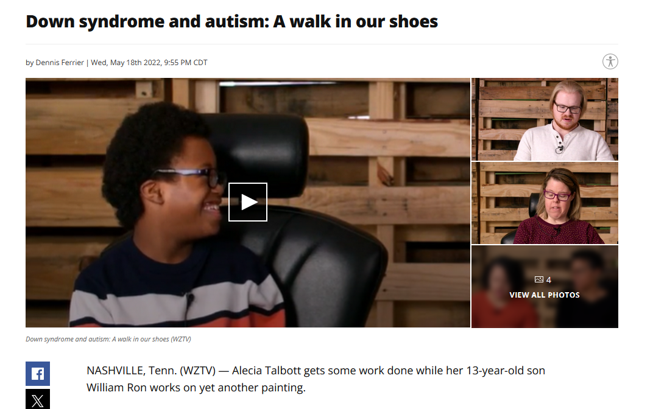
Our Stories Event
Notes:
At the end of the dinner, legislators came to US asking for information and wanting to help!

Slide 21
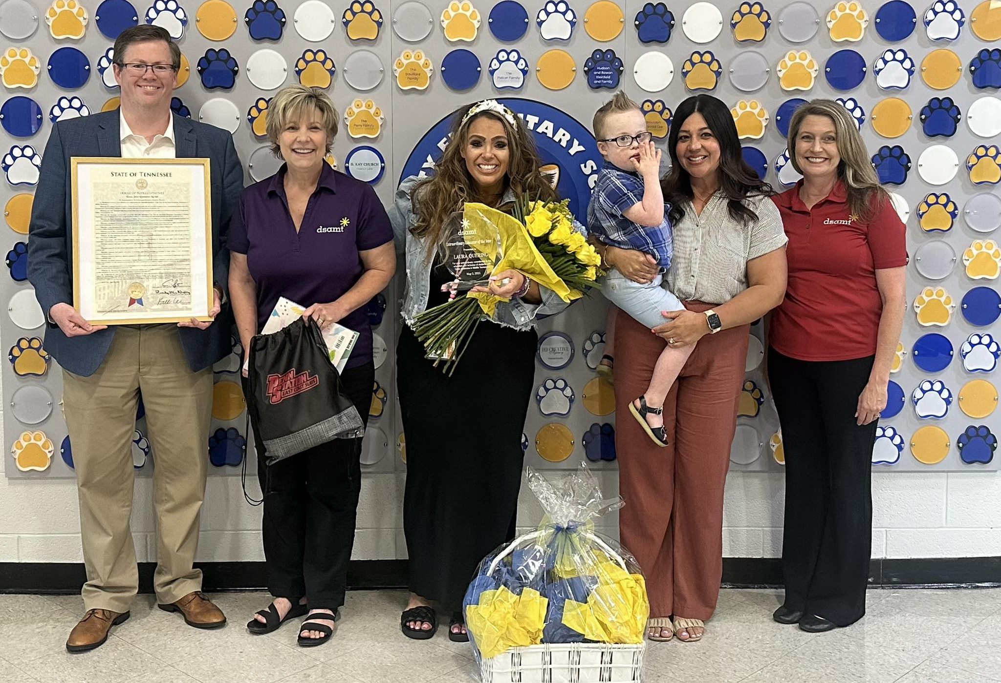
Resolutions/Proclamations
Notes:
Extraordinary Teacher of the Year

Slide 22
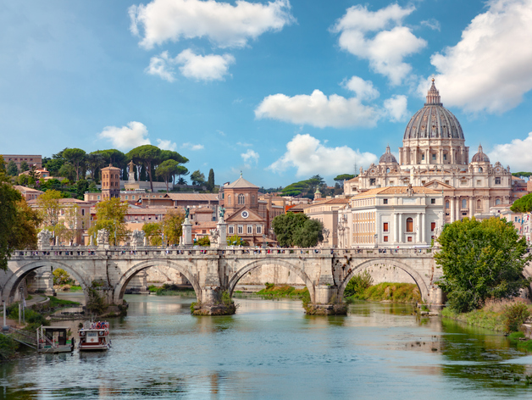
Rome Wasn’t Built in a Day
Notes:
Rome wasn’t built in a day. It takes a lot of patience & determination.

Slide 23


Slide 24






Alecia Talbott
Executive Director
DSAMT
alecia@somethingextra.org
c. 615-881-4261
o. 615-454-3129

