Slide 1
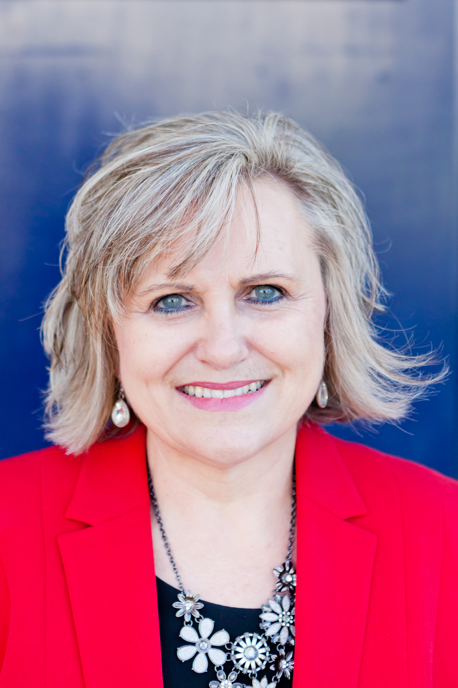
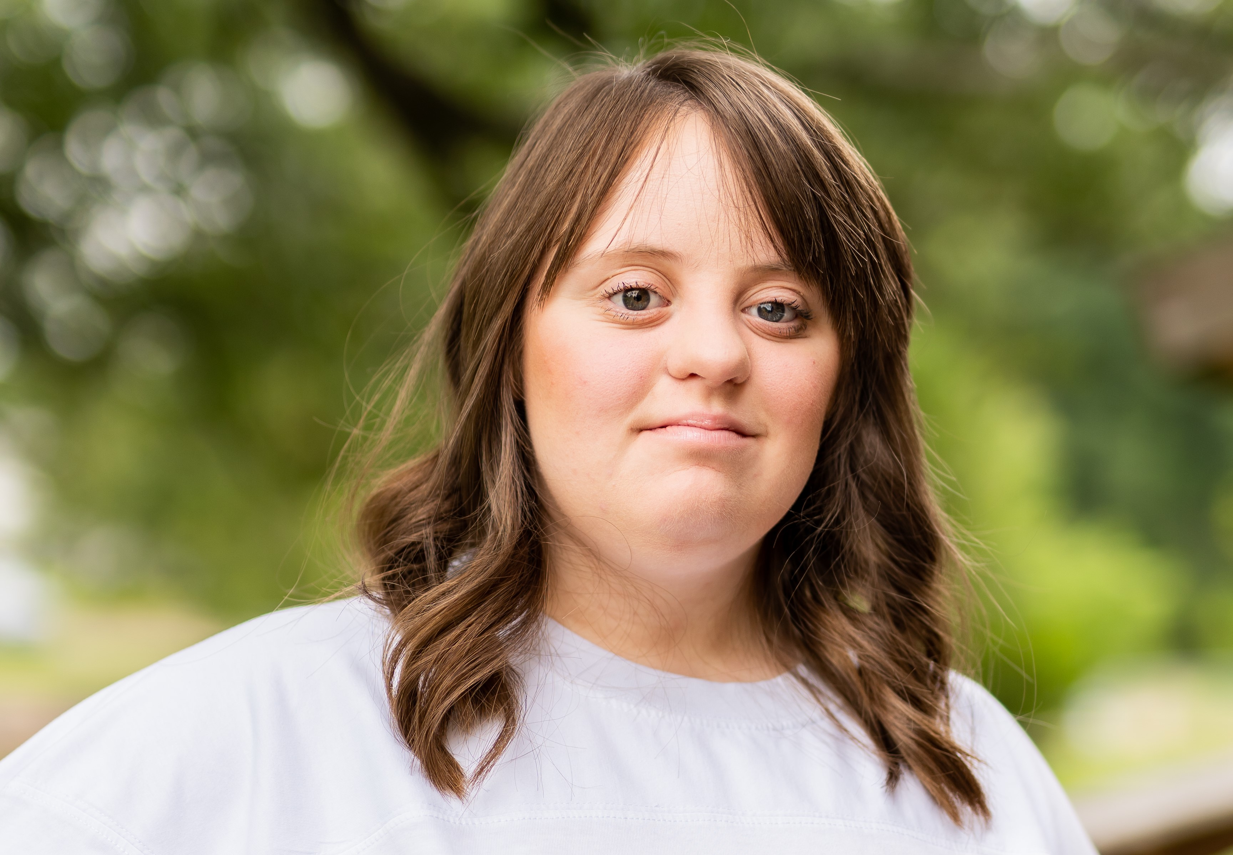
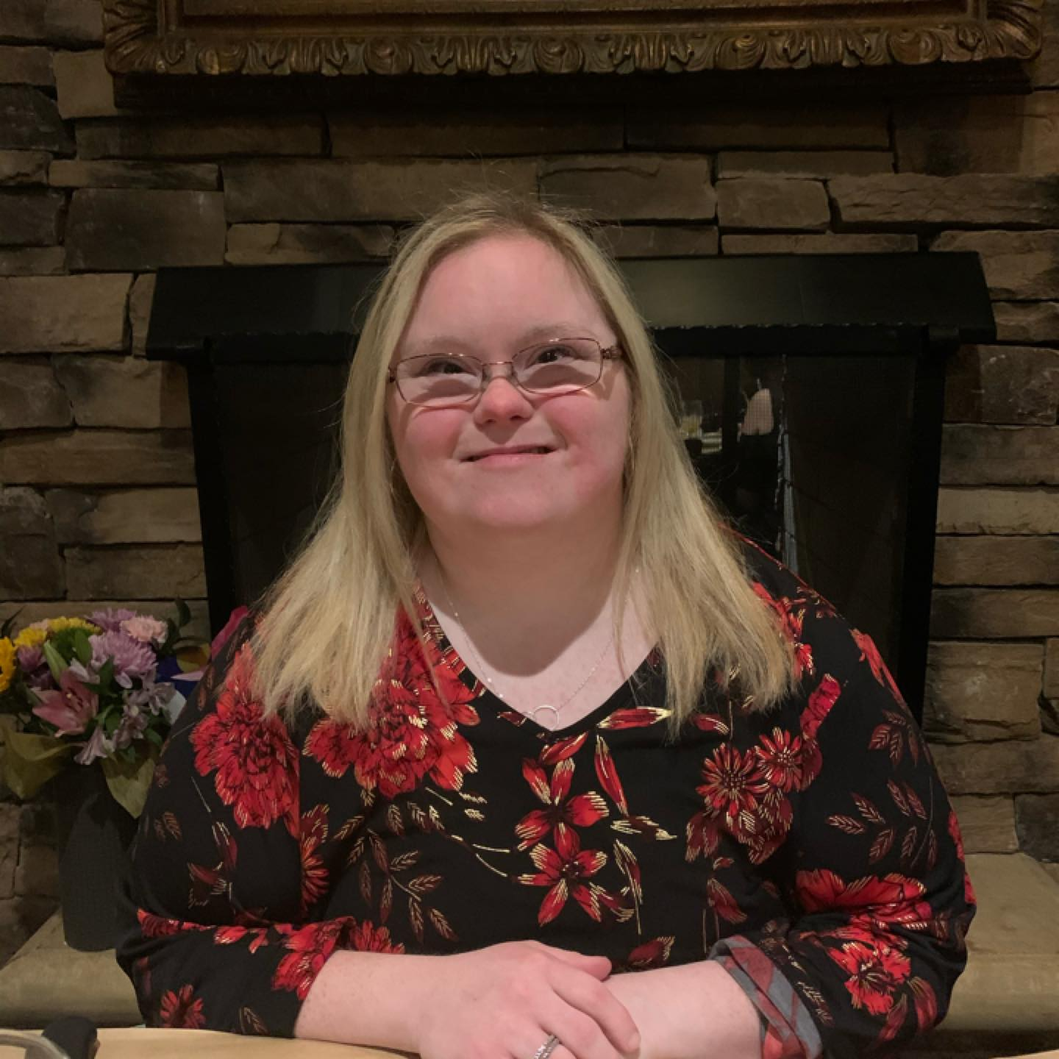

Engaging Policymakers with Your Story
Jawanda Mast
NDSC Grassroots Advocacy Manager
Hannah LaCour
NDSC Self-Advocate Board Member

Slide 2

Notes:
Telling your personal story to try to turn “what is” into “what should be”; putting a real face on the issues
Providing education and information to elected officials and the broader community about issues, problems and concerns
Continuum of advocacy activities depending on comfort level, time, and passion for the issue.

Slide 3
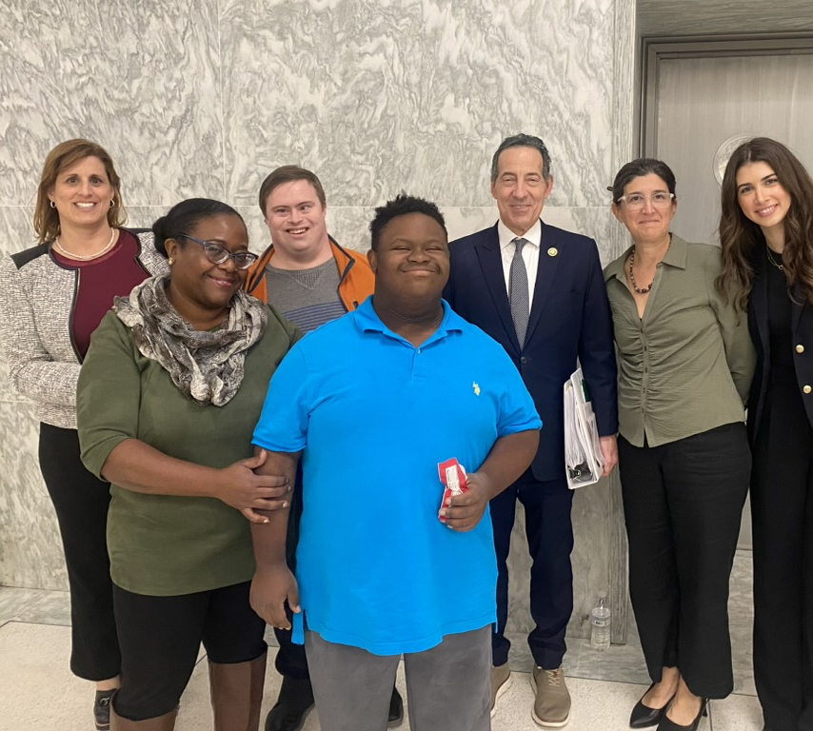

Keys to Success
Building Relationships
Telling Your Story
Staying Informed
Showing Up
Taking Action

Slide 4
Building Relationships – With Whom?
Federal level: U.S. Representative and 2 U.S. Senators
In your state: State Representative or Delegate and State Senator
Local: School Board Members, City Council, Mayor
Note: State level becoming even more important as federal gov’t makes cuts and pushes responsibilities to the states
AT ALL LEVELS: STAFF MEMBERS ARE VERY IMPORTANT!!
Find them:
Find your federal, state and local elected officials at https://www.usa.gov/elected-officials
Get to Know Them
Google elected officials and sometimes staffers to learn about them and look for common ground.

Slide 5
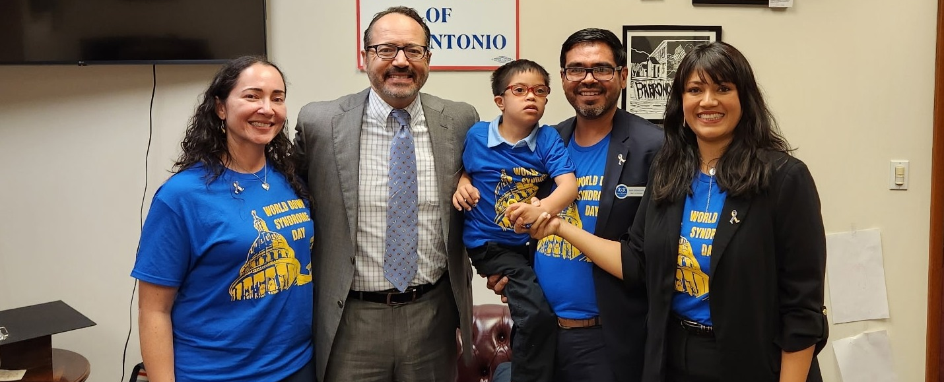
Building Relationships – Why?
You are the constituent.
Your legislators work for YOU.
They are real people with good intentions.
They want to put faces to issues and get to know you - it is their job!
They often turn to their well-informed constituents for advice and guidance.

Slide 6
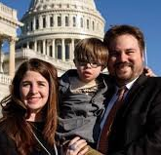
Building Relationships – When?
NOW, and year-round
Don't wait until you have a problem.
Educate elected officials and other decision maker year round.
Bring your child or a self-advocate with you!
They put a face to the story.
It is never too early to start training them how to advocate!

Slide 7
Building Relationships – How?
Request a meeting in their main or local office
Meet them at community events (Town Halls, etc)
Invite them to your group's events (e.g., awareness walks, holiday parties, summer picnics, any event) and show them around
Enlist a self-advocate to host them
Keep in touch (e.g, holiday cards, email updates, organization newsletter and sign up for their e-newsletter)
Thank them publicly when they do something good
Do NOT publicly attack them personally when you disagree
Remember – social media is forever!
Notes:
I receive holiday cards from the family of the elected officials – even after they have left office

Slide 8
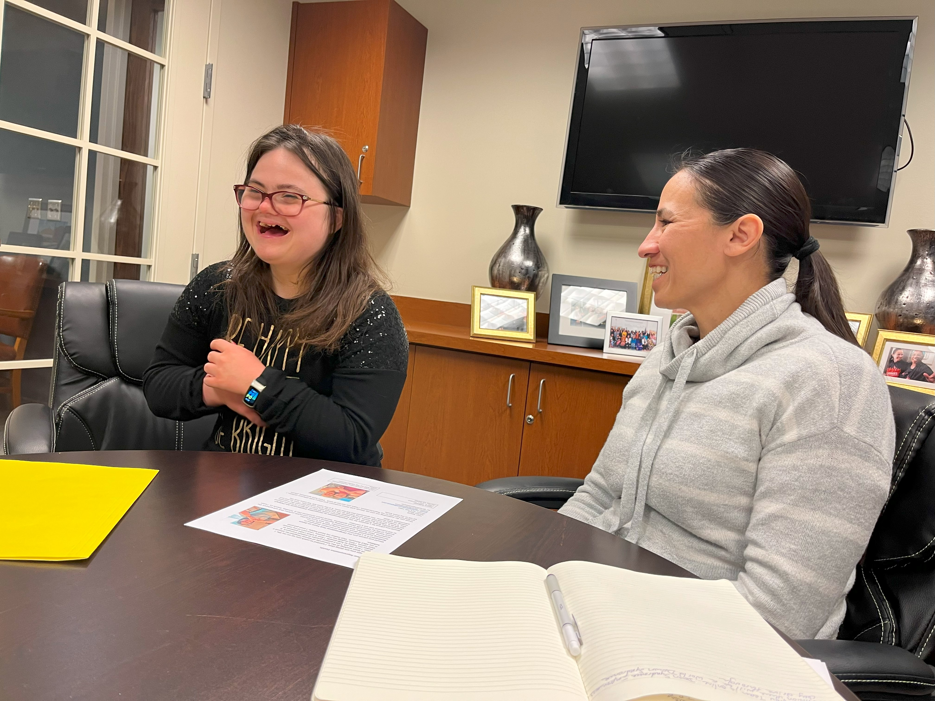
Telling Your Story
If you do not tell your story, how will they know?
You are the expert on yourself and your family
No need to be a policy expert – defer to the professionals for any questions you can’t answer
Keep it brief, factual, and relevant
Use social media if comfortable –short video, photo with story that can be shared
Develop a one-pager (Hannah will teach you how shortly!)

Slide 9
Staying Informed
E-newsletters from various disability organizations (NDSC, The Arc – federal & state, AUCD, National Disability Rights, ASAN)
Local and state alerts, email lists, newsletters
Check out the NDSC Resource List (NDSC Website/Convention App)
Check out disability policy-related websites for information such as:
Policy statements (healthcare, labor, etc.)
Issue briefs (find the list on the NDSC website)
Congressional (Legislative Agenda) (NDSC Website)
Webinars (live or archived)
Podcasts
Disability Scoop, Google alerts
Register for NDSC Action Alerts
Join NDAC and attend/listen to quarterly updates
Notes:
Many people get involved in policy because they have issues with the school system providing a free and appropriate public education. They learn they need to know special ed law so they get informed.
We are in an age of information overload. But you must stay informed.
Trusted Sources
Sort through the noise and customize
-Google – can set alerts on particular keywords that will send you a daily digest of news, e.g, “Down syndrome” “ESSA” “Restraint and seclusion”
Making calls = armchair advocacy

Slide 10

Information to Know for All Levels
Who makes the decisions, and how and when are they made?
Key leaders
Leaders of each party; committee chairs
Constituents of these leaders have important voices
Key committees
Education, Finance, Health, Medicaid/benefits
Basic process
When does legislative session start and end? Any other key dates?
Look to staff for details and deadlines
Major stakeholders
Disability groups
Other groups that could be impacted (e.g., teachers?)

Slide 11
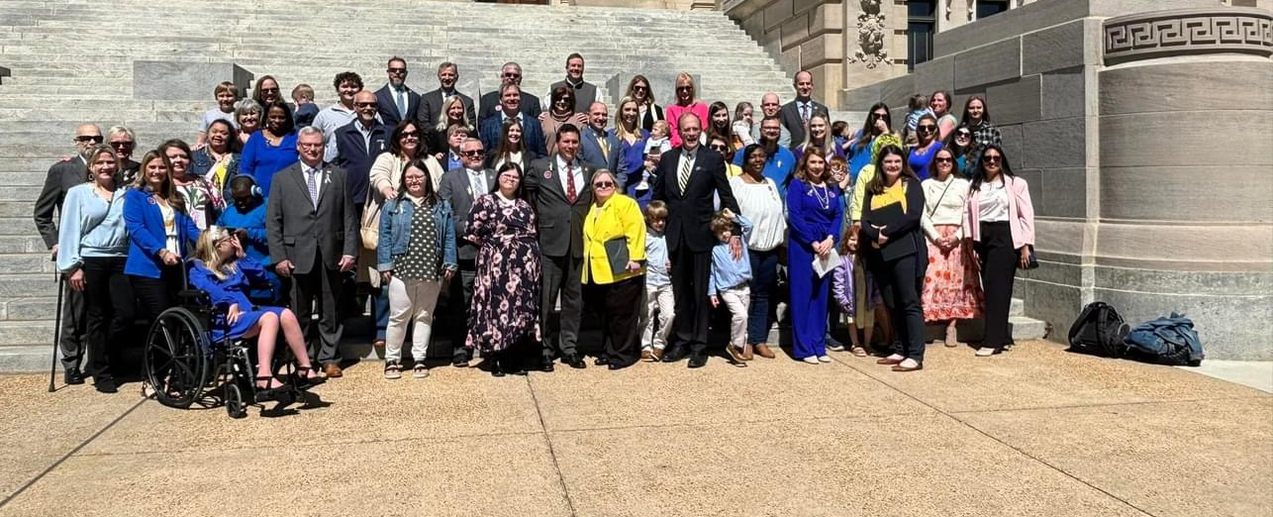
Show Up!
Special days at legislature
Down Syndrome or Disability Day at the State Capitol
Hearings
Rallies
There is power in numbers!

Slide 12
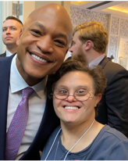
Show up: Meeting with Elected Officials
Meetings
Meet with your elected officials and/or staff
Call number on official site or email and request to meet with the elected official or staff member in charge of disability.
If possible, always invite a self-advocate and let them do much of the talking.
Always start the meeting by thanking them for past support on issues.
Focus on one or two main asks. As you build relationships, you will have the opportunity to educate and ask for more.
Follow up and provide requested materials, thank you notes, and additional development of the legislation (hearings, statements, or state-specific endorsements)
Always be respectful and courteous - patience is key on busy days. Everyone appreciates a warm smile and a courteous meeting.

Slide 13
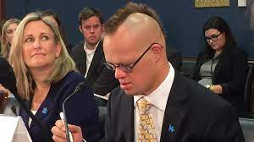
Take Action!
Meet with legislator and/or staff in person or virtually
Write Op-Eds, Blogs, Articles
Educate others
Share on social media
Attend public meetings such as:
Town Hall meetings
Committee meetings
Legislative Sessions
School board
Council Meetings
Testimony
Submit written and/or give oral testimony at
School board hearings
Supporting or opposing certain bills in state legislature (be sure to check the rules for submission, length, format)
Administrative agencies
Video Testimony option
Notes:
Follow-up. Follow-up. Follow-up. Stay in touch but don’t go overboard.

Slide 14
Amplify Your Advocacy Efforts
“FRIEND MAPPING” – who do you know in that could appeal to their Congresspeople and tell your story?
Respond to action alerts – email and call and REPEAT!
Share action alerts with friends and family across country and encourage them to act
Share posts and action alerts on social media
Share information in newsletters and blogs

Slide 15

Follow up! Follow up! Follow up!

Slide 16

Amplify Your Advocacy Efforts - Beware
Social Media can be an easy way to engage. It can also be dangerous.
Follow elected officials and staff members, and yes, even the ones you do not like or support.
What you say is forever.
Context is lost and your meaning may be misconstrued.
Social media is often personal opinion and not based on fact. In the age of Artificial Intelligence (AI), it can be challenging to validate information. Advocacy groups like NDSC, the ARC, State Protection and Advocacy (Disability Rights) are excellent resources to help validate disability-related information.
Notes:
Remember that social media posts are forever.
Stick to the issues when interacting with legislators – no personal attacks!
Sharice Davids Tweet

Slide 17
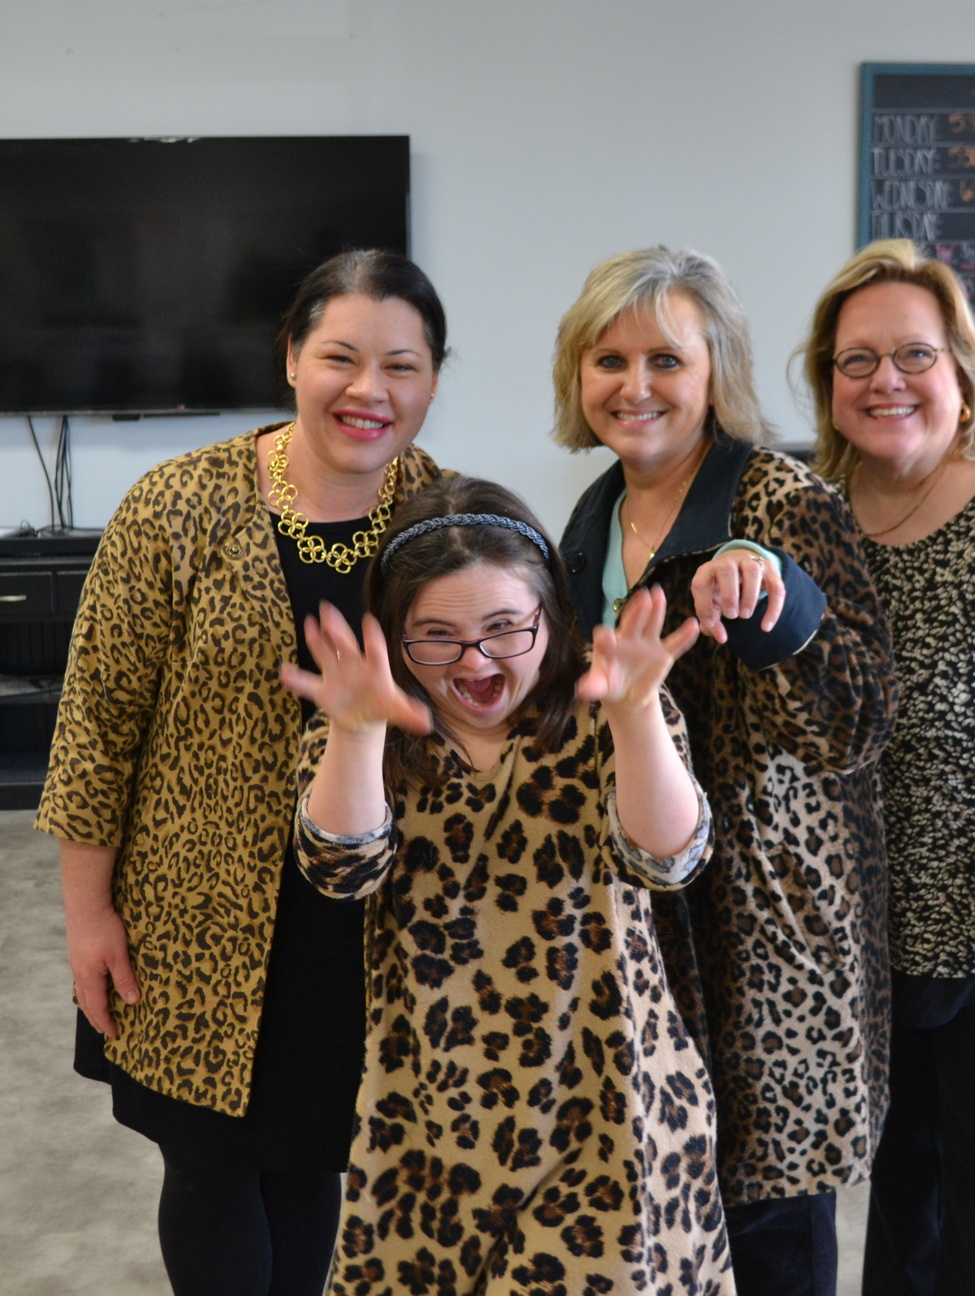
Staff Relationships
Make efforts to get to know the staff
Visit staff in person at the local office and DC office, if possible
Invite them to events or to visit your school or non-profits
Staffers may move to other offices, but your relationship may remain intact
Coffees with staffers
Attend functions such as receptions
Welcome staff into your home (if possible - friendly conversation)
RESPECT

Slide 18
Advocacy Reminders
Respect – always keep conversations and public discussions respectful, even if you disagree
Recognition – elected officials like to be publicly thanked and recognized on social media and in newsletters. Thanking both the staff and the elected official is important. Everyone likes to feel appreciated. And yes, say thank you for your time even when they do not do what you want.
Realize the power of staff – staff can be even more important than the elected officials themselves
Relationships – a big part of advocacy is
building relationships.
Notes:
“No permanent friends, no permanent enemies” – advocate for/against issues not people. Latest example – HR 620, ADA Reform Bill. Passed House but there were about a dozen Rs who voted against it after hearing from their disability advocates – these are the same people who had also voted YES to gut the ACA and Medicaid. We cannot hold grudges, we must continue to engage with them. Conversely, handful of Dems who are generally supportive of disability community who voted YES due to pressure from their business constituents.

Slide 19
Meet Hannah LaCour
26 years old – Lives in Kenner, Louisiana
Works at Sodexo doing Cold Prep and Lunch Prep at the Louisiana Superdome and Smoothie King Center
Hostess at Ruby Slipper
Active Self-Advocate and Community Leader
“I believe it is important for our communities to see the ability of individuals with Down syndrome, and I am able to demonstrate this by being employed in both of my jobs and also through my personal advocacy journey.”

Slide 20
Hannah’s Personal Advocacy Journey
Other Personal Advocacy Highlights:
I have held Board positions on the local, state, and national levels.
NDSC Self Advocate Board Member 2024- to the present
Louisiana Law Enforcement Torch Run (LETR) Athlete Advocate Representative 2023 – to the present
University of Louisiana at Lafayette (ULL) Learning Is For Everyone (LIFE) Alumni Chapter 2024 – to the present
Ruby’s Rainbow Advisory Committee 2024 – to the present
Down Syndrome Association of Greater New Orleans (DSAGNO) Self Advocate Board Member 2016 – 2023
I have received the following recognition and awards in my Parish and State:
Jefferson Parish Council Proclamation – November 15, 2017 “Hannah LaCour Day” for outstanding achievements
Governor’s Outstanding Leadership in Disabilities (GOLD) Award and 2018 – Youth of the Year Award

Slide 21
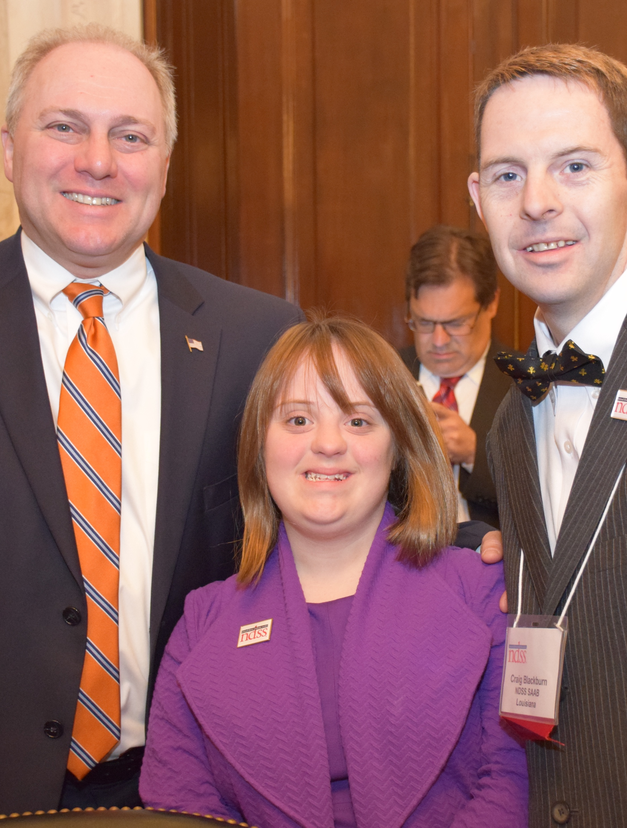
Personal Advocacy
Personal advocacy has allowed me to:
Travel to Washington, D.C. to participate in Buddy Walks where I met with Louisiana’s U.S. Senators and Representatives.
Regularly attend local Civic Association meetings where I network with local and State elected officials.
“The power of self-advocates voices are impactful when elected officials listen to me and appreciate what I have to say and that I give back to the community. These individuals see me attending council meetings and know that I can.”

Slide 22
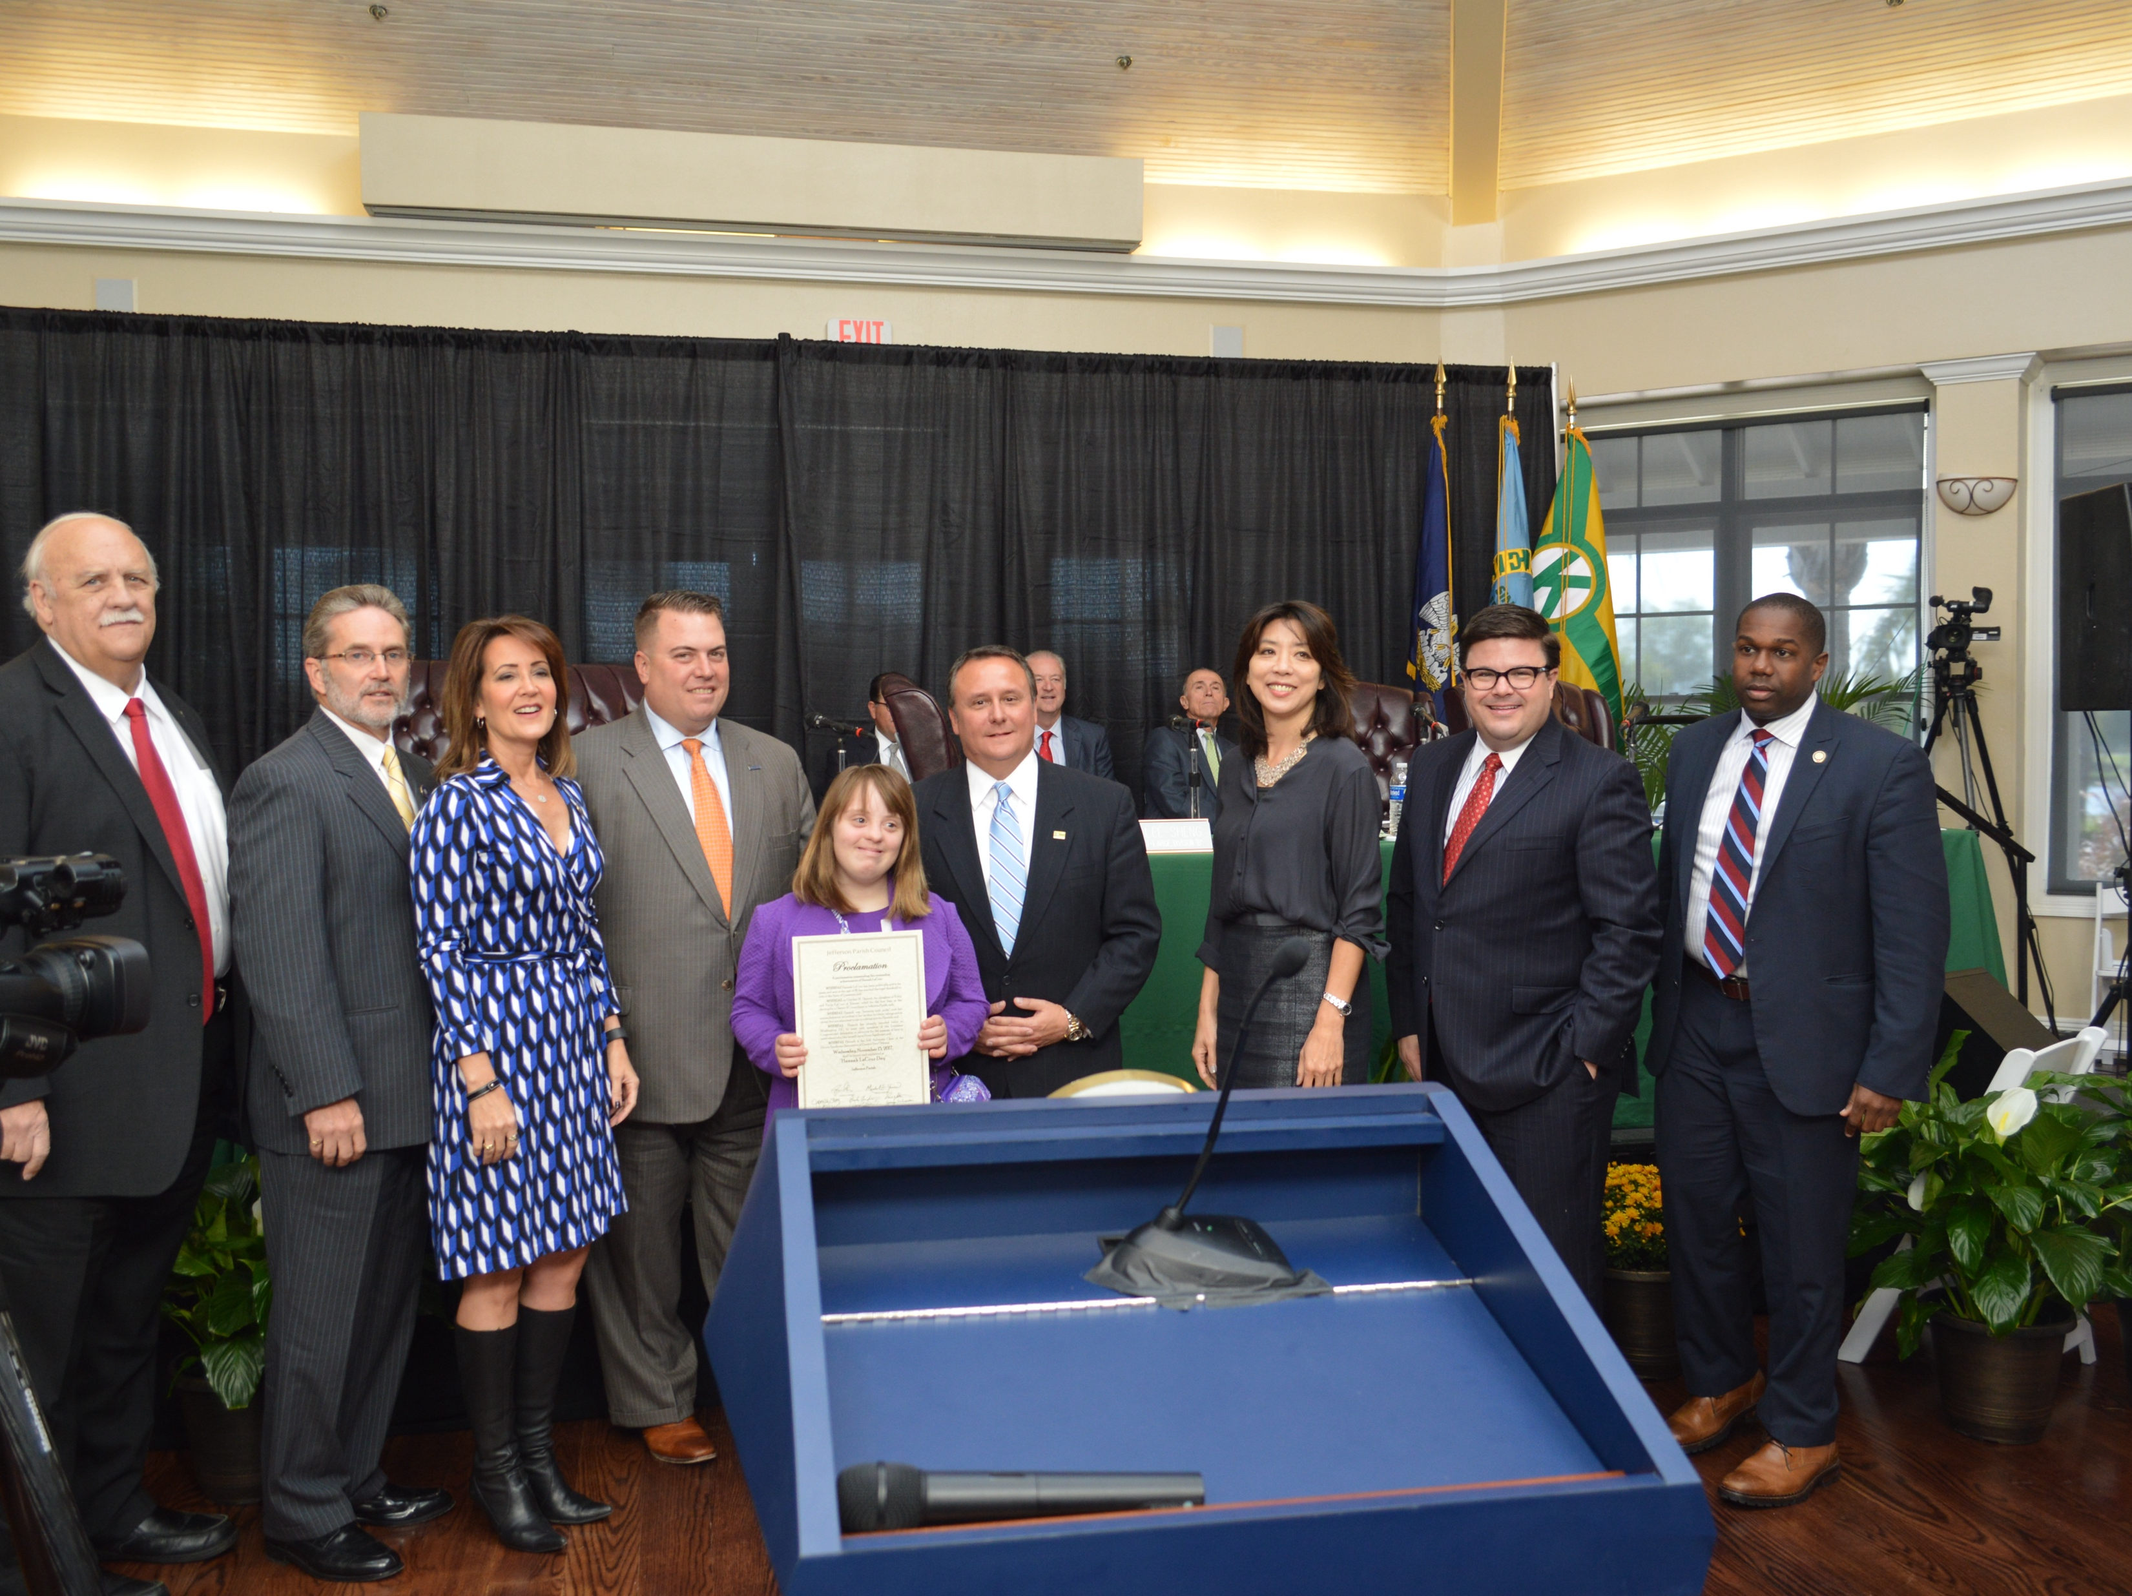
Hannah with Parish and City-Elected Officials .

Slide 23

The Power of Self-Advocates
We, self-advocates are THE MOST EFFECTIVE advocates
We should be engaged in all aspects of advocacy
Should bring one-pager about themselves to meetings
Provide necessary tools and training so we can meaningfully participate
Public speaking workshops
Participation in advocacy trainings, conferences, Hill Days
Remember to create and include opportunities for those who use alternative communication
Notes:
Consider providing workshops and training for SAs on public speaking –
Give them tools to advocate for themselves at school, in their jobs, etc

Slide 24

Preparing to Share Your Story
Know your "why" — why is this issue important to you?
Keep it short and personal
Practice with friends or family!

Slide 25

Before the Meeting
Learn your elected official's name and position
Know the bill or topic you're talking about
Bring a one-pager or leave behind info

Slide 26
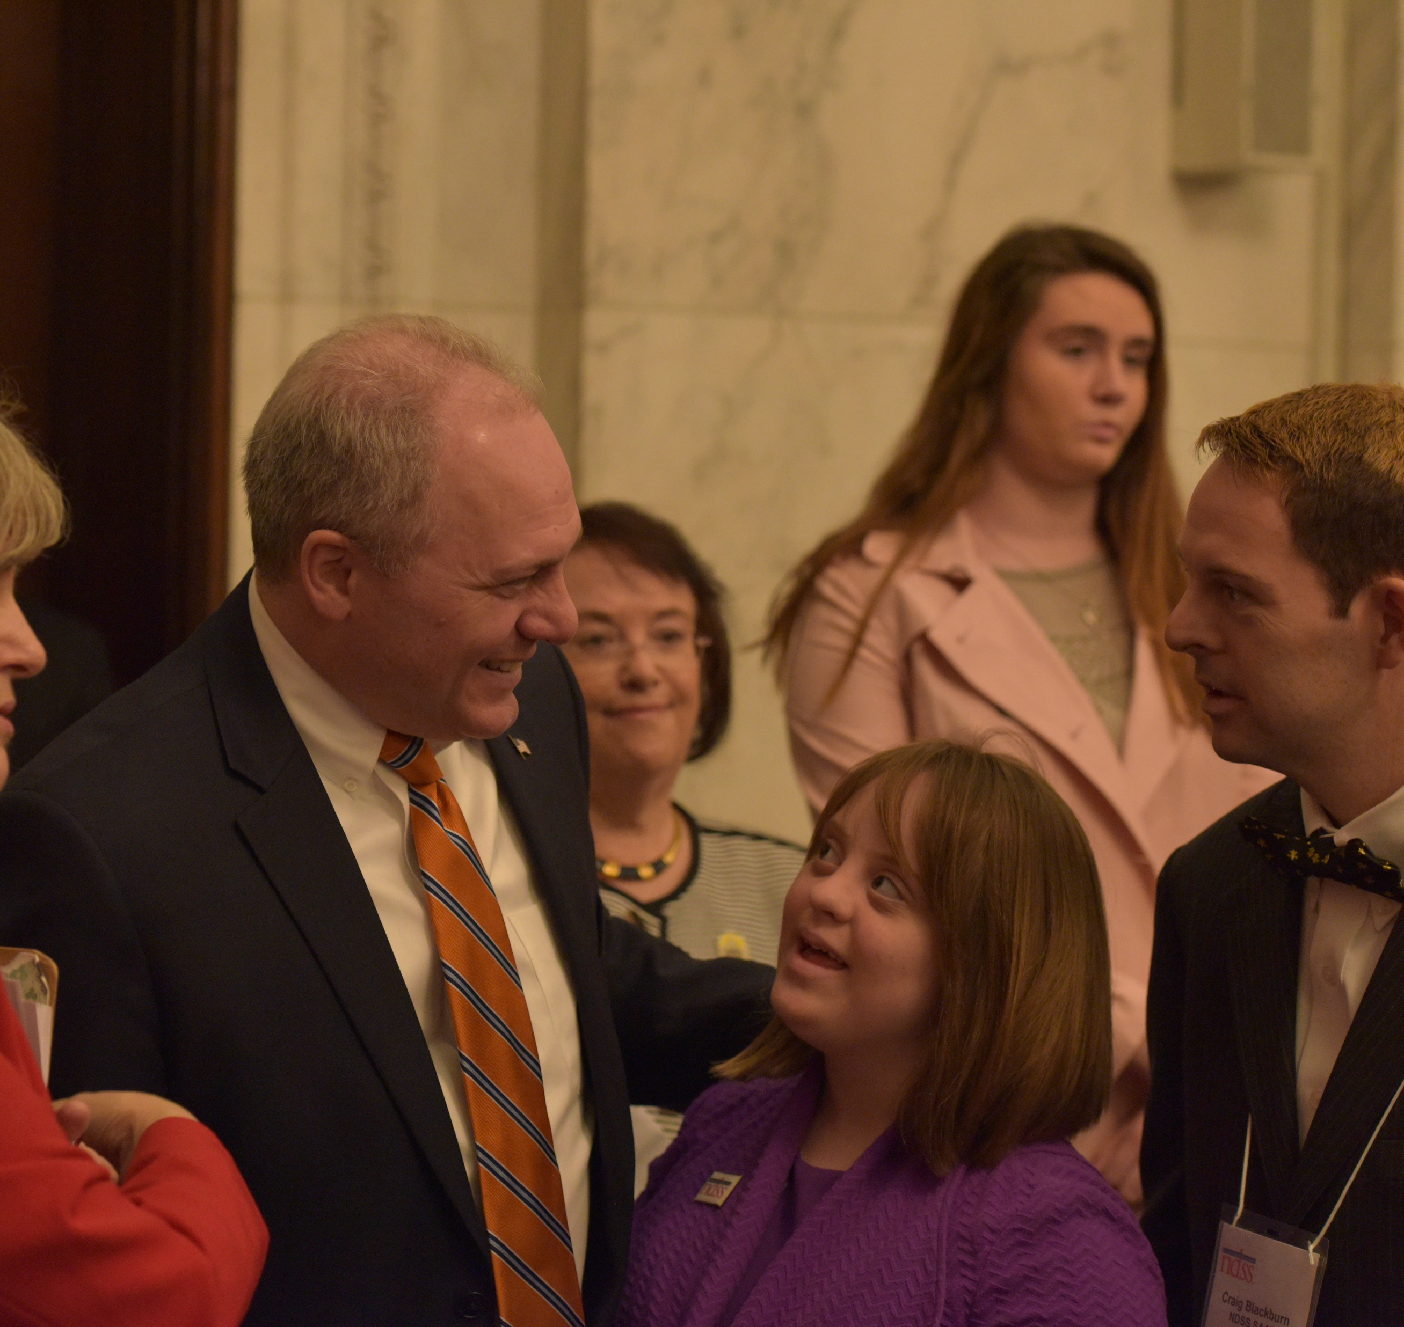
During the Meeting
Introduce yourself confidently
Share your story in 1-3 minutes
Ask for something particular (example: co-sponsor a bill)
Be polite, smile, and thank them
Be prepared to be flexible

Slide 27

After the Meeting
Send a thank you note or email
Follow up with additional information if needed
Stay connected with their office
Post on social media about your experience and what you are advocating for!
Remember to ask permission to post social media

Slide 28
Tell Your Story: One-Pagers
Tell Your Personal Story
Your most powerful tool is your story! Telling an elected official how something will impact your life is powerful.
A one-page leave-behind can be used in many situations including:
In-person meetings
Requests for virtual meetings
Emails
Be sure to update it regularly with new information and new policy related asks.

Slide 29
Tell Your Story: One-Pagers
Remember to always include:
Contact information including your name, street address including your zip code (constituents have power), phone, and email address.
If you want to include your Instagram, Twitter or other social media that is optional.
Photo – action or otherwise
A few sentences about yourself (where you work, go to school, your interests).
The Ask and why you are asking – how does this impact you, your friends, or someone you care for
Always say thank you and tell them how they can contact you.
Always keep it to one-page. People are more likely to read it.

Slide 30

What is a Policy Related Ask?
An ask is when you request that an elected official, committee member, or other leader support a bill or not support a bill, motion, or idea.

Slide 31
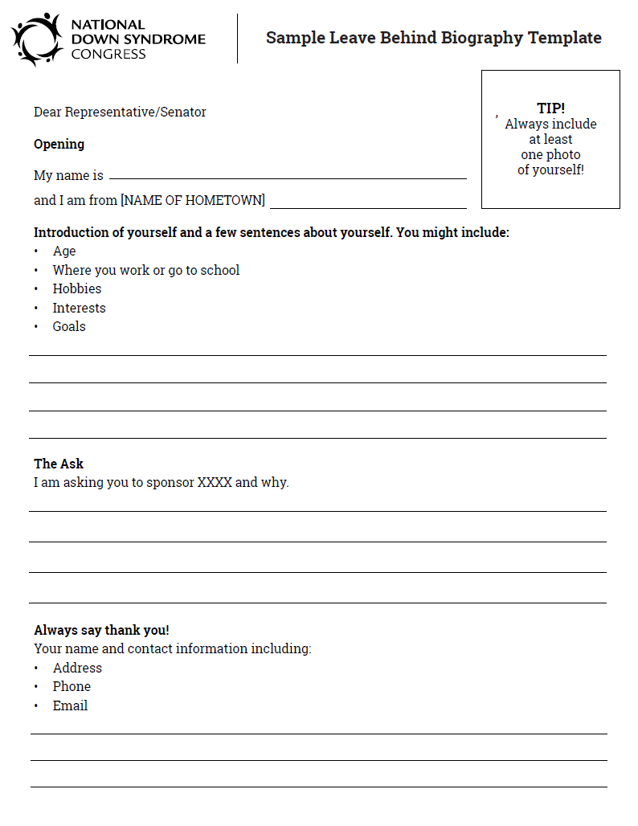
One-Pager Template for Meetings with Elected Officials This is a one-pager template that you can use as a guide. One-Pager Template

Slide 32
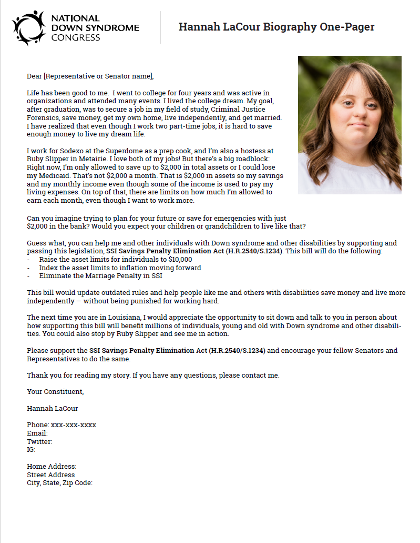
This is a copy of my one-page leave behind. You can find it and examples from other self-advocates on the NDSC website - Hannah LaCour One-Pager

Slide 33
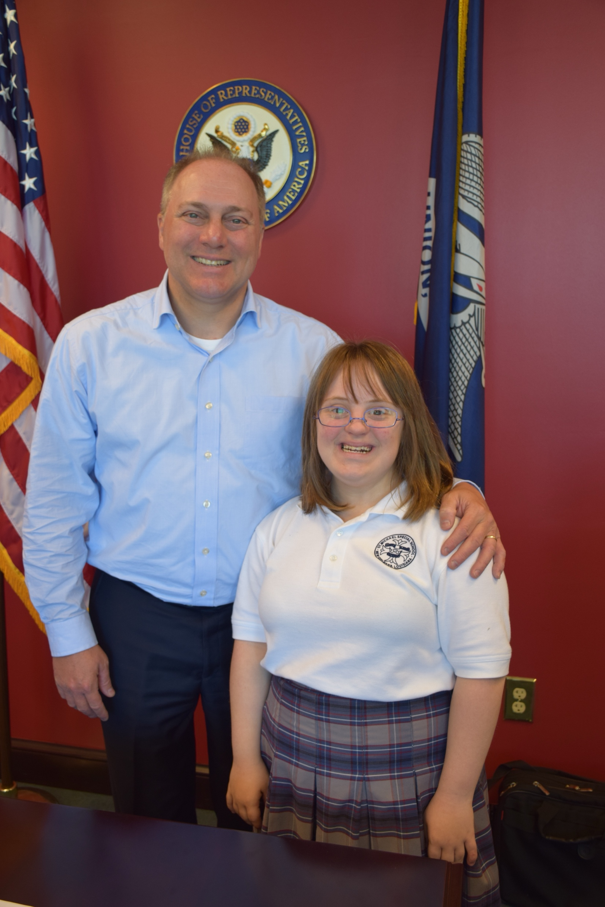
Hannah’s Advocacy Tips
Be yourself — your story is enough
Bring a friend or support person if needed
It’s okay to be nervous — just speak from your heart!
Remember:
“It is not about what we can’t do; but what we can do when given the opportunity.”

Slide 34
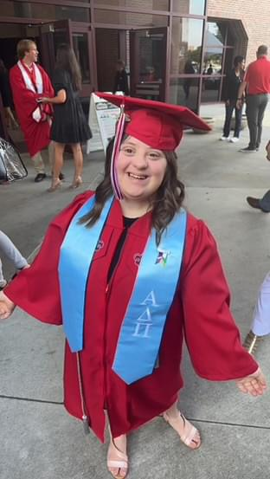
A Proud Moment
One of the proudest accomplishments in my life was completing a four-year curriculum at the University of Lafayette in 2023 as a graduate of the UL LIFE Program.

Slide 35
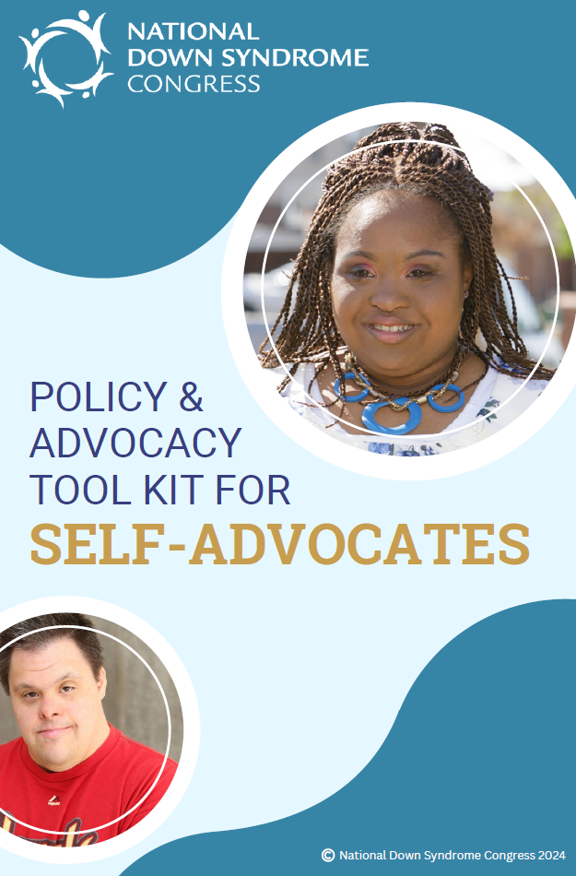
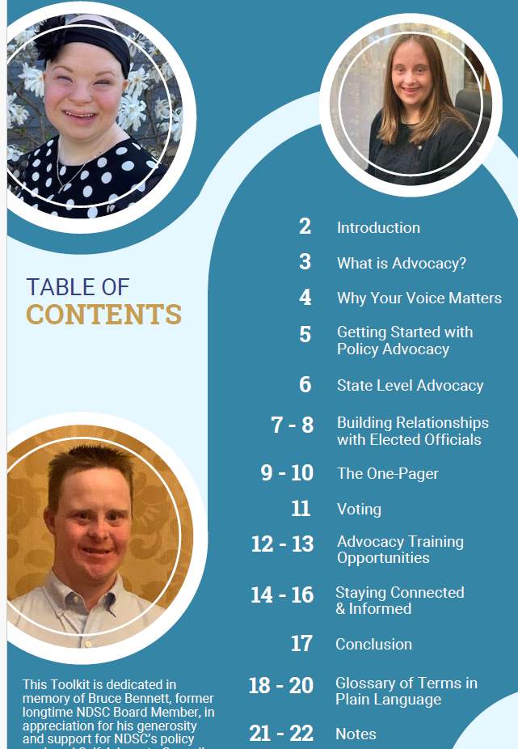
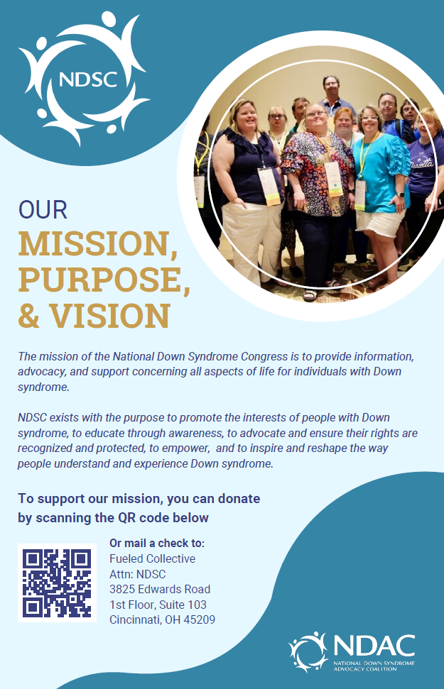
Policy Toolkit for Self-Advocates
NDSC Policy Advocacy Toolkit for Self-Advocates

Slide 36

When we advocate, we show that people with different abilities have good lives and make the world a better place.
Remember, every person’s advocacy will be different, but all of us can make a difference.

Slide 37
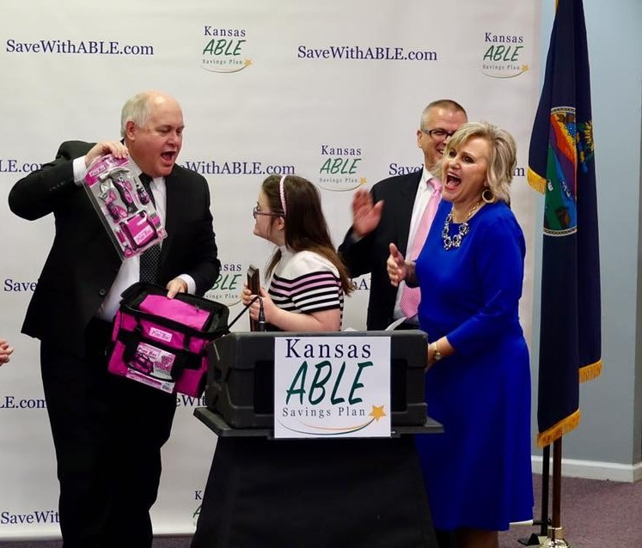
WE CAN DO THIS!!!
Do a little or a lot – but do something!
Advocacy is a marathon not a sprint
Our voices matter
We are all in this together
We are problem-solvers
We are resilient
We are powerful!

