Slide 1


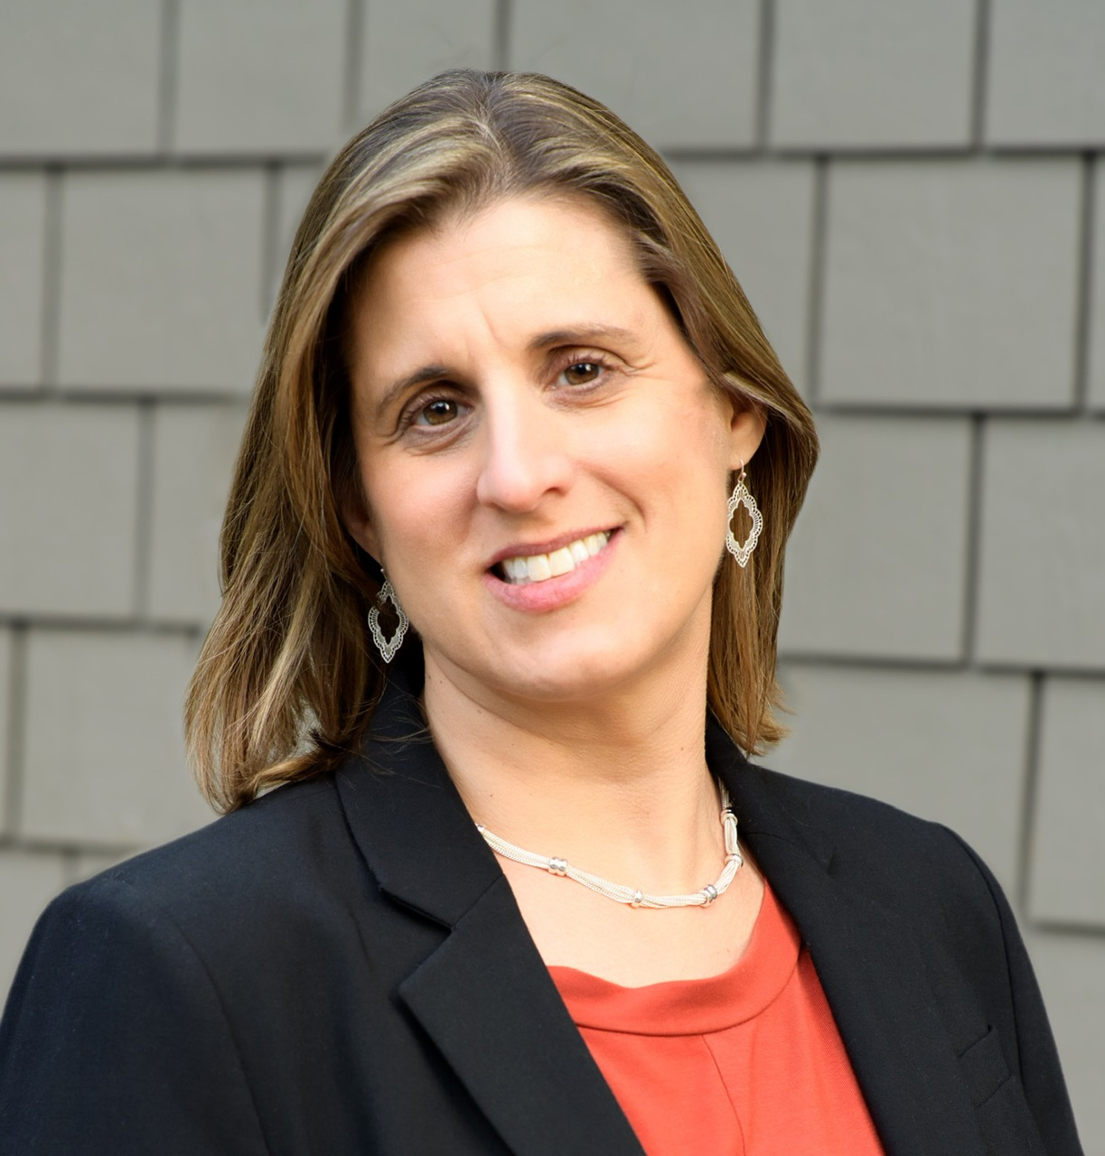
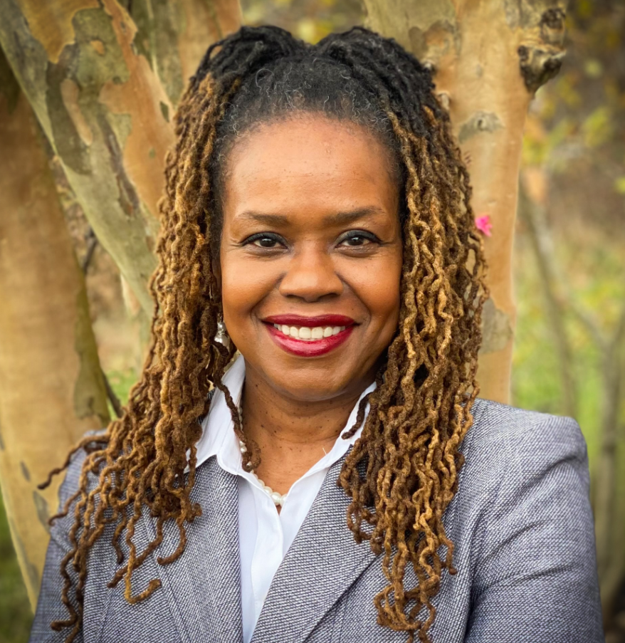
The Big Asks: What We’re Taking to Capitol Hill
Stephanie Smith Lee
NDSC Policy & Advocacy Co-Director
Heather Sachs
NDSC Policy & Advocacy Co-Director
Valerie C. Williams
Co-Founder & CEO, Apokrisis Consultants, Inc.

Slide 2



The Big Asks:
What We're Taking to Capitol Hill
Heather Sachs, Valerie C. Williams & Stephanie Smith Lee
September 29, 2026

Slide 3

Agenda
What is an "Ask"?
Supplemental Security Income (SSI) Savings Penalty Elimination Act
Transformation to Competitive Integrated Employment Act (TCIEA)
HCBS Access Act
Save the Department of Education

Slide 4
What is an "Ask"?
An Ask is what we want Congress to do
It gives your meeting a clear goal
Examples: support a bill, oppose a bill, increase funding, or move a bill forward
We chose issues that matter to people with Down syndrome
Our Asks cover different ages and stages of life
We chose issues where advocacy can make a difference
Pick 1–2 Asks that matter most to you
House and Senate Asks may be different, but your story stays the same
Notes:
We have 4 asks – you will not get a chance to discuss all of them in a 30 minute meeting.
When you meet w your Team Huddle at end of the day, you can decide what you want to focus on.
The Ask is really the point of the meeting. You’re not just telling your story—you’re asking the Member of Congress to do something.
Your story is what makes the Ask powerful. Explain why the issue matters to you, and then give them a specific action they can take. Putting a real face and voice to the issue is what propels Congress to act.

Slide 5
SSI and the Savings Penalty
SSI (Supplemental Security Income) provides monthly payments to people with disabilities and older adults with very limited income and savings.
SSI helps pay for basic needs and is an important pathway to Medicaid for many people with disabilities.
But SSI has an outdated savings limit: $2,000 for an individual and $3,000 for a couple.
These limits have not increased since 1989, making it difficult to save for emergencies and plan for the future.
Notes:
Will go through this quickly bc you will get much more information about this issue in this afternoon's breakouts
There are many more problems with SSI, especially the income limitation. All of these need to be addressed, but Congress is not going to do it in a single bill (will cost too much).
We are hoping to come back next session and work on a bill to increase the income limit.

Slide 6
SSI Savings Penalty Elimination Act
(H.R. 2540/S. 1234)
This bipartisan bill would:
Raise the savings limit to $10,000 for an individual
Raise it to $20,000 for a couple
Index the limits to inflation so they keep up over time
Address the marriage penalty in SSI’s savings rules
Allow people with disabilities to save more without losing SSI eligibility
Notes:
This bill is extremely bipartisan. 17 Senate cosponsors range from Sen. Ted Cruz (TX) to Sen. Durbin (IL); and House (37) - 19 R, 18D.
Of all of our asks, we estimate this one has the best chance of passage this session.

Slide 7
SSI Savings Penalty Elimination Act:
Talking Points
$2,000 asset limit ($3,000 for married couples) has not been updated since 1989
Lets people save and plan for the future
Eliminates the SSI marriage penalty in asset limit rules
Indexes asset limits to inflation
Promotes independence & financial security
Strong bipartisan support
THE ASK: Cosponsor the SSI Savings Penalty Elimination Act.
Notes:
The $2,000 limit was set in 1989 and Congress simply never updated it.
$2000 isn’t enough for an emergency fund today. A car repair, medical expense, or other unexpected bill can wipe that out very quickly.
SSI actually penalizes marriage. Two individuals can each have $2,000, but if they marry, they can only have $3,000 combined.
Note that this only addresses the marriage penalty in the asset limitation. There are also marriage penalties in the SSI income limitation and the actual SSI monthly payment, as well as in other gov't benefits programs e.g. SNAP
This bill fixes that by raising the limits to $10,000 for an individual and $20,000 for a couple—and indexing them so we don't end up in this situation again.
This is also a bipartisan issue. It’s about letting people with disabilities save a reasonable amount of money without losing essential benefits.

Slide 8
Subminimum Wage & Employment
Federal law still allows some employers with Section 14(c) certificates to pay workers with disabilities less than minimum wage
Workers may earn just a few dollars an hour and work in segregated settings
Competitive integrated employment (CIE) means working alongside people with and without disabilities for fair wages
People with disabilities deserve opportunities for real jobs, fair pay and career growth
Notes:
Go through this quickly bc you will get much more information about this issue in this afternoon's breakouts
This law dates all the way back to 1938. Section 14(c) still allows certified employers to pay some workers with disabilities less than the federal minimum wage.
We’ve learned that disability does not mean someone can’t work in a regular job. With the right supports, people with significant disabilities can work successfully in their communities.
This isn’t just about a paycheck. Work provides independence, relationships, skills, and a chance to build a career.
Competitive integrated employment is about having the same opportunities as everyone else. That means at least minimum wage, working alongside people without disabilities, and having opportunities to advance.

Slide 9
TCIEA (H.R. 4771/S. 2438)
This bipartisan bill would:
Phase out Section 14(c) and subminimum wages over 5 years
Stop issuing new 14(c) certificates
Provide grants and support to help states, employers and workers transition
Help people move to competitive integrated employment or meaningful day services
THE ASK: Cosponsor the Transformation to Competitive Integrated Employment Act (TCIEA).
Notes:
Bipartisan but not ripe for passage in this Congress.
This is a longer-term advocacy effort. The current Administration has taken a different approach to 14(c).
In July 2025, the Department of Labor withdrew the previous Administration’s proposed rule that would have phased out 14(c) certificates, and DOL continues to process 14(c) certificates today.
For this bill, we are EDUCATING about the issue and getting ready for next Congress if there is a change in leadership in one or both chambers.

Slide 10
TCIEA: Talking Points
People with disabilities can and want to work
Equal work deserves equal pay
Hiring people with disabilities is good for business
States are already successfully moving away from 14(c)
  16+ states have acted to eliminate subminimum wages
  Needs to be done on federal level because change needed to federal law
Employment outcomes have improved in states like New Hampshire
TCIEA phases out 14(c) over 5 years — not overnight
Time, grants & technical assistance will support the transition to CIE
Notes:
The important point is that we know this transition can be done. A number of states have already moved away from 14(c), while nationally the number of people working under 14(c) certificates has fallen dramatically—from about 424,000 in 2001 to about 40,600 in 2024.
But states can only go so far on their own. Section 14(c) is part of federal law, so eliminating it nationwide ultimately requires federal action.
We’re not suggesting that we just shut programs down and leave people without supports.
TCIEA creates a five-year transition with grants and technical assistance to help states and providers build better employment and integrated-service options, including for people with significant disabilities.
The goal is not just to eliminate something—it’s to build something better.
More opportunities for people with disabilities to earn fair wages and work alongside people without disabilities.

Slide 11
What Are HCBS & Why Do They Matter?
Home and Community-Based Services (HCBS) help people with disabilities live in their homes and communities instead of institutions.
HCBS can include:
Direct support staff and help with daily activities
Job and employment supports
Day and community services
Respite and family supports
HCBS help people live at home, work, volunteer and participate in their communities.
Without HCBS, people may have to rely on unpaid family caregivers or institutional care.
Notes:
Many people don't realize that they are using HCBS when we hear the term "waiver services."
HCBS is really the support that makes community living possible. It’s not one particular service—it’s the range of supports someone may need to live an everyday life in their community.
Think about all the things most of us do every day. Getting ready in the morning, going to work, getting out into the community, shopping, seeing friends. HCBS can provide the support a person with a disability needs to do those same things.
And HCBS doesn’t just support the person with a disability—it supports the whole family.
Without adequate services, families often end up filling the gaps themselves, sometimes providing significant amounts of unpaid care, sacrifice their jobs, etc
Now that we know what HCBS are and why they matter, let’s talk about how we actually pay for them—because that’s where Medicaid comes in.

Slide 12
How Do People Get HCBS?
HCBS are primarily funded through Medicaid, a federal-state partnership
Many HCBS are provided through Medicaid waivers, which allow states to offer community services to specific groups
Many HCBS are optional — states can decide what to offer and can limit enrollment
This can result in long waiting lists and different services from state to state
Institutional care is required under Medicaid. Many community-based services are not.
Notes:
Federal government sets broad rules, but states have a lot of control over what their HCBS systems look like.
That’s why services can look completely different depending on where you live. Someone with the same disability and the same support needs may have access to very different services in Maryland than they would in another state.
All states MUST cover things like doctor appts, hospital services, transportation to medical services
States MAY cover things like dental, vision, speech therapy, PT, respite, personal care
What are you waiving? Your right to receive services in an institution (called the "institutional bias")
The Center for Medicare & Medicaid Services (CMS) is also letting a state "waive" regular Medicaid rules so it can provide a particular package of community-based services.
There is an entitlement to certain institutional services under Medicaid, meaning the state MUST serve you...but it will do so in an institutional setting like a nursing home., but there generally isn’t the same entitlement to HCBS.
States can cap waiver enrollment, which is one reason people can end up on waiting lists for years.
So we have a system where, in many circumstances, Medicaid has to pay for institutional care—but it doesn’t necessarily have to provide the services that allow someone to stay in their own home and community. (this is called the "institutional bias")

Slide 13
Medicaid Funding Cuts Put HCBS At Risk
Medicaid is a federal-state partnership — both pay for services but the state runs the program
Federal Medicaid cuts put more pressure on state budgets, providers and services
The 2025 reconciliation law (H.R. 1) made major Medicaid changes and significantly reduces future federal Medicaid spending
States may respond to budget pressure by limiting services, provider payments or enrollment
Because many HCBS are optional, they can be particularly vulnerable
Notes:
When the federal government spends less on Medicaid, the need for services doesn’t disappear. States still have to figure out how to operate their programs with the resources available. Medicaid is jointly financed, while states administer their programs within federal requirements.
States have choices about how they respond. Changes can affect eligibility and enrollment, what optional services are offered, and how providers are paid.
Studies have shown that nationwide, HCBS services are one of the first things states cut from their budgets
The federal changes are not small! CBO now projects that the 2025 reconciliation law will reduce federal Medicaid outlays by about $1.2 trillion from 2026–2035 compared with its prior baseline
Less federal funding = states must make up the gap

Slide 14
Olmstead & Community Living
Are Under Threat
Olmstead (1999) protects against unjustified institutionalization and supports receiving services in the most integrated setting appropriate
In 2026, DOJ took a narrower position on the federal integration mandate
On Sept. 23, a federal court struck the community-integration provisions of the 2024 Section 504 rule nationwide
Olmstead, the ADA and Section 504 remain the law — but federal protections and enforcement supporting community living have been weakened
Notes:
At its heart, Olmstead was about two women (Lois Curtis and Elaine Wilson) who were capable of living in the community but were kept in an institution anyway.
They fought for the right to live in the community—and the Supreme Court said unnecessary institutionalization can be disability discrimination under the Americans w Disabilities Act and Section 504 of the Rehabilitation Act.
What’s changed is not the underlying statutes or the Olmstead decision—it’s the federal government’s interpretation and some of the regulations supporting enforcement.
DOJ’s June 2026 legal opinion took the position that the ADA and Section 504 themselves do not impose an integration mandate
We may see much less federal enforcement when states fail to provide the services people need to live in the community.
DOJ has already started withdrawing from Olmstead enforcement cases. That means private disability advocates may increasingly have to bring these cases without the federal government standing beside them

Slide 15
The HCBS Access Act
(H.R. 8540/S. 5321)
The bill would:
Make HCBS a required Medicaid service
Help end waiting lists
Strengthen the direct care workforce
Support family caregivers
Help more people live in the community
THE ASK: Cosponsor the HCBS Access Act.
Notes:
This bill really gets at the problem we just talked about: HCBS are optional while institutional care is mandatory.
The bill would make HCBS a mandatory Medicaid benefit, giving eligible people a meaningful option to receive services at home and in the community.
It’s not enough to say people have a right to live in the community if they sit on a waiting list for years.
The bill is designed to expand access and address waiting lists.
Services only exist if we have workers to provide them. That’s why strengthening the direct-care workforce is an important part of the proposal.
This is also a family issue. When services aren’t available, families often become the default caregivers.
Unfortunately the bill is

Slide 16
HCBS Access Act: Talking Points
Promotes independence and self-sufficiency
Costs less than institutional care
Helps people work and contribute to their communities
Prevents unnecessary institutionalization
Reduces pressure on family caregivers
Addresses years-long HCBS waiting lists
Strengthens the direct support workforce
Helps people live, work, and thrive in their communities

Slide 17
Protecting the Education of Students with Disabilities and Stopping ED Dismantling
What does the US Department of Education do?
What does the Department not do?
Key offices for students with disabilities.
Why keeping the Department is essential for students with disabilities
Why moving special education to HHS would harm students, cause chaos, and make problems for states and districts
What Congress can do.
Notes:
Stephanie

Slide 18
The U.S Department of Education
What It Does:
Protects students' civil rights
Oversees special education implementation by states
Distributes federal education funding
Provides guidance, technical assistance, and accountability for states
Expands access to higher education
What It Does NOT Do:
Set curriculum or decide teaching materials
Control how states train and certify teachers
Develop or approve IEPs
Notes:
Stephanie

Slide 19
Key U.S. Department of Education Offices for
Students with Disabilities
Office of Special Education and Rehabilitative Services (OSERS)
Office of Special Education Programs (OSEP)
Enforce IDEA
Oversees billions in special education funding
Ensure states actually provide legally required services to students with disabilities
Rehabilitation Services Administration (RSA)
Runs federal vocational rehabilitation programs that help SwD transition from school to jobs and adult life
Office of Elementary & Secondary Education (OESE)
Manages Title I and other K-12 funding streams that directly support low-income students with disabilities in public schools
Office for Civil Rights (OCR)
Investigates discrimination complaints and forces schools to fix violations when students with disabilities are denied equal access or illegally excluded
Office of Postsecondary Education (OPE)
Oversees college access, disability accommodations, and federal aid programs that allow SwD to attend and succeed in higher education)
Notes:
VALERIE
SWD are general education students first.

Slide 20
Office of Special Education Programs (OSEP)
What OSEP does
OSEP helps make sure IDEA works for students with disabilities
Makes sure states follow IDEA, the federal special education law.
Sends special education funds to states.
Reviews state reports each year.
Tells each state if it met IDEA requirements or needs help.
Requires action when a state has repeated or serious problems.
Checks state fix-it plans and helps states solve problems.
Notes:
VALERIE
OSEP reviews state reports each year.
OSEP sends each state a letter saying if it met IDEA requirements or needs help.
When a state has repeated or serious problems, the Department must take action.
OSEP checks state fix-it plans and helps states solve problems.
-----------------------------------MODIFY
Monitoring/Enforcement - States submit annual performance reports (APRs).
OSEP determination letters tell states whether they have met IDEA requirements, need assistance or need intervention
If in the “needs assistance” category for 2 or more consecutiveyears or “needs intervention,” ED must take enforcement actions
OSEP must monitor the states to make sure states comply with their Corrective Action Plans (CAPs), and provide technical assistance to the states
OSEP distributes the formula grants and funds technical assistance centers, teacher preparation grants, and other grants.

Slide 21
Administration Attempting to Dismantle ED
The Department of Education cut over 40 percent of jobs.
It also canceled almost $2 Billion in contracts and grants.
These cuts will make it harder for the Department to do its work, including checking programs and enforcing laws.
The Department made agreements to move programs to other federal agencies
  Some education programs have moved to Labor, and others to Health and Human Services
  Civil rights has moved to Justice
Notes:
Valerie
June 2026 ED Office of Inspector General Report:
ED reduced workforce by 40% (3,902 to 1579). Cancelled contracts of $1.3B and grants of $504M. May impact statutory responsibilities, monitoring and enforcement.
14 Interagency Agreements (IAAs) transfer programs to 6 agencies, including
OESE to DOL
OSERS (including Office of Special Education Programs and Rehabilitation Services Administration) to HHS, and
Office of Civil Rights (OCR) to DOJ

Slide 22
Moving OSEP to HHS:
A Crisis for Students with Disabilities
Buried in Bureaucracy
The rights of students with disabilities would be buried in a vast bureaucracy where larger programs would take priority
Education and Civil Rights Law
IDEA is fundamentally an education and civil rights law, not a medical program. It must remain in a department dedicated to education and educational equity.
Disrupted Collaboration
Closing ED and scattering its offices across multiple agencies will disrupt critical collaboration among offices within ED, including OSEP, OESE, OCR, OPE, RSA, and IES
Weakened Accountability
Moving OSEP will lead to loss of institutional knowledge, reduced funding for critical programs, and make it easier for states to ignore their responsibilities under IDEA.
Notes:
VALERIE
Civil rights enforcement collapsed
OCR investigations stalled or stopped, leaving discrimination complainsunresolved and illegal practices in schools uncorrected
IDEA oversight weakened
Loss of critical staff who monitor state compliance, provide technicalassistance, and intervene when special education services are denied =fewer federal safeguards for SwD
Grant delays and cancellations increased
Schools and nonprofits experienced delayed payments, canceledcompetitions, and sudden grant terminations - triggered local stafflayoffs and service cuts
States lost federal guidance
School systems left without training, monitoring, and compliance support

Slide 23
Congressional Action on Dismantling
House: A House Committee voted to approve 10 bills to make it legal to move some education programs to other agencies. Special education and civil rights were not part of those bills. A bipartisan bill, H.R. 10232 was introduced in the House, to keep some education programs at ED, including special education, vocational education, elementary and secondary education, postsecondary and Indian education.
Senate: Bipartisan bill S. 5046 passed the Senate Committee. It is the same as the House bill H.R. 10232.
The Office for Civil Rights was not part of these bills and also needs to stay at ED
Notes:
STEPHANIE
House: On July 15, the House Education and Workforce Committee voted on party lines to advance bills that would put into law the efforts by ED to move programs to other agencies. OSERS and OCR were not included in these bills.
Senate: Bipartisan bill S. 5046 introduced by Sens. Tim Kaine (D-Virginia), Susan Collins (R-Maine), and Lisa Murkowski (R-Alaska):
Would block ED from using IAAs, or other means, to move core functions of certain education programs out of ED.
On July 30, with a 13-9 vote, the bill advanced out of committee.
The programs this bill would keep at ED: OSERS, OESE, OPE , and OIE (an amendment to add OCR was defeated).

Slide 24
Policy Summit Ask: Support Bill to
Stop Dismantling (S. 5046/H.R. 10232)
What the Bill Would Do:
Keep key education programs within the Department of Education. The bills prohibit transferring the functions of the Office of Special Education and Rehabilitative Services (OSERS), as well as key elementary/secondary, postsecondary, and Indian education offices to other federal agencies.
Protect federal expertise and accountability for the Individuals with Disabilities Education Act (IDEA). Special education programs would remain within the agency Congress charged with overseeing education rather than being shifted to agencies such as the Department of Health & Human Services(HHS).
Ensure transparency and congressional oversight by requiring reporting on interagency agreements and preventing major transfers of education functions without congressional authorization.
Notes:
STEPHANIE

Slide 25
The Ask: Please cosponsor and support S. 5046/H.R. 10232 to keep special education and other critical education programs within the Department of Education and preserve strong federal oversight of IDEA.
Talking Points for Hill Meetings
Students with disabilities need strong federal oversight of IDEA. Moving special education functions out of the Department of Education risks fragmenting expertise, accountability, and enforcement.
Special education is education – not a health or human-services program. Students with disabilities are students first, and IDEA should remain integrated with the federal government's broader education work.
This will create more bureaucracy, not less. States, schools, educators, and families should not have to deal with multiple federal agencies to implement IDEA and obtain guidance, technical assistance, monitoring, and oversight.
These bills are bipartisan in both the Senate and House, and the Senate bill has already advanced out of the Senate HELP Committee.
Notes:
STEPHANIE

