Slide 1
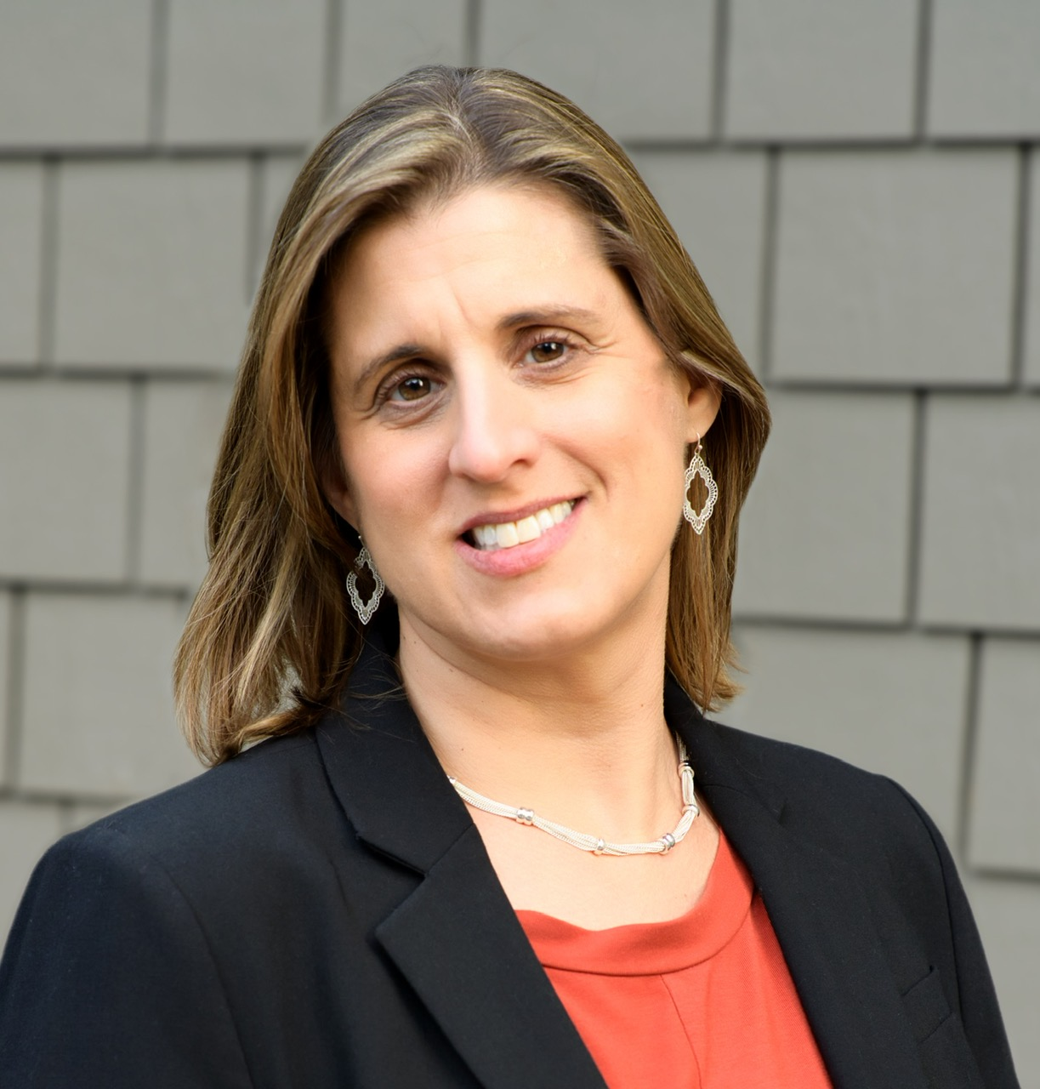

Next Steps and Q&A
Pivoting to the State Level
National Down Syndrome Advocacy Coalition(NDAC)
NDSC Resources
Questions?
Heather Sachs
NDSC Policy & Advocacy
Co-Director

Slide 2
It's Time to Pivot to the State Level
Federal gridlock & partisanship in Congress
  Congress closely divided & bitterly polarized, making it difficult to pass bipartisan legislation
  Many federal agencies weakened or being restructured
Rollbacks & cuts across all disability-related areas
  Massive cuts to Medicaid, SSI/SSDI, other programs
  Dismantling of key disability, education & health protections and federal agencies
  Puts more pressure on state budgets
Push for "choice" and local governance and weakening of federal guardrails
  States in charge of implementation of many federal programs

Slide 3
What State and Local Governments Control
Health & Services: Medicaid eligibility, waivers, HCBS design, mental health, DSP wages, provider reimbursements
Education: Early intervention (Part C), special ed staffing/services, preschool & transition supports, discipline & accommodations
Disability Rights & Daily Life: Accessibility enforcement, housing supports, vocational rehab, guardianship & supported decisionmaking laws
Transportation & Inclusion: Paratransit, local transit, sidewalks, zoning, inclusive recreation

Slide 4
Benefits of State Level Advocacy
States move more quickly
Legislatures meet for short time periods and move fast.
Change can happen within a single session or budget cycle.
Better access to state level legislators
Less staff so more likely to meet in person.
They are part of your local community.
States decide what services actually look like
They implement Medicaid waivers, special education supports, HCBS, employment services
The same federal law can look very different from state to state
States can innovate & model creative solutions
Can provide protection against federal rollbacks
States can counter harmful federal policy
State law can expand rights beyond minimum federal standards
They often have other jobs and are in-district more.
Implementation periods tend to be shorter.

Slide 5
How to Advocate at the State Level
Build relationships, tell your story, stay nonpartisan and professional
Engage in state legislative sessions
  Testify at hearings or submit written testimony
  Show up at rallies, hearings
Mobilize local voices
  Organize advocacy days at your state capital
  Empower self-advocates & families to speak out
  Use social media, op-eds, town halls to reach lawmakers and the public
Watch budgets & waivers closely
  Monitor Medicaid waiver renewals & amendments
  Advocate for state funding for services that may be cut federally
  Push for re-investment of state surplus or rainy-day funds into disability services
Serve on issue-specific task forces, workgroups, advisory committees
Submit comments, attend town halls
Join or form coalitions (DS, cross-disability, civil rights)

Slide 6

NDSC's State Advocacy
Engagement Plan
Learn about your state legislature
  https://www.congress.gov/state-legislature-websites
Length and dates of session
Learn about your state legislators
  https://www.usa.gov/elected-officials
  Constituency is paramount
  Are they in leadership positions?
  Are they on key committees?
  What are their main priorities?

Slide 7
State Advocacy
Engagement Plan
Identify other disability groups
State Developmental Disabilities Council
State Protection & Advocacy Organization
State level chapter of the Arc
Any autism or other disability-specific groups
Do they focus on or specialize in particular issues?
Are you interested in advocating for any of those issues?

Slide 8
State Advocacy
Engagement Plan
Individual coalition-building and networking
Who are the other NDAC members in your state? Contact us to ask – policy@ndsccenter.org
Statewide DS or IDD coalitions? Cross-disability coalitions or workgroups?
SELF-ADVOCATES, SELF-ADVOCATES, SELF-ADVOCATES!
Opportunities for Learning and Outreach
Partners in Policymaking
DD Day at your state legislature
UCEDD and LEND program
World DS Day
Public events (town halls, briefings, etc)

Slide 9
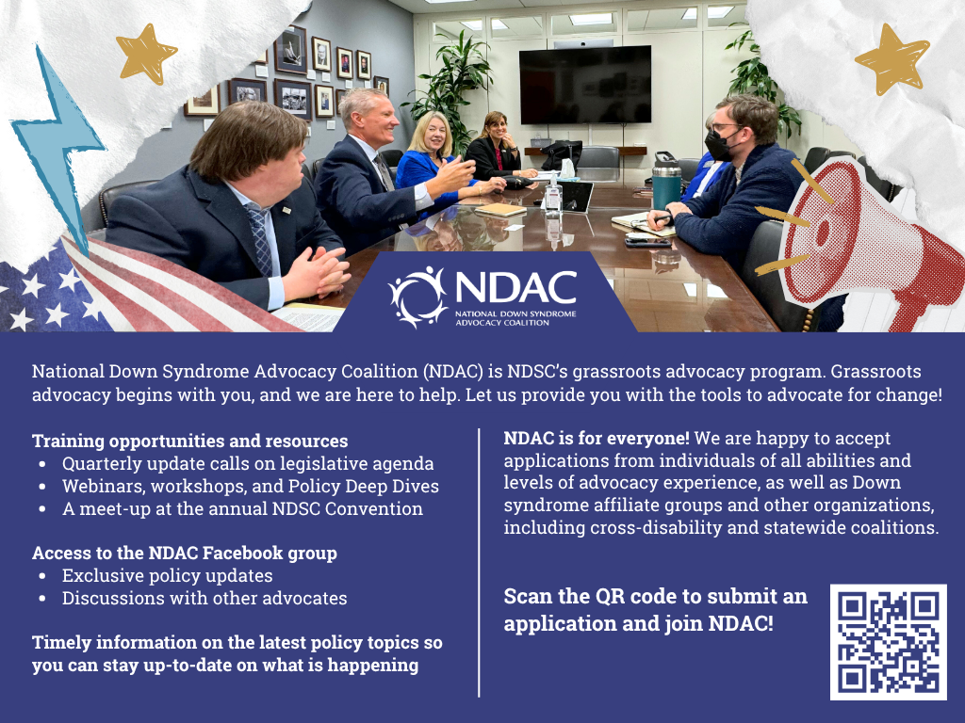
https://bit.ly/3TanDav

Slide 10
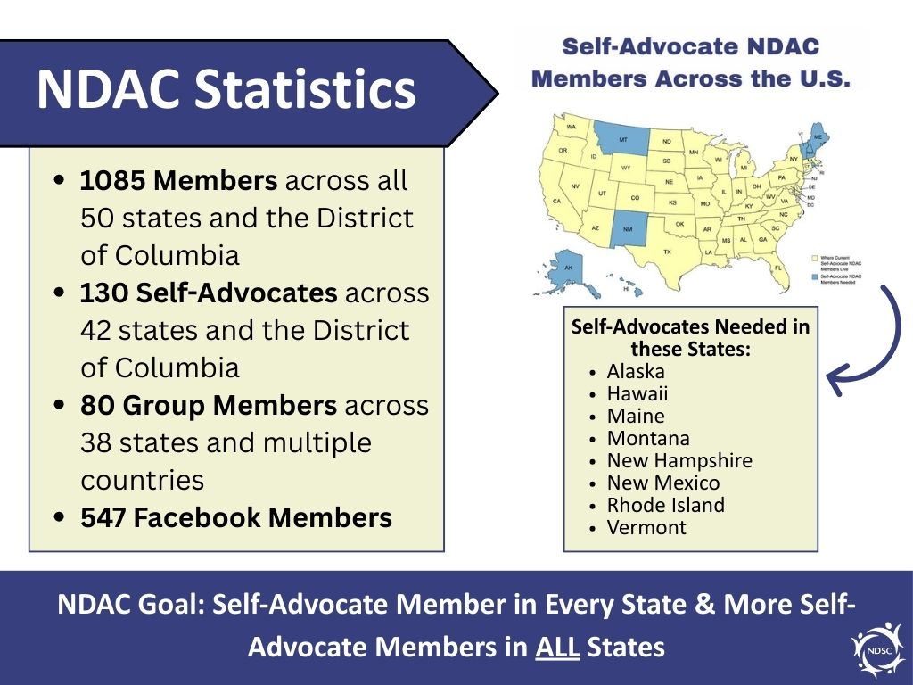

Slide 11
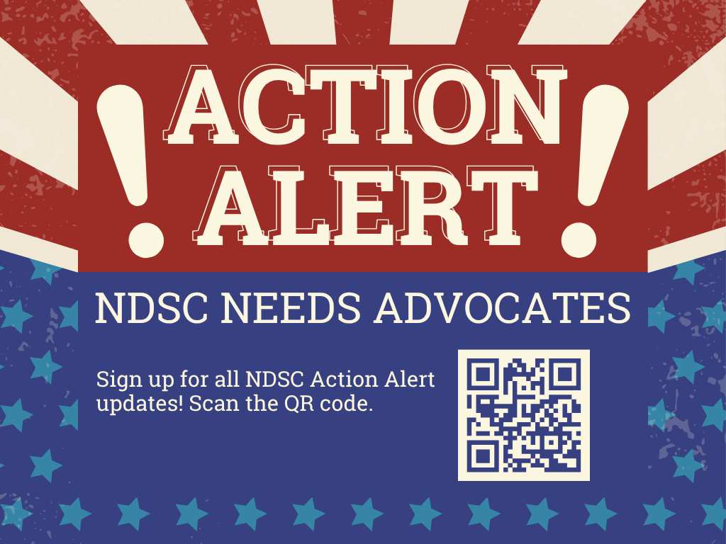
https://bit.ly/NDSCActionAlerts
https://bit.ly/NDSCActionAlerts

Slide 12

Other NDSC Advocacy Resources
NDSC Advocacy Training & Resources:
Basic Government Processes
  Basic Government Processe Video
  Basic Government Processes Slides
Self-Advocate (SA) One-Pagers
  SA One-Pager Template
  SA One-Pager Examples
    Blackburn
    LaCour
    Mast
    Smart
Additional Advocacy Resource Documents
  Creating an Elevator Speech Template
  NDSC Advocacy Resource List
  State Advocacy Engagement Plan
  Ten Tips for Giving Effective Testimony
  NDSC Policy & Advocacy Toolkit for Self-Advocates
2025 NDSC Advocacy Training Boot Camp Presentations - available August 2025

Slide 13


Slide 14
NDSC Policy & Advocacy Team
Heather Sachs
NDSC Policy and Advocacy Co-Director
heather@ndsccenter.org
Stephanie Smith Lee
NDSC Policy and Advocacy Co-Director
stephanie@ndsccenter.org
Ricki Sabia
NDSC Senior Education Advisor
ricki@ndsccenter.org
Jawanda Barnett Mast
NDSC Grassroots Advocacy Manager
Jawanda@ndsccenter.org
Contact information for all presenters can be found on the Convention App.
Contact the NDSC Policy and Advocacy team at policy@ndsccenter.org
14

Slide 15
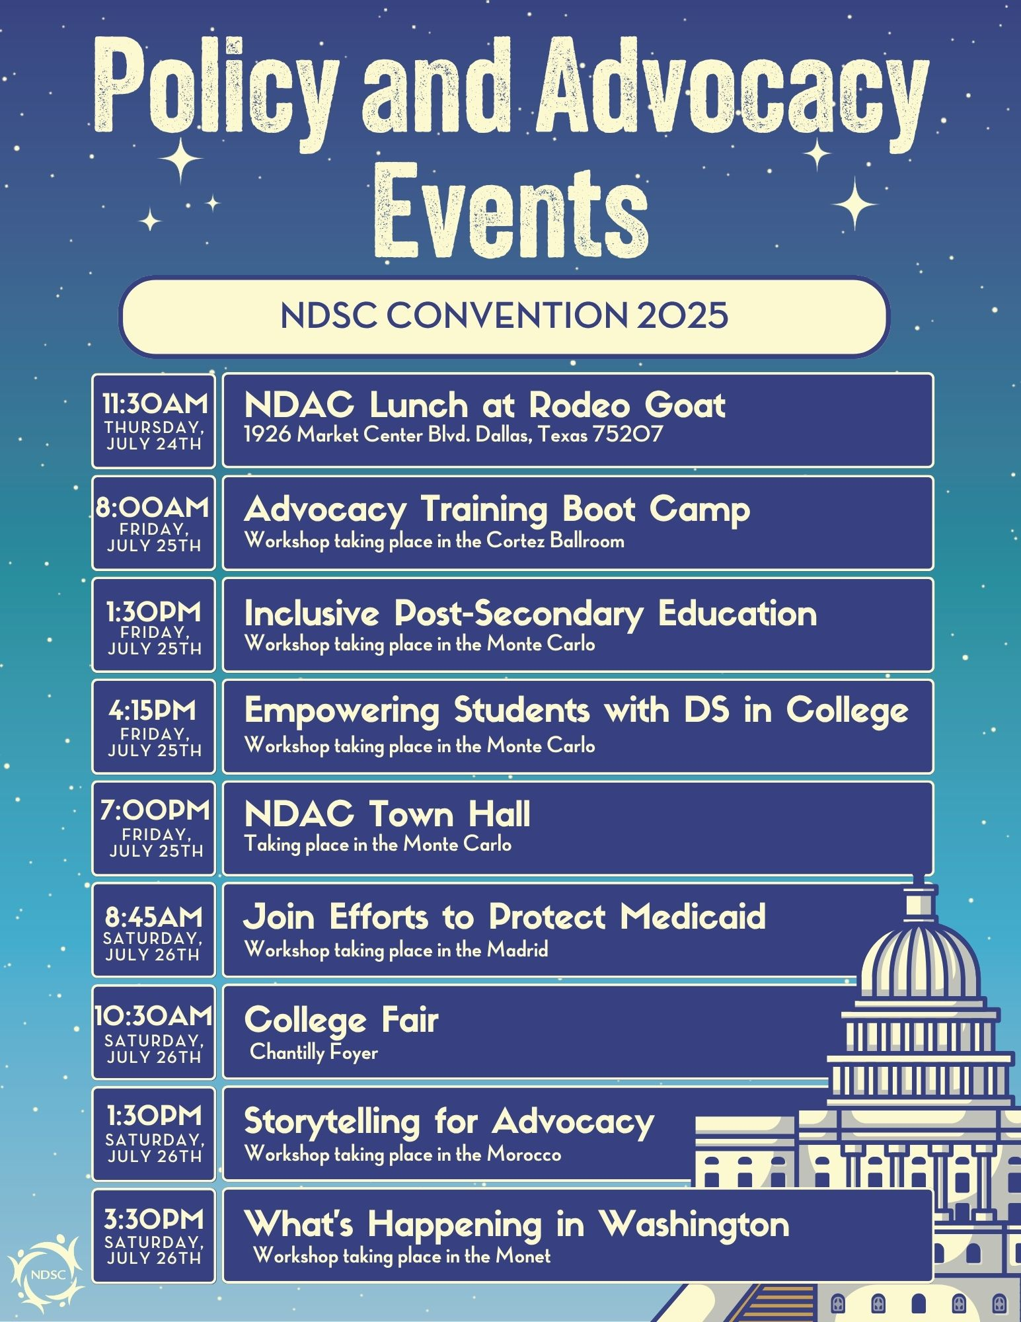

Slide 16
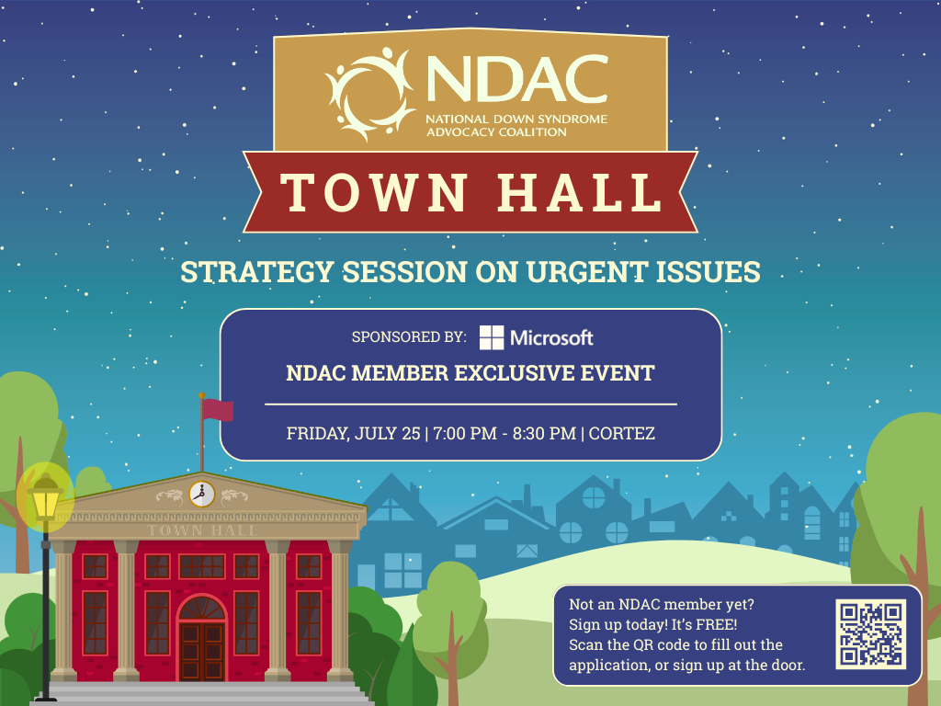

Slide 17


